Slide 1
Distance Learning in Modern Languages Forum SCORCI ITALIANI a learning environment for Italian as L2
Alice Gasparini 27° May 2020

Slide 2
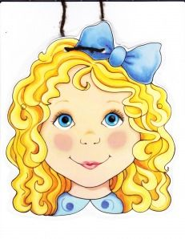
Ph.D. Project

Slide 4
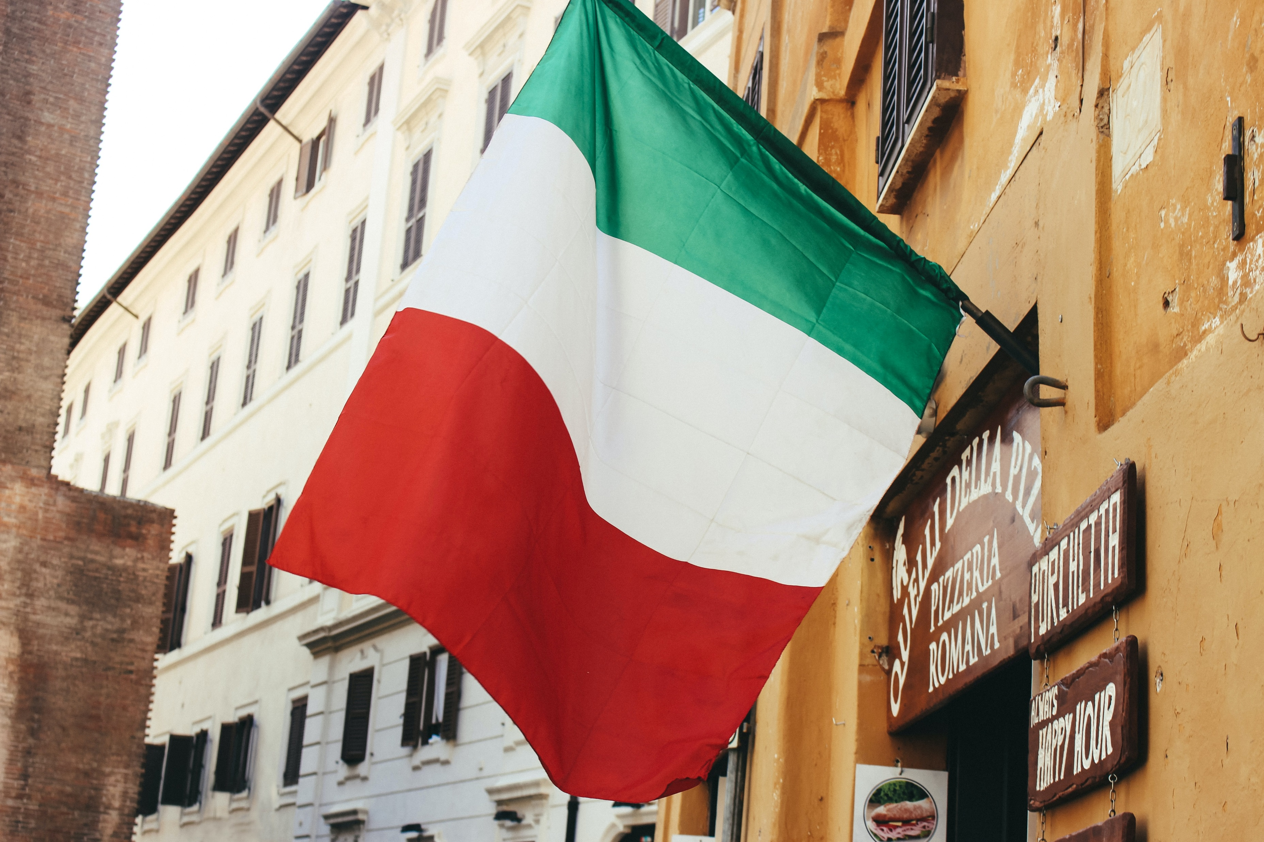
Ph.D. Project
https://labitals.it/
Photo by Jametlene Reskp on Unsplash

Slide 5
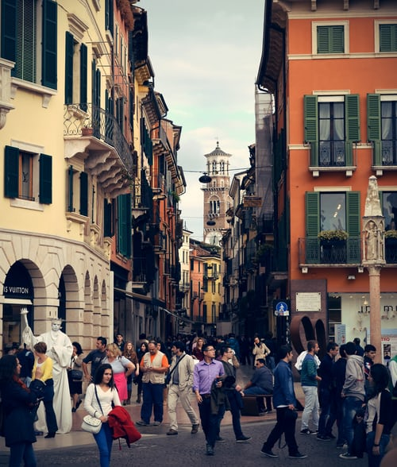
Scorci Italiani (Italian glimpses)
A2/B1
Photo by Max Böhme on Unsplash

Slide 6
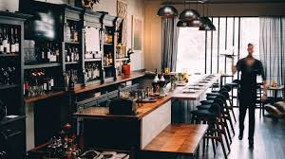
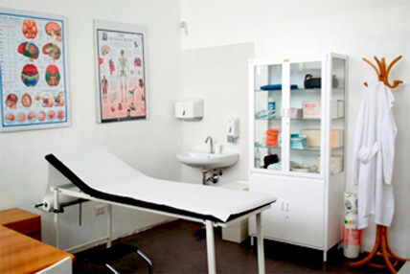
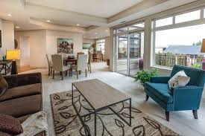
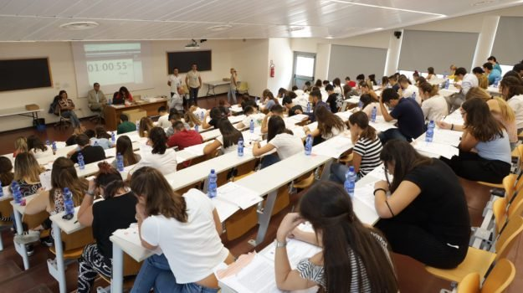
5 Units

Slide 7
Songs
Photo by Hanny Naibaho on Unsplash

Slide 8
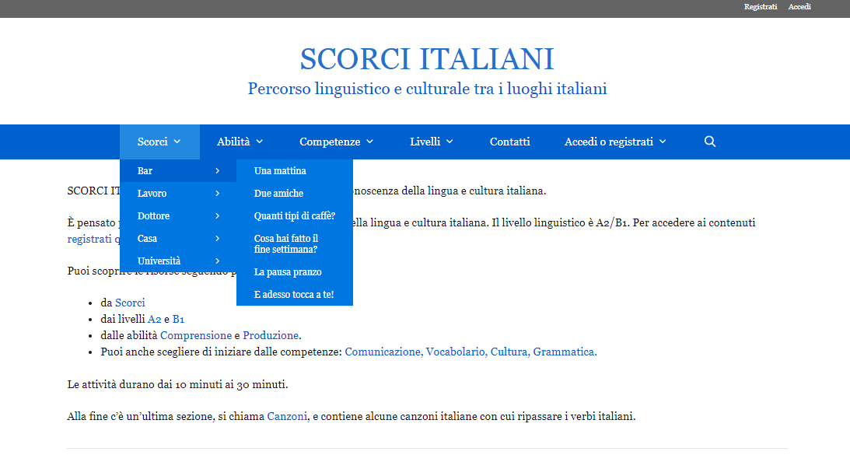
https://labitals.it/scorci/

Slide 9
Learning
Environment

Slide 10
Create
Interactive contents

Slide 11
Focus on listening comprehension
Interactive video
Audio
Song

Slide 12
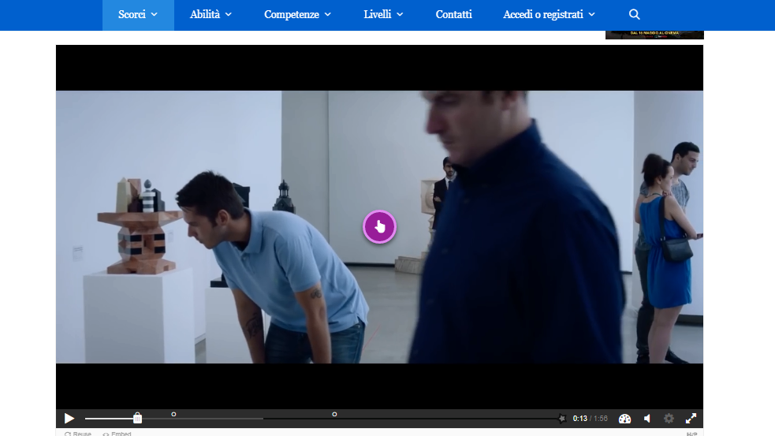
https://labitals.it/scorci/la-societa-che-cambia/

Slide 14
https://labitals.it/scorci/gli-italiani-e-laffitto/

Slide 15
https://labitals.it/scorci/mio-figlio-e-malato/

Slide 16
https://labitals.it/scorci/raggio-di-sole-passato-prossimo/

Slide 18
ALICE GASPARINI Università G. D’Annunzio Chieti and Pescara
Contact details:
alice29682@gmail.com
alice.gasparini@unich.it
https://labitals.it/

