Slide 1
Communication and sense of community in the Virtual Language Classroom
Laura Stecca
Educator for SLCC, Ca’ Foscari University of Venice

Slide 2
Problems of the language lesson online
Compensatory tool
Frontal lesson
No
Student-to-student
communication
Only one person can
speak at a time
No work in groups
With
Monitoring from the teacher

Slide 3
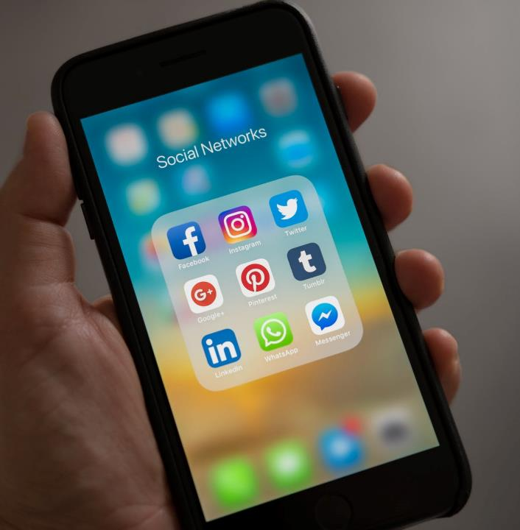
CREATE A GROUP ON A SOCIAL NETWORK
Set rules for online communication;
Motivates students;
Everyone has everyone’s contact;
Single students or groups can share the outcomes of their in-class-activities;
Sense of unity equivalent to the physical classroom one.

Slide 4
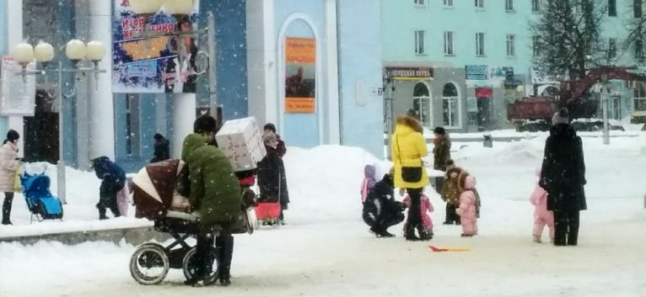
Experimentation
Russian students of ESL
Vavilon Language Centre
Ljudinovo (Bryansk Region, Russian Federation)

Slide 5
Describe a painting to a partner
Each student receives a painting, privately;
One student describes the painting to the partner, who needs to draw it on a piece of paper;
The partner can ask questions in case they are not sure (possibility to create a dialogue);
Once the description is finished, both the drawing and the painting are shown to the partners;
Analyzing the drawings, the teacher can see problems in vocabulary, comprehension, use of strategies…

Slide 6
Strategies applied by the students
Unknown vocabulary
ROBE HANGER
STOOL

Slide 7
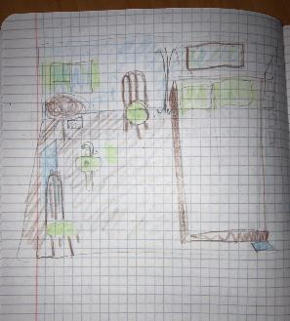
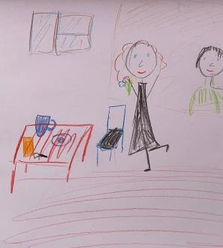
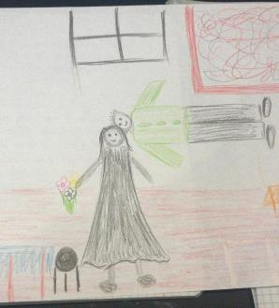
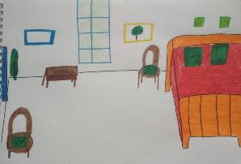
Outcomes

Slide 8
How to use the activity with the whole class

Slide 9
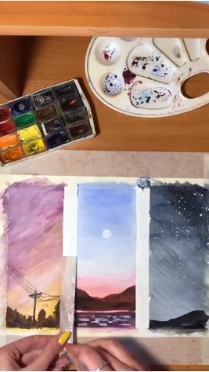
Tutorials: how to make quarantine better

Slide 10
References:
- Bonfiglio, 2013, Le nuove frontiere della didattica: e-learning, podcasting e Wikipedia per una didattica collaborativa in rete, Roma, Aracne;
- Calvani A., Rotta M., 2000, Fare formazione in Internet: manuale di didattica online, Trento, Erickson;
- Celentin P., 2007, Comunicare e far comunicare in internet: comunicare per insegnare, insegnare per comunicare, Venezia, Cafoscarina;
-Troncarelli D., 2011, “Percorsi per l’apprendimento dell’italiano L2 online”, in Minerva T., Colazzo L., Connessi! Scenari di Innovazione nella Formazione e nella Comunicazione. VIII Congresso della società italiana di e-Learning, Milano, Ledizioni.

