Slide 1
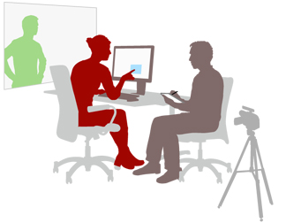
Benefits of user testing
JANE HASELDEN
Notes:
Hi – thanks for attending our session on the benefits of user testing. Now, we’re using the term user testing here, but this is also known as usability testing. I like to use the term user testing myself because, at the end of the day, this is about our users. It’s their experiences we are interested in primarily. They are real people who use our services. We need to observe actual users using our digital services. The word usability seems to speak more about the website or documents themselves. And, after all, today is about accessibility for all people, so let’s go with user testing.

Slide 2
TOPICS in
this session
User testing with members of the public
User testing for accessibility
Notes:
So we’re going to break this up into two parts (all in 15 minutes!). Firstly we will look at user testing with members of the public. And then we’ll look more at user testing for accessibility, because this is really our focus today and really we should be for every day from now on!

Slide 3
USER TESTING WITH MEMBERS OF THE PUBLIC
Notes:
First of all let’s look at testing with members of the public. Ideally we should be testing with all sorts of different people, different ages, different abilities, different cultural backgrounds and included should be those with disabilities so that we can test the accessibility of our material as well.

Slide 4
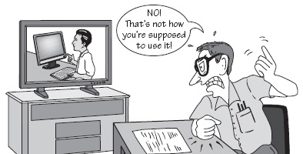
Observing
Taking notes
Feeding back
User testing for our partner organisations
Notes:
So the traditional user testing we do is observational user testing, We watch users undertake a variety of realistic scenarios that we give them and we and observe where they encounter barriers or successes as they try to complete a transaction or find information. Click →
We take notes of what we see and with their permission, may also video the experience to provide real detail for the service team where issues have occurred. Click →
We provide a presentation and detailed report of findings for the service to act upon.
I’m now going to show you a user testing video, so that you can see what this type of user testing looks like. This person has been asked to report a broken litter bin to the council.

Slide 5
Notes:
LEAVE LAST FRAME OF VIDEO ON.
I expect you saw how this person struggled to find the information he was looking for. Surprisingly he didn’t get that frustrated like many of us would have! That’s the nature of user testing, people generally try quite hard to achieve something when they’re being watched. But what if he had a disability? It could make things even harder for him.
So, now we’ve got to think about our users with disabilities and how we’re going to test for accessibility as well.

Slide 6
Notes:
Let’s consider the main types of disabilities we might encounter. Firstly Vision impaired people. And this can be both those who can’t see at all and those with impaired vision.

Slide 7
Notes:
Then we have Hearing – so in this case we need to be aware of things like captioning videos and transcribing any audio content.

Slide 8
Notes:
Then we have those with Motor skills, so maybe someone with arthritis or problems using a mouse. Sometimes disabilities can even include temporary issues like having your arm in a sling.

Slide 9
Notes:
The final one is Cognitive – and this covers quite a few of issues created by the first three as well as comprehension, understanding and attention.

Slide 10
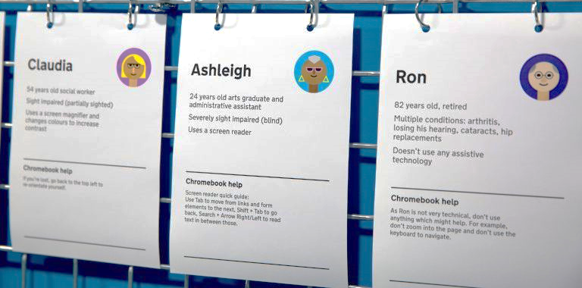
USER TESTING FOR PEOPLE WITH DISABILITIES
Notes:
So with those disabilities in mind, we also need to test our material for accessibility. If we are able to gather users with a variety of disabilities to test our material that is great but I know that this can be quite difficult unless you can tap into a disability user group or have a reliable source of people to call on. GDS have thought about this and their accessibility lab provides some really useful personas you can use.

Slide 11
Notes:
Here we have Christopher who has rheumatoid arthritis. He’s unable to use a mouse and he says he needs to use a keyboard to get around websites as it’s less painful than using a mouse. I’ve got a bit of a demo for you here. I’m going to visit a local authority website and see how Christopher might get on completing a form as part of a user test. He’s only going to be using a keyboard, so no mouse allowed for me in this user test as I’m getting into Christopher’s persona mindset.
RH9 8HG

Slide 12
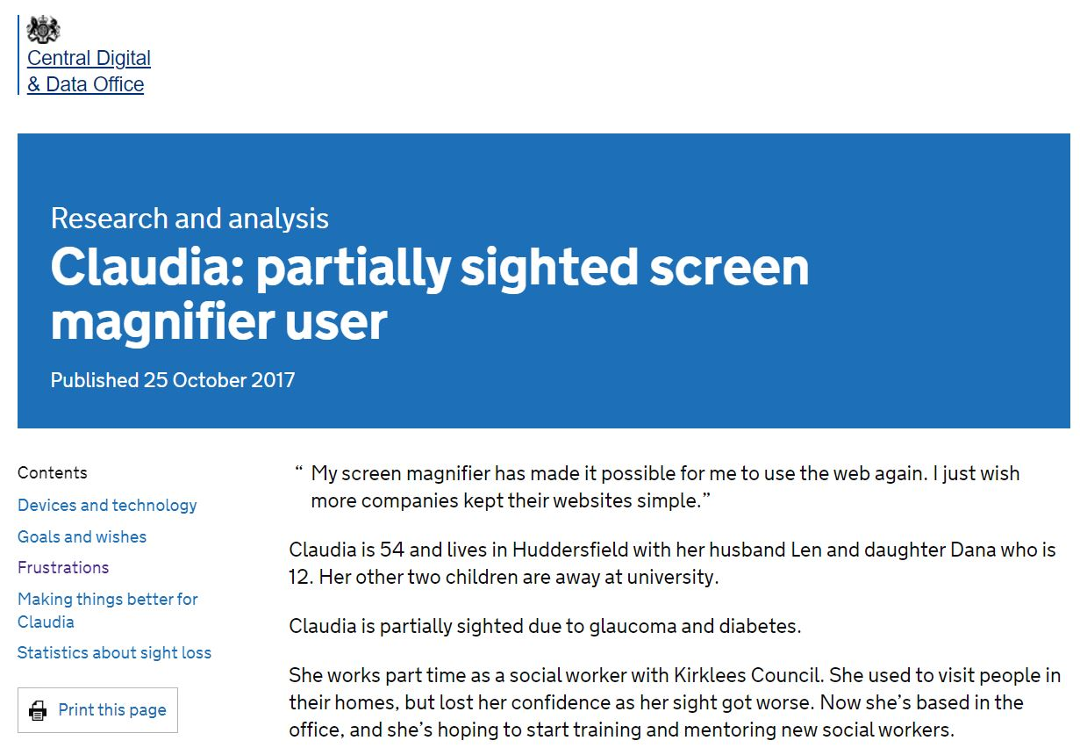
Notes:
Let’s have a look now at Claudia – she’s a partially sighted user who uses a screen magnifier. Her frustration is that sometimes she forgets to scroll horizontally when she’s using Zoomtext. What happens if there’s important information on the right hand side of a page or document that she might miss? Especially awkward for her if that information is important!
So for a demo, I am going to open a PDF and set it to 400% just to replicate what it might look like for her when zoomed in.

Slide 13
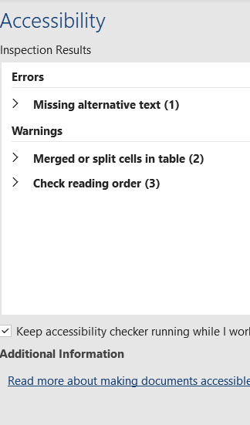
Notes:
So – we can see from doing these accessibility user tests that some things won’t necessarily be highlighted by user testing with people without disabilities and that we need to use people with real disabilities in our user tests, or at the very least, personas with disabilities. Some of those issues might not come up in a standard accessibility checker either. And of course, we haven’t even got onto using a screenreader which will highlight even more issues. Using a screenreader you can “listen” to your material, making sure that links and images have descriptive text and that the screenreader user is guided to relevant places to complete their task. Things to look out for in your user tests are:-

Slide 14
Accessibility issues to be mindful of
Keyboard navigation
Magnification
Flashing and Blinking Content Elements
Video and Audio Captioning/Text
Colour Contrast
Proximity
Page Titles
Notes:
Keyboard navigation: I think we’ve covered that in the demo user test.
Magnification: We saw how important it is to consider where you position important material, remember Claudia often forgot to scroll horizontally to the right so could easily have missed something.
Flashing or blinking content elements: Flickering and blinking objects and fast animation can trigger seizures for people with epilepsy as well as being really distracting for users with cognitive impairments, so keep these to a minimum and at a slow rate.
Video and audio captioning: People who can’t hear won’t know what’s being said in a video unless it’s captioned or there’s a text transcript. And people who can’t see won’t have access to the visual information, unless we make audio or text descriptions available.
Colour contrast: Some people with vision disabilities can only read the text if there’s enough contrast between the text and the background color. We saw that on the Search for an Address button.
Proximity of objects: Try not to put your form submit button too far away from the last field the person completes, it could be especially frustrating for our user who uses a magnifier as they might not have any idea where to look for the button.
And Page Titles: Individual pages should have unique titles that are brief and sufficiently descriptive. This will help someone using a screen reader to know what page they’re on as soon as they land there.
Lots of these things don’t come up on accessibility checkers and you’ll need to manually check for these kind of things.

Slide 15
Catherine Bright
SDS Team Manager catherine.bright@tunbridgewells.gov.uk
www.smarterdigital.info
@SDSProjectTeam
Notes:
And don’t forget, we’re here to help you with your accessibility requirements. You can come and chat to us in the supplier showcase at 3pm. Thank you.

