Slide 1
The Hitchhiker’s Guide to Accessibility Statements
Huw Alexander

Slide 2
once upon a time…

Slide 3
Innsbruck Austria
* 770.6 miles (via A4)

Slide 5
42

Slide 6
the humble towel

Slide 7
A towel, The Hitchhiker's Guide to the Galaxy says, is about the most massively useful thing an interstellar hitchhiker can have.
The Hitchhiker’s Guide to the Galaxy | Douglas Adams

Slide 8
Universe*
University*
* not to scale

Slide 10
Public Sector Bodies Accessibility Regulations

Slide 11
evolution

Slide 12
think differently

Slide 13
user guide
Intuitive design
Features
Tools + Services
Issues + Fixes
Partnerships

Slide 14
inclusive marketing tool

Slide 15
tell your story
Investment + Time
Resources
Innovation
Vision + Identity
Student Recruitment

Slide 16
window on the soul of the institution

Slide 17
ongoing conversation

Slide 18
roadmap
Listening
Engaging
Encouraging
Measuring

Slide 20
measure compliance

Slide 21
risk management

Slide 22
statement

Slide 23
Formative: making users smarter.
Actionable: making users resilient.
Compliant: keeping the organisation safe.
Transparent: keeping disabled users on board.
Supportive: making users confident.

Slide 24
The FACTS criteria
COMMUNICATION COMPLIANCE
CONTENT COMPLIANCE
USER EXPERIENCE
Scope
Discoverability
Statement Preparation
Testing
Contact information
Feedback + Complaints
Responsiveness
Enforcement Procedure
User tools
Technical information
Web standards
Non-accessible content
Non-compliance with regulations
Disproportionate Burden
Content not in scope
Accessibility roadmap
Third-party suppliers
Colours + Contrast
Magnification + Reflow
Page navigation
Menu navigation
Screen reader navigation
Images + alt text
Meaningful hyperlinks
Video + Audio content
Heading Structure
Forms
https://www.textboxdigital.com/aspire-education-guidelines

Slide 25
https://www.kent.ac.uk/accessibility/accessibility-statement/kent-website-accessibility-statement

Slide 26
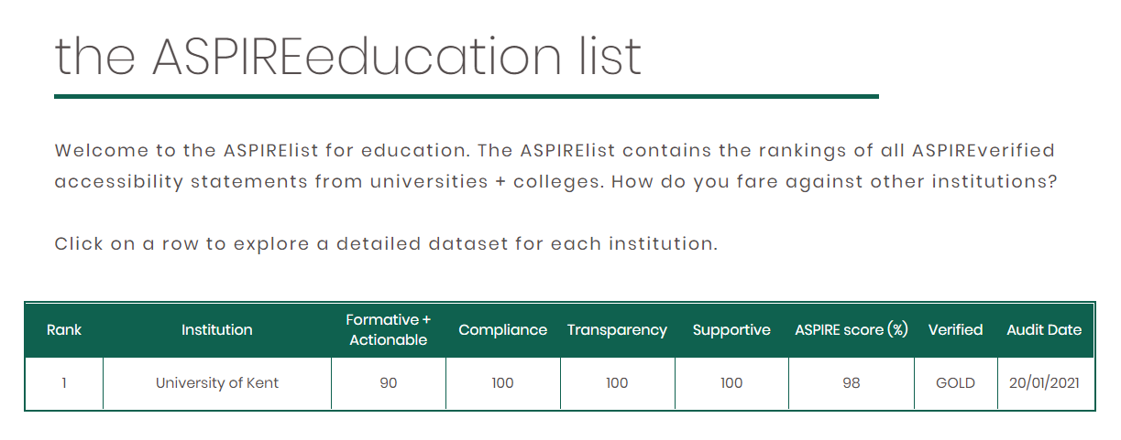
ASPIRE list

Slide 27
User Guide
Marketing Tool
Engagement Forum
* May also serve as an after-shower drying implement

Slide 28
make a
statement
based on the
FACTS

Slide 31
aspire@textboxdigital.com
@textboxdigital
@aspirelist
textboxdigital.com
https://www.textboxdigital.com/aspire-education-guidelines

