Slide 1
Further Education Vision Impaired student support and accessibility research
George Rhodes
Twitter: @Access_Rhodes @All_Able @TPTgeneral
Web: allable.co.uk pocklington-trust.org.uk

Slide 2
Research Aim
How do blind and partially sighted students access teaching, learning and assessment (TLA) (including learning and information materials) and assistive technology whilst studying in FE colleges?
What are the barriers for accessing learning and information materials and assistive technology in FE colleges?
What are some areas of good practice in FE colleges, and where are they found?

Slide 3
Actions so far
Review of public facing accessibility statements for 427 colleges
Mystery shopper engagement
Research on Virtual Learning Environments (VLEs) accessibility and market coverage
Launched SEND / ALS Staff engagement survey

Slide 4
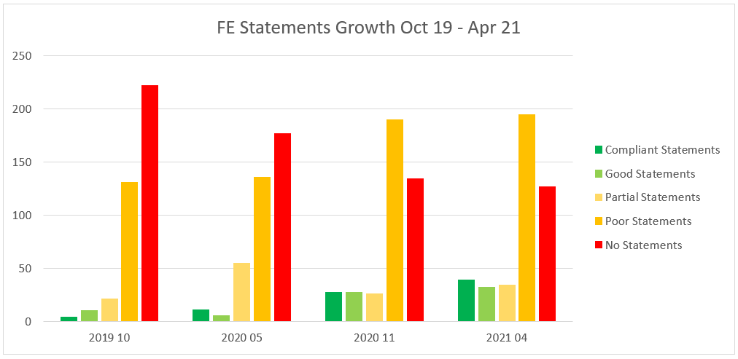
Current findings - Statements

Slide 5
Current findings – Mystery shopper
Screenshots
Suspicion
Rudeness or poor professional etiquette
Doesn’t know anything about the accessibility regulations
Lack of initial individual engagement
382 contacts so far
175 contacted through main mailbox or website contact form, no responses
15 forwarded on with no follow up
39 would not answer in writing

Slide 6
Current findings - VLE
78 Moodle
50 Office 365
16 Google Classroom
12 Blackboard
12 Canvas
4 outliers
Trends
Multiple VLEs per organisation, different VLE depending on course
Move away from traditional VLE platforms to Office 365 and Google Classroom
Distinct lack of any accessibility guidance on VLEs from respondents

Slide 7
Next steps
Ongoing SEND / ALS engagement survey
Student interview series across a number of colleges
Initial recommendations back early July 2021
Full recommendations paper October 2021

Slide 8
How you can get in touch
We are looking to share examples of good practice across the FE sector and to hear about the current challenges facing students and support staff. If you want to contribute, either fill out the survey or get in touch directly.
Survey
https://bit.ly/3cxZBkC
Contact us direct
info@allable.co.uk

Slide 9
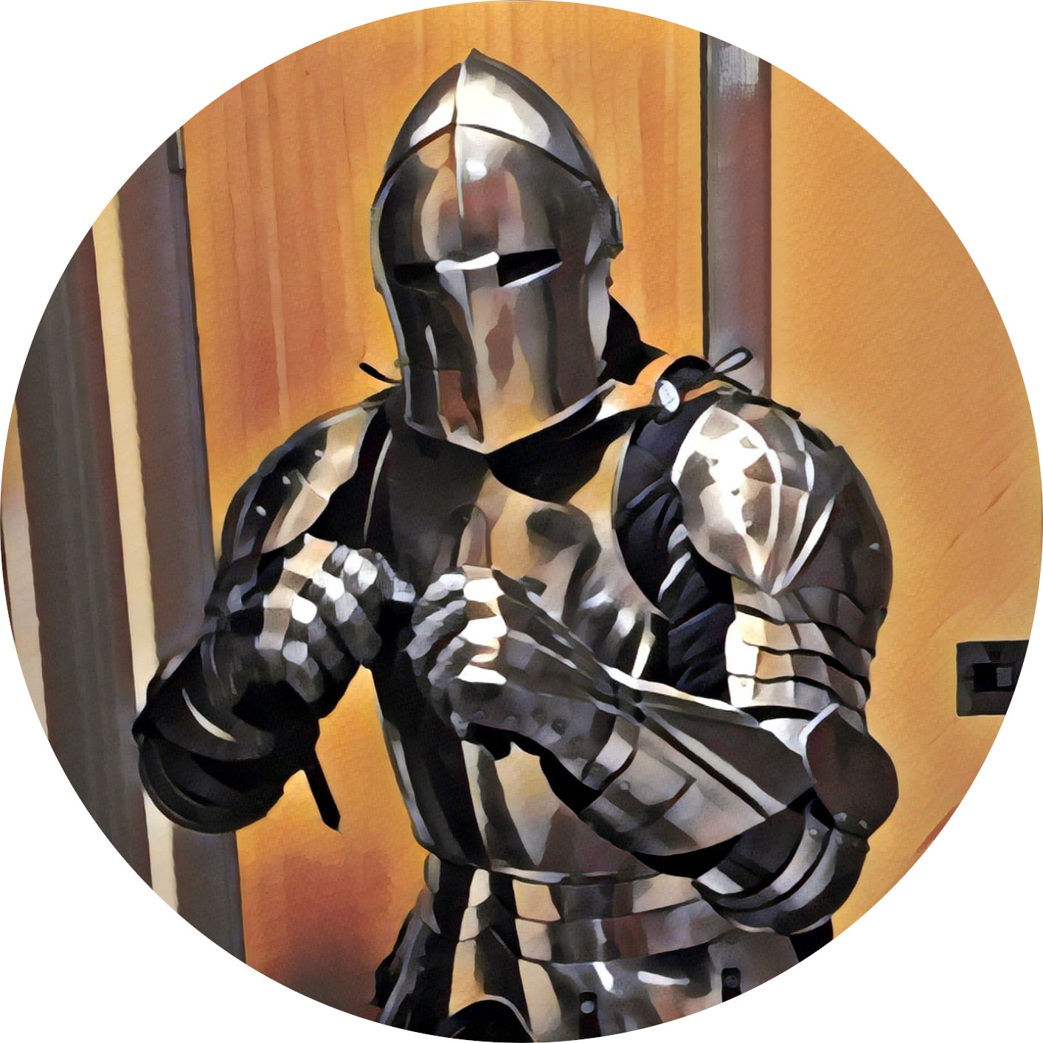
Contact me
Twitter: @Access_Rhodes @All_Able @TPTgeneral
Email: Info@allable.co.uk
Website: AllAble.co.uk
Pocklington-trust.org.uk

