Slide 1
The Power Of Storytelling
Why digital accessibility needs stories to make it stick

Slide 2
Can I tell you a secret?
Kristina Flour
Notes:
So today, I am going to tell you guys a story, maybe even more of a secret so please don’t tell anyone…
When I started at AbilityNet, digital accessibility was so new to me I couldn’t even spell it – To be honest I still struggle particularly when I’m typing quickly!
This was getting on for 6 years ago and it was the start of probably the steepest learning curve of my professional life. I didn’t realise it then, but I was joining an organisation that was deceptively small but incredibly complex in the services and activities that we provide.
One thing that was abundantly clear to me was the huge opportunity to make a positive impact that we had in our hands.

Slide 3
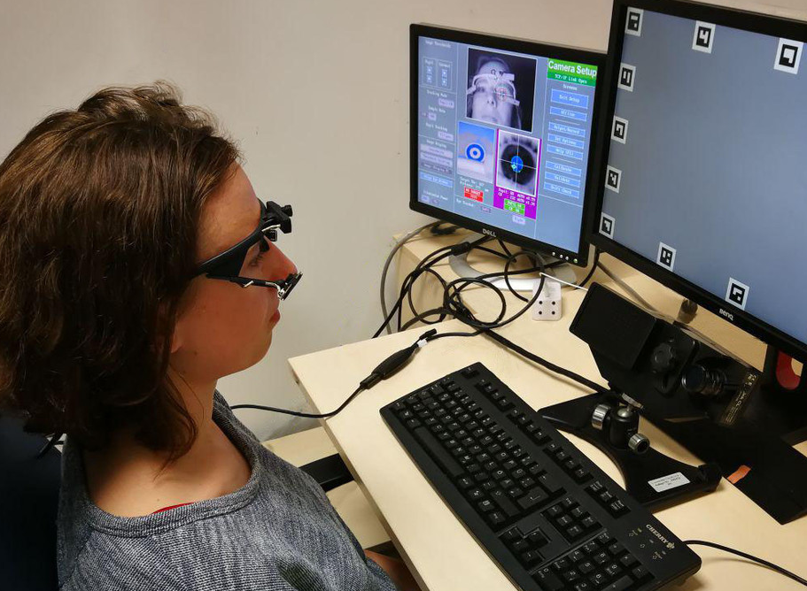
What does it all mean? (1)
Notes:
So I set about trying to work out what was what and how it all fitted together.
There were websites and applications – I knew a bit about these.
There were assistive technologies – bit more mysterious.
There were disabled people and assistive technology users – apparently neither of these were necessarily linked or mutually exclusive – again, my knowledge and understanding was pretty basic.

Slide 4
What does it all mean? (2)
Medical
Social
Charity
Economic
Minority
Identity
Notes:
There were models of disability -some were “bad” some were “good”. Everyone seemed to know which and why.

Slide 5
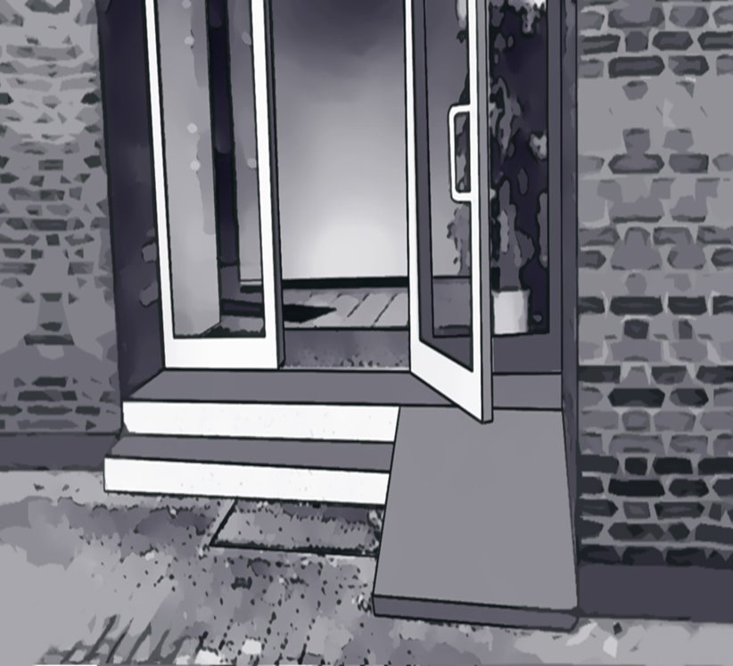
What does it all mean? (3)
Notes:
There were barriers – most of which I was completely unaware of.
There were recommendations and solutions to overcome or remove barriers – most of which I was completely unaware of.
Sometimes there were new barriers caused by the recommendations to remove barriers – which again, came as a bit of a surprise.

Slide 6
What does it all mean? (4)
Notes:
There were accessible websites that had really poor usability – which was very confusing.
There were websites that appeared really usable but were not fully accessible -which was even more confusing!
There was great debate about what constituted an accessibility issue over a usability issue and vice versa.

Slide 7
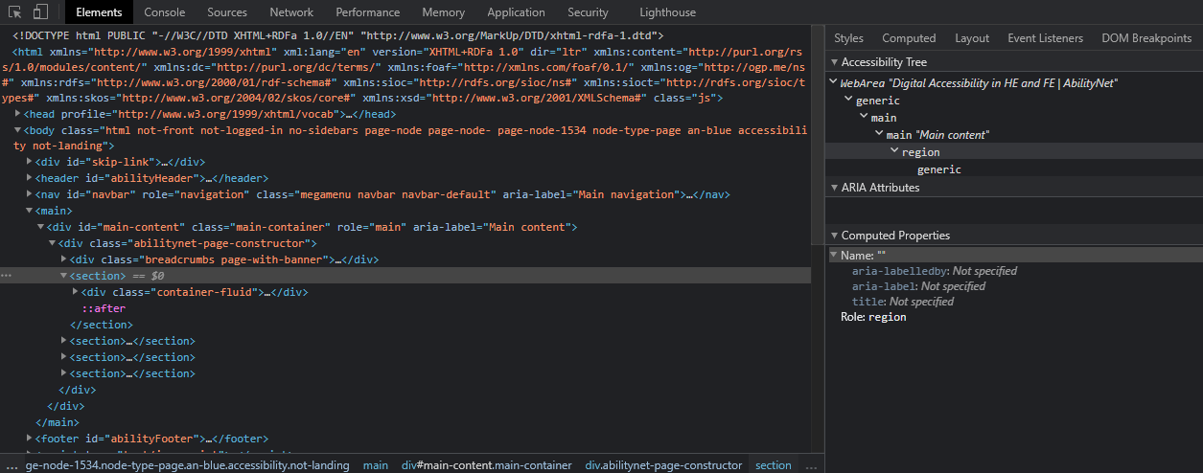
Wading through the jargon
Notes:
I tried to categorise all this stuff and split it up to make sense of it in terms of who worked on what and why – but actually it all rolled back into one eventually and most of it had impacts on each other.
It felt REALLY complicated.
And when you went digging to the next level of detail, some of it looked like this !!!!
SHOW IMAGE OF CODE SNIPPET AND SUCHLIKE – (ALT TEXT = image of code)
There were lots of acronyms such as WCAG, TTS, STT and other things I didn’t know about that completely bamboozled me!
I will tell you another secret now - It was not REALLY particularly accessible for me to make sense of.

Slide 8
Is it me?
Photo: bantersnaps
Notes:
So I reached a point where part of me felt a huge surge of imposter syndrome EG what am I doing here I shouldn’t be here someone else should be doing this that can understand what the heck it all means.
But the other part of me said. I know about people, I know about technology I can get my head around the rest of this I just need to approach it in a different way.

Slide 9
Tell me a story
Notes:
I then remembered I once had a boss who used to say “explain it to me like I am 3 years old”, when he needed to understand something really quickly. I thought this might just about help me get there so I went at it that way.
This was a really interesting approach as this naturally led to people giving me ‘stories’ to help me understand.

Slide 10
Stories made it stick (1)
Notes:
Some example stories I heard included:
STORY 1 – Once upon a time there was a guest speaker at an event attended by at least one blind delegate that put on a video that was about disability inclusion that had no talk track and no audio description leaving non sighted audience members at a complete loss as to what was going on other than there was some music playing and they were completely excluded. THE END.

Slide 11
Stories made it stick (2)
Notes:
STORY 2 – Once in a land not far away there was a keyboard only user who was trying to buy a ticket to a festival and at the very last step there was a keyboard trap which meant by the time they managed to get the damn thing to work the basket had timed out and the tickets had sold out and they were completely excluded THE END.

Slide 12
Stories made it stick (3)
Notes:
STORY 3 – Once there was a beautiful kingdom where everyone not only thought about legal considerations or accessibility guidelines after they had built something for everyone to use, but they went further and thought about them before they designed and built any new service. What’s more, they made the link that accessibility considerations when planned in from the very start make products better for everyone and no-one is excluded. And they all lived happily ever after. – THE END.
That last story might be more of the fantasy or SCI-FI genre of stories as things stand today, but it certainly landed with me and it SET the ambition.

Slide 13
This is only the beginning
Notes:
These stories helped me to EMPATHISE, to CONTEXTUALISE and also and rather excitingly to be able to make my own judgements on completely new things as to what may or may not be accessible. This was a special moment – I felt like I was really winning then!
I kept asking questions and the ensuing stories helped me to understand that understanding this stuff didn’t require for me to understand and explain the ARIA tree, it just required me to be curious, to be humble, to listen, to empathise and to keep asking questions. I now find I can’t UNKNOW how to think that way, although I am still making mistakes, being alive to what can go wrong, not being complacent, doing my best to improve and be better at it all and as a result, learning new things all the time.
This is why stories matter. This is why context matters, this is why empathy matters. If you are a lone voice that is trying to get people engaged around digital accessibility. Don’t give them the stick, don’t even really give them the carrot – GIVE THEM THE STORIES. People love stories, people listen to stories, people don’t forget stories.

Slide 14
How we can help
Maturity model guided sessions – institutional and module level
Digital Accessibility Bundle
Accessibility & Me eLearning module
Accessibility auditing and training
User centred services – focus groups, user testing, persona creation and more
Notes:
Stories solutions from AbilityNet & McNaught
1) Maturity model guided sessions – institutional and module level
2) Digital Accessibility Bundle
3) Accessibility & Me eLearning module
4) Accessibility auditing and training
5) User centred services – focus groups, user testing, persona creation and more

Slide 15
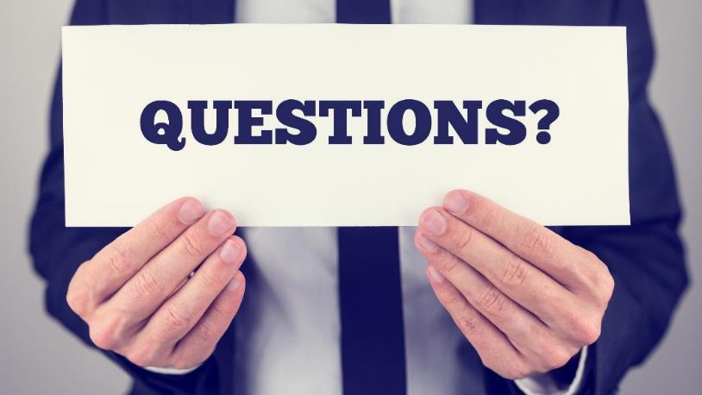
Any questions?
@Mark

