Slide 1
Running Accessibility Testing Workshops
Beverley Newing (they/them)
Accessibility Lead at Ministry of Justice
@webdevbev

Slide 2
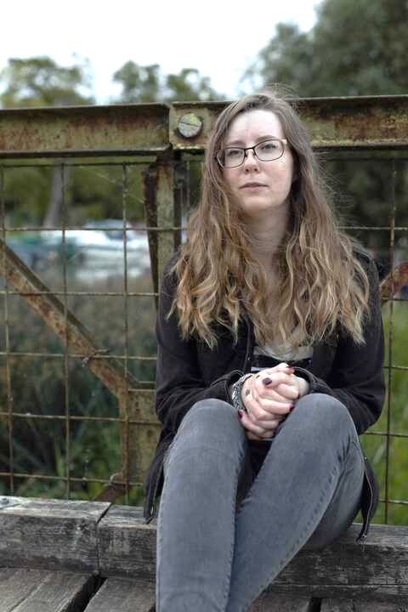
About me
Accessibility lead at Ministry of Justice
Co-created 3 training workshops
Used to be a front-end developer

Slide 3
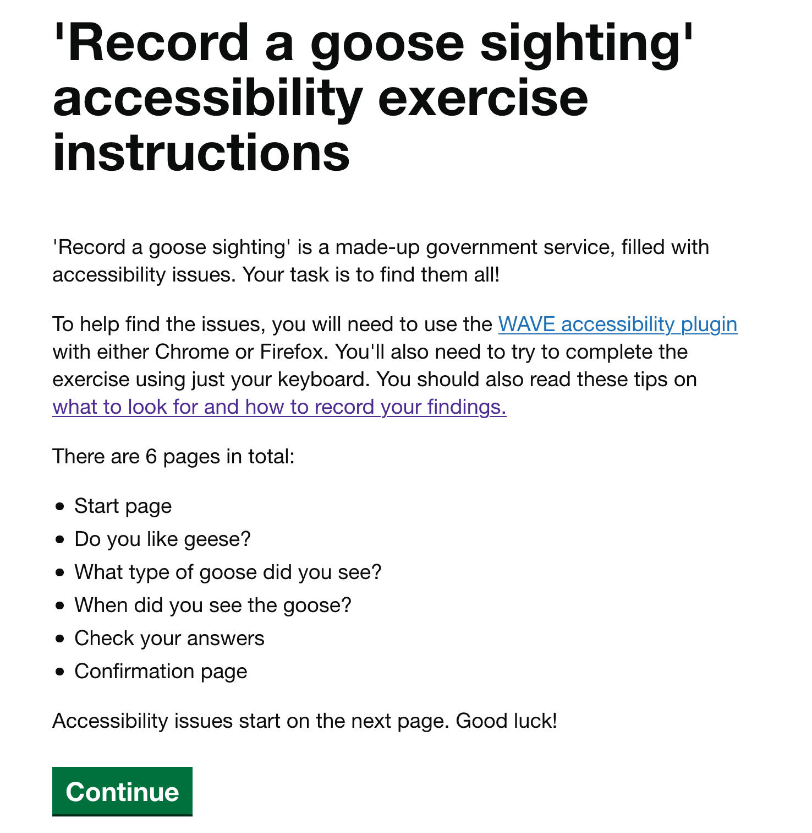
Record a goose sighting
Run ‘Record a goose sighting’ at:
User Centred Design conference
GOV.UK GAAD 2020
codebar festival 2021

Slide 4
What I’ll cover:
Why run accessibility testing workshops?
Creating the material
Running the workshop
Summary of tips

Slide 5
Why run accessibility testing workshops?

Slide 6
Accessibility is a team sport

Slide 7
People are often really keen to learn

Slide 8
Help people to interpret and understand their findings

Slide 9
Creating the material

Slide 10
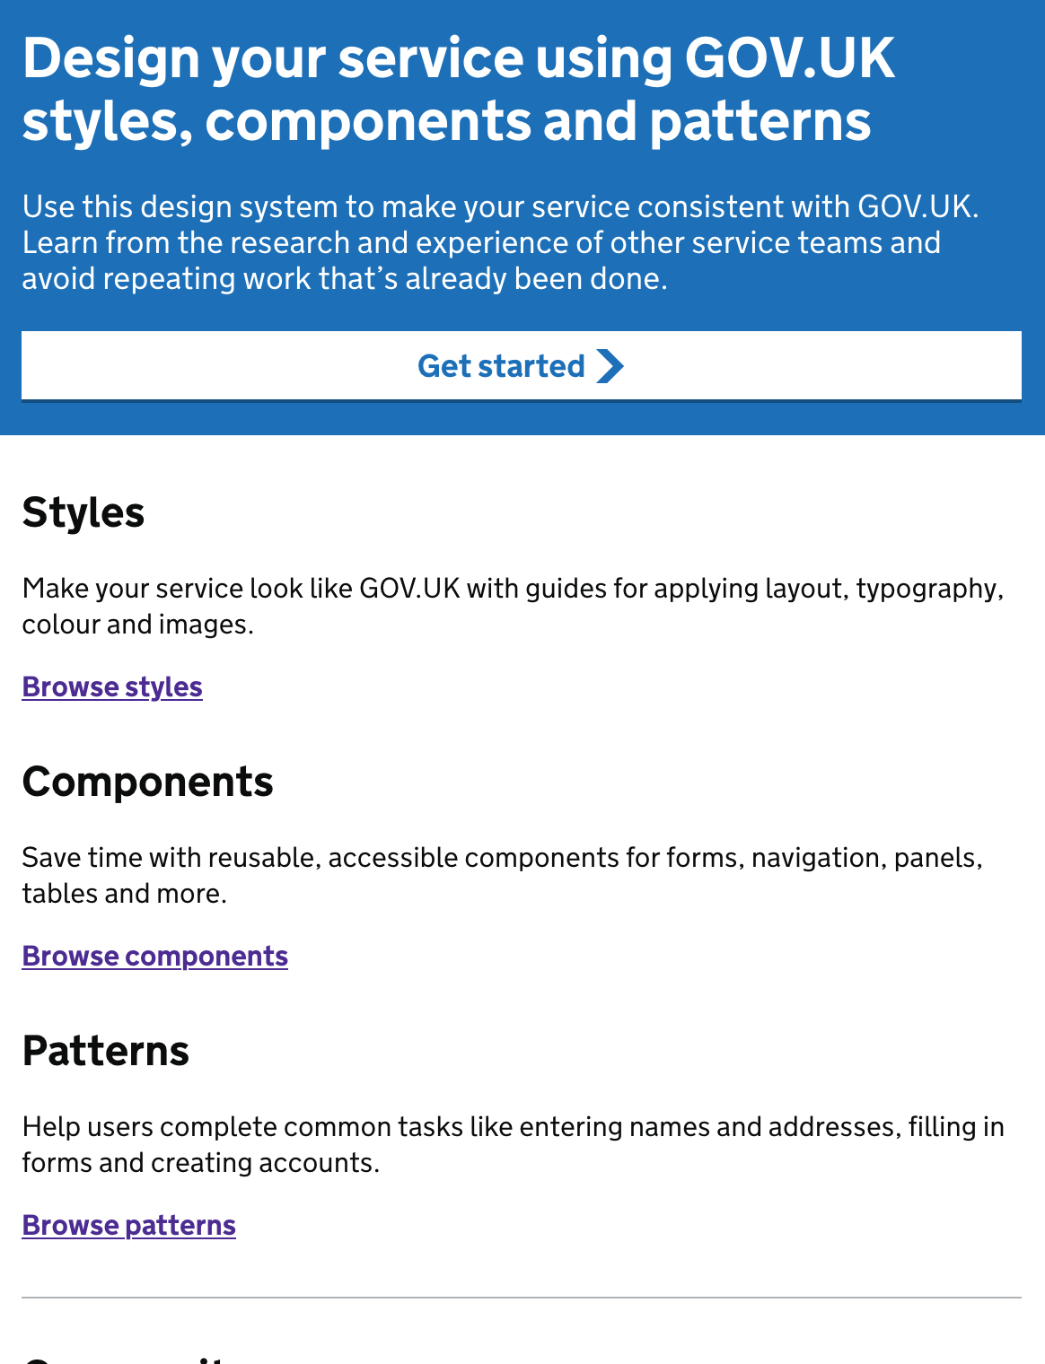
Use your Design System, or branding

Slide 11
Identify common, recurring issues at your organisation

Slide 12
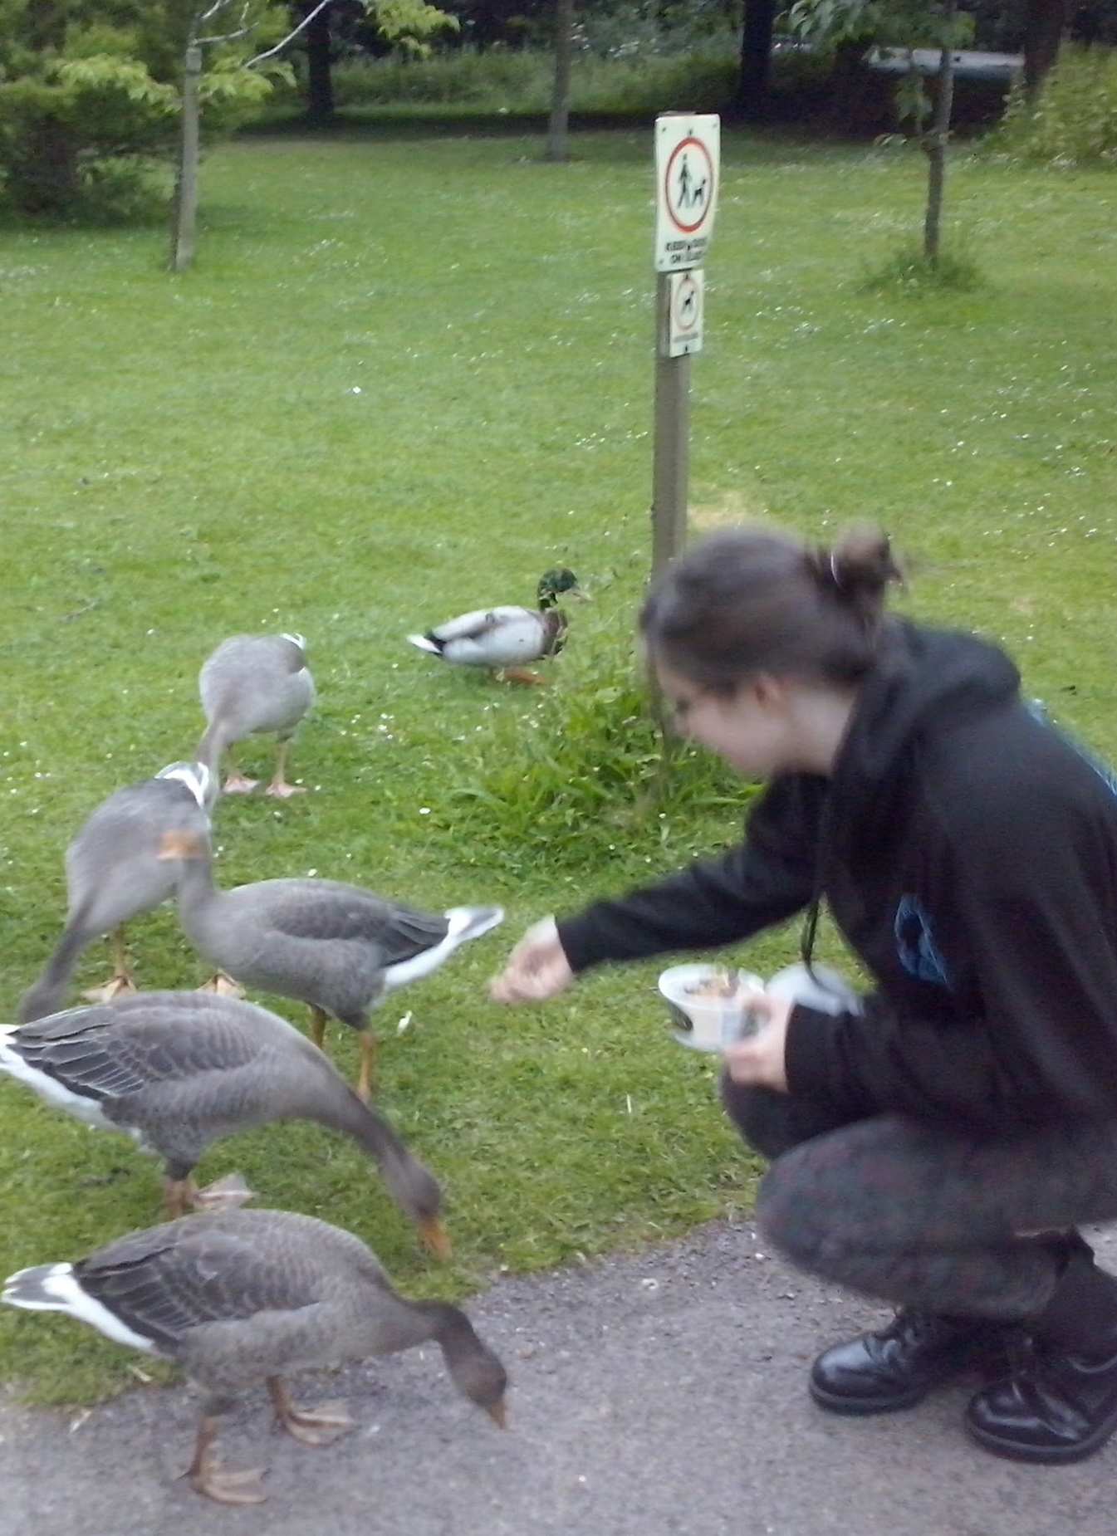
Make it fun and friendly

Slide 13
Running the workshop

Slide 14
Run pilots with supportive audiences

Slide 15
Create a feedback form and factor in time for people to fill it out

Slide 16
Expand out to more groups and iterate

Slide 17
Give people the chance to iterate on their testing

Slide 18
Create lots of space for questions

Slide 19
Create a friendly and welcoming environment

Slide 20
Summary of tips

Slide 21
Tips
Identify your audience, and their technical level
Understand their tools - can they use plugins?
Give them links in advance
Allow them to iterate on testing techniques
Make space for lots of questions!
Keep it friendly and welcoming

Slide 22
Thank you! Any questions?
Beverley Newing
Accessibility Lead at Ministry of Justice
@webdevbev

