Slide 1
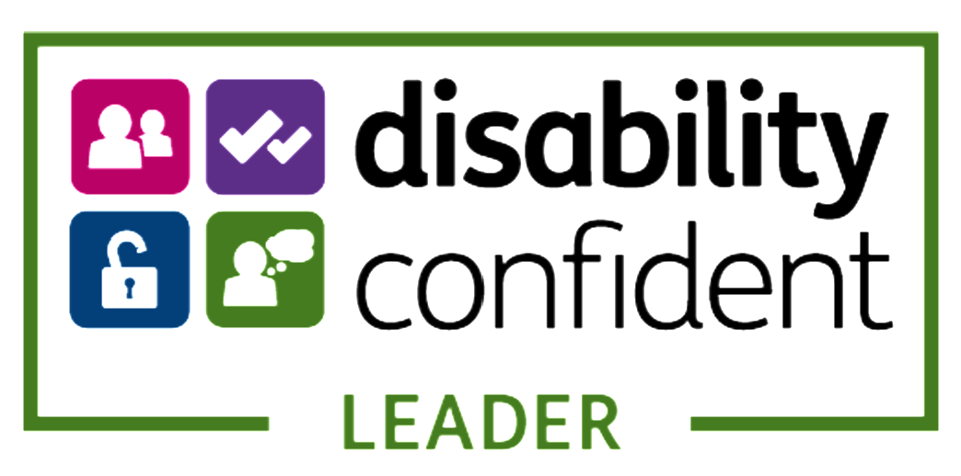


Creating Accessible Documents using Accessibility Checker
Michael Vermeersch
Digital Inclusion Lead
Chair MS UK Disability
Employee Resource Group

Slide 2



Accessibility is a responsibility
1+ billion
But only
1in10
have access to the
products needed
people have disabilities, many of whom need assistive technology
and
disability can affect any
of us at any time
unemployment rate
2x
Permanent
Temporary
Situational
(one arm)
(arm injury)
(new parent)
Notes:
There over are 1 billion people in the world who have disabilities, many of whom need assistive technology. But only 1 in 10 have access to the products needed, and this means many of them can't fully participate in our economies and societies. Accessible technology can allow them to fully participate.
In a 2004 Forrester study, they found that 57% of current working-age computer users may benefit from accessible technology because of mild to severe vision, hearing, dexterity, speech and cognitive difficulties. As the U.S. population continues to age, the number of people who experience these impairments will increase, and more people will likely turn to accessible technology to mitigate the effects of their changing physical abilities.
In the U.S., the unemployment rate for people with disabilities is double that of people without. And this has not substantially changed in the last 30 years since the establishment of the Americans with Disabilities Act (ADA). And the unemployment rate for with an Autism Spectrum Disorder is around 80 percent. This is a huge untapped talent pool.
Also, it's important to know that 70% of disability is invisible, so you don't always know what may be a challenge for those around you.
And finally, remember that disability – whether temporary, situational, or permanent - is something that can affect any of us, or someone we love, at any time.
-------------------------------------------------------------------------------------------
Source: World Health Organization
http://www.who.int/phi/implementation/assistive_technology/2206_infographic.pdf?ua=1
https://news.microsoft.com/2004/02/02/new-research-study-shows-57-percent-of-adult-computer-users-can-benefit-from-accessible-technology/
https://invisibledisabilities.org/what-is-an-invisible-disability/

Slide 3
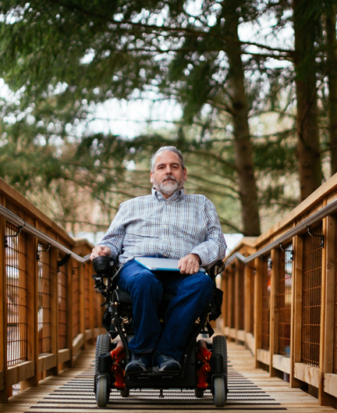
If you don’t design for accessibility
It’s like saying to every fifth person who walks in your door… ‘I don’t really want your business.’
Bert Floyd,
Team Lead of Assistive Technologies,
TD Bank, Canada
Notes:
Think about it this way—if you don’t design for accessibility and inclusion, you are excluding a large segment of the global population who could be customers or employees.
It’s like saying to every fifth person who walks in your door… “I don’t really want your business.”

Slide 4
Enabling your accessibility journey
Example criteria to assess your progress
Getting started
Building momentum
Innovators in accessibility
People and culture
Increasing representation of people with disabilities
Vision, strategy, engagement
Establishing and implementing an accessibility strategy
Investments
Getting right people, tools, processes, and training in place
Standards
Building towards and testing against accessibility standards
Training, support, and tools
Putting systems in place to scale accessibility
Procurement
Partnering with suppliers to improve ecosystem accessibility
Product development lifecycle
Embedding accessibility into planning, designing, coding, and deploying products and services
Sales, marketing, communications
Effectively telling the accessibility story in an accessible way
Notes:
Our model is comprised of eight overarching dimensions by which we assess our accessibility journey.
We realize that each organization has its own pace and starting point, and you may have your own criteria. Consider these as examples to consider as you progress on your journey.
In the end, you don’t have to address these dimensions in any set order, and you may think of new ones, it is simply our goal to help your organization grow from any point in your journey. Whether you are just defining your strategy or already have great systems in place, we want to help you become innovators in accessibility.
Our dimensions include:
People & Culture
Vision, Strategy and Engagement
Investments
Standards
Training, Support & Tools
Procurement
Product Development Lifecycle
Sales, Marketing & Communications

Slide 5
Investments
    Spend sufficient time scoping the work
    Collaborate across groups and departments to develop realistic forecasts
    Put right people, tools, processes in place so accessibility is factored into product development
Our learnings:
Starting later in development process costs time and money
Costs decrease as organizations improve their processes, tools, and engineering knowledge
Notes:
Initially, much of our effort was in scoping the amount of work needed.
This was a collaboration across Microsoft teams, including engineering, finance, marketing, and HR.
As we matured, these forecasts and plans shifted to putting the right people, tools, processes, training, testing and design resources in place so that new products could be created, from the start, with accessibility in mind.
Microsoft learnings:
Waiting until the last phase of development to address accessibility takes more time and costs more money
As organizations mature the processes, tools, and engineering knowledge and capabilities, costs related to accessibility should decrease.

Slide 6

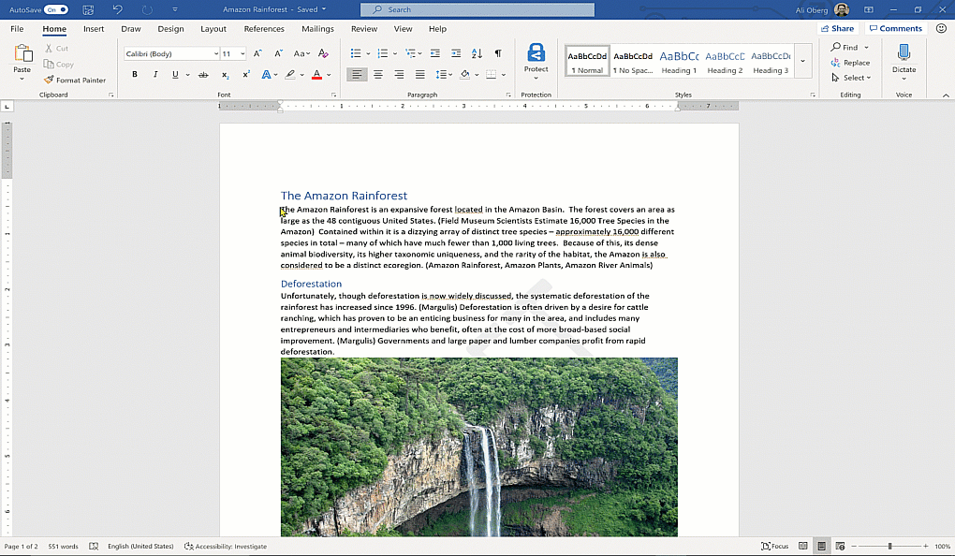
Accessibility Checker
Analyzes your material and provides recommendations to help fix errors and create more accessible content.
With the Accessibility checker I can easily improve the accessibility of my documents to make them accessible for everyone.
Use Case: Before sending your e-mail, message or sharing your document or spreadsheet, run the Accessibility Checker to create inclusive content that everyone can read and edit.
Learn More:
aka.ms/AccessibilityChecker
Notes:
Unlock your content for everyone. Office 365 apps include an Accessibility Checker that finds accessibility problems and lists suggestions, or you can find specific tips for making your content accessible to all for the products and platforms listed below.

Slide 7

Demo!!!

Slide 8


Creating excitement building accessible experiences
Help put accessibility principles into practice
All organizations
At Microsoft
Accessibility Fundamentals training series
Learn how to create experiences that are accessible for people of all abilities
Accessibility in Action Digital Badge
Earners of badge have familiarized themselves
with how to:
Create an inclusive culture
Implement accessibility best practices
Present inclusively
Host inclusive events
Educators
Microsoft Educator Community
Learn how to create personalized learning experiences to meet needs of diverse learners
https://docs.microsoft.com/en-us/learn/paths/accessibility-fundamentals/
https://education.microsoft.com/en-us/course/a41ac17d/overview
Notes:
At Microsoft
To create knowledge, excitement, and pride in building accessible experiences, we developed our Accessibility in Action digital badge for Microsoft employees. It’s one way that we can help our employees put our principles into practice.
Earners of the badge have familiarized themselves with the knowledge and skills required to create an inclusive culture, implement accessibility best practices, present inclusively, and host inclusive events. Earners also understand how accessibility is part of Microsoft's mission of empowering every person and every organization on the planet to achieve more and are dedicated to creating accessible and inclusive experiences for everyone.
For other organizations
In order to help other organizations, we have created the Accessibility Fundamentals training series so that they can learn how to create experiences that are accessible for people of all abilities. It is available to anyone, so if you or someone in your organization would like to learn more, check out our Accessibility Fundamentals courses at: https://docs.microsoft.com/en-us/learn/paths/accessibility-fundamentals/
We’ve also created a special program for Educators that gives teachers the information they need to provide personalized learning experiences to meet the needs of diverse learners. Accessibility tools: Meeting the needs of diverse learners - Microsoft Educator Center

Slide 9

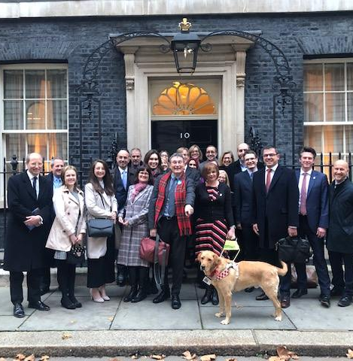
“Sometimes, a journey begins by reaching out and taking someone's hand.
At other times, it begins by inviting another to take yours.”

