Slide 1
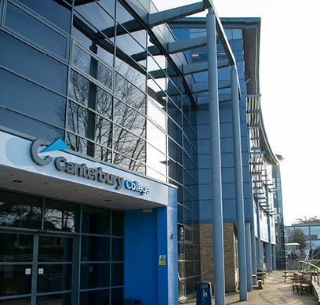
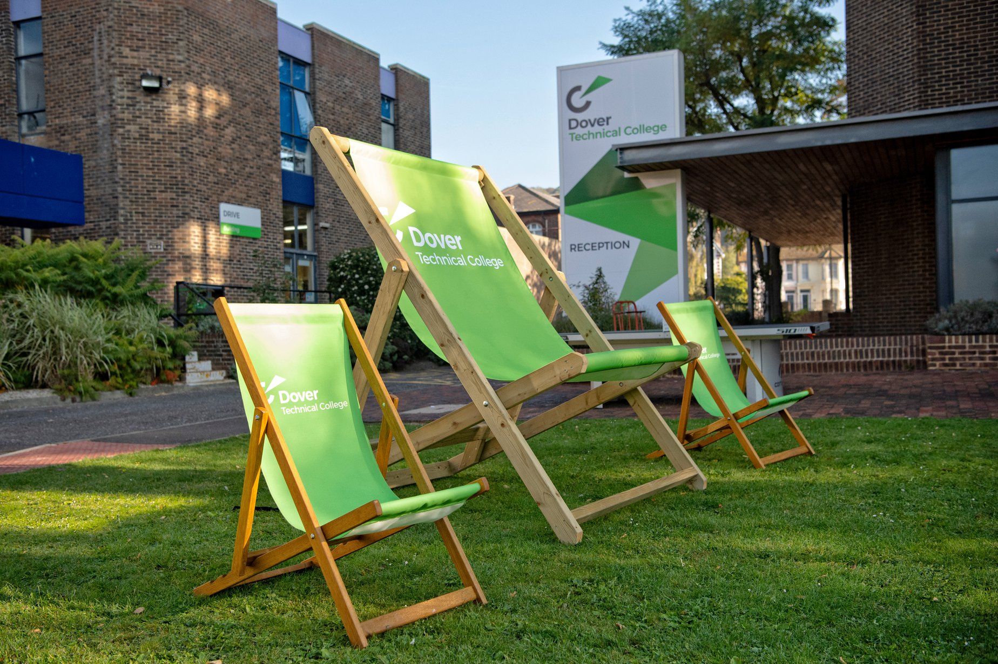
Transitioning from Further Education to Higher Education: EKC Group and the University of Kent - Jo Campbell and Ben Watson

Slide 2
Universal support
All students have access to the following:
Mentors: act as an advocate for each student, link with home and the curriculum, safeguarding officers
Additional Learning Support: gather information on students to inform strategies to meet student needs in class and for the workplace, co-ordinate support in class and other services to meet student's needs
Dyslexia Tutors: Assess students who require exam access arrangements
IAG, Industry Liaison Officers
Wellbeing Centre, Counselling
Targeted support is available

Slide 3
Personalised support
A higher level of support is available where required
Speech therapy programme
Personal Social Achievement activities to support attainment of personal outcomes
Access to Support Services:
QTVI (Qualified Teacher for the Visually Impaired), TOD (Teacher of the Deaf), CAT (Communication Assisted Technology), KAB (Kent Association for the Blind) , Physio, KCC Independent Travel Training (ITT), OT
Time to move on and to be more inclusive
Further Education is on a journey towards meeting regulation requirements and embedding accessibility by design

Slide 4
Where do we go next?
Opportunity for public sector bodies to share development and resource for the benefit of everyone:
Digital Accessibility Policies
Procurement measures
Approaches to auditing, strategic implementation and accessibility statements
Shared training and eLearning
Support using mainstream assistive technologies
Local and national networks to share knowledge
Promoting independence and further encouraging access to Higher Education

Slide 5
Contact
Jo Campbell, Director of SEND Development
EKC Group
jo.campbell@eastkent.ac.uk
Ben Watson
Student Support and Wellbeing
University of Kent
b.watson@kent.ac.uk

