Slide 1
Getting the most out of
MS Word
www.kent.ac.uk/learning

Slide 2
Getting the most out of MS Word
MS Word has a number of functions and options to help you structure and present your work. This session will show you how to use some of these, including:
Headers/footers and page numbers
Using headings and creating an automatic contents page
Inserting tables, charts and diagrams
Using the reference management tool and creating an automatic bibliography
Track changes for feedback

Slide 3
Headers/footers and page numbers

Slide 4
Headings and contents pages
Level 2 heading e.g. ‘Interviews’
Cover page/essay title
Level 3 heading e.g. ‘Staff’
Level 1 heading e.g. ‘Methodology’

Slide 5
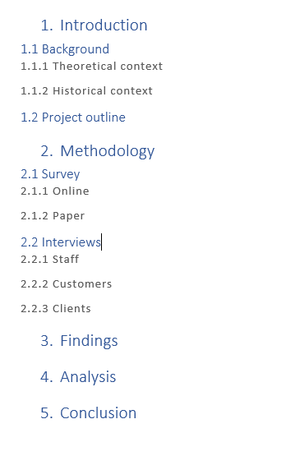
Headings and contents pages
Heading 1
Heading 2
Heading 3

Slide 6
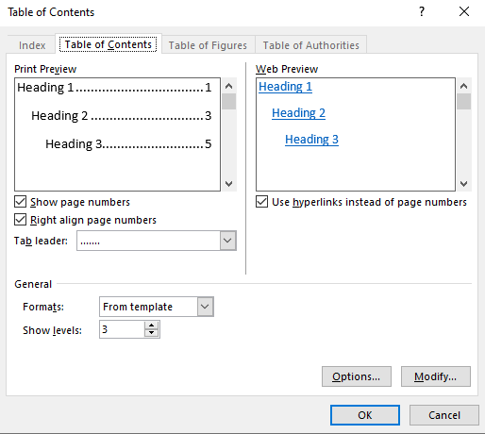
Headings and contents pages

Slide 7
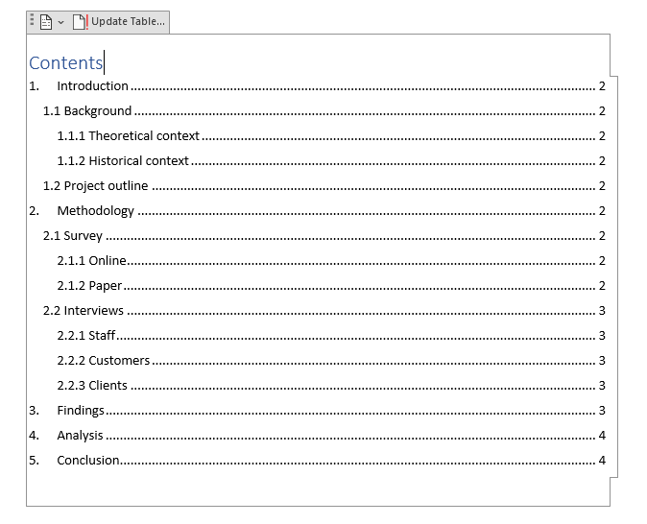
Headings and contents pages

Slide 8
Tables, charts and figures

Slide 9
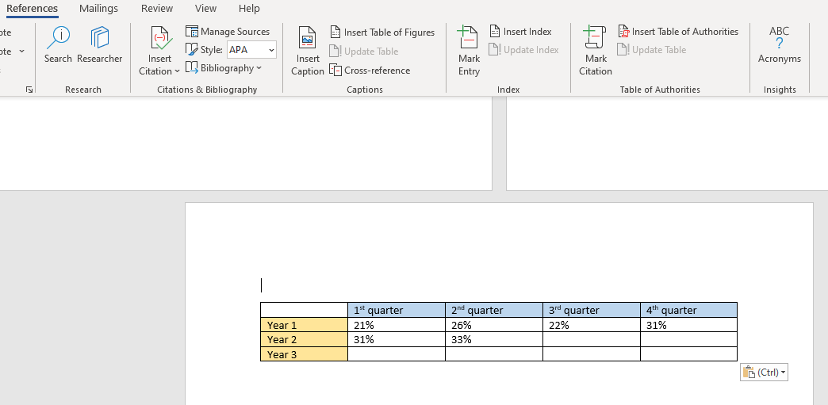
Tables, charts and figures

Slide 10
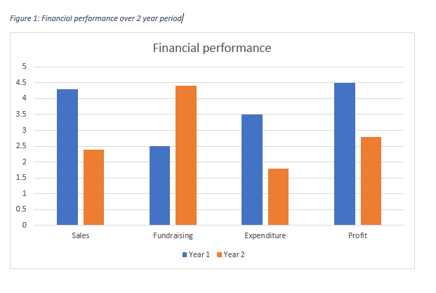
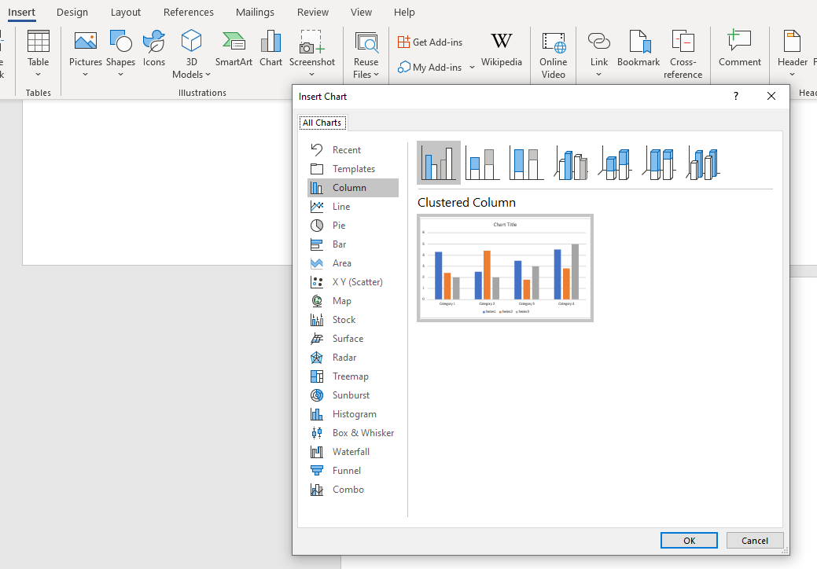
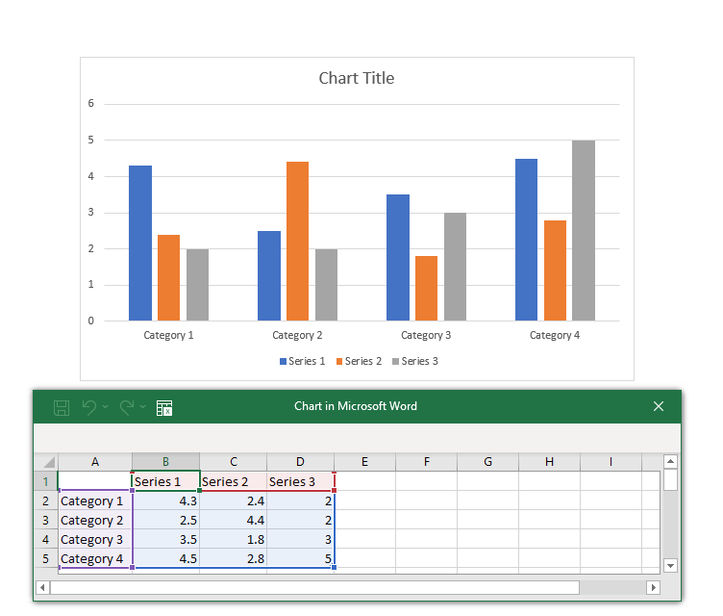
Tables, charts and figures

Slide 11
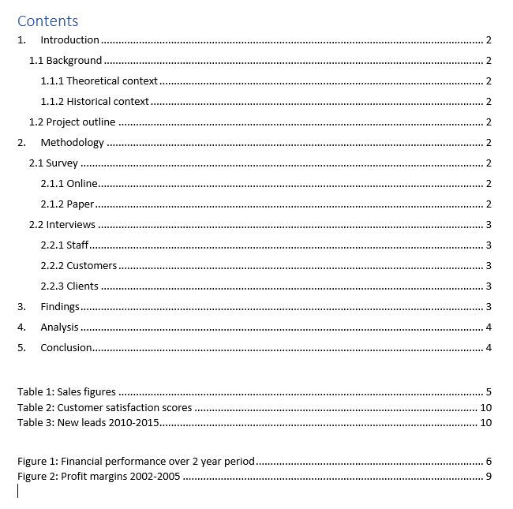
Tables, charts and figures

Slide 12
Making a page landscape

Slide 13
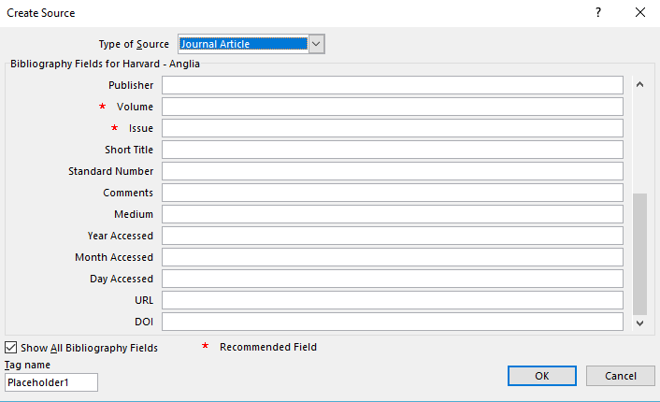
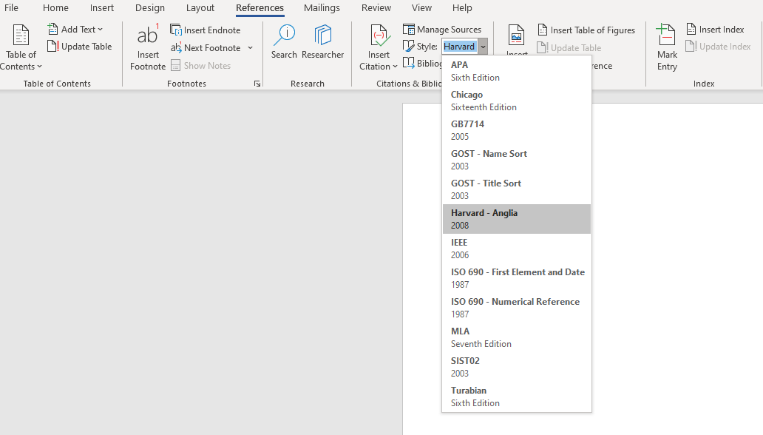
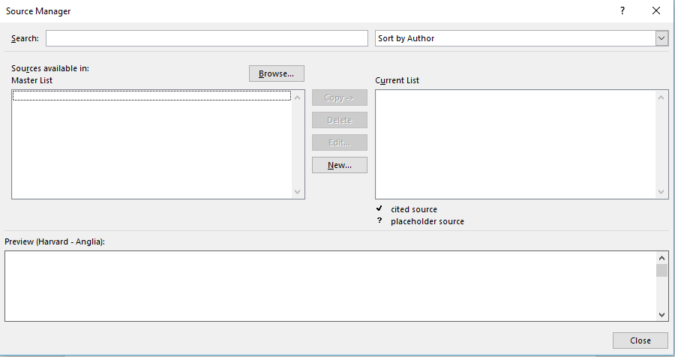
Reference management tool

Slide 14
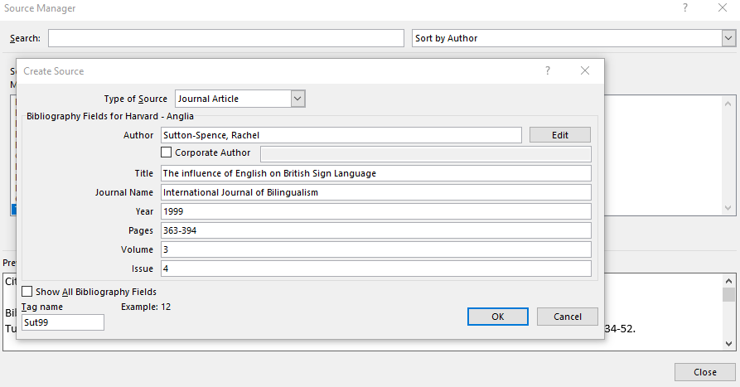
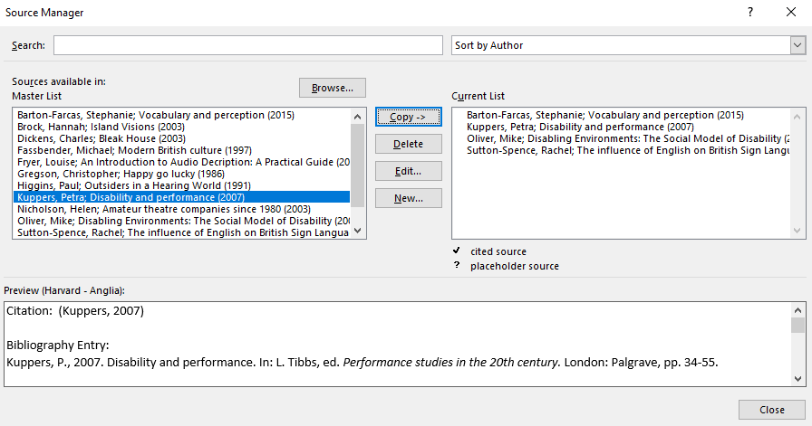
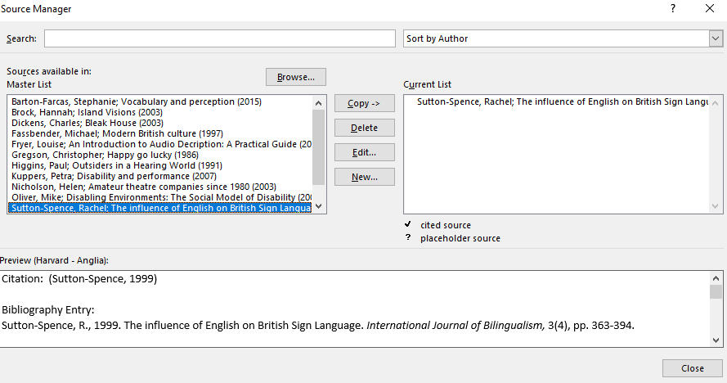
Reference management tool

Slide 15
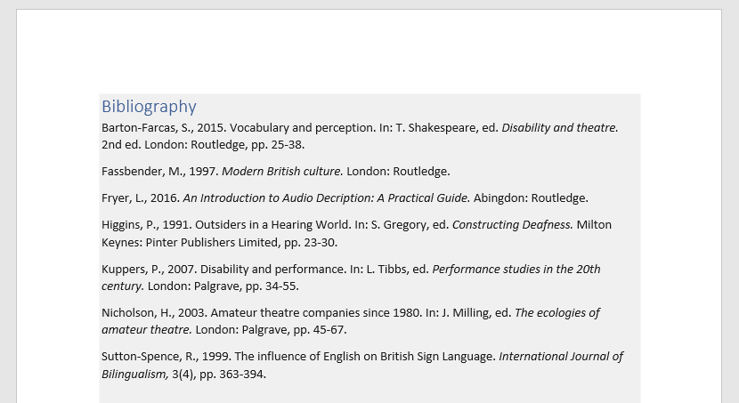
Reference management tool

Slide 16
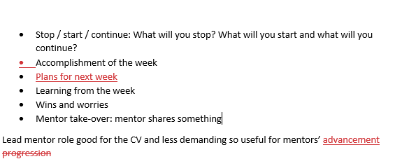
Track changes

Slide 17
Track changes

Slide 18
Further resources
For guidance on a broad range of learning skills please go to the SLAS webpages www.kent.ac.uk/learning where you can:
Book a one-to-one appointment with a SLAS adviser
Attend a range of Online Bitesize Skills Development sessions
View tutorials and workshop materials in your own time

Slide 19
Get in touch…
SLAS
CONNECT
To book an appointment:
www.kent.ac.uk/learning
learning@kent.ac.uk
SLASkent
KentUniSLAS
SLASkent

