Slide 1
KENTVISION PROGRAMME/
UPDATE TO PARTNERSHIP FORUM
Alex Addison and Lee Martin

Slide 2
Agenda
What is KentVision?
Current Status & Moving Forward
Training: Enrolment & Assessment
Close & Questions

Slide 3
What is KentVision?
The KentVision Programme is a Business Change Programme that involves …
Refining our business processes across enrolment to congregations
Implementation of the Tribal SITS product across enrolment to congregations
Integration of admissions with enrolment to congregations
Decommissioning of the Student Data System (SDS)

Slide 4
Scope
Our scope includes …
All UG, PGT & PGR programmes that are delivered across the student lifecycle
All required integration & interfaces with other institutional systems
All statutory, management and operational reporting
Migration of ‘current students’ to the new system
We Prepare
I Enquire
I Arrive
I Learn
I Complete
I Apply

Slide 5
Objectives
Providing an administrative journey that is clear, informative and seamless to all applicants and students
Creating a united academic administration across central services, faculties, schools and colleges; operating common lean business processes and a single source of high quality authoritative data
Improving business processes and delivering IT enablement that fulfils the University’s strategy for effective and efficient operation, using standard SITS capability to maximum advantage
Establishing a digital campus with a fully integrated suite of mobile enabled services for students and staff
Refining student administration, reducing administrative effort to create time for staff to address other goals and provide a robust and agile foundation for the future

Slide 6
What does that mean we are achieving?
Unified and value-added business processes, planned and controlled by your business rules
A system with our business rules embedded in the functionality, better to support our processes and easier to maintain
Efficiencies enabled by KentVision as an administrative ‘management’ system
Security of reliable, quality data
Unified Programme structures
A robust foundation for the future – simplified, lean and agile

Slide 7
Why is it imperative KentVision launches for September 2018?
To realise major University investment
To deliver immediate improvements to student experience and student administration
To prepare for external changes that we need to respond to, including CMA, GDPR and Data Futures
(Competition & Markets Authority, General Data Protection Regulation, Data Futures – HESA’s Transformation Programme)
For these reasons and many more, stakeholders and the team are committed to a successful launch in September of this year

Slide 8
Current Status - What we’ve been doing
We’re working to the original scope
The portfolio of programme structures has been unified & reduced from over 650 to 41 models
Business processes have undergone significant analysis to leave us with unified, value-added processes
Processes are supported by the new system, particularly where the agreed business rules have been embedded in system functionality
Our test team is currently testing both at a functional level and preparing for system testing and UAT, starting with taught prior to PGR as we trace the Student Lifecycle
Testing has seen us process many students through various programmes right from enrolment to awards

Slide 9
Current Status – Ongoing work
All continuing work is organised for delivery down the student lifecycle for UG, PGT and PGR phases
Most business areas are analysed, designed, built and in functional testing, but there are two exceptions; PGR is in analysis & Congregations is on hold
Re-work following the programme structures unification is on-going
The University’s infrastructure is being readied for system changes
Further specifics of the detailed implementation strategy are under scrutiny to ensure we are all synchronised in the implementation effort - Internal rehearsals of ‘Go Live’ planned
Taught packages will be released into UAT from APRIL - same process as completed by the test team, but actioned by stakeholders with our support
MoSCoW prioritisation and BAU backlog

Slide 10
Moving Forward
Not necessarily a great deal of change in what has to be done
Everyone will be able to do what they need, and with marked improvement in HOW its done
Example: Assessment and handling of marks
Likewise, there won’t be anything asked of your students that is completely foreign
And what is provided will again be a marked improvement in the student experience
Example: KentVision student enrolment

Slide 11
KENTVISION PROGRAMME/
TRAINING
Lee Martin
Notes:
V1.0
To change the footer on every slide:
1. On the menu go to Insert > Header and Footer…
2. Select the Footer checkbox and enter the footer text in the accompanying text box
3. Click “Apply to All”

Slide 12
KentVision Training 2018
Approach and Method
Communications Delivery and Attendance
Materials
Assessment, Review and Support
Example: Student Registration demo

Slide 13
Enrolment and Registration
Students enrol themselves online. Continuing students complete verification of id and Registers online also.
UKVI – Overseas’ students can be registered after Passport/ VISA pre-checks

Slide 14
KentVision Registration

Slide 15
Assessment Components – Key Changes
SDS assessment pattern code e.g. CE1 replaced by code reporting academic year, module code and sequence/version number e.g. 18/ACCT5020/01
Reassessment part of the module assessment pattern. Recorded at start of academic year in two forms – like for like or reassessment instrument e.g. 100% examination; allows for automatic reassessment processing/tagging
Kent Vision enables user to view assessment data and report issues but not update directly
Deadline data held as part of assessment component and can be rolled forward each year

Slide 16
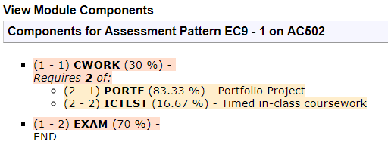
Assessment Pattern – Compare & Contrast

Slide 17
Mark Entry – Kent Vision
Marks recorded online (Kent Vision) for all components (coursework, project and examination) and reassessment
Mark entry and calculation controlled by mark schemes at the assessment and module level
Requires the entry of both a mark and a grade e.g. 50/P Users will be given clear guidance as to the mark and grade combinations allowed and these are validated
No verification of marks (standard practice in institutions using SITS)
Ability to export and import module marks by sub-group e.g. seminar group

Slide 18
Mark Entry – selection of assessment component(s)

Slide 19
Mark Entry – entry of mark and grade

Slide 20
Export Marks
Marks of each assessment may be exported as individual files. You can also export all of the marks for a module to a pdf or excel document for reference, circulation or update for import back into the system.
Within the Export area in the Files to Generate box, select whether to generate an Export file of marks for Assessments, Re-assessments or Both.
Select the View File link in the Status column in browser to Open or Save your file as a *.csv

Slide 21
Import Marks
After exporting marks you can then import updated marks back into the system.
Open or Save the file as a *.csv.

Slide 22
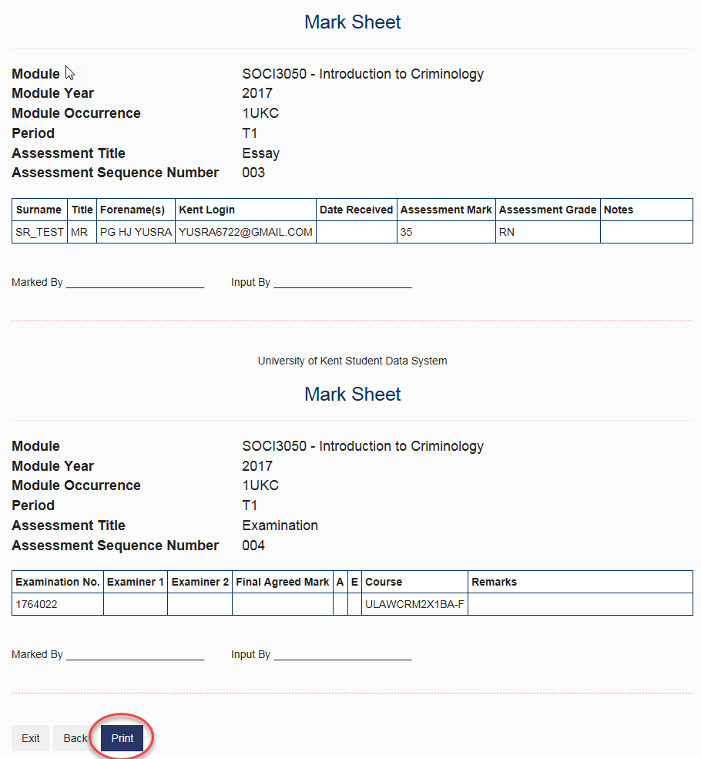
Marksheet
The Module Mark-sheet is used to print Mark-sheets for mark entry of assessments of students on selected modules.

Slide 23
Board of Examiner Processing

Slide 24
Questions
Over to you…

