Slide 1
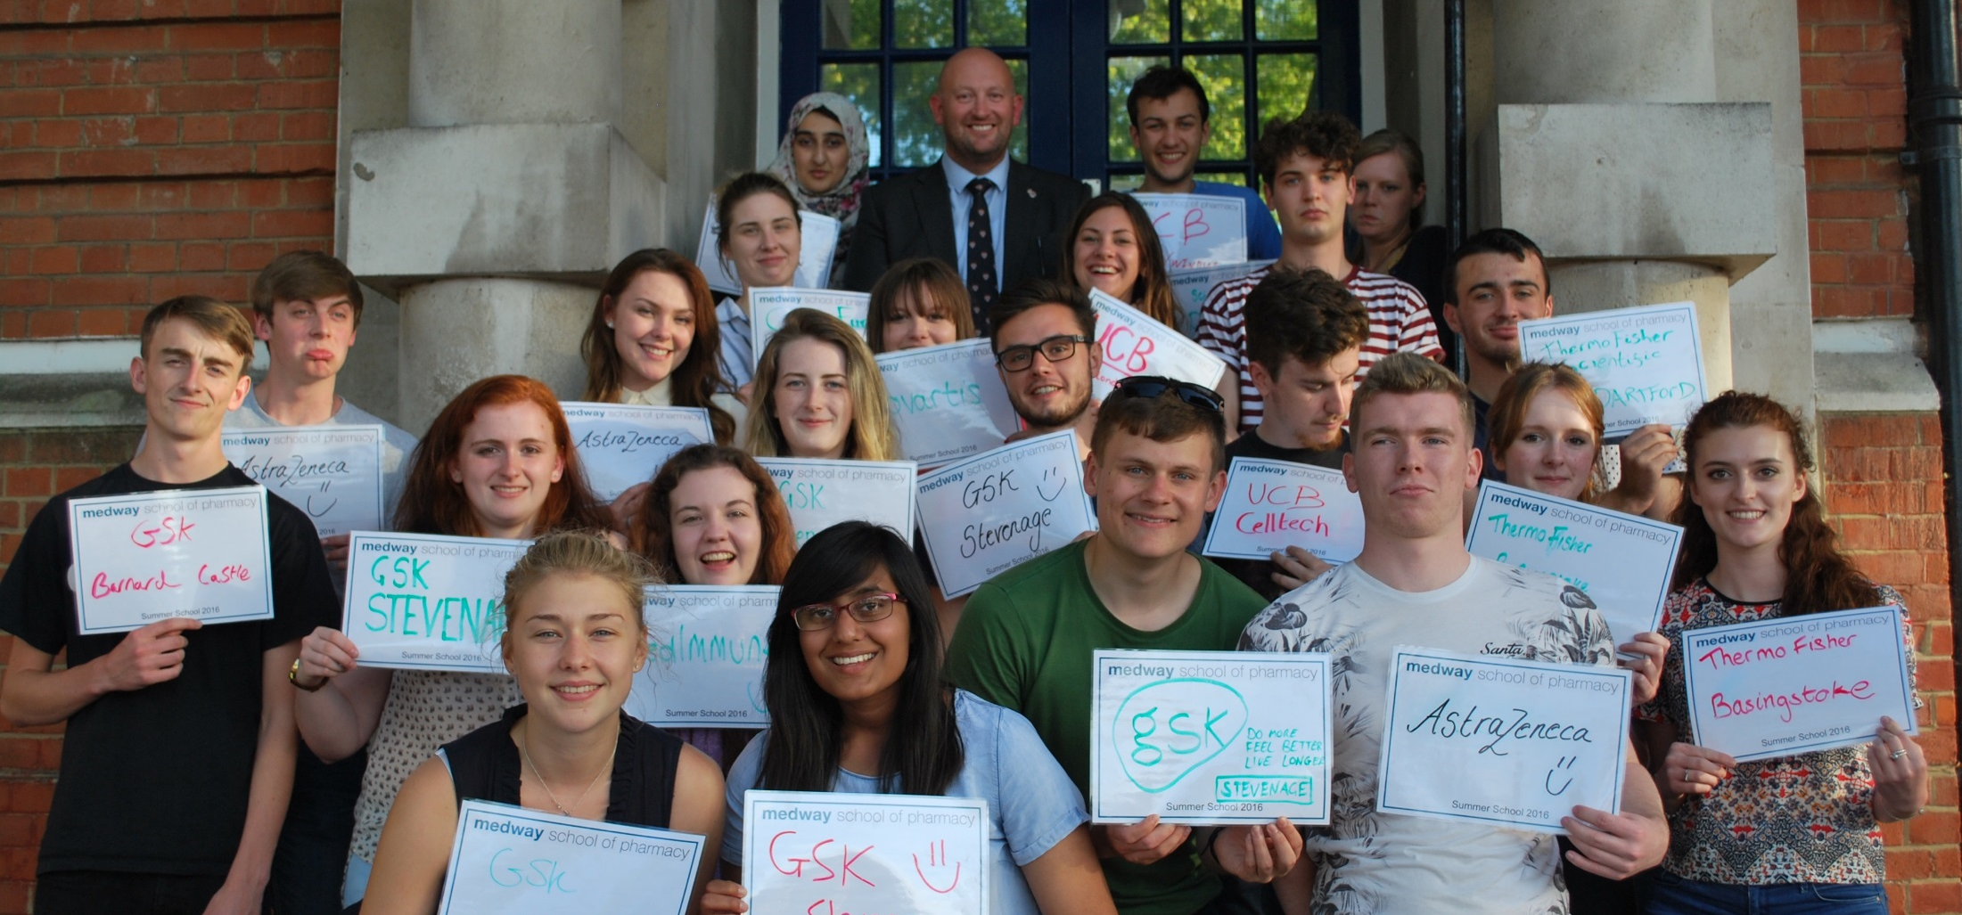
Partnership Forum briefing:
Centre for Higher and Degree Apprenticeships (CHDA)
Dr Scott S. P. Wildman PhD
s.s.wildman@kent.ac.uk
Notes:
V1.0
To change the footer on every slide:
1. On the menu go to Insert > Header and Footer…
2. Select the Footer checkbox and enter the footer text in the accompanying text box
3. Click “Apply to All”

Slide 2
1. Background
In response to:
The government actively promoting higher and degree apprenticeships (HDAs) as an alternative to traditional university study.
The Conservative party manifesto pledging to create 3 million new apprenticeships in England by 2020.
The launch of the apprenticeship levy.
….the University of Kent launched the
Centre for Higher and Degree Apprenticeships
in September 2016.

Slide 3
2. Apprenticeship levy
Any employer in England with an annual paybill >£3 million pays 0.5% of their paybill into a ‘levy pot’ (started April 2017).
  20,000 employers
  £2.3bn annually
Any employer in England with annual paybill <£3 million is eligible for generous government incentives (100% cost).
  98% employers
  £450m commitment up to July 2018
The levy pot is then to be used to train apprentices (including higher and degree apprentices).

Slide 4
3. What does CHDA do?
Internally, we:
Advise on apprenticeships standards (current / future).
Advise on market demands and provide centralized marketing.
Lead on bids to tender.
Manage the contractual aspects, and financials.
Manage learner data and admissions for apprenticeships.
Provide workplace progress visits and manage EPA.
Manage Provide oversight of QA and reporting for HDAs.
Support academic Programme and Module approval.
Manage the University’s internal DA Development Fund.
‘Own’ and manages academic programmes (not modules) aligned to HDAs.
Validate academic programmes (aligned to apprenticeships) for Partners.
Ensures consistency across all HDA products.
A centralized CHDA mitigates significant risk.

Slide 5
3. What does CHDA do?
Externally, we:
Advise on apprenticeships standards (current / future).
Advise on funding.
Support the contractual aspects, and financials.
Offer recruitment service (e.g. screening and advertising).
Provide workplace progress visits and manage EPA.
Support Trailblazer groups:
Social Worker
Clinical Trials Specialist
Substance Misuse Professional
Cultural Leader Professional
Life Sciences & Industrial Science Group
Advanced Manufacturing & Therapeutics Products Group
Facilitate collaborative research opportunities.

Slide 6
4. USP
Quality degree apprenticeship provision, managed by a dedicated central service department, offering a full range of support* to employers of every size.
University of Kent offers multiple start dates throughout the year, with a focus on a blended learning** approach permitting flexibility for the employer and learner. As well as research-led teaching by subject experts, and award winning learner support services, each apprentice will study for a university-awarded qualification***.
*services include: advice on funding, advertising, screening and recruitment, workplace competency monitoring, and collaborative research opportunities.
**blended learning uses web-based online learning to replace much of the traditional face-to-face teaching associated with a university qualification, and permits a flexible approach to study (i.e. removes the necessity of set study days away from the workplace). Face-to-face teaching is provided via blocks of teaching (e.g. Summer Schools) or visits to the workplace. Blended learning incorporates a variety of ways in which a learner can interact with their university academics.
***graduating at either Canterbury or Rochester Cathedral.

Slide 7
5. Key successes to date
Inclusions on RoATP and non-levy paying employers.
Doubled starts year on year for 3 years.
Kent apprentices have represented England in Ice Hockey and Polocrosse.
Kent apprentices have won:
Higher or Degree Apprentice of the Year 2017
East of England Apprentice of the Year 2017
runner-up Best School Leaver Apprentice 2017
Successful application to HEFCE’s Degree Apprenticeship Development Fund.

Slide 8
5. Current offerings
Technician Scientist Level 4-5
(p/t FdSc in Applied Bioscience or FdSc in Applied Chemical Sciences).
Laboratory Scientist Level 4-6
(p/t BSc [Hons] in Applied Bioscience or BSc [Hons] in Applied Chemical Sciences).
Chartered Manager Level 4-6
(p/t BSc [Hons] in Management).
Senior Leader Level 7
(p/t Master of Business Administration).

Slide 9
6. Future offerings (18/19)
Social Worker Level 4-6
Professional Economist Level 4-6
Clinical Trials Specialist Level 4-6
Advanced Clinical Practitioner Level 7
Architect Level 7
Architects Assistant Level 4-6
Quantity Surveyor Level 4-6*
Academic Professional Level 7
*in collaboration with EKCG

Slide 10
6. Vision
Collaborative provision of HDAs with FE and HE partners – pooled resources.
Preferred partners.
Seamless progression pathways for learners.
Employer friendly approach to provision (a one-stop-shop model).
Efficiencies in marketing with preferred partners.
Subcontracting arrangements.
End point assessor.
Apprenticeship Training Agency.

Slide 11
12. Kent apprentices
https://youtu.be/GXLXyBIg0ao

Slide 12
Questions please….
Dr Scott S. P. Wildman PhD
s.s.wildman@kent.ac.uk
Notes:
This

