Slide 1
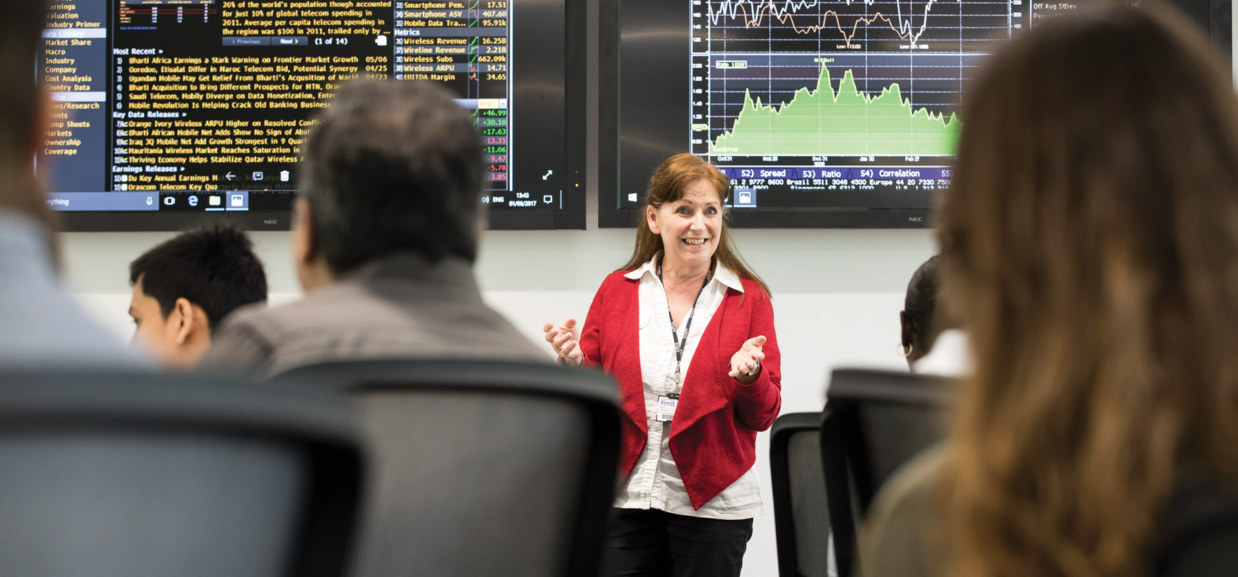
University of Kent’s approach to eLearning: Current Developments and Practice
Jane Carne and Daniel Clark (UELT)
Partnership Forum 2018

Slide 2

Aims and Approach
For technology to be used effectively, creatively and confidently for the enhancement of the student learning experience. (2007)
Education and Student Experience Strategy
(2016-2020)

Slide 3
Aims and Approach
  Support institutional, school & individual learning and teaching objectives
  Annual TEL focus
  Enhance Learning Teaching & Assessment practices with technology
  Develop the curriculum e.g. flexible provision, international reach
  Talented E-learning team

Slide 4

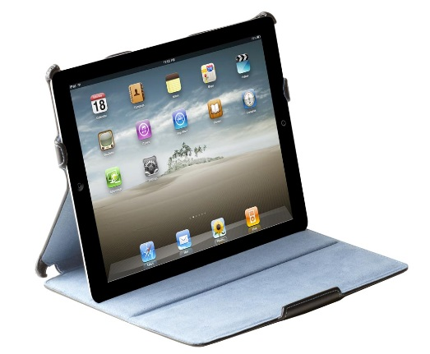

3 elements to consider
Pedagogy / Purpose
Technology
People

Slide 5
Core technologies – what, why, uptake
VLE – Moodle
E-submission, Online marking and Feedback - Turnitin Feedback Studio,
  Moodle assignments
Lecture recording – KentPlayer (Panopto)
E-portfolio – MyFolio (Mahara)
Audience response systems (clickers)

Slide 6

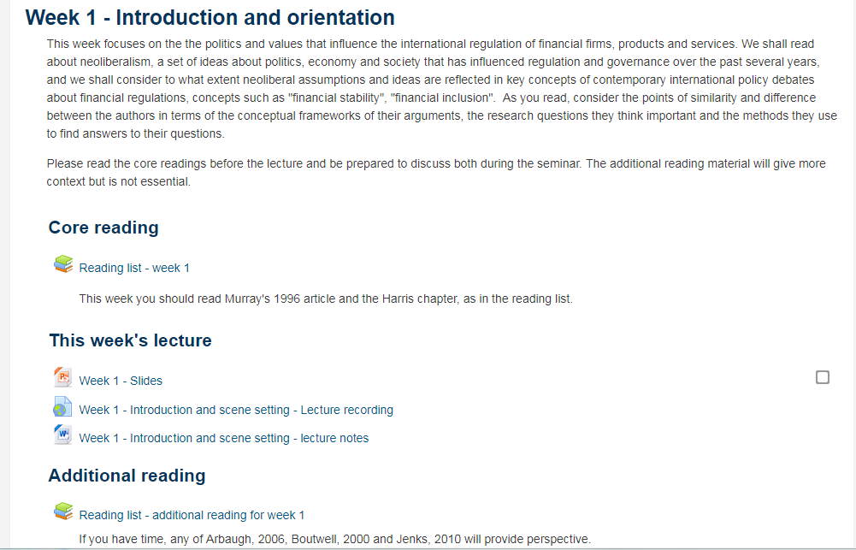
Moodle (resources)

Slide 7
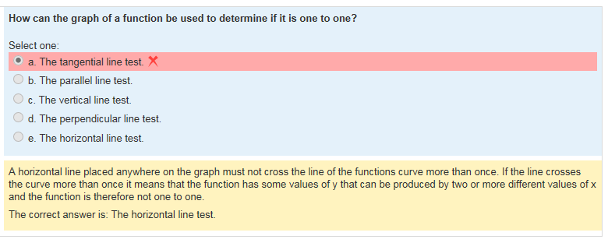
Moodle (quizzes)

Slide 8
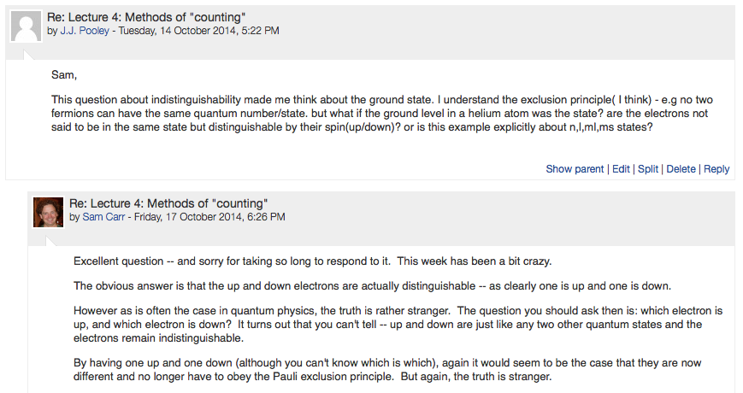
Moodle (discussion forums)

Slide 9
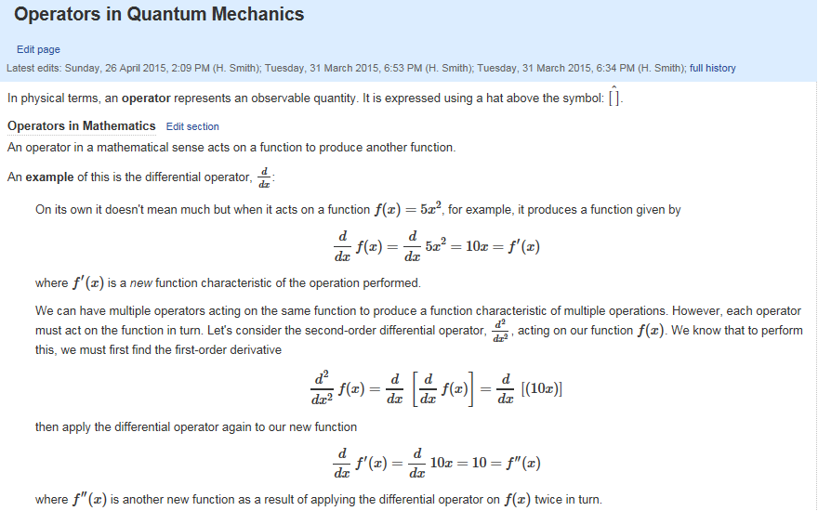
Moodle (wikis)

Slide 10

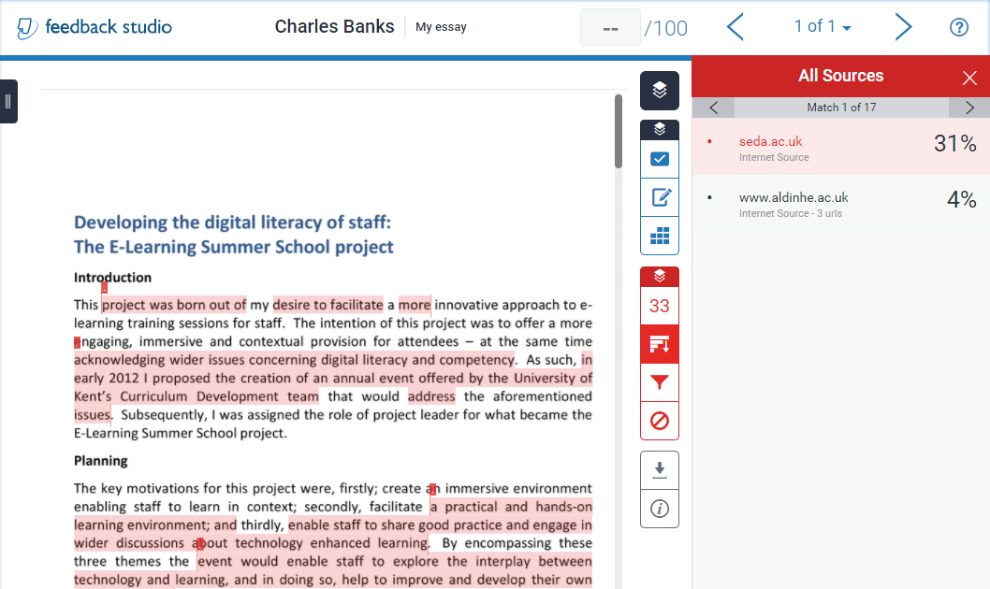
Turnitin (similarity)

Slide 11
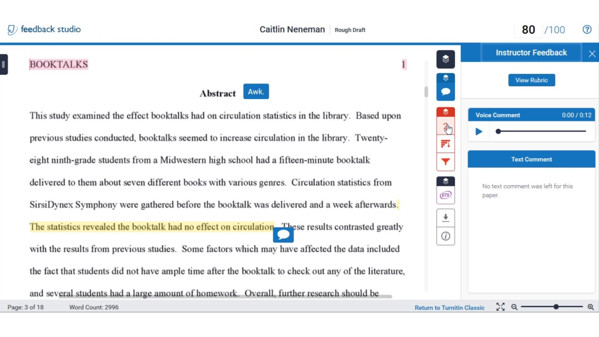
Turnitin (marking & feedback)

Slide 12

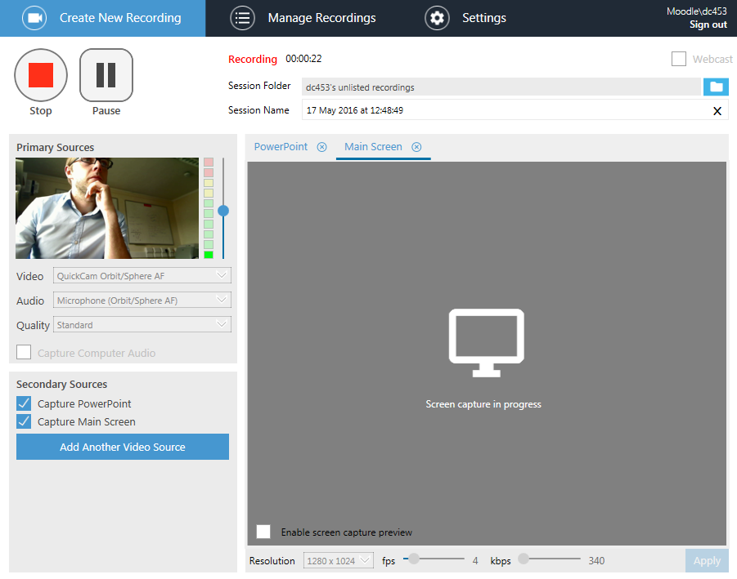
KentPlayer (making recordings)

Slide 13
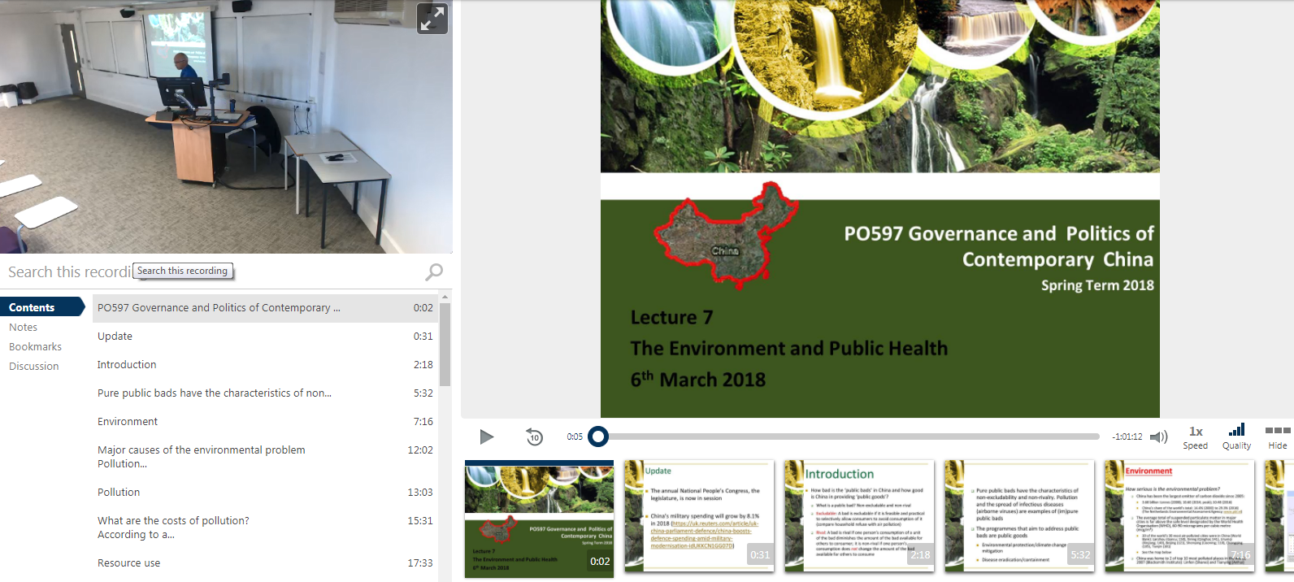
KentPlayer (playback)

Slide 14

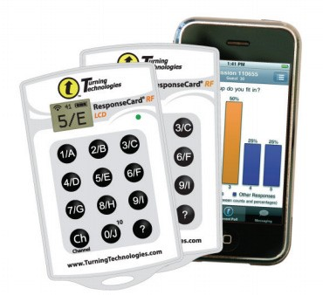








Non-core technologies

Slide 16
How we engage people
Sitting within a disciplinary context
Identifying School champions
Identifying and promoting discipline-specific technologies
Working closely with School DoEs
Discipline-specific
  Priorities
  Focus
  Concerns

Slide 17
How we work in practice
Work closely with academics & professional services staff
  E-Learning Forums - Co-delivered with academic staff
  School drop-in sessions
Provide support and training for core learning technologies
  University-level and School-based training
Advise on use of learning technologies in the curriculum
  School and Faculty-level committees
Investigate emerging technologies
  Case studies & examples of good practice
E-learning website: www.kent.ac.uk/elearning

Slide 18
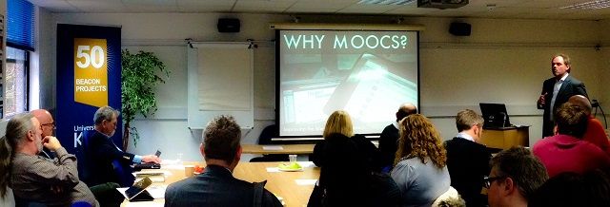
Other Projects 2017/18
Future Learn MOOCs https://www.futurelearn.com/partners/the-university-of-kent
Online Degree Apprenticeships

Slide 19

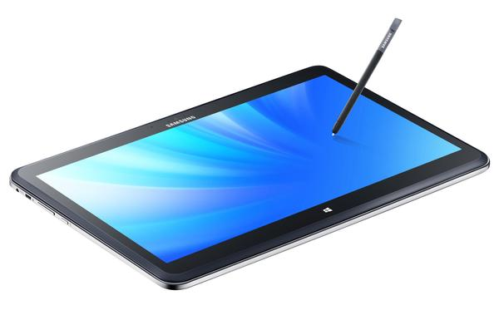
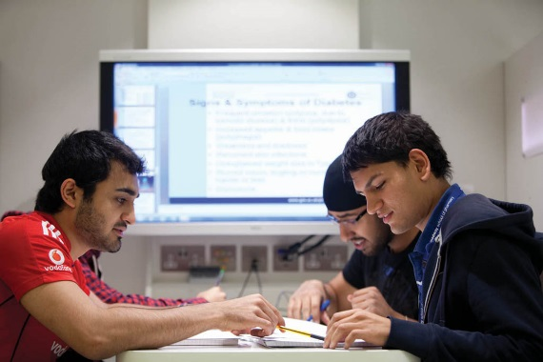
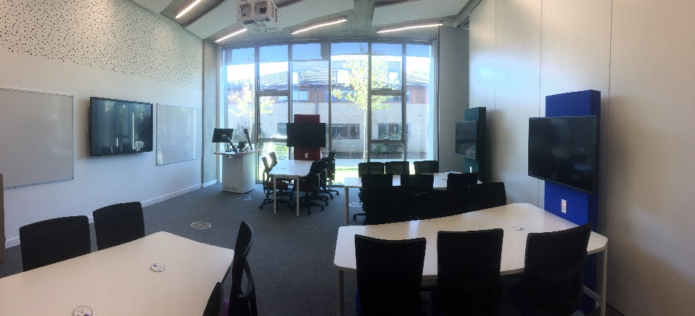

Digital Classroom / Future Learning Spaces
- Space, pedagogy and technology

Slide 20
Discussion / Questions
Time for questions and sharing your experience, knowledge and queries with the group.

Slide 21
Notes:
This

