Slide 1
Higher Nationals
Pearson Update
Image placeholder
Image by Photographer’s Name (Credit in black type) or
Image by Photographer’s Name (Credit in white type)
Rebecca Mameli
Head of Higher Education Research and Qualifications
Higher Education Qualifications
March 2018
Presentation Title Arial Bold 7 pt
1

Slide 2
HN sector phasing
Phase 3: First registration Sept ‘18
Healthcare Practice
Community Care and Social Work
Hospitality Management
International Travel and Tourism
Creative Media Production
Performing Arts
Music
Sport
Sport and Exercise Sciences
Public Services
Animal Management
Agriculture
Horticulture
Phase 4: First registration Sept ‘18
Applied Sciences
Rail Engineering
Early Years
Phase 1: First registration Sept ‘16
Business
Phase 2: First registration Sept ‘17
Engineering
Aeronautical Engineering
Nuclear Engineering
Construction
Computing
Art & Design
Policing
2

Slide 3
HN frameworks for redevelopment
Accredited to the Ofqual Regulated Qualifications Framework (RQF).
Mapped against the QAA Framework for Higher Education Qualifications and Subject Sector Benchmarks.
Mapped to meet the standards of relevant Professional Bodies.
Designed to be demanding, rigorous, inclusive and empowering.

Slide 4
HN Creative Media Production
Pathways at HNC and HND:
Sound Media
Journalism
Film & Television
Motion Graphics
Game Development
Web & App Development
Visual Effects
Creative Media Production qualifications have been developed with a view to providing centres with a flexible framework in which to develop courses that support students to progress to universities or enter employment in the creative industries.

Slide 5
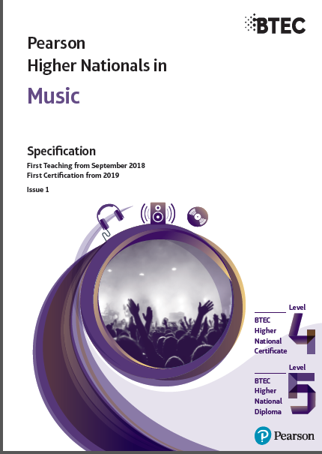
HN Music, HN Performing Arts
Music Performing Arts
Pathways at at HNC and HND: Pathways at at HNC and HND:
Performance General (HNC only)
Business Technical Arts
Technology Dance
Composition Acting
General (HNC only) Musical Theatre
Pathways at HND:
Sound Engineering
Sound Design
Music Production
Artist Development
Session Musician
Composition
Business

Slide 6
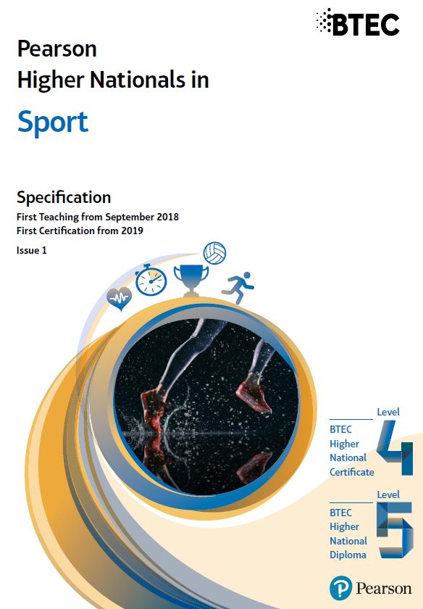
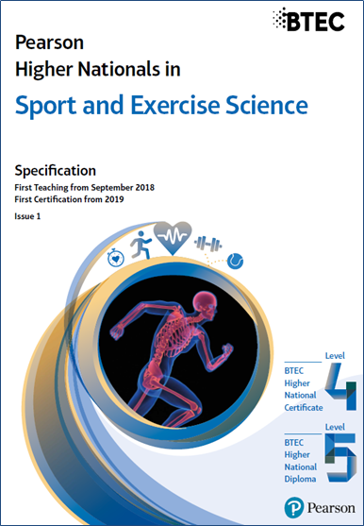
HN Sport; HN Sport and Exercise Science
Sport
Pathways at HNC and HND:
Outdoor Adventure (Management)
Leisure Management
Community Sport & Physical Activity
Sport and Exercise Science
Pathways at HNC and HND:
Sport and Exercise Science
Coaching Science
Exercise, Health & Lifestyle

Slide 7
HN Hospitality Management;
HN International Travel and Tourism Management
Image by Tang Yau Hoong
Hospitality
Pathways at HNC and HND:
Culinary Arts Management
Food and Beverage
Accommodation and Revenue Management
Events
Innovative Marketing and Sales
Travel and Tourism
Pathways at HNC and HND:
Aviation
Events
Destination Management
Innovation, Culture and Heritage
Tour Operations
Sustainable Management
7

Slide 8
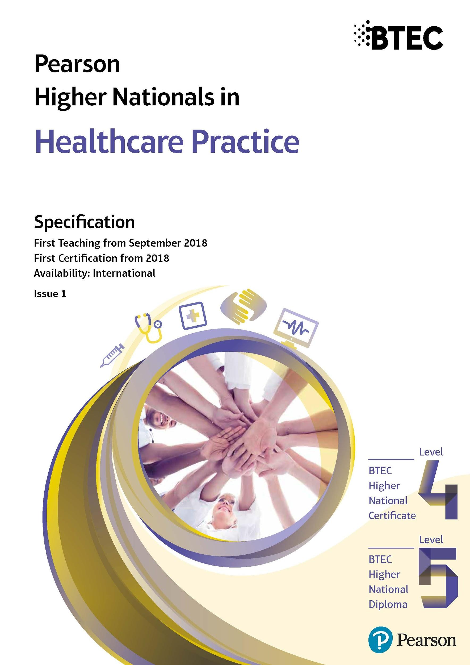
HN Healthcare Practice; HN Social and Community Work
Healthcare Practice
Pathways at HNC and HND:
Integrated Health and Social Care
Healthcare Management
Public Health & Health Promotion
Nursing and Healthcare Support
Social and Community Work
Pathways at HNC and HND:
Integrated Health and Social Care Practice
Social Care Leadership and Management
Community Development
Social and Community Work Practice (HNC only)
Social and Community Work Practice with Adults (HND only)
Social and Community Work Practice with Children, Young People and Families (HND only)
8

Slide 9
Support and resources
What’s coming up? Focus on RQF assessment
RQF HN assessment guide
Talk over training video on RQF assessment
RQF HN assessment ‘best practice’ - planning assessment on the new model with sector-based examples
Enhanced reading lists
Student-facing assessment resources (e.g. a leaflet to support students in understanding RQF assessment model)
Looking at paid-for teaching and learning resources
all the usual free resources will be made available e.g. EABs, SOWs, core textbooks (selected sectors) etc
4
Notes:
9

Slide 10
HN Quality Assurance Update
Re-approvals
Student Survey
Annual Student Fee
APMR
Phase III
Commenced October 2017
Launched March 2017
Invoicing commenced November 2017
2016/17 submission deadline was 22 December 2017
All centres need re-approval to move onto the RQF:
Phase III for nine subjects
Comms to Centres Oct ‘17
Launched in March 2017
Report ready for publication
Details coming soon for 2017/18 launch date
Launched from September 2016
Fee payable by centres for all students in second or subsequent year of study
APMR 2015/16 report is out now.
Findings of 2016/17 APMR due for publication March 2018

Slide 11
APMR submissions - 2016/17 report
APMR Submissions
Yes | No
360 | 75
83% | 17%
Total Centre's Eligible
435
Submitted
UK | International
250 | 110
69% | 31%

Slide 12
HN Global

Slide 13
HN Global Vision
HN Global is the most reliable BTEC Higher National community that can effectively facilitate you as a student in finding the right support and resources to get the most out of your BTEC Higher National programme.
The platform has been created in parallel with the development of the new Higher National qualifications, however it is available for all HN students. Available resources for subjects in Business, Computing, Engineering, Arts & Design, and Construction + 12 more to be added in September 2018.
Not only students can access HN Global as there is a dedicated section for tutors, where they can find teaching material and get access to an exclusive tutor forum.

Slide 14
Numbers overview - Who? Where?
11.000 users worldwide
1100
tutors
9900
students
650 centres in 54 countries
Others
8%
Southeast Asia
21%
UK 71%

Slide 15
What’s available?
Study Skills Modules to provide students with the tools to develop their academic skills. This is the place to get started and be prepared for the demands of Higher Education.
Core Textbooks that provides students with key resources to develop their knowledge and understanding of the core units of every BTEC Higher National qualification.
A Forum for students to engage in conversation with other BTEC Higher National students from around the world and discuss common themes.
Access to the Careers Centre which empowers students to take charge of your their own career development and forge their personal career path.
Higher Education Blog - A space to gain insights into the higher education industry, Pearson and more.
The Degree Finder is a section that displays universities around the world, which have confirmed recognition or progression of a Pearson BTEC Higher National (HN) qualification.

Slide 16
Tutor resources
Unit descriptions, Schemes of Work, Sample Assessment Material and Pearson Set Units.
A dedicated Tutor forum, a space for tutors to ask questions about their subjects and share thoughts on different programmes of study.
Next Steps
Dedicated Tutor Sign-up
New search functionality
Updated Reading lists
More content for additional 12 subjects (International Travel and Tourism Management, Hospitality Management, Healthcare Practice)
Hosco (Hospitality, Travel and Tourism)
New e-textbooks
Tutor and Student Focus Groups

Slide 17
HN Online

Slide 18
A Blended BTEC Higher National Certificate (HNC) in Business - RQF*
HN Online is a new way to deliver BTEC Higher National Qualifications, allowing you to deliver the same industry-related units through a mixture of online and classroom learning. The first course is available is the new RQF BTEC Higher National Certificate in Business, ready for first teach in September 2018.
8 Units (6 core, 2 optional)
30 Guided Learning Hours Per Unit
The platform links to your centre’s VLE
Training & Implementation
Support included
*Centres will need to have programme approval to deliver the RQF BTEC Higher Nationals in Business. If centres do not have programme approval, they can request an application form.

Slide 19
For you and your centre:
Widening Access
Supporting Effective Interventions
More Engaging Classroom Time
Delivers Specialist Content
Better Engagement with Students
Reduce Delivery Costs
For your students:
A Course to Fit Any Schedule
Personalised Learning Journey
More Collaboration

Slide 20
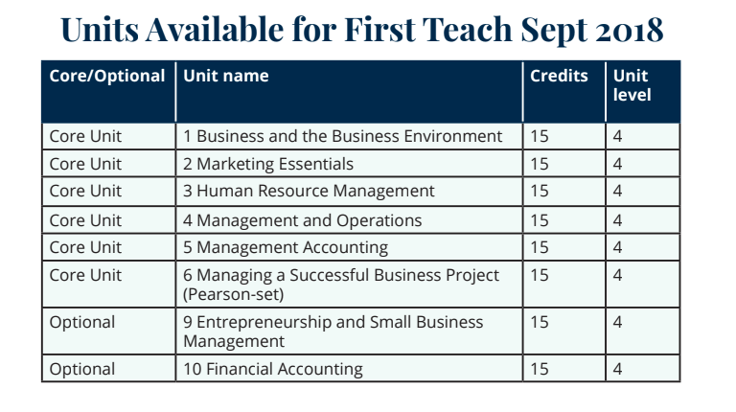
HN Online
“When I go into the classroom, rather than explaining the basics, I can actually
go into the much higher level content and hopefully engage with a decent level of
discussion, so I can concentrate on things like analysis and evaluation skills.”
Testimonials have been provided by colleges that participated in the original pilot of Unit 1: Business and the Business Environment

Slide 21
For more information...
General queries about the Pearson BTEC HN redevelopment
highernationals@pearson.com
Queries regarding HN Global & how to register your students and tutors
support@highernationals.com
Queries regarding the new Pearson BTEC HN quality assurance measures
hnqa@pearson.com
21

Slide 23
Pearson Higher Nationals Under Licence

Slide 24
HNs under Licence
32 Universities in England offer Higher Nationals under licence from Pearson
HNs under licence are not BTECs, are not Ofqual regulated - they are awarded under the Universities’ degree awarding powers
Pearson does not develop, validate, award or quality assure HNs under licence
As the trademark owner, Pearson are responsible for monitoring licence holders

Slide 25
Why an HN under Licence?
Allows access to the Higher National brand - recognised by employers and students whilst the university still retains ownership.
Allows universities, colleges and employers to design HNs which meet specific local needs.
Allows universities to franchise their HNs to FE with articulations to the university for a final year if required.
Assists in meeting widening participation targets.
Further enhances collaborative partnerships.
Allows access to higher apprenticeship frameworks.

Slide 26
What is the Intellectual Property Licence?
An additional licence for those universities that already have a Trademark Licence Agreement.
Entire content of the BTEC Higher Nationals is available to offer under licence.
Entire content is defined as: units, credit structure, learning outcomes, rules of combination, and assessment criteria.
HEIs must use the entire content and cannot use separate parts of it.
HEIs own the qualifications and the same requirements exist as for the Trademark Licence.

Slide 27
Why offer the Intellectual Property Licence?
Attractive to employers and students - developed with their input.
Can be used as part of a Higher Apprenticeship with progression to a Degree Apprenticeship.
No development or validation costs for the universities.
Universities still retain ownership.

Slide 28
Further Information
If you would like further information please contact: licensehn@pearson.com
Centre Guide for Universities offering Higher National Qualifications under Licence from Pearson
Provides information about:
Becoming a Licensed Centre
Developing qualifications
Validation and Review
Registration and Certification
Support for centres
Certification and Quality Assurance

