Slide 1
WORKING WITH AND UNDERSTANDING INTERNATIONAL STAFF AND SUDENTS
7 March 2019
Partnership Forum
Canterbury
Charlene Earl – C.M.Earl@kent.ac.uk - CEWL
Silvia Colaiacomo – S.Colaiacomo@kent.ac.uk – UELT/CDT

Slide 2
In what capacity do you interact with international staff and/or students? What works well and what could be improved in your interaction with them?
http://helpwritingessays.net/20/49/student-group-work-clipart/clipart-students-group-work-within-student-group-work-clipart
Notes:
Ice breaker

Slide 3
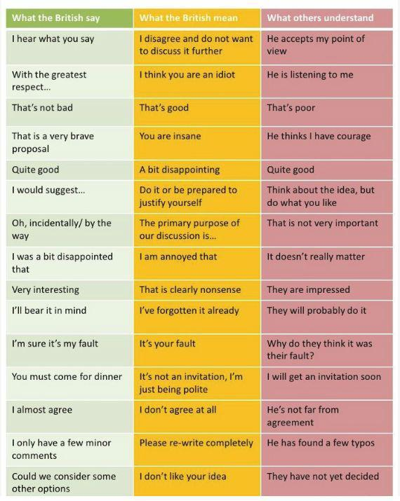
Cross Cultural Pragmatics
From: Talking Cultures https://www.kent.ac.uk/cewl/talking-cultures/materials.html?tab=w-4
Notes:
This is stolen from Talking Cultures!!!!!
Ask participants if they can think of more ex. ‘sorry’
Elicit possible misunderstandings that could occur which further highlights importance of cross-cultural communication

Slide 4
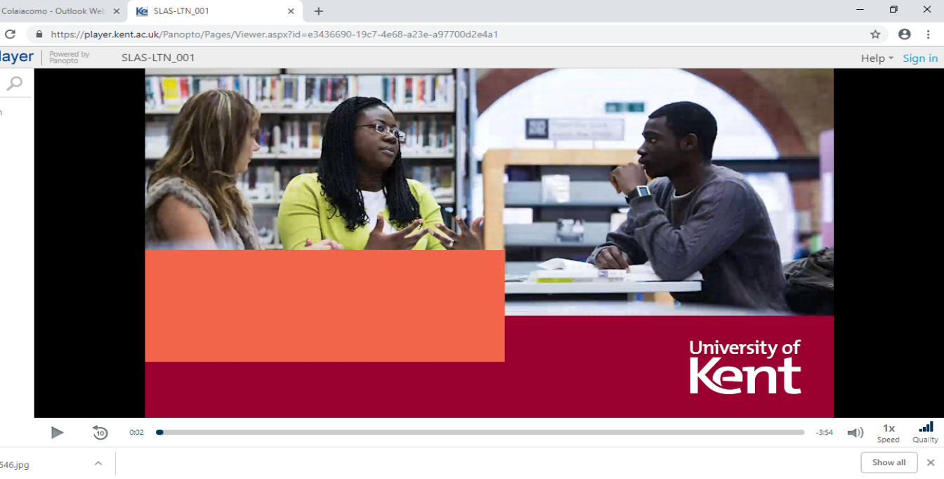
An example… Watch the video and reflect on the following points
What implicit knowledge is taken for granted by the speaker?
Are there any cultural assumptions?
Is the language used truly accessible for a non native speakers (think about phrasal verbs, jargon, informal expressions..)
https://player.kent.ac.uk/Panopto/Pages/Viewer.aspx?id=e3436690-19c7-4e68-a23e-a97700d2e4a1
Notes:
Before playing the sketch we will provide examples of phrasal verbs
We will show the sketch and then we will ask them to reflect on/discuss the questions in groups
Some points to highlight:
Setting OK?
Expansion of problem needed
Overload of information
‘Signal markers’ helpful – first, then, next, finally…
Eye contact good?
Terminology ‘Booking on’ – phrasal verbs = difficult for international students to comprehend / ‘Proofread’ help with grammar and structure
Is the conversation/dialogue well-structured? Not really, could organise points more logically
Good listening skills?
Body language OK – open, mirroring technique?
NB: Strategies to avoid misunderstandings, difficulties, tensions will be further discussed in the ‘checklist’ activity (last slide)

Slide 5
What about your experience?
https://www.shutterstock.com/image-vector/personal-experience-word-cloud-concept-vector-1029459643
Notes:
Ask participants first to share their experiences (similar to what was illustrated in the video) in groups and then discuss some examples in plenum - time permitting

Slide 6
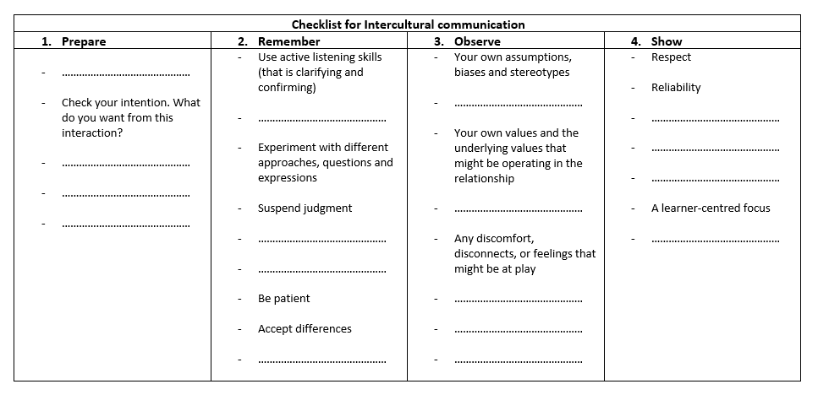
Checklist for Intercultural Communication Activity:
https://www.shutterstock.com/image-vector/personal-experience-word-cloud-concept-vector-1029459643
Notes:
Ask participants first to share their experiences (similar to what was illustrated in the video) in groups and then discuss some examples in plenum - time permitting

Slide 7
Check list for intercultural communication
1. Prepare Research your interlocutors’ culture before you meet whenever possible! Check your intention. What do you want from this interaction? Clarify the goals of the interaction 2. Remember Use active listening skills (that is clarifying and confirming) Show interest, attention, and empathy Respect differences in communication pace and respect silence Experiment with different approaches, questions, and expressions Suspend judgment Before concluding on any point. clarify meaning and support connection using descriptor questions (who, what, when, how, how much, how many) Express your need to think about something and get back to the person so that appropriate reflection and research might be pursued Be patient Accept differences | 3. Observe Your own assumptions, biases and stereotypes Consistency and relevance in responses and feedback to make sure that adequate communication is taking place Your own values and the underlying contrasting values that might be operating in the relationship. Any discomfort, disconnects, or feelings that might be at play. 4. Show Respect Reliability Expertise and knowledge A learner-centered focus

Slide 8
Notes:
This

