Slide 1
Partnership Forum 2019
An Introduction to the revised UK Quality Code for Higher Education
Tina Hagger

Slide 2
The old UK Quality Code for Higher Education
2013 - 2018
Three Parts
Part A: Setting and Maintaining Academic Standards
Part B: Assuring and Enhancing Academic Quality
Part C: Information about Higher Education Provision

Slide 3
An Expectation was deemed essential.
Higher education providers were required to meet all the Expectations.
Each chapter of Part B and Part C also included a series of Indicators.
Explanatory notes.

Slide 4
The revised UK Quality Code for Higher Education –
https://www.qaa.ac.uk/quality-code
A New Dawn

Slide 5
“The revised UK Quality Code for Higher Education (the Code) ensures that the Code will continue to fulfil its role as the cornerstone for quality in UK higher education, protecting the public and student interest, and championing UK higher education’s world-leading reputation for quality. The Code is now future-facing, accessible, and truly UK-wide. QAA have considered students’ and providers’ feedback carefully, and are now presenting a Code that is fit for purpose in an evolving regulatory landscape, and accessible to the full diversity of the sector and its wider stakeholders.”

Slide 6
The revised Code is based on 3 elements:
1. Expectations REQUIRED
2. Practices
a. Core practices REQUIRED
b. Common practices NOT REQUIRED
3. Advice and guidance NOT REQUIRED

Slide 7
Expectations
There are now just four Expectations in the Code which must be met:
Expectations for Standards
The academic standards of courses meet the requirements of the relevant national qualifications framework.
The value of qualifications awarded to students at the point of qualifications and over time is in line with sector-recognised standards.
Expectations for Quality
Courses are well-designed, provide a high-quality academic experience for all students and enable a student's achievement to be reliably assessed
From admission through to completion, all students are provided with the support that they need to succeed in and benefit from higher education.

Slide 8
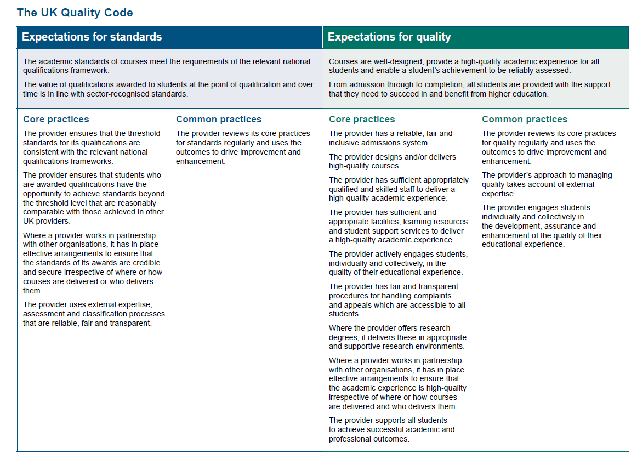
Core Practices
The Expectations are under-pinned by 13 Core Practices which must be demonstrated:

Slide 9
This is underpinned by Advice and Guidance:
http://www.qaa.ac.uk//en/quality-code/advice-and-guidance
12 Themes
They include guiding principles, practical advice and useful resources, based on the experience of a wide range of providers.
Not mandatory for providers, but illustrative of possible approaches.

Slide 14
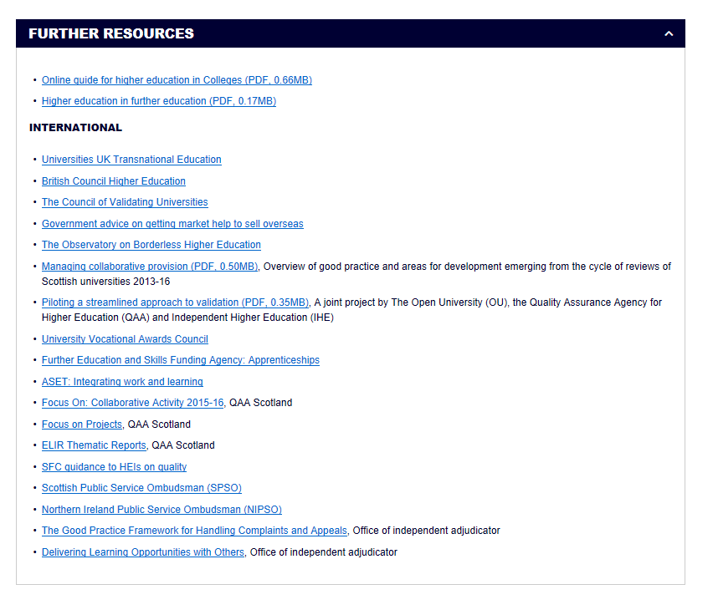

Slide 15
Conclusion
You have now been introduced to the revised Quality Code
Please explore further at your own leisure:
https://www.qaa.ac.uk/quality-code

