Slide 1
STUDENT SUCCESS
(EDI) PROJECT
Jan Moriarty – Project Manager
Student Success (EDI) Project - https://www.kent.ac.uk/studentsuccess/

Slide 2
Let’s just get this out of the way!

Slide 3
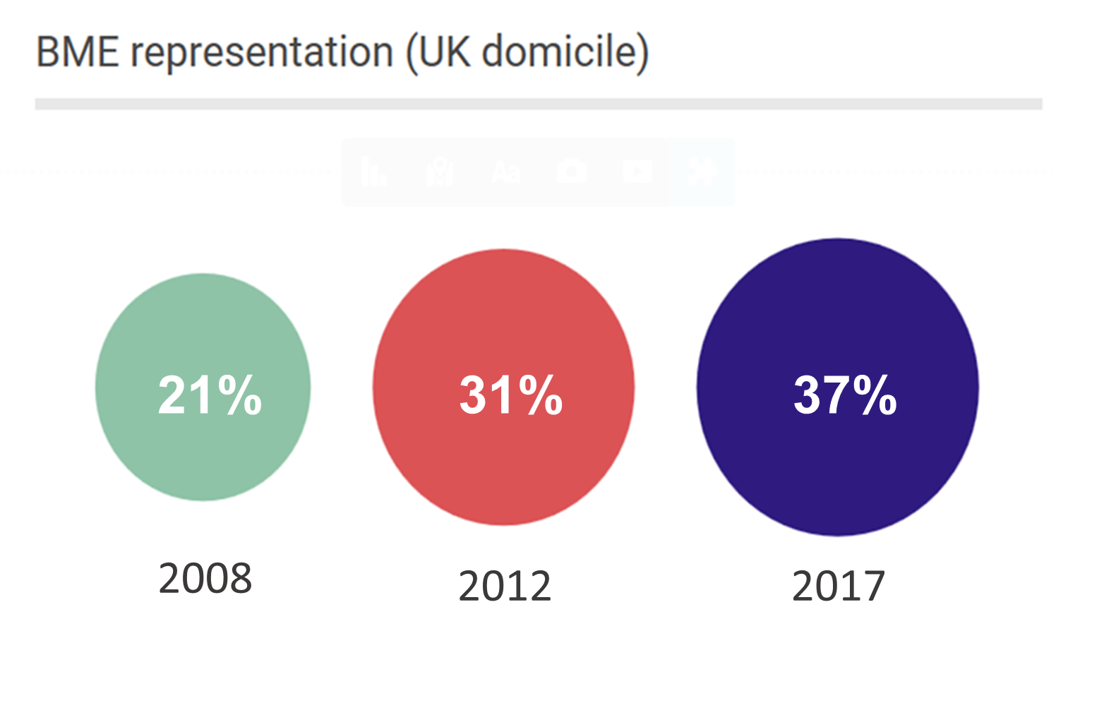
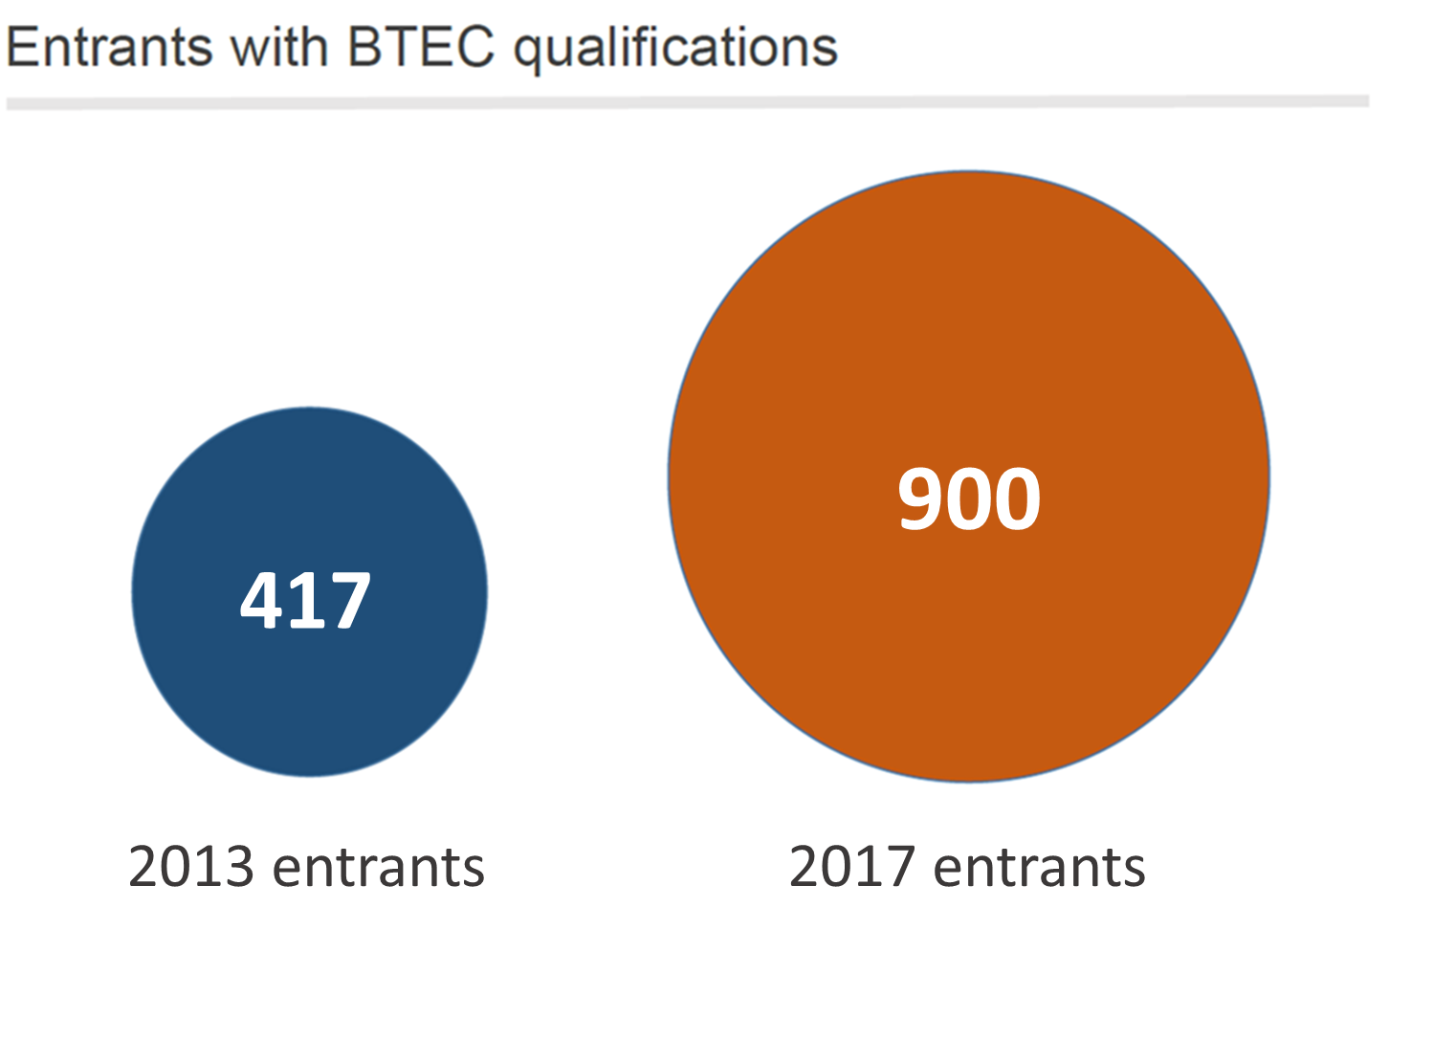
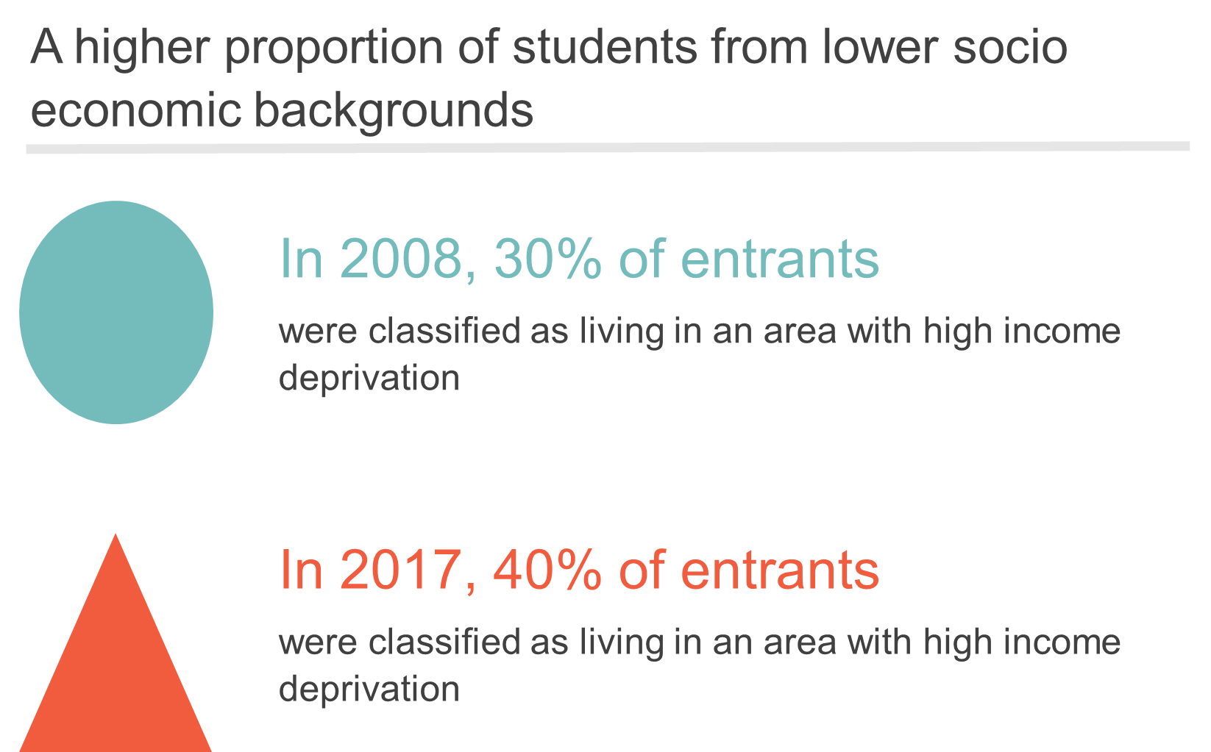
Kent Context

Slide 4
Phase 1
Institutional research – dedicated researcher
BME Student Voices – Kent union
Action research – 9 pilot schools
Central project team

Slide 5
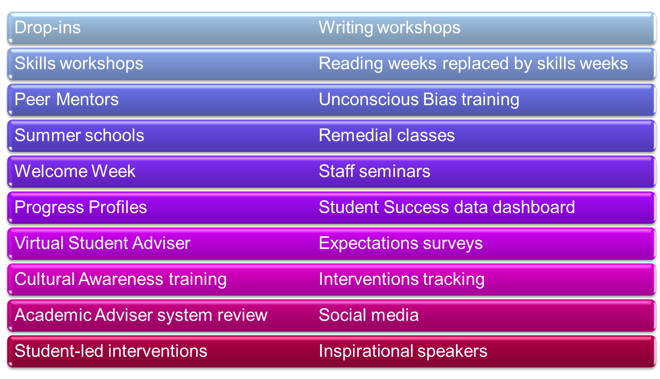
Intervention Types

Slide 6
Phase 1 Findings
Students are entering the university with different levels of economic, cultural and educational capital and varying levels of preparedness
On entry, BME students have higher expectations of degree outcomes than their white peers and higher confidence of achieving a ‘good degree’. There are strong links to high family expectations and pressure to succeed.
BME students are more likely to be from London, have lower household income and be first generation HE. They are also more likely to study non A level qualifications and are more likely to commute.
Students who enter without A level qualifications are at a higher risk of under-performance and need early intervention and support (especially those with a BTEC qualification)
Assessment and feedback processes need to be reviewed
In general, the Academic Advisor system is not working to help support under performing students (student and staff perspective)
Support services are many and varied, sometimes causing confusion about where to get help
The University’s approach will also need to tackle staff awareness, staff representation and a review of teaching practice if we are to succeed.
There is no magic wand to close the attainment gap – students are individuals with different needs and a student led, education approach is required across the institution and academic schools.

Slide 7
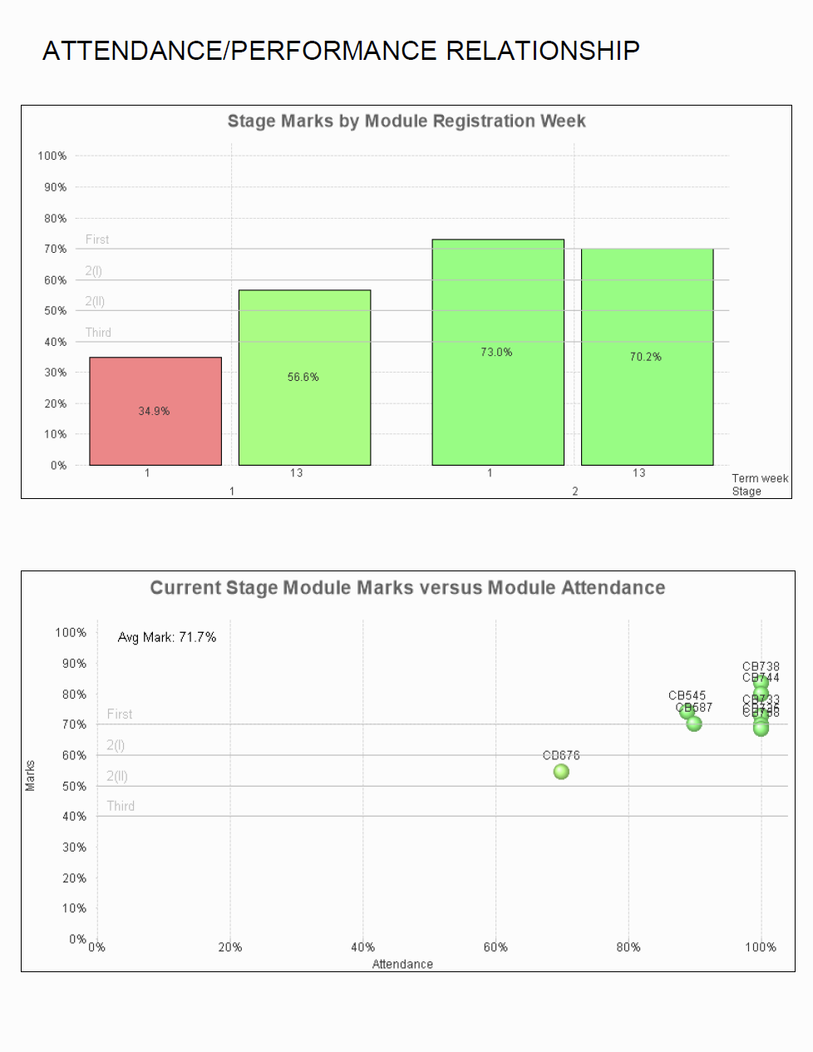
Progress Profiles
Much lower attendance for this module – is there an issue here?

Slide 8
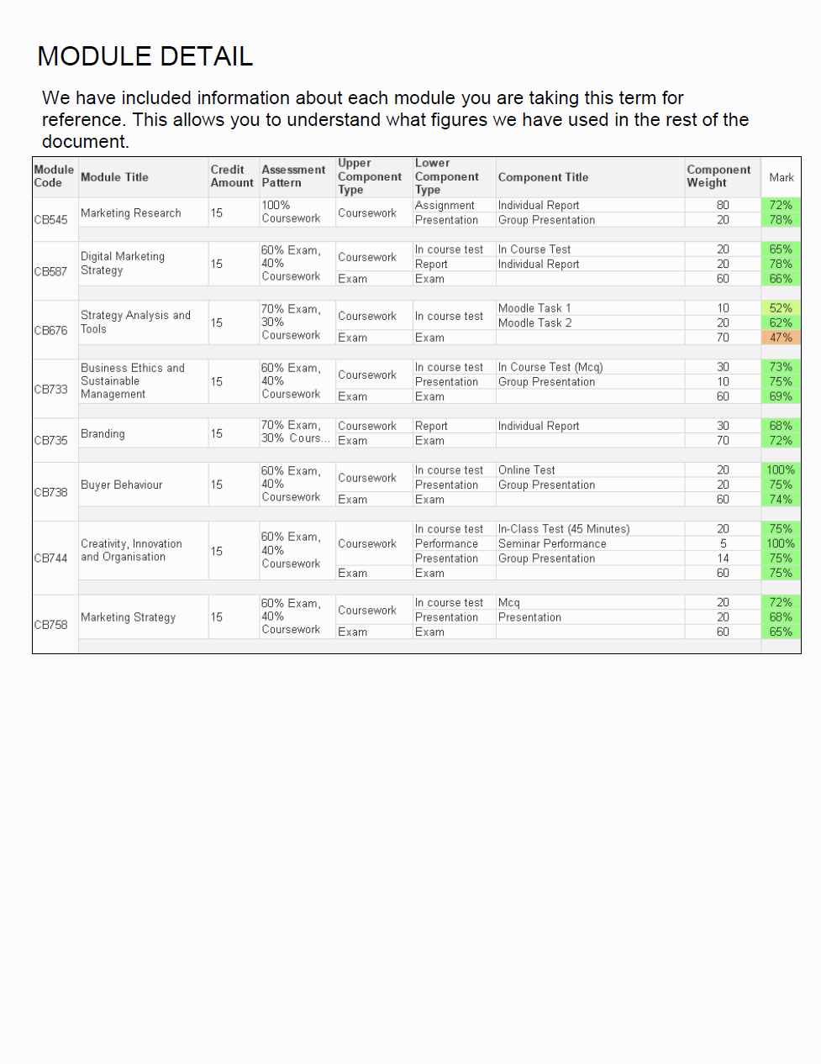
Progress Profiles

Slide 9
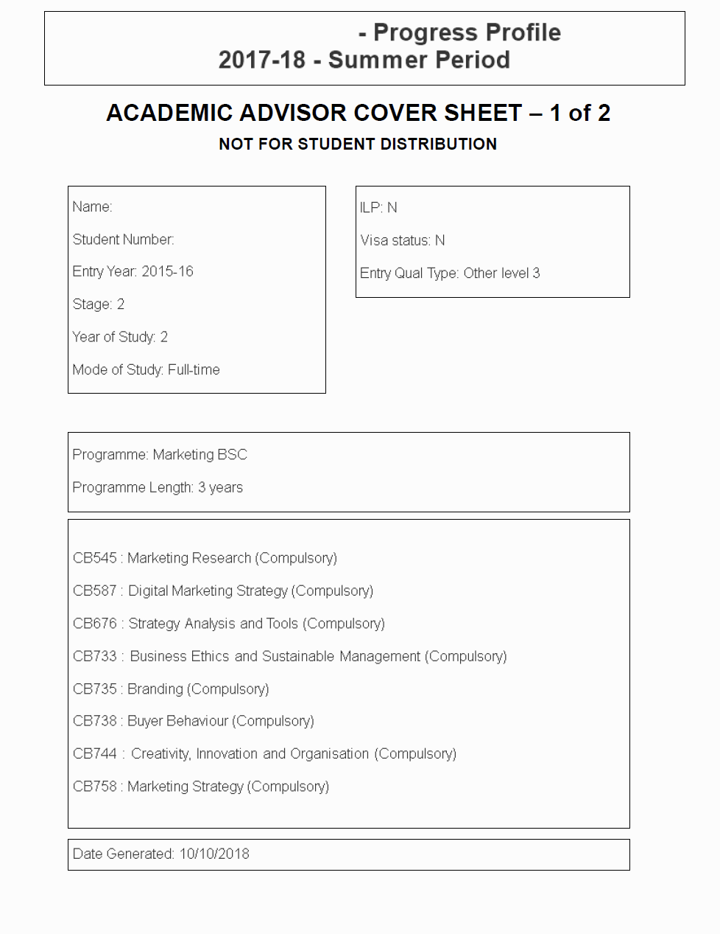
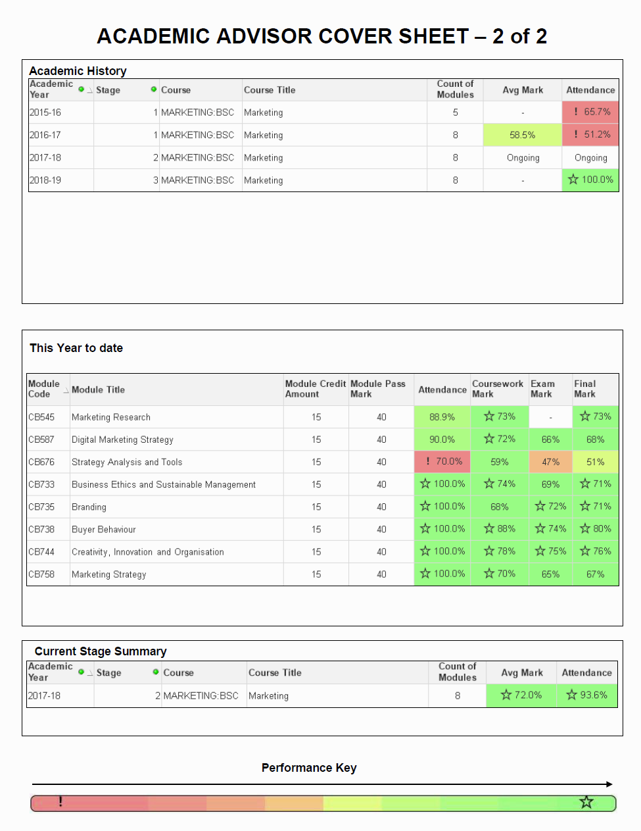
Progress Profiles – Staff Cover Sheet

Slide 10
Phase 2
Student Success data dashboard
Intervention tracking
SStaRT – Student Success Resources Toolkit
Race, identity & belonging
Students’ experiences at Kent
How to talk about race, white privilege, institutional racism
The colour of our curriculum
Diversity Mark
Transition, Orientation & belonging
Intersectionality – class, gender but also first in family, commuting, qualifications, mental health
Inclusive teaching:
Moving from micro-aggressions to micro-affirmations
Acknowledging diversity every day

Slide 11
Role of the central project team
Driving the change agenda
Evidence collection, data surfacing
Showing us who we are
Challenge
To institutional practice
To leaders
Showing us who we can be
Managing and supporting viral change¹
Developing evidence based practice
Encouraging ‘dangerous ideas’
Maintaining momentum
1. Viral Change – Herrero, L (2006)

Slide 12
Questions – easy ones please!
https://www.kent.ac.uk/studentsuccess/

