Slide 1
Embodying Reflective Practice
Rambert School -university of Kent - ucl

Slide 2
“It is a great thing indeed to make use of the poetic forms,…but the greatest thing by far is to be a master of metaphor” (Poetics 1459a)
"Ordinary words convey only what we know already; it is from metaphor that we can best get hold of something fresh" (Rhetoric 1410b)
–Aristotle
Notes:
By using a metaphor, one can tap into their “inner world” and express emotion in a unique way, linking into a word, image, symbol or visualisation,

Slide 3
Phaedra Petsilas - Head of Studies at Rambert School of Ballet and Contemporary Dance.
Nicole Brown - Lecturer in Education and Academic Head of Learning and Teaching at UCL Institute of Education.
Dr Jennifer Leigh - lecturer in Higher Education and Academic Practice at the Centre for Study of Higher Education, University of Kent.
Catriona Blackburn – Visual Ethnographer and film-maker
Rambert School Foundation Degree Y2 Students
Notes:
Phaedra Petsilas - Head of Studies at Rambert School of Ballet and Contemporary Dance. She is a passionate educator in dance and her interests lie in student development through reflective practice and how to embed positive reflective models within a conservatoire dance training. Further research interests include the notion of space and place in relation to choreography, as well as institutionalisation and politics in dance education.
Phaedra.petsilas@rambertschool.org.uk
Nicole Brown - Lecturer in Education and Academic Head of Learning and Teaching at UCL Institute of Education. Her research interests relate to identity and body work, physical and material representations and metaphors, the generation of knowledge, and advancing learning and teaching within higher education.
Dr Jennifer Leigh - lecturer in Higher Education and Academic Practice at the Centre for Study of Higher Education, University of Kent. She uses creative approaches to explore embodiment, identity, reflective practice and reflexivity and inclusion in the academy.

Slide 4
What/why
Explore whether a creative, embodied approach to teaching reflective practice would be of value
Explicitly embed reflective practice at Rambert School.
Explore the capturing of embodied reflective practice at the school

Slide 5
Dewey 1910 reflection
‘the active, persistent and careful consideration of any belief or supposed form of knowledge in the light of the grounds that support it’
‘enables us to direct our actions with foresight … It enables us to know what we are about when we act’

Slide 6
Creative Professional practice
Reflection informing artistic practice
Understanding and unpacking process
Developing self-awareness and self-efficacy
Developing agency as a performer
Be able to evaluate artistic process and product

Slide 7
Brief Description of Research Project on the outset:
Identify and explore the reflective potential of a variety of embodied experiences
Explore divergent methods of reflection on performance and choreography that Y2 students undertake at Rambert School
Identify the most effective of these methods in collaboration with the students
Students act as active agents in the exploration and dissemination of these methods

Slide 8
What/How
Five sessions working with the cohort in an open space,
Movement exercises based around Authentic Movement (Adler, 2002)
Theoretical models of reflective practice (Brookfield, 1995; Kolb, 1984)
Arts-based activities using ideas of model-making and metaphor (Finlay, 2015).
Notes:
Promoting good practice
Enhancing self-efficacy and agency
Cross-institutional and cross-disciplinary influence
Collaborative research activities
Practical – embodied explorations with students in dance conservatoire environment

Slide 9
DIFFERENT ONTOLOGIES
INDIVIDUALS
ENSEMBLE
COMMUNITY
ORGANISATION
PROFESSION
INDUSTRY

Slide 10
The reflective Conservatoire
interface between education and professional worlds
Encourage two-way influence and exchange
Challenge rigid conceptions of transmission/apprenticeship or one-way traffic from professional to student
Make way for co-created spaces focused on experiment, collaborative enquiry and risk-taking, supported by rigorous feedback and reflection.

Slide 11
Creativity
Expression
Play
Multi-modality
Metaphor
Transformation of consciousness
Abstraction
Communication
Questioning
Reflection

Slide 12
Questions?
Do we have set ways of thinking about our practice?
Do we have set ways of evaluating our practice?
Are we entrenched in models of learning and pedagogy that drive our perception of our practice?
Can this change?
Can we borrow from other practices?
How can we expand the notion of ‘creativity’ and utilise it in the ‘thinking about’ our practice?
What influences the way we perceive (‘look at’) our practice?
Can we change the way we ask questions?

Slide 13
Motivations
Bridging the distance between concrete experience and articulation of that experience
Facilitate the journey towards professional goals
Expand the notion of creativity to encompass reflective practice
Open up the methods of reflection to encompass creative processes
Collaboratively develop systematic reflective practice models for dancers
Creating bespoke models of reflection for dancers in training

Slide 14
What does creativity in research mean?
Engaging with a range of tools from other disciplines (eg arts-based methods see Kar 2015)
Playfulness and fun allow participants to go deeper into their process and share more (Statler et al 2011)
Draw on multimodal forms of communication, allowing different ‘voices’ to be heard’ (Jewitt et al 2016)

Slide 15
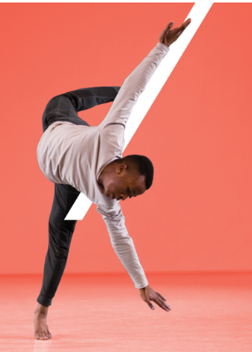
Embodied Exploration
Accessing concepts through embodied means
Utilising familiar creative methods to tap-into reflective thinking
Utilising the body as a site of knowledge to draw from – challenging mind-body dualism

Slide 16
Creative Play
Non-linguistic methods of exploration
Access language via creative means

Slide 17
Create - Verbalise
Abstracting from the body and the self in order to discuss body and self
Bridging the gap between embodied experiences and language used to articulate them

Slide 18
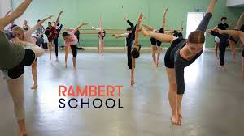
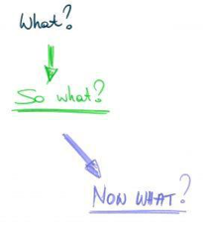
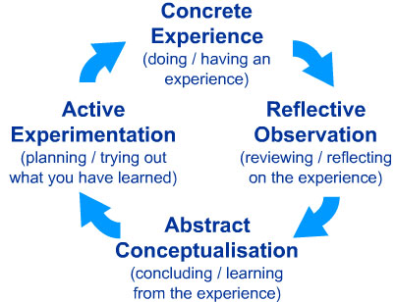
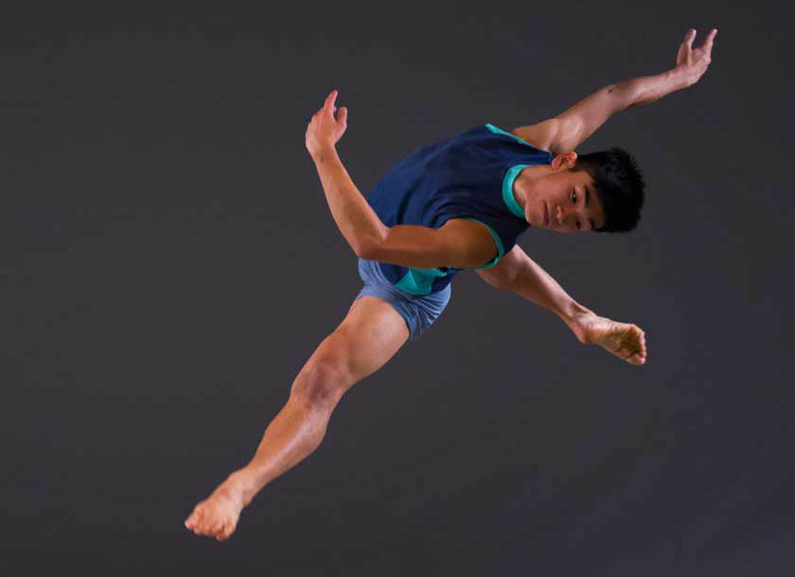
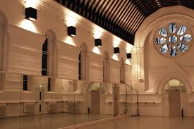
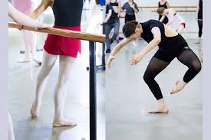

Slide 19
Accessing new and/or different information in your mind
Setting yourself free from the usual thinking patterns and automatic thoughts you ’run into’
Starting and inspiring an associative process where the metaphors/LEGO bricks work as ‘inspirators’ for new thoughts and connections
Finding new lines of thought
Externalising thoughts, feelings, experiences
Look at these things from an outside view
Something that can be acted on

Slide 25
Conceptual explorations
Reflection needs to be in context and conscious in order to affect change
Reflection can be embodied in the context of the dance conservatoire
Reflective practice – Reflexivity
Self-esteem, Self-efficacy, Self-Image

Slide 26
Creative methods
Widen out the idea of reflection
Journaling
Drawing
Model-making
Moving
Audio-visual explorations

Slide 27
Opening up the channels of evaluative thinking
Shortening the gap between embodied experience and verbal articulation of that experience
Collective reflection – engaged practice
Dialogue between practice and the nature of that practice or behaviours within that practice
Personal growth

Slide 28
Data collected
multi-modal, comprising of the researchers’ reflective journals
the padlet page where students posted short reflections
images and videos
the filmed footage
interview transcripts from focus groups

Slide 29
Research context
Pedagogical approaches
Reflective Practice models
Artistic Practice – Research
Creativity

Slide 30
outputs
Short film
Conference presentations
Articles in peer reviewed journals
Further projects

Slide 31
Impact
Explicit teaching of reflective practice in the School
Improved reflective skills in student cohort
Cross-fertilization of disciplines
Cross-conservatoire dissemination

