Slide 1
Consortium for the Humanities and the Arts South-East England (CHASE) / Studentship Competition for 2023
Lucy O’Meara
CHASE Academic Lead
Bob Henderson
CHASE Administrative Lead

Slide 2
Today’s briefing
Benefits of CHASE funding
Eligibility
What to do now
Application and selection process + timeline
How proposals are assessed
Resources to use when working on proposal
Information about further upcoming webinars

Slide 3
Consortium for the Humanities and the Arts South-East England (CHASE)
The CHASE Arts and Humanities Research Council Doctoral Training Partnership brings together 8 universities in the South East of England engaged in collaborative research activities
The competition for studentships for Autumn 2023 entry opens during week of 24 October 2022

Slide 4
CHASE Academic Community
Over 1000 academics in the arts and humanities many of whom are leading practitioners (artists, curators, novelists, poets, musicians and lawyers)
Over 200 CHASE doctoral researchers across the partner institutions
39 CHASE doctoral researchers at Kent

Slide 5
Some of CHASE’s Strategic Partners
Canterbury Cathedral
Intel
British University Film and Video Council
British Library
V&A
National Portrait Gallery
Tate
BFI
BBC

Slide 6
Disciplinary spread
Notes:
A: History, Thought and Systems of Belief Applications to: History; Law and Legal Studies; Philosophy; Theology, Divinity and Religion; Archaeology; Classics; Political Science and International Studies B: Art History and Visual Cultures Applications to: Art History; Conservation; Visual Art History and Theory; Digital Arts & Photography History, Theory and Practice; Visual Arts (covering Art Theory & Aesthetics; Community Art including Art and Health); Museum Studies; Ethnography and Anthropology; History and Theory of Architecture; Cultural Geography
C: Media and Creative Practice Applications to: Design; Creative Writing; Music (Practice-based, composition, musicology); Visual art practice; Installation and Sound Art History, Theory and Practice; Film-Based and Time-Based History, Theory and Practice; Media: New Media/Web-Based Studies; Media: Film History, Theory and Criticism; Media: Television History, Theory and Criticism; Drama and Theatre Studies Practice; Information and Communications Technologies; Media and communication studies; Journalism and Publishing
D: Literature, Language and Culture Applications to: Drama and Theatre Studies Theory; Languages and Literature (including American Studies, Life writing, History and Development of English Language, Literary and Cultural Theory, Post-Colonial Studies, Comparative Literature, Medieval Literature, Comparative Studies, Gender and Sexuality); English Language and Literature; Popular Culture; Cultural Studies (Policy, Arts Management and Creative Industries); Interpreting and Translation; Linguistics; French Studies; German Studies (including Dutch and Yiddish); Italian Studies; Hispanic, Portuguese and Latin American Studies; Asiatic & Oriental Studies; Middle Eastern and African Studies; Russian, Slavonic and Eastern European Studies; Cultural Studies and Popular Culture

Slide 7
CHASE Offers PhD Students
Innovative training in advanced research skills across the consortium and with other cultural institutions
Opportunities for work placements, international study trips, and professional development
The possibility of a cross-institution supervisory team.
Twice yearly ‘Encounters’ conference
Virtual Research Environment (VRE).
Opportunity to shape future development of CHASE via Student Committee
Studentship award covers the cost of fees and maintenance (£17,668 in 2022/23; 2023 rates to be announced).
Successful applicants can draw on a Research Training Support Grant (RTSG), Engagement Provision (EP) and Cohort Development Funding (CDF) during the lifetime of their award.
Notes:
Innovative training in advanced research skills across the consortium and with other cultural institutions
Opportunities for work placements, international study trips, and professional development
The possibility of a cross-institution supervisory team
Placement with a CHASE Non-HEI partner (or another organisation)
Projects lasting between 1 and 6 months
Develop your skills and gain professional experience outside an academic setting
Help is on hand to assist with the development of your project ideas…

Slide 8
CHASE Stuart Hall Foundation studentships
CHASE will offer two studentships this year in partnership with the Stuart Hall Foundation
The Foundation is committed to addressing urgent questions of race and inequality in culture and society, and building a growing network of Stuart Hall Foundation scholars
Candidates from Black or ethnic minority backgrounds are eligible for these awards
Notes:
Innovative training in advanced research skills across the consortium and with other cultural institutions
Opportunities for work placements, international study trips, and professional development
The possibility of a cross-institution supervisory team
Placement with a CHASE Non-HEI partner (or another organisation)
Projects lasting between 1 and 6 months
Develop your skills and gain professional experience outside an academic setting
Help is on hand to assist with the development of your project ideas…

Slide 9
Period of Funding
Studentships will be awarded for 3 years initially (or 6 years part-time), but applicants can apply to extend the funded period to 3.5 or 4 years (or part-time equivalent), if their project:
Involves a period of intensive skills development (e.g. language learning) identified at application or during first year of funding.
Involves additional or complex methodologies identified during first year of funding.
Includes a placement with a partner organisation applied for at any point during the funded period.

Slide 10
Eligibility and Residential Criteria
Home and international students are eligible; note that the number of international awards are limited by UKRI
Existing PhD students are also eligible if they have at least 50% of their period of study remaining at end of Sept. 2023
To be classed as a home student candidates must meet the following criteria:
Be a UK National (meeting residency requirements), or
Have settled status, or
Have pre-settled status (meeting residency requirements), or
Have indefinite leave to remain or enter
If a candidate does not meet the criteria above, they are classed as an International student. Further guidance on residential eligibility is in Annex B of the UKRI Training Grant Guidance.
Notes:
All students receive a full award - including a stipend and fees at the home level (Kent will waive the fee difference between Home and International).

Slide 11
CHASE Application Process: What to do now
Discuss your research proposal (ASAP) with a prospective supervisor.
Apply for a PhD place at Kent by midnight on Sunday 4th December 2022 www.kent.ac.uk/courses/postgraduate/apply/
Hear what our current CHASE researchers have to say about their time at Kent: https://www.kent.ac.uk/graduate-researcher-college/doctoral-training-partnerships/chase

Slide 12
The process after applying to Kent
Selected candidates are longlisted for CHASE
Longlisted candidates fill out CHASE application form
Selected candidates are then shortlisted
Kent University panel considers all shortlisted applications, and selects 17 of these to send forward to CHASE
Before you find out whether you are longlisted, you can prepare by reading CHASE guidance notes about writing your proposal, drafting your proposal, and attending briefings

Slide 13
Kent Level Selection Process and Dates
Schools will interview new applicants and consider existing eligible students. They will longlist candidates: those longlisted will be informed between mid-December 2022 – 13 January 2023
Longlisted candidates receive a link to the CHASE application form* which must be completed by 12 noon, 27 January 2023
Schools will then shortlist candidates using the CHASE application forms, between 30 January – 9 February 2023
Kent CHASE Selection Panel will meet on 24 February 2023 to consider shortlisted applications and approve final list of 17 applications to go forward to CHASE consortium stage
Candidates selected to go forward will have until midnight 5 March 2023 to finalise their CHASE application form, incorporating feedback from selection panels
* The guidance notes for the application form can be viewed in advance on the CHASE website.

Slide 14
For longlisted candidates - Supervisor statement and references
If you are longlisted and asked to fill out a CHASE application form:
Your supervisor will need to make a 500 word statement about your proposal for the CHASE form
You will also need two references commenting on: academic record, quality of the research proposal and preparedness for doctoral study.
Both referees may be the prospective supervisors
Supervisor statements should support the necessity of any period of language study applied for
Contact your prospective referees in good time to check they can provide this reference in mid-January
Notes:
Supervisors provide a statement in support of the candidate’s application for funding for their proposed project
Focus on: (i) quality of the proposal including the research environment (at ‘home’ and within CHASE) and (ii) ‘fit’ with the supervisor’s expertise and interests
Addresses candidate’s proposal directly in terms of strength, interest and feasibility.
It should draw on interview performance.
It should clarify the merits of a highly specialized or technical proposal to a non-specialist reader.

Slide 15
Consortium Level Selection Process
Applications are submitted to the consortium stage on 8 March 2023.
CHASE Selection Panels will meet in late March and recommendations for awards will be approved by the CHASE Management Board in April.
Applicants will be advised of the final outcome by the end of April 2023.

Slide 16
How are proposals assessed?

Slide 17
What are the assessors looking for when they assess proposals?

Slide 18
Research proposal

Slide 19
Preparedness for research

Slide 20
Research environment

Slide 21
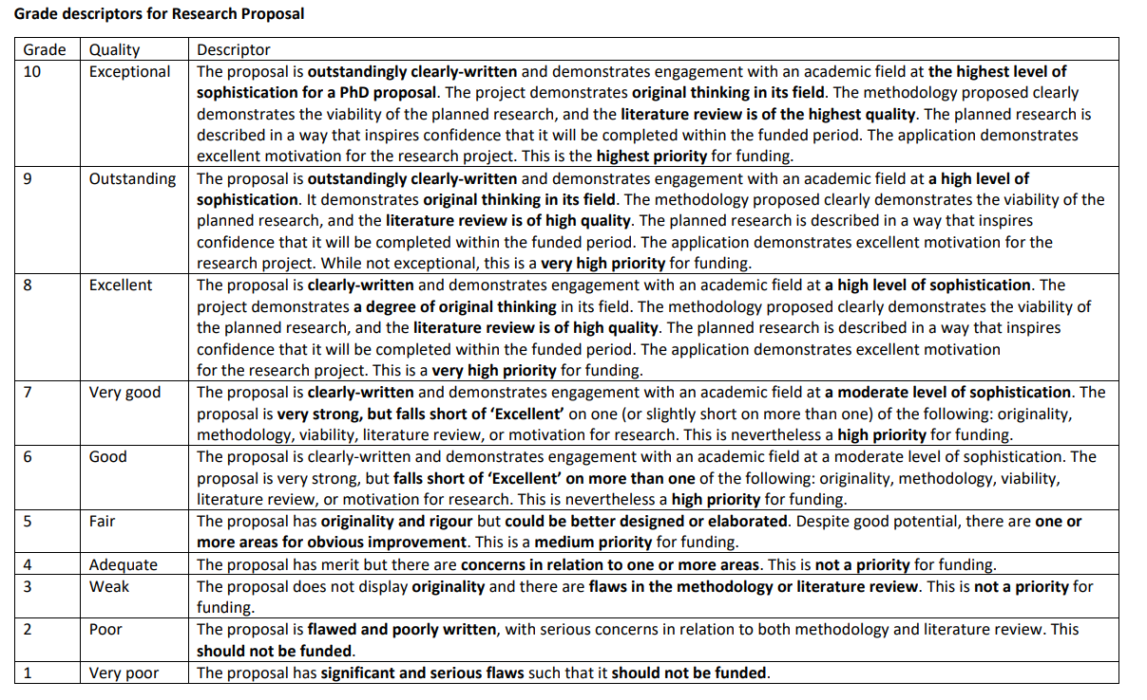
Notes:
Research proposal: 50%
The project demonstrates original thinking in its field.
The methodology proposed clearly demonstrates the viability of the planned research.
The planned research is described in a way that inspires confidence that it will definitely be completed within three years.

Slide 22
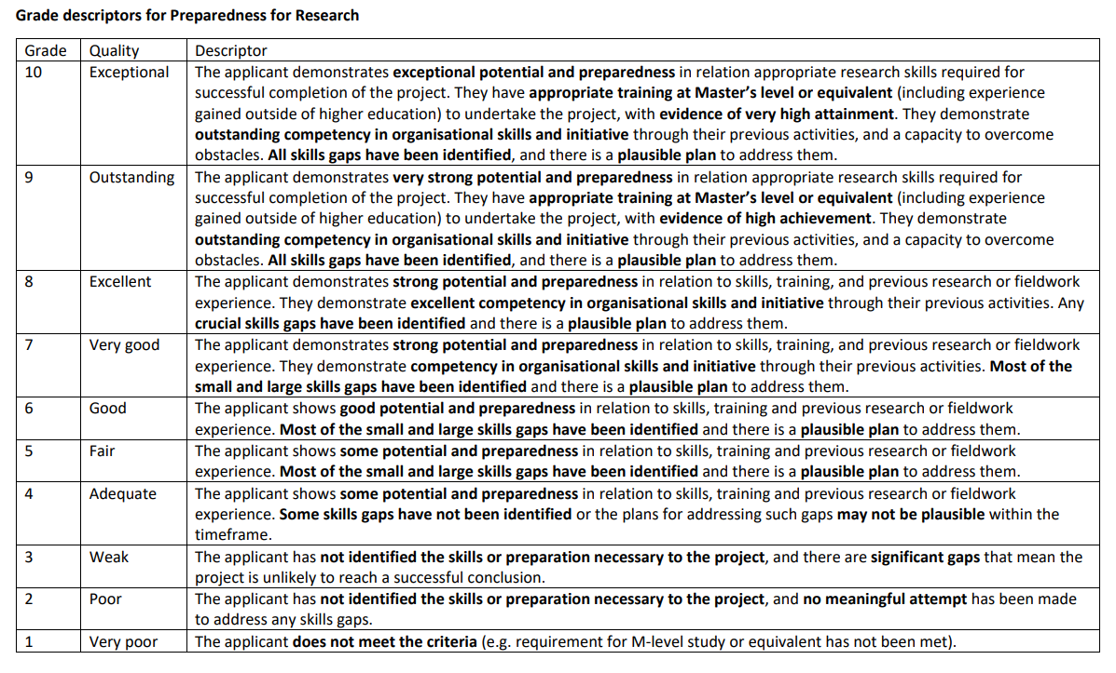
Notes:
Preparedness for research: 25%
The applicant demonstrates understanding of appropriate research skills required for successful completion of the project.
The applicant has appropriate training at master’s level or equivalent to undertake the project.
The applicant’s references fully support the applicant’s preparedness for doctoral study

Slide 23
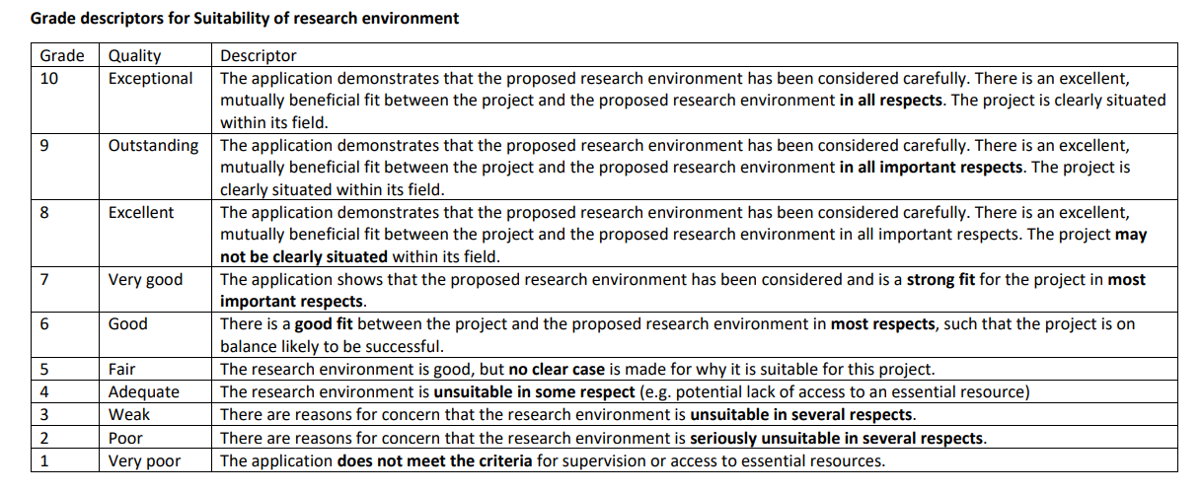
Notes:
Suitability of research environment: 25%:
The research environment (as constituted by the proposed supervision, the home department or equivalent, the institutional support including available archives, sources, research centres and any external organisations) is appropriate to the project.
The applicant has given clear thought to the fit between their project and their proposed research environment.
The supervisor statement fully supports the project’s fit with the proposed research environment.

Slide 24
Resources to use when working on your proposal
Your prospective supervisor can provide advice.
The CHASE guidance for applicants and FAQs (at https://www.chase.ac.uk/apply): clear, detailed instructions.
Upcoming webinars to help you develop a strong proposal…

Slide 25
Upcoming CHASE applicant webinars
Provisional dates:
Friday 11 Nov, 1pm – Stuart Hall Foundation studentship webinar
Friday 18 Nov, 1pm – CHASE main competition webinar
Recordings will be made available afterwards
Check https://www.chase.ac.uk/apply during week of 24 October for more details
Meanwhile, see recordings of previous sessions at https://www.chase.ac.uk/chase-studentships

Slide 26
Upcoming Kent webinars
CHASE briefing session, ‘Designing a Good Research Proposal’ with Professor Gordon Lynch and Dr Lucy O’Meara. Thurs 10 Nov. 13:00-15:00 GMT
Current PGT students sign up here: https://grctraining.targetconnect.net/leap/event.html?id=2665&service=Graduate%20&%20Researcher%20College
Current MRes students sign up here:
https://grctraining.targetconnect.net/leap/event.html?id=2667&service=Graduate%20&%20Researcher%20College
External/new to PG study at Kent sign up here:
CHASE - Designing a Good Research Proposal (google.com)
Further online proposal workshop on Friday 25 November – 13:00 – 15:00; register on Target Connect.
Notes:
https://www.kent.ac.uk/graduate-researcher-college/doctoral-training-partnerships/chase - check this page for updates on the 25 November workshop

Slide 27
Questions?

Slide 28
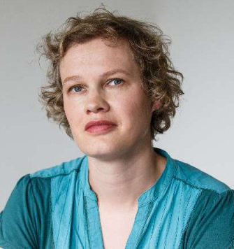
Kent CHASE Contacts
Lucy O’Meara (CHASE academic lead) leo@kent.ac.uk
Bob Henderson (CHASE administrative lead) r.d.henderson@kent.ac.uk

