Slide 1
Designing a research proposal for CHASE
Lucy O’Meara – CHASE Doctoral Training Partnership Academic Lead, University of Kent
leo@kent.ac.uk

Slide 2
What we’ll cover today
What studentships are CHASE offering?
What to do first in order to be considered for CHASE funding at the University of Kent
Thinking ahead to the CHASE application form
The CHASE research proposal: what are you asked for?
How is your proposal assessed?
Further resources including upcoming webinars

Slide 5
CHASE Collaborative Doctoral Awards
CHASE Collaborative Doctoral Awards at the University of Kent for Sept 2023 entry:
School of History: ‘The Church and the Plantations: The Bishops of London and their Workforces in the Tobacco Colonies, c. 1680-1800’ (with Fulham Palace)
Contact: Dr Ben Marsh – B.J.Marsh@kent.ac.uk
Medieval and Early Modern Studies: ‘Rejecting and Recycling the Past in Reformation Canterbury’ (with Canterbury Cathedral)
Contact: Dr David Rundle – D.G.Rundle@kent.ac.uk
Deadline for applications: 27 January 2023
Applications to these CDA awards are considered separately to the main CHASE studentship competition – the advice in this session relates to the main competition, for student-led proposals.
Contact Dr Marsh or Dr Rundle if you have queries about the collaborative projects.

Slide 6
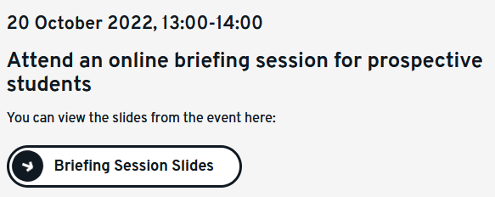
To be considered for CHASE funding at the University of Kent
You must apply for your PhD place at Kent by 23:59 GMT on Sunday 4 December 2022
Or if you are an existing student, send your research proposal and supervisor statement to your Director of Graduate Studies by the same date
Full guidelines on the process: see https://www.kent.ac.uk/graduate-researcher-college/doctoral-training-partnerships/chase

Slide 7
After you have applied to Kent
Directors of Graduate Studies will consider all proposals and will longlist candidates to consider them for CHASE
Longlisted candidates will be invited to fill out the CHASE form
You will hear by 13 January 2023 if you are longlisted
If longlisted, you will be invited to fill out the CHASE form and you will need to submit your CHASE application form by 27 January 2023.

Slide 8
Thinking ahead to the CHASE application form
You can’t fill out a CHASE form until you are invited to do so. But you can familiarize yourself with the guidance in advance
You need to submit a research proposal as part of your application for a PhD place at the University of Kent
Thinking ahead, you can save time by structuring your research proposal for your PhD application to Kent according to the format of the CHASE application form

Slide 9
CHASE application form – full guidance online
Full guidance notes at http://www.chase.ac.uk/apply
Your eligibility – see p. 1 of guidance notes
home student, international student, or current first year PhD student
Grades / previous or ongoing training (e.g. MA)
Takes you through the form step by step, including examples of aspects to think about

Slide 10
Full guidance on Chase website

Slide 11
CHASE Assessment criteria
Importance of your supervisor and referees

Slide 12
Research proposal: What does the CHASE form require? (1/4)
Title: ‘concise and explicit’. It can change later!
Abstract: (c. 200 words, 1,000 characters) aimed at a non-specialist reader:
‘This should be a complete but concise description of the project that will allow a non-specialist reader to quickly ascertain the purpose of your project. Most CHASE panellists will not be expert in your precise disciplinary area.’
Tip: you are likely to find it easier to write the abstract last.
Notes:
Excerpted from CHASE guidance notes for applicants:
Please provide a description of your research proposal of no more than 10,000 characters, under the following headings:
Introduction
Use this section to introduce the questions and issues central to your research. Identify the field of study in broad terms and indicate how you expect your research to intervene in the field.
Research background and question
Use this section to expand your Introduction. What are the key sources, texts and approaches in the field? How does your proposal differ from existing lines of argument? What does your project contribute to existing work in the field? How does it extend our understanding of particular questions or topics? You need to set out your research questions as clearly as possible. Identify the problems that you want to explore and explain why it is important to do so. Please use this section to indicate how your previous studies, professional and/or other experience contribute to your understanding of the field and your preparedness for research, and also your motivation for undertaking this project. Think about how to situate your project in the context of the university and its disciplines. You can also discuss the impact of your research for non-academic institutions and audiences.

Slide 13
Research proposal: What does the CHASE form require? (2/4)
Proposal: (10,000 characters including spaces)
Introduction Statement of aims and key questions. Identify the field of study and how your research intervenes in it
Research background and questions Key sources + approaches in the field. How is your project different? What is its contribution? Also YOUR research background and training and how they prepare you for this work – experience and motivation
Notes:
Excerpted from CHASE guidance notes for applicants:
Please provide a description of your research proposal of no more than 10,000 characters, under the following headings:
Introduction
Use this section to introduce the questions and issues central to your research. Identify the field of study in broad terms and indicate how you expect your research to intervene in the field.
Research background and question
Use this section to expand your Introduction. What are the key sources, texts and approaches in the field? How does your proposal differ from existing lines of argument? What does your project contribute to existing work in the field? How does it extend our understanding of particular questions or topics? You need to set out your research questions as clearly as possible. Identify the problems that you want to explore and explain why it is important to do so. Please use this section to indicate how your previous studies, professional and/or other experience contribute to your understanding of the field and your preparedness for research, and also your motivation for undertaking this project. Think about how to situate your project in the context of the university and its disciplines. You can also discuss the impact of your research for non-academic institutions and audiences.

Slide 14
Research proposal: What does the CHASE form require? (3/4)
Proposal, continued:
Research methods: How will you collect your data? How will you analyse your data? What challenges will you face? Ethics? Fieldwork?
Schedule of work: Demonstrate planning, capacity for project management, consideration of resources
Tip: Consider dividing proposal into broad sections (not necessarily chapters), with timetable
Notes:
Excerpted from CHASE guidance notes for applicants:
Research methods
Give a brief statement detailing how you will achieve the aims set out in the previous sections. Your focus here will depend very much on your discipline(s) and research topic. You can consider the following questions (no one project will require you to answer them all):
• Does your project involve archival sources, particular databases or
specialist libraries?
• Will you need access to facilities at another institution? Is your study
interdisciplinary?
• How does your creative practice contribute to your research?
• What theoretical resources do you intend to use and why?
• Are there any organisations working in your area who might offer the
opportunity for collaborative research?
• Is your research based on the work of a single author, artist or theorist, or a
group of individuals or texts?
• What forms of textual, historical, visual or material analysis are relevant to
your topic?
• Is there a ‘gap’ in established approaches to your field of study that you
want to explore?
• Are there ethical issues that you need to address in undertaking your research?
• Will you be involved in fieldwork?
Schedule of work
Use this section to show that you have a realistic plan for completion of the project within the period of the award. You may want to think here about dividing the proposal into sections (not necessarily chapters at this stage) with a timetable for researching and writing up each section.
Research environment
Use this section to detail how your proposal will be supported by the research environment at your institution. This might include: the proposed supervision, the home department(s) or equivalent, the institutional support (including available archives, sources, research centres), and any external organisations involved. You should demonstrate that you have given clear thought to the fit between your project and the proposed research environment.

Slide 15
CHASE guidance screenshot

Slide 16
Research proposal: What does the CHASE form require? (4/4)
Proposal, continued:
Research Environment: Proposed supervision, the department, the institutional support – any other organisations involved? ‘You should demonstrate that you have given clear thought to the fit between your project and the proposed research environment.’
QUESTION: how do you research this?
Type your answers in the chat
Bibliography: Up to 20 items. Indicative.
Notes:
Excerpted from CHASE guidance notes for applicants:
Research methods
Give a brief statement detailing how you will achieve the aims set out in the previous sections. Your focus here will depend very much on your discipline(s) and research topic. You can consider the following questions (no one project will require you to answer them all):
• Does your project involve archival sources, particular databases or
specialist libraries?
• Will you need access to facilities at another institution? Is your study
interdisciplinary?
• How does your creative practice contribute to your research?
• What theoretical resources do you intend to use and why?
• Are there any organisations working in your area who might offer the
opportunity for collaborative research?
• Is your research based on the work of a single author, artist or theorist, or a
group of individuals or texts?
• What forms of textual, historical, visual or material analysis are relevant to
your topic?
• Is there a ‘gap’ in established approaches to your field of study that you
want to explore?
• Are there ethical issues that you need to address in undertaking your research?
• Will you be involved in fieldwork?
Schedule of work
Use this section to show that you have a realistic plan for completion of the project within the period of the award. You may want to think here about dividing the proposal into sections (not necessarily chapters at this stage) with a timetable for researching and writing up each section.
Research environment
Use this section to detail how your proposal will be supported by the research environment at your institution. This might include: the proposed supervision, the home department(s) or equivalent, the institutional support (including available archives, sources, research centres), and any external organisations involved. You should demonstrate that you have given clear thought to the fit between your project and the proposed research environment.

Slide 18
CHASE ‘Preparedness for research’ part of the form
Your relevant training and experience – Master’s degree or equivalent, OR other experience beyond undergraduate degree that is specifically relevant to your topic.
Have you already started your PhD (applying as current student)?
Any relevant experience (research or practice-based, or professional experience) – list
Extra funding + time for skills development needed? E.g. language skills
It’s fine if you have skills gaps! You just have to recognise and account for them
Optional: widening participation statement (2,000 characters)
Notes:
Excerpted from CHASE guidance notes for applicants:
Task 3: Preparedness for research
Those applying for a doctoral studentship should normally have, or be studying for, a Master’s degree or similar postgraduate qualification. You should have met all the course requirements prior to the start date of your AHRC doctoral studentship. If you do not have experience of formal postgraduate study, you may be eligible for a studentship only if you can demonstrate evidence of sustained experience beyond your undergraduate degree level that is specifically relevant to your proposed research topic, and could be considered equivalent to Master’s study. Please provide evidence as to how the training and development you have received is equivalent to that obtained through a Master’s course and, therefore, prepares you to continue to doctoral study.
Question 1: Please provide information about any professional experience (research and/or practice-based) that is relevant to your proposed programme of study. You will be asked how many entries you wish to provide. This could include professional experience that is relevant to the planning and completion of a research project, as well as the topic of the research. You can also use your research proposal to elaborate on how this experience supports your project.
Question 2: Please indicate whether you have already started your PhD, i.e. if you are applying for funding as a current student. Students who have already commenced doctoral study are eligible to apply for AHRC funding, provided that, at the start of the AHRC award, you will have at least 50% of your period of study remaining (excluding the ‘writing up’ period). Please provide full details of all your higher education qualifications. You will be asked how many you wish to submit.
Question 3: In DTP2, a CHASE award may include up to an additional 12 months of funding to allow for skills development. We expect that most language skills development would require up to 6 months, but that some projects may require acquisition of an entirely new language, for which up to 12 months is offered. Please indicate the length of additional time your project requires, as well as a proposal for how you plan to use this time to develop your language skills to the necessary level. This may include training offered by your department (please check with your proposed department for the local resources available) or by an external provider (e.g. language school or immersive training). Your supervisor should write in support of any additional funded period in their statement.
Question 4: You are asked whether you would like to include a widening participation statement. CHASE is committed to addressing inequalities in participation in our DTP, and encourages applications from all under-represented groups, including people with disabilities, ethnic minorities (especially Black British), lower income families and mature students. You can use this question to show how you qualify under these
criteria. You might wish to include obstacles that you’ve overcome relating to these, and/or your motivation for pursuing PhD study. There is a limit of 2000
characters (about 300 words) This question is not compulsory. If you provide a widening participation statement, it will be used by assessors alongside your responses to Questions 1-3
and your references to assess your ‘Preparedness for Research’. If you don’t provide a widening participation statement, your ‘Preparedness for Research’ will be assessed on the basis of the information provided in Questions 1-3 and your references.

Slide 19
What are the assessors looking for when they assess proposals?
Next slides: screenshots of guidance for assessors

Slide 20
Research proposal

Slide 21
Preparedness for research

Slide 22
Research environment

Slide 23
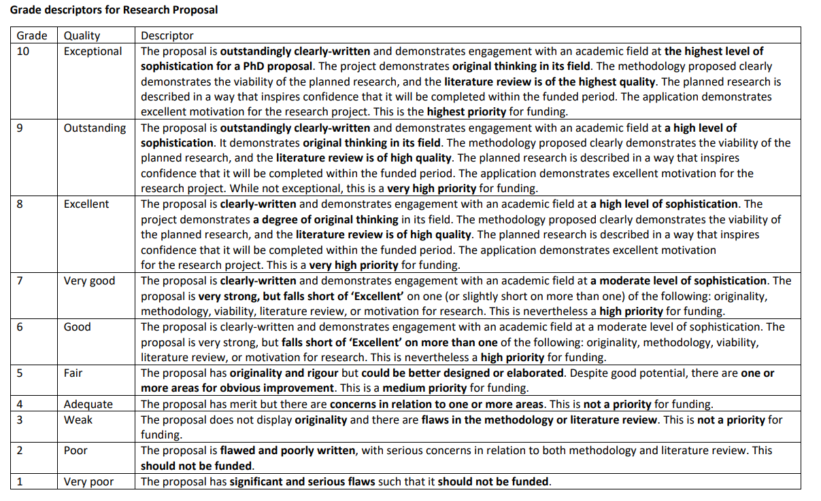
Notes:
Research proposal: 50%
The project demonstrates original thinking in its field.
The methodology proposed clearly demonstrates the viability of the planned research.
The planned research is described in a way that inspires confidence that it will definitely be completed within three years.

Slide 24
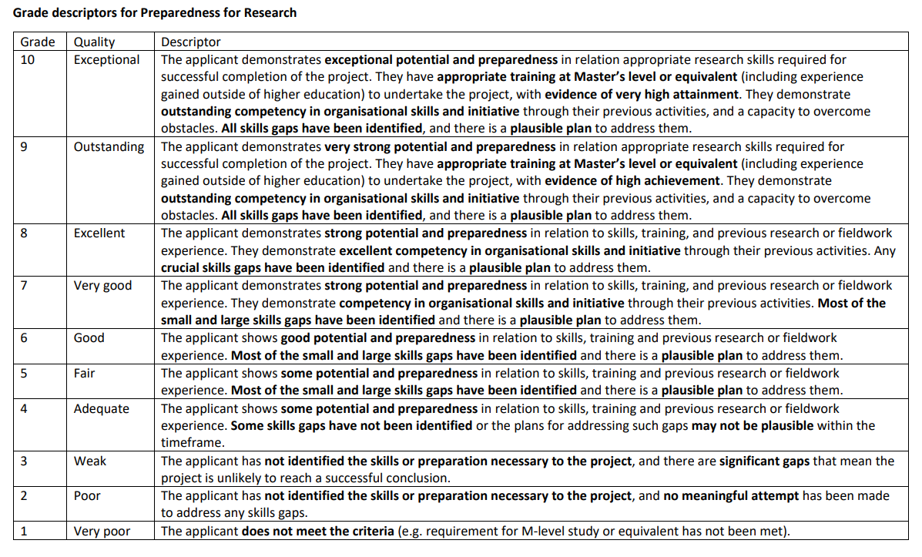
Notes:
Preparedness for research: 25%
The applicant demonstrates understanding of appropriate research skills required for successful completion of the project.
The applicant has appropriate training at master’s level or equivalent to undertake the project.
The applicant’s references fully support the applicant’s preparedness for doctoral study

Slide 25
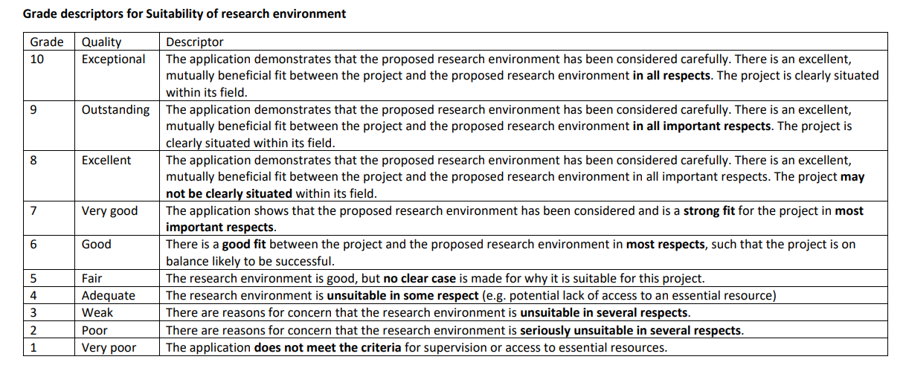
Notes:
Suitability of research environment: 25%:
The research environment (as constituted by the proposed supervision, the home department or equivalent, the institutional support including available archives, sources, research centres and any external organisations) is appropriate to the project.
The applicant has given clear thought to the fit between their project and their proposed research environment.
The supervisor statement fully supports the project’s fit with the proposed research environment.

Slide 26
Resources to use when working on your proposal
Your prospective supervisor can provide advice.
The CHASE guidance for applicants and FAQs (at https://www.chase.ac.uk/apply): clear, detailed instructions.
Upcoming webinars to help you develop a strong proposal…

Slide 27
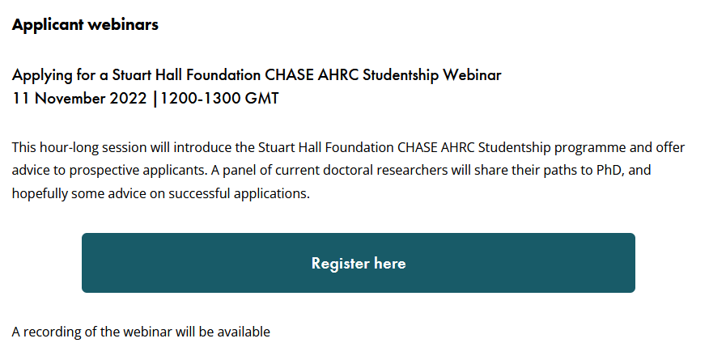
Upcoming CHASE applicant webinar – Stuart Hall Foundation scholarships
Visit https://www.chase.ac.uk/shf-studentships for information about this webinar, which includes student panellists:

Slide 28
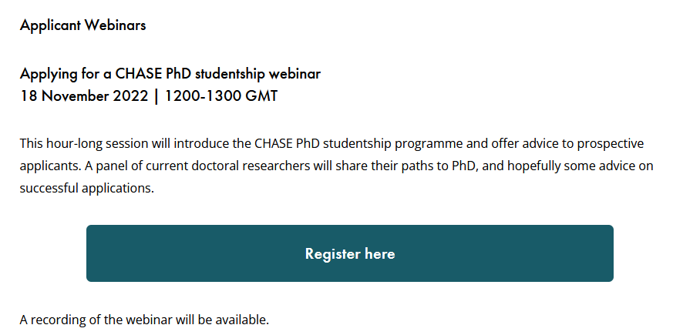
Upcoming CHASE applicant webinar
See https://www.chase.ac.uk/chase-studentships for info about this webinar, which includes student panellists:

Slide 29
Upcoming research proposal workshop
Run by University of Kent’s Graduate and Researcher College
Friday 25 November, 1-3pm
Register at https://www.kent.ac.uk/events/event/57560/designing-a-good-research-proposal-online-2

Slide 30
Closing advice
Brainstorm against the guidance to ensure you have covered everything the funder is asking for
Draft and redraft – you need to discover what is key and cut out what is unnecessary
Don’t be intimidated. You know your project
Your funders want to know the project can be completed
Be realistic: better to make a slight change to the field and be detailed than vague and over-ambitious
Get feedback from people – friends and family as well as potential supervisors. Remember, communication is key, and not just to subject specialists
Do mock interviews: prepare yourself to be challenged

Slide 31
A current CHASE doctoral researcher at Kent provides advice https://www.youtube.com/watch?v=1TJvR0pxfjg

Slide 32
Further questions?

