Slide 1
Agent Guide to Clearing 2023

Slide 2
Key dates
17 August
A Level and BTEC results day
5 July - Clearing Opens
6 July - IB results day
11 August - UCAS Embargo
17 August - A Level and BTEC results day
24 August - GCSE results day
16 September - University of Kent Arrivals Weekend
25 September - University of Kent start of term
17 October - Clearing ends*

Slide 3
Clearing tips for agents
KENT CLEARING HOTLINE NUMBER: 01227 768896
Research
Help them find out as much as they can about their clearing options.
Get prepared
Help the applicant create a Clearing plan for results day. Knowing what they have to do will help them (and you!)
On results day
Once the applicant knows what course they want to apply for, they can complete our online application form.
Receiving an offer
Remind the applicant that they can take time to consider any offer they are made to make sure it’s the right choice for them.
Accepting their offer
You can help them check their application and make sure they’ve received their confirmation email.
Relax!
Congratulations, the applicant has a place at university for 2023!.

Slide 4
Clearing at Kent

Slide 5
Routes into clearing

Slide 6
Priority clearing for 2023

Slide 7
Students who apply through Clearing Expand your thinking
1
THE TRADITIONAL CLEARING STUDENT
The Traditional Clearing Student represents the largest group in Clearing. Typically, they will enter the Clearing process having not secured one of their original UCAS choices and will have got lower grades than expected on results day.
2
THE STUDENT WHO HAS EXCEEDED THEIR GRADES
The Student has entered Clearing because their grades were higher than expected and they are looking for a Higher Education Institution with higher grade boundaries.
3
THE DIRECT APPLICANT
The Direct Applicant will have already received their results and not been through the main UCAS cycle
4
THE MIND CHANGER
The Mind Changer is going through Clearing for reasons other than educational, linked to social or environmental factors, which have influenced them to change their mind on their destination.
Notes:
So who are we expecting to apply to us through Clearing? Here we have the 4 differnet types of students:
At the top we have our traditional clearing student. This is a student who has failed to meet the conditional offer requirements of their firm and insurance university and needs to go through the clearing process to find a university place. Next we have the group of students who previously would have gone through the “Adjustment” process. These students have grades that exceed the offer of their firm choice and can now use these higher grades to look for better courses. Our third category is the “Direct Applicant”. These applicants have not been though the main UCAS cycle we saw on the previous slide and have decided to apply directly in the clearing period. Finally, we have an ever growing group of ”Mind Changers”…students who for reasons other than academic, have decided to apply for different courses or universities.

Slide 8
Entry requirements
In some cases, universities might change their course entry requirements for Clearing applications.
Courses that have not been filled may now accept applicants with grades lower than the originally advertised requirements.
Students who miss their grade conditions will be automatically re-considered against any adjusted entry requirements before results day.
This can however mean that students have more options in Clearing than they previously thought
Remember that this is not guaranteed for any course though, so don’t rely too heavily on this
In 2022, 33,280 students found their place through Clearing

Slide 9
1. See which courses are available: Use our university Clearing vacancy course listing Consider different subjects – they don't have to stick with their original idea. They could also look at joint honours courses, so they can study a mix of subjects Keep checking – universities update their course information regularly Check the course details – how is it structured each year? What modules make up each year? What are the entry requirements?
2. Talk about options: discuss the clearing process with your students

Slide 10
3. Submit an application: apply to Kent directly through our clearing vacancy webpages Remember to think about accommodation options and non-academic criteria too
4. Take note: this year there are two different clearing application options There is an application form for students already in UCAS and a separate form for students not yet in UCAS
5. Once decided, submit their clearing choice through the UCAS Hub
Go to the “Your choices” section of the Hub
Click ”Add Clearing choice”
Enter the details of the course

Slide 11
Kent International Foundation Programme
For students with qualifications and possibly language levels insufficient for direct undergraduate entry.
Subject module based, with 15 different subjects on Autumn IFP
Strong links with the Academic Schools.
Our Autumn IFP runs September to June, for entry onto undergraduate the following September

Slide 12
Applying for accommodation through clearing
Accommodation is understandably a big concern during Clearing
We will try to provide all Clearing applicants with accommodation but this will be subject to availability.
The first 500 Clearing applicants to firmly accept their offer to study at the University of Kent are also guaranteed to receive an accommodation offer
Bear in mind that they might not have as much choice by the time it comes to Clearing

Slide 13
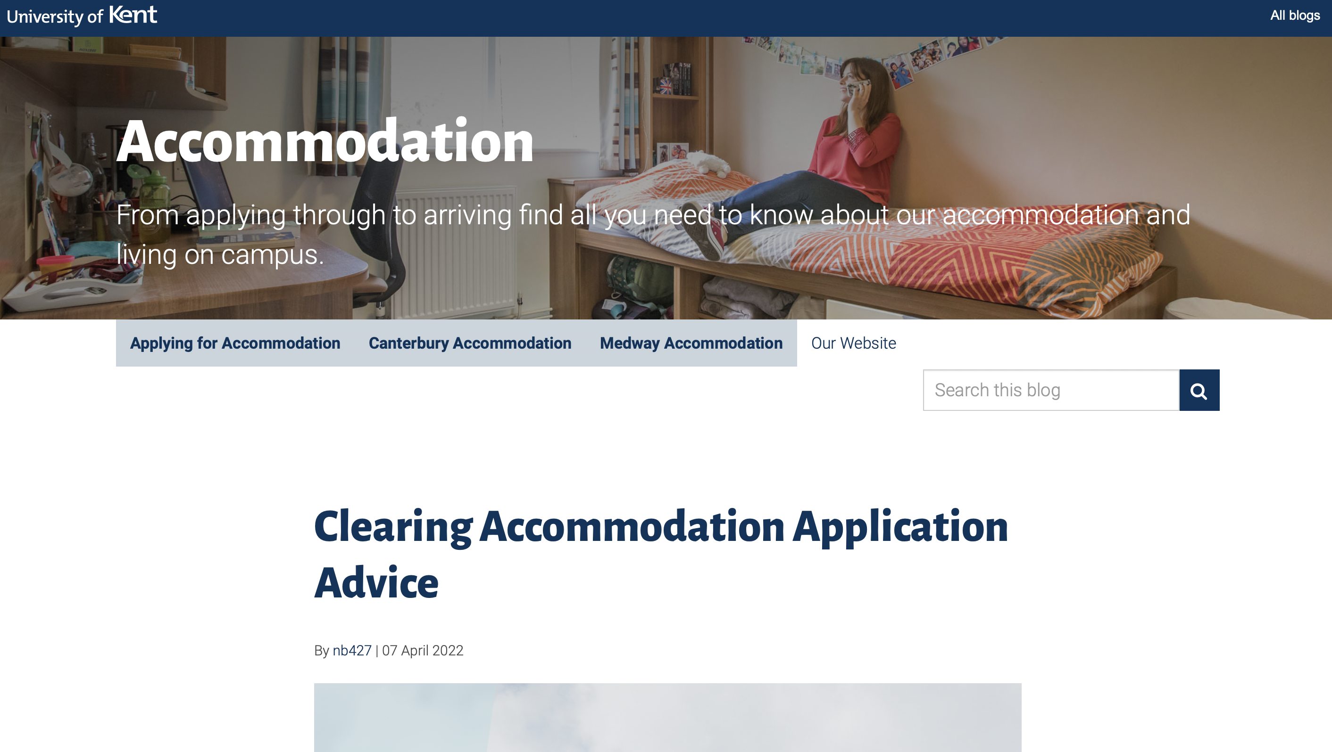
Applying for accommodation through clearing
Clearing students can select ‘yes’ or ‘no’ for on-campus accommodation
Accommodation is all on one site
Range of room types to suit all budgets
https://blogs.kent.ac.uk/accommodation/clearing-accommodation/
Notes:
Our accommodation team have put together some great advice on their blog – you can see the URL on the right hand side of the screen. To summarise:
The accommodation application option forms part of the main clearing application. Once YES is selected and the application completed, our Clearing team will pass over the details to the accommodation team who will start the work on allocating a room to the student
The accommodation offer will be made via email and can be accepted through the MyAccommodation Portal
The accommodation team email our room offers in small batches every day so remind the student not to worry if they don’t hear back immediately

Slide 14
Visa processing assistance
Our CAS Team have a checklist which must be reviewed by two members of staff
The CAS Team are not permitted to assist or advise on the visa application process
The best contacts are:
KU advice team – webform (3-5 days) or advice@kent.ac.uk (urgent help)
Visa Compliance team (visacompliance@kent.ac.uk)
PLEASE ENSURE ANY REQUESTS FROM THE CAS TEAM ARE ACTIONED IMMEDIATELY TO AVOID DELAYS

Slide 15
Any questions?

