Slide 1
English Language requirements
Emma Spittles, International Officer
Notes:
UKVI, Undergraduate, Postgraduate, Pre-sessional English programmes, Where to go for further information

Slide 2
Meeting the language requirements
To study at Kent, students must be able to demonstrate an excellent level of spoken and written English
Students who require a visa must meet the language requirements of both the UK university and UKVI
Multiple ways for students meeting the language requirements:
UKVI list of English-speaking countries
Qualifications including UK and international examinations
Medium of Instruction letters for degrees taught entirely in English
SELT (secure English language test)
Pre-sessional English programmes
Different requirements for Foundation, Undergraduate and Postgraduate programmes

Slide 3
UKVI list of English-speaking countries
Antigua and Barbuda
Australia
The Bahamas
Barbados
Belize
Canada (nationals only)
Dominica
Grenada
Guyana
Ireland
Jamaica
Malta
New Zealand
St Kitts and Nevis
St Lucia
St Vincent and the Grenadines
Trinidad and Tobago
UK
USA
Notes:
If you are a national of one of the countries below, you do not need to prove your English language ability for Student visa purposes. You may also be exempt if you have an academic qualification equivalent to a UK Bachelor's degree from one of these countries. However, you must still meet our English language requirements.

Slide 4
Undergraduate language requirements

Slide 5
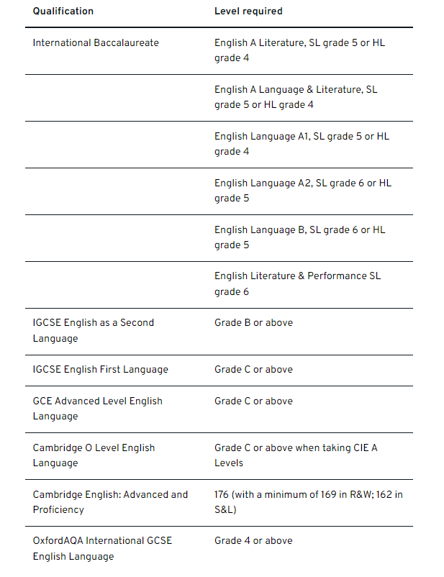
Language requirements: UG
Qualifications – A Level, GCSE, IB
In-country qualifications
https://www.kent.ac.uk/courses/undergraduate/apply/english-language-requirements#ukvi-list
Not all country qualifications are accepted for English proficiency. Check country pages for details
Approved English language test
Pre-sessional English programmes
Notes:
Key thing to note about in-country qualifications: This does not guarantee you will be exempt from taking a SELT. The University will conduct an assessment of your application and determine if an offer can be made.

Slide 6
Approved Language Tests for UG
IELTS Academic
6.5 overall (with a minimum of 6.0 in R&W; 5.5 in S&L)
PTE Academic
62 overall with 60 in each subtest
online version not accepted
TOEFL iBT / TOEFL iBT Special Home Edition
90 overall (with a minimum of
22 in R; 21 in W; 17 in L; 20 in S
Cambridge English Proficiency Test (C2)
176 overall (with a minimum of 169 in R&W; 162 in S&L)
NCUK English language test
6.5 overall (with a minimum of 6.0 in R&W; 5.5 in S&L
LanguageCert International (both online and test centre)
B2 High Pass (minimum 33 in all components)
Social Work, Journalism and Pharmacy have higher level requirements
Foundation programme only IELTS UKVI or PTE Academic UKVI are accepted for UKVI
Test results must be dated within the two years immediately preceding the start date of your course
https://www.kent.ac.uk/courses/undergraduate/apply/english-language-requirements#ukvi-list

Slide 7
Postgraduate language requirements

Slide 8
Language requirements: PG
Academic qualification equivalent to a UK Bachelor's degree from one of the UKVI countries. Qualification must have been completed within the last two years
Medium of instruction letters - for students who studied in a non-UKVI list country but was taught in English
MOI letters must be signed and stamped by the institution and the student must have graduated a maximum of two years before the start date of your course at Kent.
MOI is always considered on a case-by-case basis and not a guarantee a language exemption
MOI letters not applicable for every country. Check country pages for details
Approved English language test
Pre-sessional English programmes
Notes:
MOI – student studied a degree in the medium of English in a country not listed above, but that is on the UKVI ‘differential evidence requirement’ list (https://www.gov.uk/student-visa/money), we are likely to be able to consider a letter from your awarding institution confirming this.

Slide 9
Approved Language Tests for PG
IELTS Academic
6.5 overall (with a minimum of 6.0 in R&W; 5.5 in S&L)
PTE Academic
62 overall with 60 in each subtest
online version not accepted
TOEFL iBT / TOEFL iBT Special Home Edition
90 overall (with a minimum of
22 in R; 21 in W; 17 in L; 20 in S
Cambridge English Proficiency Test (C2)
176 overall (with a minimum of 169 in R&W; 162 in S&L)
NCUK English language test
6.5 overall (with a minimum of 6.0 in R&W; 5.5 in S&L
LanguageCert International (both online and test centre)
B2 High Pass (minimum 33 in all components)
Some subjects have different requirements including KBS, English, Law, Journalism
Test results must be dated within the two years immediately preceding the start date of your course
https://www.kent.ac.uk/courses/postgraduate/apply/english-language-requirements#ukvilist

Slide 10
Kent pre-sessional English for both UG and PG
Available for students who do not meet the language requirements
Our Pre-sessional courses run for 4, 6, 10 and 16 weeks. Offered both on campus and online
IELTS scores determines length of course needed
Develop skills in academic reading, writing and critical thinking, listening to lectures, speaking in seminars and delivering presentations
End of the course, students take the Kent International Test of English. They must meet the required exit level to progress directly onto their main programme
Applications for pre-sessional programmes can be submitted via agent portal
Combined CAS for the 6-week or 10 Week Pre-Sessional English Programme
Check website for application deadlines: https://www.kent.ac.uk/international-programmes/pre-sessional-courses

Slide 11
Contact the International Team
agents@kent.ac.uk
international@kent.ac.uk

