Slide 1
School of Computing 2023
Olaf Chitil
Director of Undergraduate Admissions
School of Computing

Slide 2
What do people say about us?
BSc (Hons) Computer Science with a Year in Industry
National Student Survey:
Staff are good at explaining things: 82%
I have been able to contact staff when I needed to: 88%
Accredited by BCS fully for Chartered IT Professional,
partially for Chartered Engineer.
Employment (work or study within 15 months): 95%
https://discoveruni.gov.uk/

Slide 3
Who are our Graduates?
People who can build robust and reliable systems.
Who are well prepared for
employment
further study
and a lifetime of innovation.

Slide 4
The Course Structure
First Year
Building strong programming skills, laying mathematical foundations, understanding the context of the subject.
Second Year
Learning core technical skills across computing and its applications.
(Optional) Placement / Year in Industry
Final Year
Choice from many optional modules and a large project on a topic chosen by students.

Slide 5
What We Teach
Core fundamentals that everyone learns in the first two years include:
Object-oriented programming (Java)
Human-computer interaction
Networking, computer architecture and operating systems
Databases
Web technologies (HTML, CSS, JavaScript, PHP)
Agile software development
All modules are assessed by either:
Coursework and examination (e.g. 50/50)
or 100% coursework

Slide 6
Computing Courses
BSc Computer Science
BSc Computer Science (Cyber Security)
BSc Artificial Intelligence
BSc Software Engineering
BSc Business Information Technology
BSc Data Sciences → School of Mathematics, Statistics & Actuarial Sciences
Offers for 2023/24 entry: A-levels BBB;
BTEC DDM.

Slide 7
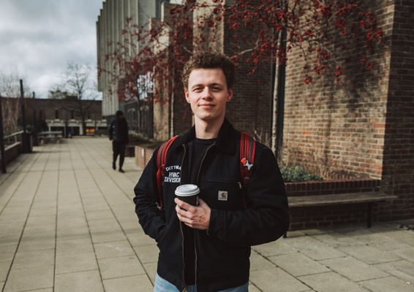
Year in Industry
Placement in the UK or overseas
Technology: IBM, Microsoft, Fivium
Entertainment: Disney, Sky
Pharmaceutical: Elanco, Pfizer
Consulting: Accenture, CGI, Deloitte, EY, KPMG
Public Services: Kent County Council, NHS, Transport for
London
Others: Bank of America, Hiscox, Holiday Extras,
Thales, Thomson Reuters, Vodafone
Putting principles into practice
real experience
real salary (£18-23k)£18 -23k) (£18 -23k)
90-100% employment
Win-Win-Win
"My placement helped me see what a positive and helpful team can look like within a professional setting and has made me want to strive even more to reach my goals within the technology industry."
Trygve Ulsnes
BSc Computer Science
with a Year in Industry

Slide 8
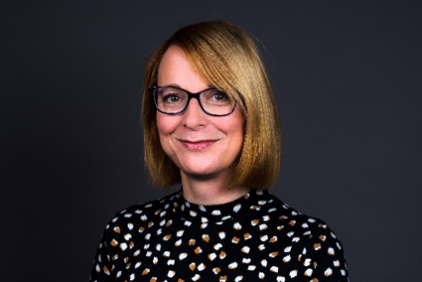
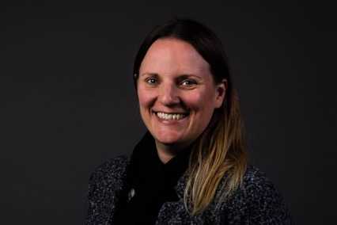
Supported by Division’s Placement Team
Appointments with the team
Practise Interviews
Weekly employability sessions
Employer events and sessions
Application and CV support
Online assessments and video interview help
Assessment centre help
Kate Ayres – Employability and Placements Manager
Jen Davey – Employability & Placements Officer

Slide 9
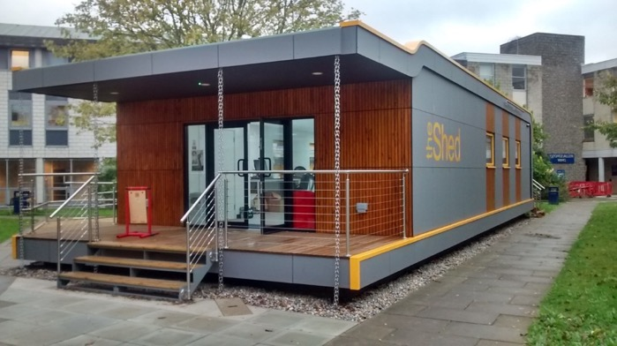
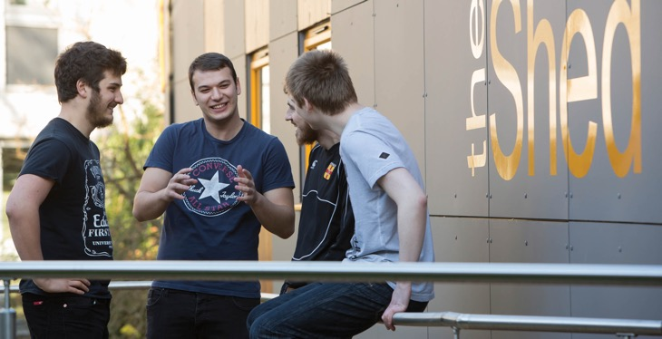
Hands-On Experience
Our Makerspaces
Open access workshops for practical projects
CAD, CAM, turning, 3D printing, electronic PCB design, laser cutting, mould making etc.
Hardware controlled by Arduino or Raspberry Pi
Computing in the Classroom
Working in a local school
Real responsibility
Supported by experienced staff

Slide 10
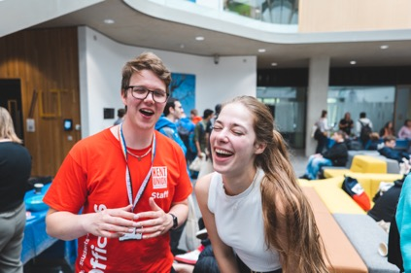
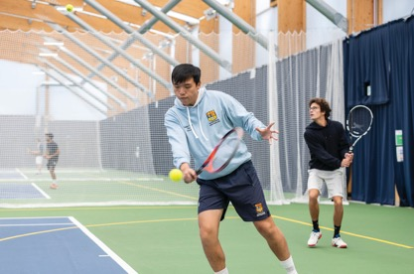
Beyond the Curriculum
Opportunities to be involved in a wide range of activities…
Social, cultural, sporting and volunteering activities
Learn a language, play music….
Study Plus: journaling, leadership….
Employability points: opportunities for training and internships
Support other students in the Homework Club
Work for us (e.g. as Student Ambassadors)

Slide 11
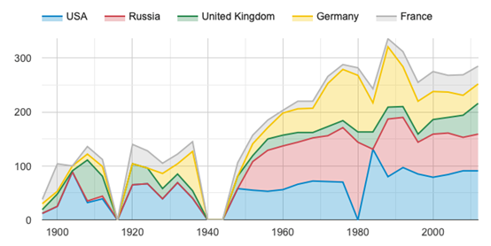
Excellence in Research
Excellent Research Outputs (Publications)
53.8% 4* world-leading
42.5% 3* internationally leading
Research Groups:
Cyber Security Academic Centre of Excellence in Cyber Security Research (GCHQ) Member of National Quantum Communications Hub
Computational Intelligence (AI)
Data Science
Programming Languages and Systems
The Gamma: interactive data exploration of Olympic medals

Slide 12
Moving to Kennedy next Month

Slide 14
Any Questions?

