Slide 1
Implementing Sustainability into Biosciences
Dami Kuye

Slide 2
Implementing Sustainability into Biosciences: Abstract
This was a 6-week student-led project with the main aim to inspire change in Natural Sciences by including sustainability in the curriculum
This was done by suggesting changes to all Biosciences modules that would include sustainability and changing lab infrastructure using the UN’s SDGs and LEAF

Slide 3
What were our aims and approaches ?
We approached this by taking a wholistic look at sustainability in biosciences using curriculum mapping data readily available
Implementing sustainability into the Biosciences curriculum
Improving lab infrastructure
Increasing student interest and understanding of sustainability
Encouraging student interest in sustainability outside of Biosciences
Implementing the SDGs into curriculum more significantly
Examined lab infrastructure and evaluated areas where sustainability could be improved
Explored different methods of delivering this information to students to communicate our aims effectively
Notes:
Explain what SDGs are – goals set by the UN to improve sustainability globally meant to be implemented on an individual, institutional and national level

Slide 4
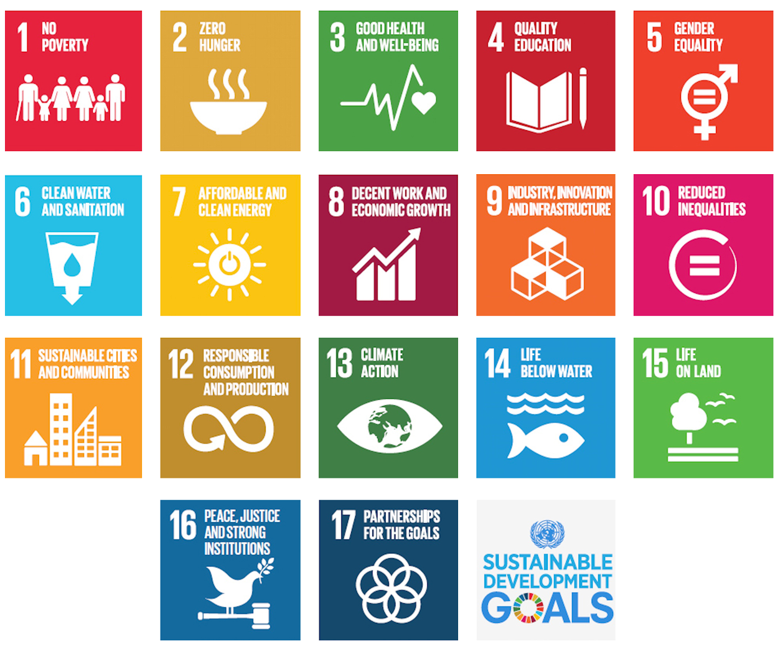
How was sustainability added to the curriculum?
Used resources like LEAF and the ESD 2021 report to further inform our decisions while keeping students in mind.
Using different forms of media to communicate effectively to students e.g., journals, TED talks, vevox, discussion posts.
Evaluated the areas where Biosciences excelled at sustainability and areas of improvement using curriculum mapping.
Good at implementing SGDs 3 (good health), 9 (infrastructure and industry) and 15 (life on land). Critical thinking skills and well-rounded in implementing ESD methods.
Potential in implementing SDGs 6, 7, 8, 11, 12, 13 and 14, encouraging understanding of SD and challenging ‘business as usual’.
Kept these in mind when implementing sustainability into biosciences whenever relevant by linking to SDGs often overlooked in Biosciences and introducing students to the idea of challenging ‘business as usual’.
Redesigned the cover of lab manuals to make it clearer to students what can and can't be recycled in compliance with COSHH
Also redesigned the labels on the lab bins to prevent incorrect materials entering the recycling bins
Notes:
Explain what sdgs are and how they could fit into the modules
‘business as usual’ example would be the fact that we looked at hospitals and the resources they use encouraged students to suggest greener alternatives (green endoscopy) or the fact that the lab infrastsrusture was challenged and changed to be more sustainable

Slide 5
BIOS3000: Introduction to Biochemistry
Dami Kuye

Slide 6
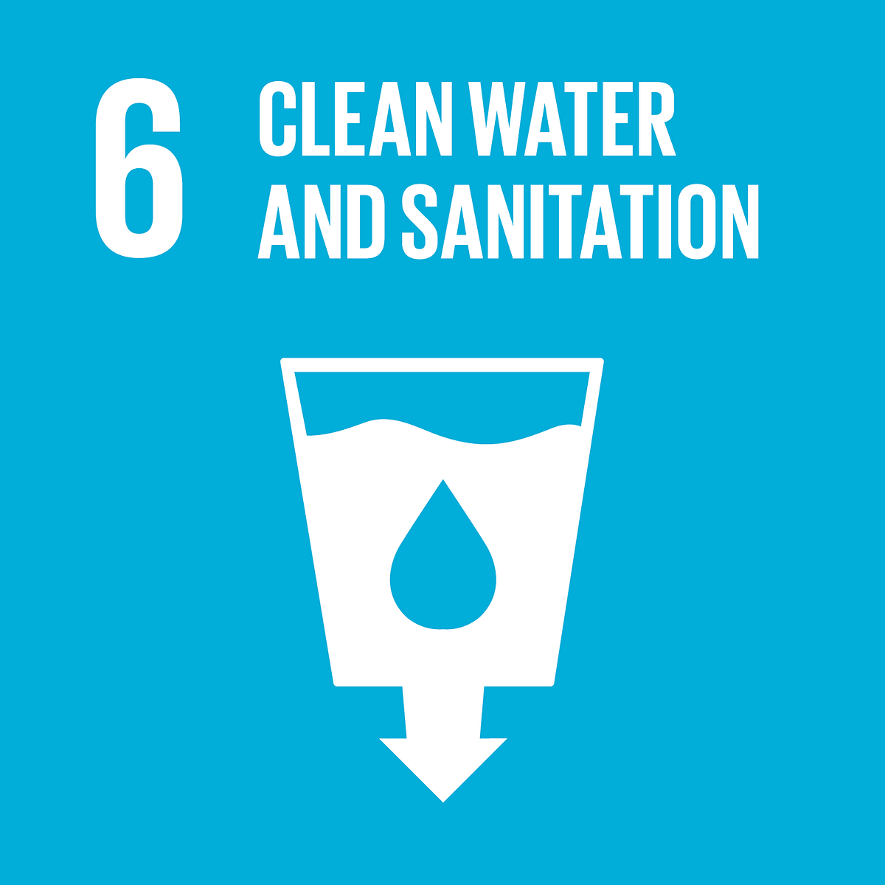
Spectroscopy and its use in sustainability
Incorporation into BIOS3000
Spectroscopy
This can be incorporated seamlessly into the BIOS3000 curriculum while discussing applications of spectroscopy.
Could add as part of the PowerPoint
Ask students to research in their own time then use vevox
Oil in Water Analysis ASTM D7575 | FT-IR Spectroscopy | Environmental Monitoring - Bing video – this video can be shown as an example of environmental monitoring of water.
Students would be tested on their understanding of spectroscopy while being able to identify how it could be used environmentally. This would improve their systems thinking as well as their problem-solving skills.
Spectroscopy is the study of the interactions of electromagnetic radiation with matter and the current version of the BIOS3000 module goes over:
Ultraviolet/Visible Spectroscopy (UV/Vis)
Fluorescence Spectroscopy
Infrared Spectroscopy (IR)
These spectroscopy techniques have many uses in sustainability. For example, the analysis and detection of pollutants in the environment using UV/Vis, as well as monitoring the chemical composition of the atmosphere using IR.
Spectroscopy and Its Advancements for Environmental Sustainability | SpringerLink
Notes:
Systems thinking: Systems thinking is a way of approaching problems that analyses how all the elements within a system influence one another. It is the ability to recognise and understand cause and effect in complex systems.
Problem solving competency

Slide 7
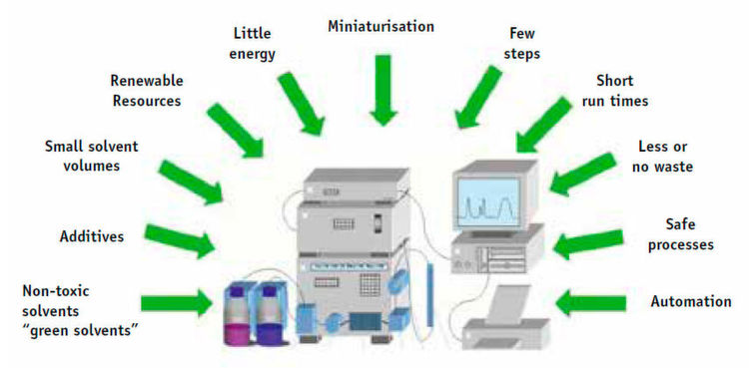
Chromatography and its effect on the environment
Incorporation into BIOS3000
Chromatography
This can be incorporated into the BIOS3000 curriculum while summarising chromatography as a technique.
This would help with cementing student understanding of chromatography and encouraging systems thinking.
Solutions like green chromatography can be explored, recommending the use of less toxic solvents whenever possible
Another analytical technique explored in BIOS3000 that goes over the process by which mixtures of molecules are separated into the constituent components by means of a mobile phase passing over a stationary phase.
The technique is widely used within pharmaceutical and environmental/chemical safety industries.
Advancements made towards more sustainable chromatography due to the toxic nature of the chemicals, like organic solvents, used on an industrial scale.
What is Green Chromatography? (azolifesciences.com)
Notes:
Systems thinking: Systems thinking is a way of approaching problems that analyses how all the elements within a system influence one another. It is the ability to recognise and understand cause and effect in complex systems.
Problem solving competency
‘The use of organic solvents in chromatography is one of the most toxic parts of the process. Solvents present a threat to the environment and human health. The use of them in chromatography puts those who work with the chemicals at risk of exposure. In addition, the environment is threatened by chemical leaks either by accidents or via the slow accumulation of toxins into the nearby environment.’
‘The most commonly used solvent in chromatography is acetonitrile, a volatile organic compound. Studies have shown that a mixture of propylene carbonate–ethanol-water can be used to replace this toxic solvent, resulting in comparable levels of efficacy. Other studies have shown that an ethyl acetate–ethanol mixture can also be used as an eco-friendlier substitute for acetonitrile. Other alternative non-toxic solvents have been established to replace other toxic substances. Solutions of 0.04% triethylamine in water are an effective alternative, for example. Ethanol, ethyl acetate, or even water has also commonly been used.’

Slide 8
BIOS3010: Enzymes and Introduction to Metabolism
Dami Kuye

Slide 9
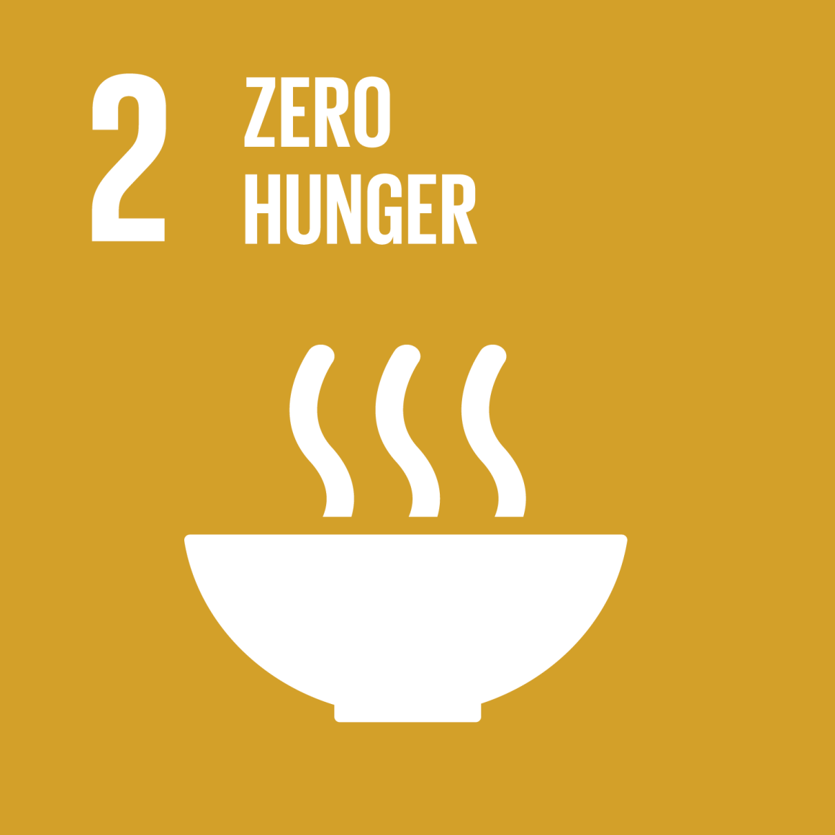
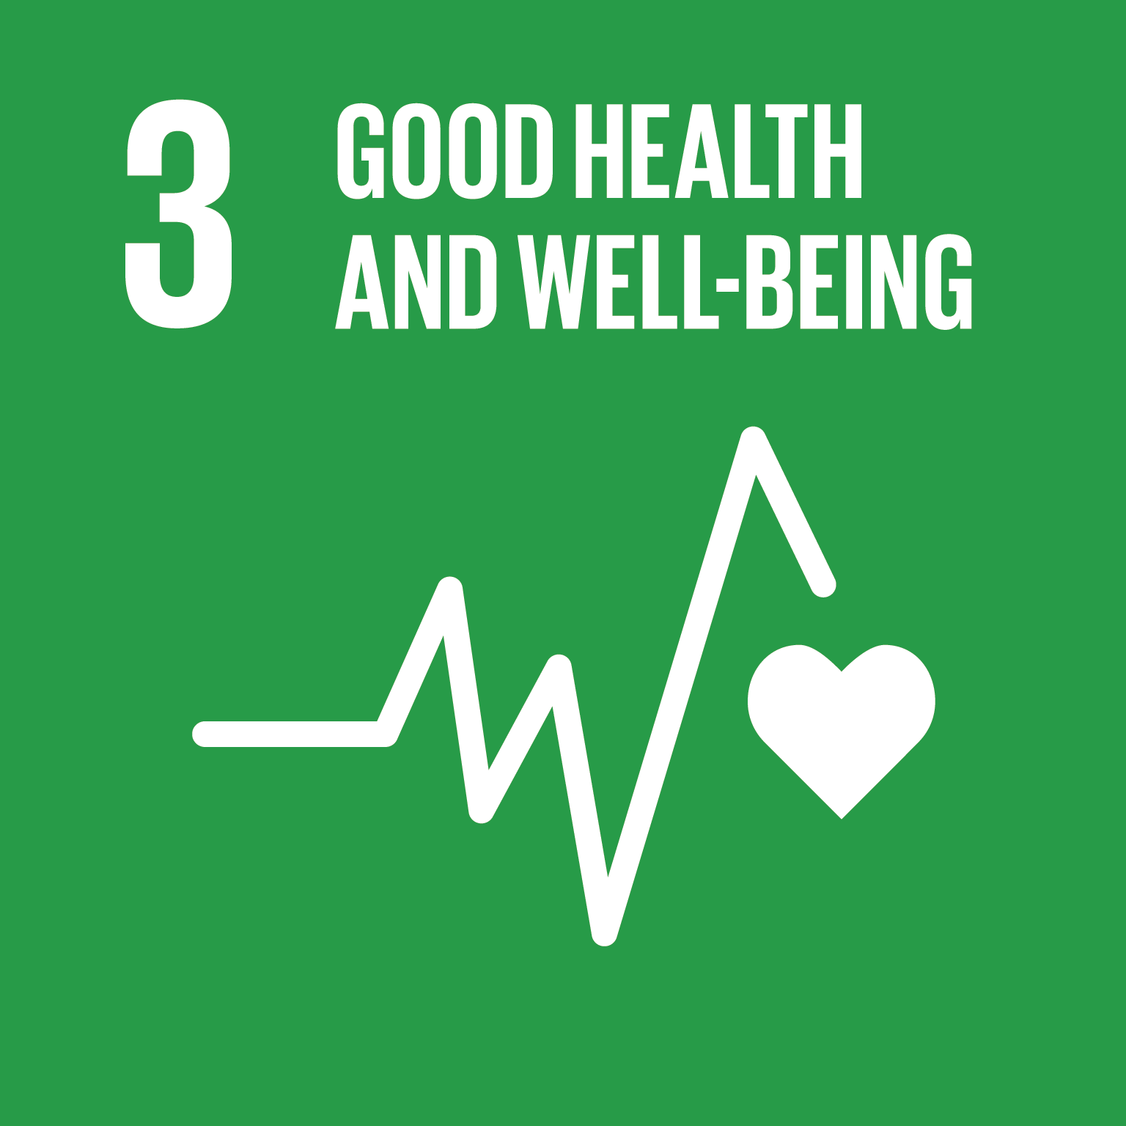
Fermentation in sustainability
Incorporation into BIOS3010
Fermentation
Fermentation is explained in the module as Generation of energy (ATP) without consuming oxygen or NAD+ and has the potential to be related to sustainability.
Fermentation has the potential to be used in plant based alternative foods which would be more environmentally friendly than protein options from the meat industry. While also encouraging food preservation and reducing food waste.
Limitations come from scaling up fermentation with it being slow and energy consuming like with batch fermentation or hard to implement with continuous fermentation – also good segway to BIOS5480 and BIOS5210
This could be slotted in while talking about fermentation. Students could be asked to investigate the uses of fermentation in sustainability or tasked to research further and discuss with links to outside reading sources.
Nutrients | Free Full-Text | Harnessing Microbes for Sustainable Development: Food Fermentation as a Tool for Improving the Nutritional Quality of Alternative Protein Sources (mdpi.com)
Why is Fermentation Critical for a Sustainable Future? | by Jennifer Kan | Vectors Angel | Medium
Looking at the real-life applications of fermentation in food production would help with student understanding and systems thinking, while allowing students to consider the environmental limitations of fermentation and encouraging critical thinking
Notes:
Systems thinking: Systems thinking is a way of approaching problems that analyses how all the elements within a system influence one another. It is the ability to recognise and understand cause and effect in complex systems.
Problem solving competency

Slide 10
BIOS3050: Fundamental Human Biology
Dami Kuye

Slide 11
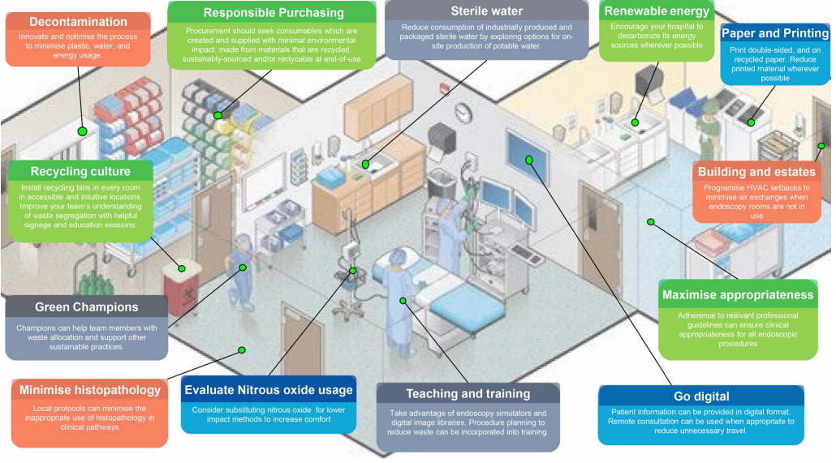
Green endoscopy
Incorporation into BIOS3050
What is green endoscopy?
The endoscopy process could be mentioned in the digestion and absorption topic when discussing methods of monitoring the GI tract. This could help with employability as students would become familiar with common clinical techniques. This would also help with problem solving skills of students by encouraging them to think of sustainable solutions to other clinical techniques.
Endoscopy is a highly resource intensive procedure that generates endoscopy is held to be the third highest hazardous waste generating department in a hospital that contributes to greenhouse gas emissions.
Green endoscopy is making conscious changes to mitigate some of the unsustainable parts of the endoscopy procedure like the frequent use of single-use items, the resource-heavy decontamination and water consumption.
Green endoscopy: British Society of Gastroenterology (BSG), Joint Accreditation Group (JAG) and Centre for Sustainable Health (CSH) joint consensus on practical measures for environmental sustainability in endoscopy - PubMed (nih.gov)
Notes:
Systems thinking: Systems thinking is a way of approaching problems that analyses how all the elements within a system influence one another. It is the ability to recognise and understand cause and effect in complex systems.
Problem solving competency

Slide 12
BIOS3070: Human Physiology and Disease
Dami Kuye

Slide 13
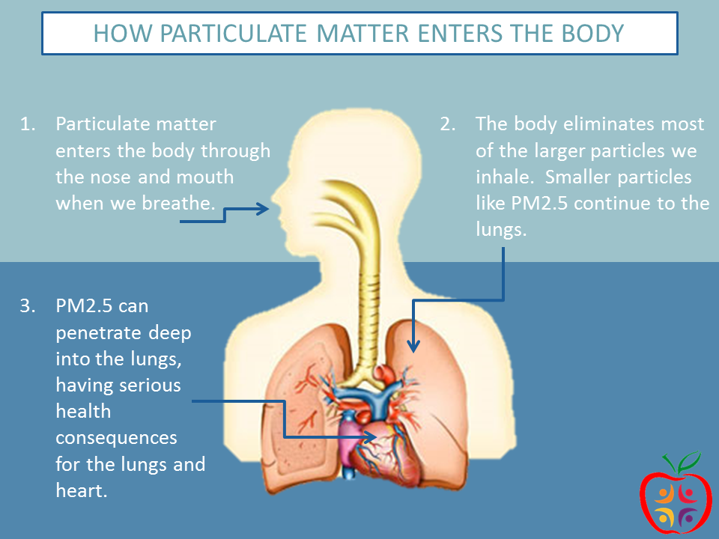
The effects of climate change on lung health and the liver
Interesting video to show to students about pollution in the lungs
https://youtu.be/GVBeY1jSG9Y
Climate change on lung health
Climate change and the liver
As climate change worsens the number of pollutants found in the air has been increasing along with complications as a result. This leads to the rise of health conditions like Chronic Obstructive Pulmonary Disease (COPD), asthma, bronchiolitis, lung cancer and cardiovascular events.
Students can expand their learning by being asked to look at how different environmental factors caused by climate change can affect lung health, this would also have the added benefit of improving their problem solving and critical thinking skills too.
Links have been found between liver disease and environmental factors like pollution for example the exposure of workers to petrochemicals.
This can be communicated effectively to students while discussing the role of the liver in the body and allow them deepen their understanding of its function. This would also help with student’s system thinking as they understand the industries responsible for pollution.
Environmental and Health Impacts of Air Pollution: A Review - PubMed (nih.gov) Health Benefits of Air Pollution Reduction - PubMed (nih.gov)
Climate change risk perception in global: Correlation with petroleum and liver disease: A meta-analysis - PubMed (nih.gov)
Notes:
Systems thinking: Systems thinking is a way of approaching problems that analyses how all the elements within a system influence one another. It is the ability to recognise and understand cause and effect in complex systems.
Problem solving competency

Slide 14
BIOS3210/BIOS3211: Biological Chemistry A
Dami Kuye

Slide 15
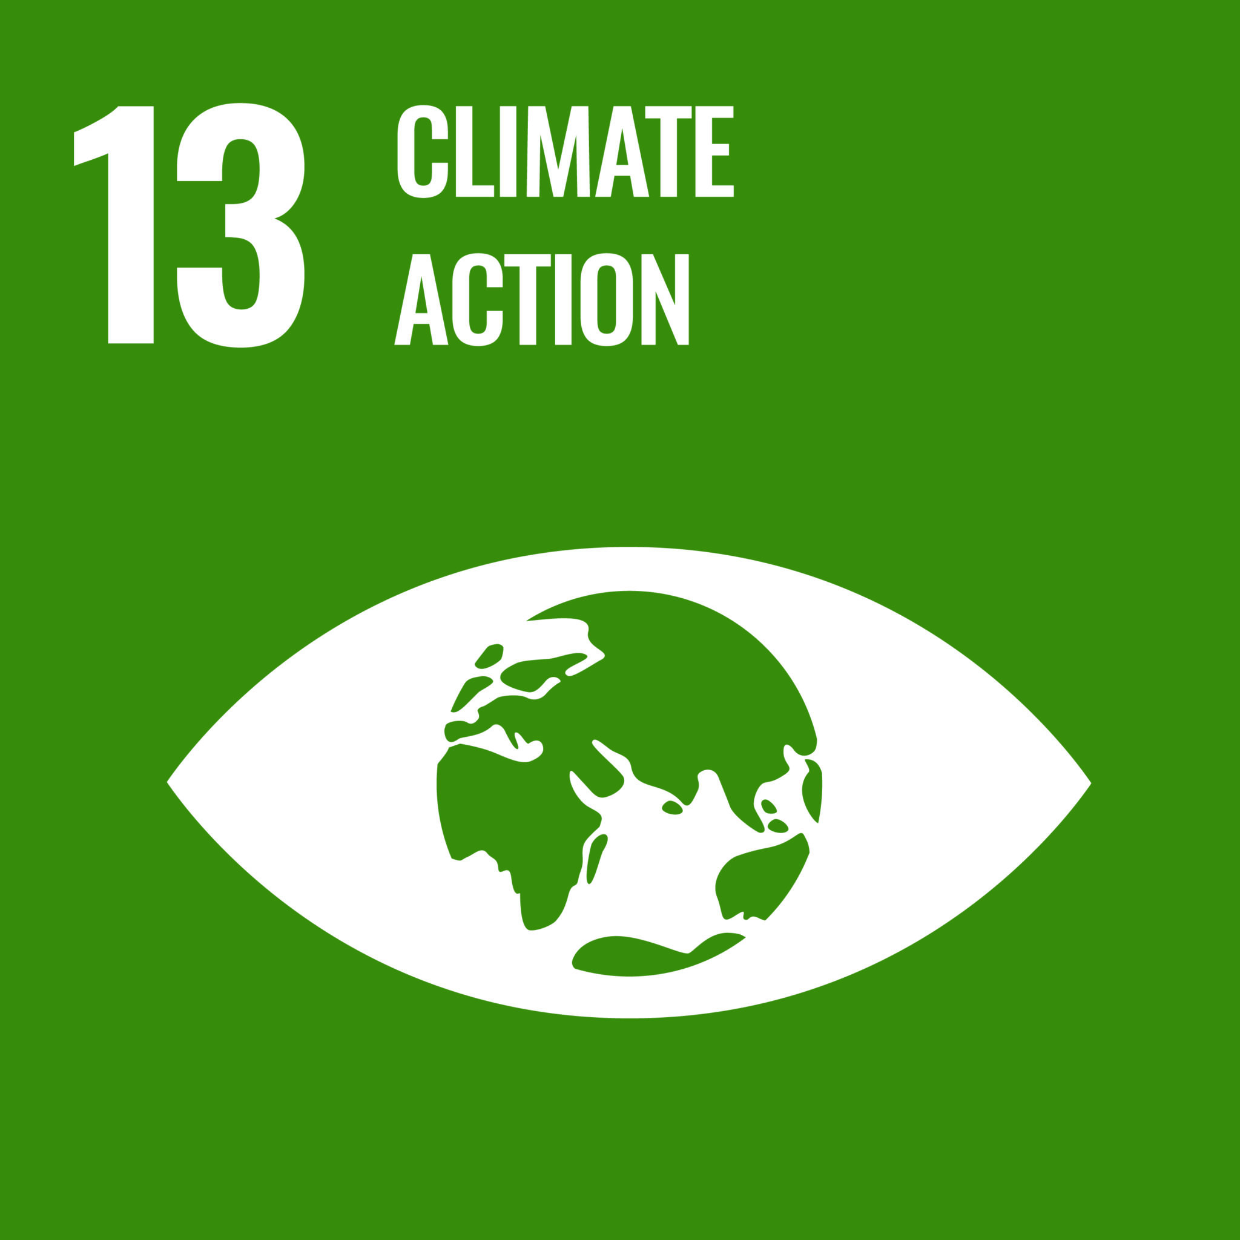
The role of NMR in sustainability
NMR in sustainability
Incorporation into BIOS3210/3211
‘NMR spectroscopy is a versatile tool for the study of structure and interactions in environmental media such as air, soil, and water as well as monitoring the metabolic responses of living organisms to an ever-changing environment.’
NMR us a powerful tool for environmental monitoring and plays a big role in sustainability through its potential to measure pollutants in water and soil.
This can be incorporated into the curriculum while discussing NMR during phase 4 and could be useful in communicating the importance of NMR outside of the classroom.
Students can be asked to go and research uses of NMR in sustainability
This gives students the chance to consider NMR’s role in industry while improving systems thinking and problem solving.
Notes:
Systems thinking: Systems thinking is a way of approaching problems that analyses how all the elements within a system influence one another. It is the ability to recognise and understand cause and effect in complex systems.
Problem solving competency

Slide 16
BIOS3230: Diversity of Living Organisms
Dami Kuye

Slide 17
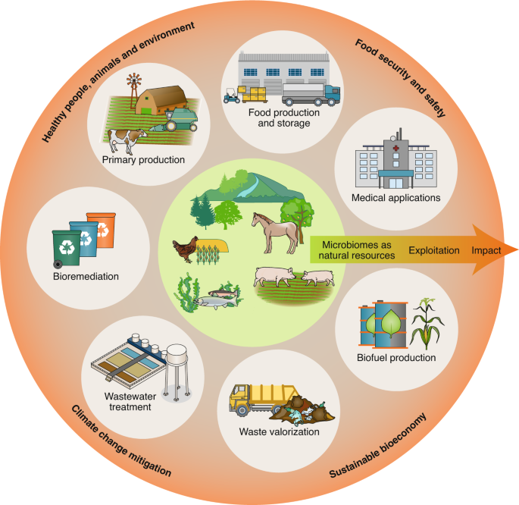
The role of bacteria in sustainability
Incorporation into BIOS3230
The uses of bacteria in sustainability can be easily incorporated into the BIOS3230 curriculum during the bacteria and archaea topic . Students could be introduced to the functions of bacteria which would be an opportunity to link to the BIOS5480 module in stage two.
Students could also improve on their critical thinking skills by being asked about the limitations of using bacteria in sustainability like GMOs being exposed to the environment which would help to develop their critical thinking skills.
Uses of bacteria in sustainability
There are multiple roles that bacteria play in sustainability for example in endophytic bacteria in agriculture have been proven to improve crop productivity.
Another example would be the role of bacteria in food production whether it be in fermentation or biofuel production.
Bacteria have a broad use in sustainability and provide an interesting new perspective to sustainability development.
Can bacteria save the planet? – PMC (nih.gov)
Endophytic bacteria: Role in sustainable agriculture – ScienceDirect
Microbiome innovations for a sustainable future | Nature Microbiology
Notes:
Systems thinking: Systems thinking is a way of approaching problems that analyses how all the elements within a system influence one another. It is the ability to recognise and understand cause and effect in complex systems.
Problem solving competency

Slide 18
BIOS3240: Genetics and Evolution
Dami Kuye

Slide 19
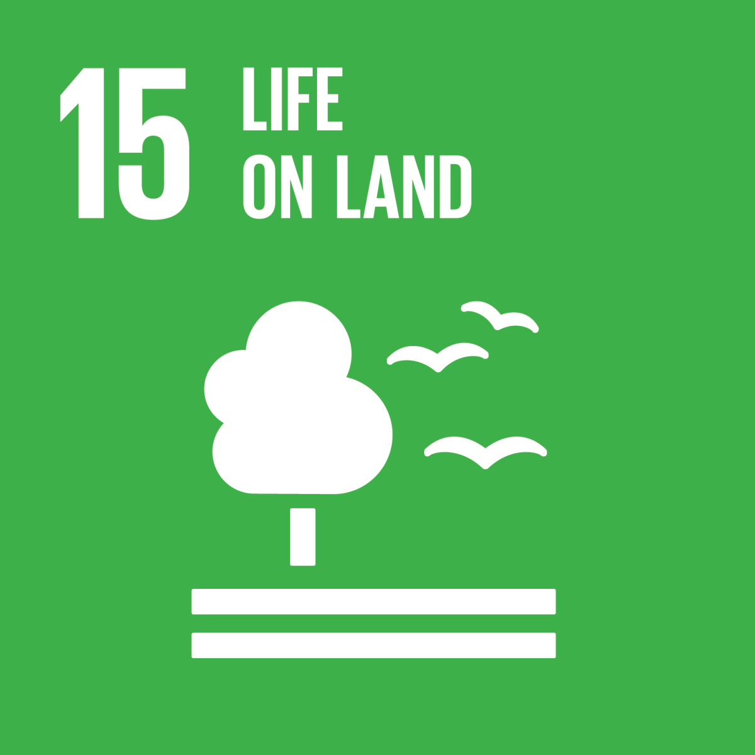
Genetics in sustainability
Incorporation into BIOS3240
Sustainability could be brought up while discussing genome evolution, especially when linking the importance of understanding a genome and its components when undergoing genetic engineering.
Explaining the process of genomic editing while adding examples of sustainability would be useful to student understanding and encourage them to look further into the topic.
Students could also be introduced to the cost and ethical concerns surrounding genome editing in order to give them a more well-rounded look and improve critical thinking skill.
This could be communicated to students using videos or links to journals for them to look at in their free time.
The uses of gene editing in sustainability
Gene editing is a powerful tool in sustainability with potential in many industries. An example would be the use of gene drives in the eradication of malaria where CRISPR is used to disrupt female fertility in mosquitoes thereby supressing the population.
Another example would be the genetic modification of crops. This is where crops are engineered to be more resilient to disease, famine and heat stress which would be widely beneficial in developing countries under food stress.
https://youtu.be/RSObzwI1aMk - interesting TED talk on genetic editing in agriculture
https://youtu.be/6tw_JVz_IEc - TEDed video on
CRISPR
FTQ_May_2019.pdf (un.org)
Genetic modifications associated with sustainability aspects for sustainable developments - PMC (nih.gov)
Notes:
Systems thinking: Systems thinking is a way of approaching problems that analyses how all the elements within a system influence one another. It is the ability to recognise and understand cause and effect in complex systems.
Problem solving competency
Cost concerns – gene editing is expensive so does that mean that only certain countries can benefit? Poorest communities in need of GMOs not having access to it
Ethical concerns – what are the ethical implications of techniques like gene drive, eradicating mosquitoes etc

Slide 20
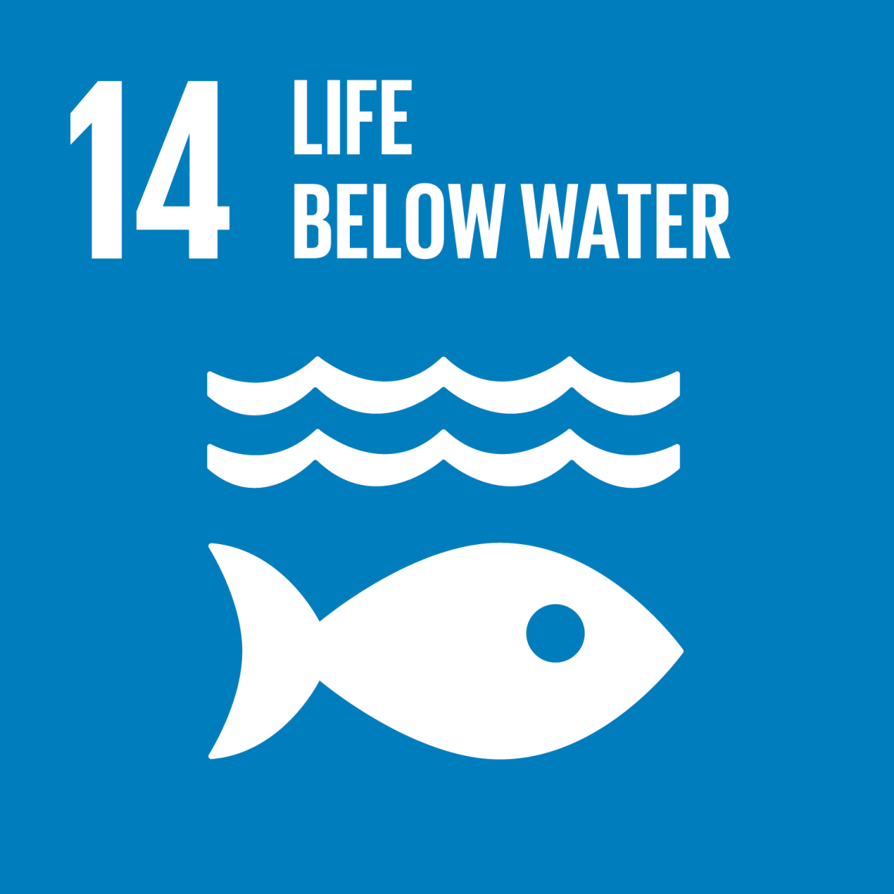
Extinction in evolution
Incorporation into BIOS3050
Extinction and sustainability
Extinction as a topic could be added to this module and explored further as it links to genetics and the idea of natural selection.
Educating students on the different causes of extinction would help students to understand genetics more thoroughly and improve their problem-solving skills by giving them the space to think of ideas to mitigate this.
Students could be encouraged to look at websites like WWF to see what they can do on a local/personal level to help endangered species. WWF - Endangered Species Conservation | World Wildlife Fund
Extinction is the process where a species dies out as a result of a multitude of factors.
The most common causes of extinction include overharvesting, pollution, habitat destruction and introducing invasive species this goes to stress the importance of sustainability in species protection.
A lot of the causes of extinction are man-made and thus the prevention must be man-made too examples of this could be;
Educating people on their role in protecting the environment.
Legislation preventing the poaching of endangered species.
International agreements, especially those tackling climate change.
Creating nature reserves to protect habitats.
Notes:
Systems thinking: Systems thinking is a way of approaching problems that analyses how all the elements within a system influence one another. It is the ability to recognise and understand cause and effect in complex systems.
Problem solving competency
Phyletic extinction is when a species evolves into another species that is similar but can no longer be categorized as the same species. This is less impactful, as there is no net loss of species.
Terminal extinction happens when a species is lost from the Earth completely. Once this happens, there is no natural way this species can return.

Slide 21
Stage two
Dami Kuye

Slide 22
BIOS5010: Gene Expression and its control
Dami Kuye

Slide 23
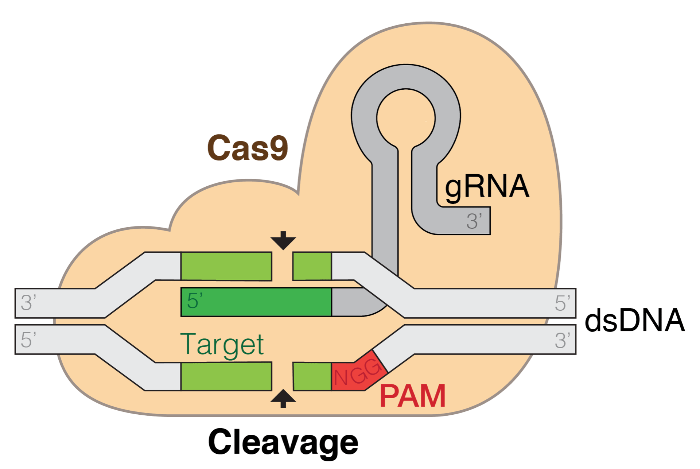
CRISPR in sustainability
https://youtu.be/6tw_JVz_IEc - TEDed video on CRISPR
Incorporation into BIOS5010
CRISPR and gene editing
This module goes over the CRISPR system and its functions and could be a good opportunity to mention the benefits that gene editing using methods like CRISPR could have on sustainability.
Being able to identify where gene editing would be useful in the form of a vevox questionnaire, or a discussion forum could be a good activity for students.
This would also help with student’s critical thinking and systems thinking as it would encourage innovative thinking in students while deepening their understanding on the genome and how it works in a real-world setting.
CRISPR gene editing is a powerful tool in sustainability, where a synthetic guide RNA is used to edit the desired sequence while utilising the CRISPR-cas9 bacterial antiviral defence system.
An example of this would be the use of gene drives in the eradication of malaria where CRISPR is used to disrupt female fertility in mosquitoes thereby supressing the population.
Another example would be the genetic modification of crops using CRISPR. This is where crops are engineered to be more resilient to disease, famine and heat stress which would be widely beneficial in developing countries under food stress.
Responsible governance of gene editing in agriculture and the environment | Nature Biotechnology
Gene Editing Is a Key to Environmental Sustainability | Innovature
Beginning Stages of CRISPR Detection in Athletes – Dartmouth Undergraduate Journal of Science
Notes:
Systems thinking: Systems thinking is a way of approaching problems that analyses how all the elements within a system influence one another. It is the ability to recognise and understand cause and effect in complex systems.
Problem solving competency

Slide 24
BIOS5030: Cell Biology
Dami Kuye

Slide 25
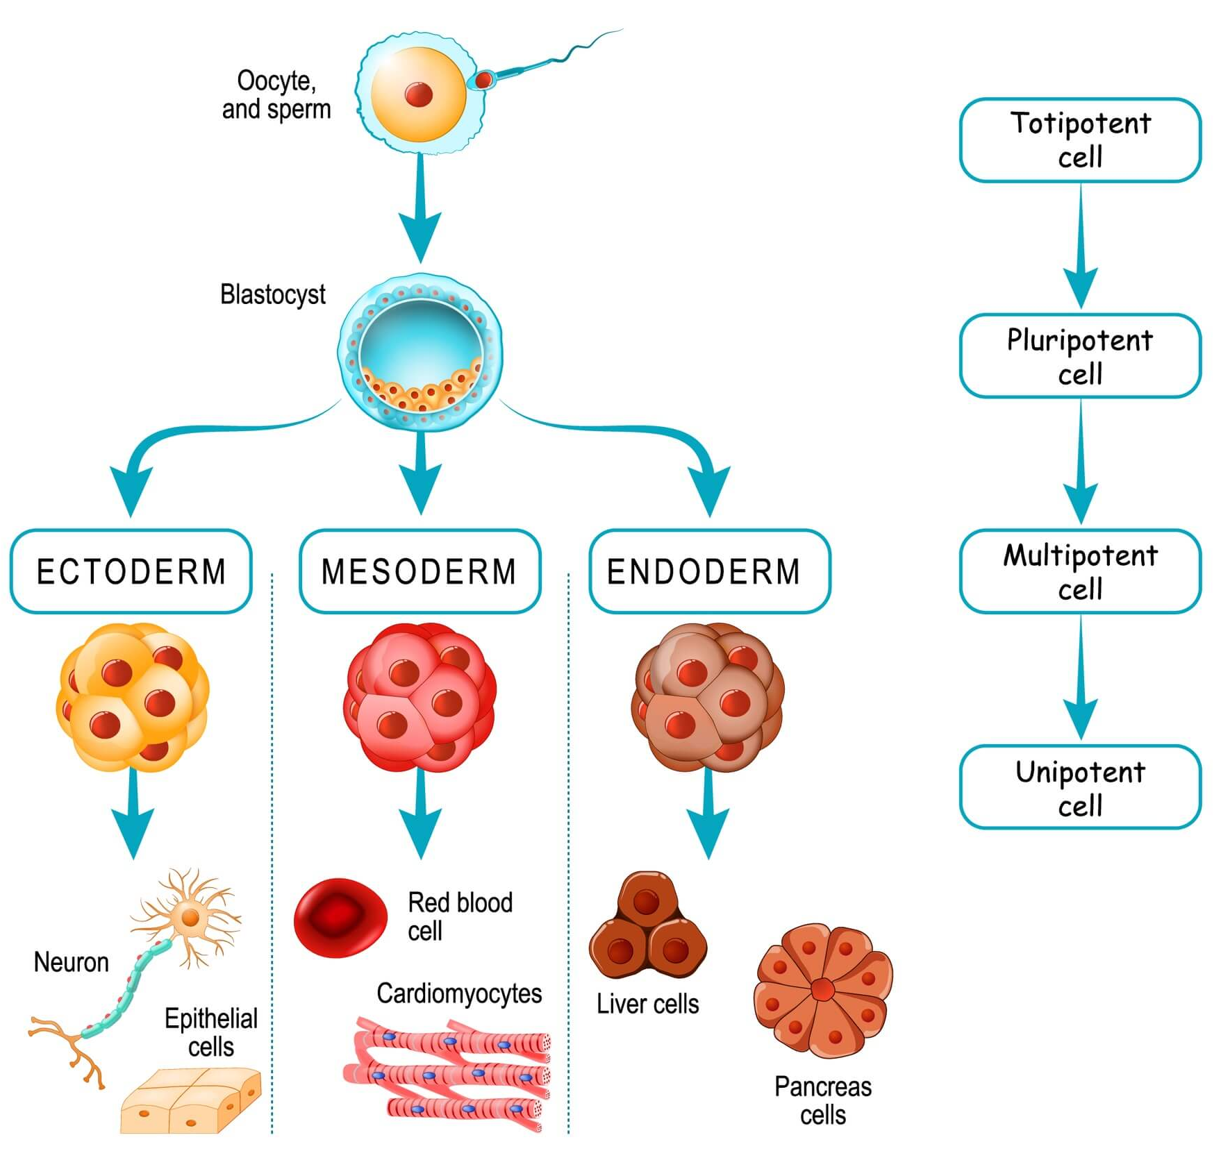
The applications of stem cells in sustainability
Incorporation into BIOS5030
Stem cells and sustainability
Students could make time to discuss the ethical implications of using stem cells in science especially in the use of sustainability and reversing environmental damaging practices like animal farming.
This would be a good chance to foster student’s critical thinking skills which would be beneficial for future employability, this could also encourage students to look further into stem cells which would encourage outside reading.
Stem cells are cells that can differentiate into other body cells and have huge potential in health and sustainability. Stem cells have a wide range of use in many degenerative diseases like Parkinson's, diabetes and multiple sclerosis.
Sustainability also includes the sustenance of human health so stem cells could also play a large part in sustainability as well as good health being a part of the SDGs.
There are ethical concerns over the use of stem cells due to one of the sources being from embryonic cells
Recognizing the ethical implications of stem cell research: A call for broadening the scope: Stem Cell Reports
Notes:
Systems thinking: Systems thinking is a way of approaching problems that analyses how all the elements within a system influence one another. It is the ability to recognise and understand cause and effect in complex systems.
Problem solving competency

Slide 26
BIOS5050: Infection and Immunity
Dami Kuye

Slide 27
Climate change and its effect on the skin and allergies
Climate change and the increase in allergies
Climate change and the skin
There have been strong links discovered between the increase in global temperatures with the prevalence of pollen allergy cases.
This is due to plants being able to show enhances photosynthesis and reproduction to produce more pollen as a result of increased atmospheric CO2 levels.
An increase in Mold proliferation caused by floods and rainy storms is responsible for severe asthma.
The modules already mentions this in the slides, but more focus could be put on discussing with student why they think this is and any problem solving they can provide to this issue.
The changing climate has caused many changes to the skin, including the rise of cutaneous diseases due to the geographical distributions of vectors changing the spread of some infectious diseases like leishmaniasis and Lyme disease. As well as more wet and humid environments encouraging the colonisation of the skin by bacteria and fungi.
This could be smoothly implemented into the BIOS5050 curriculum while discussing the skin.
Including this knowledge into BIOS5050 would help encourage interest in sustainability in students as well as make relevant connections to real life scenarios to increase their understanding of the skin.
Notes:
Systems thinking: Systems thinking is a way of approaching problems that analyses how all the elements within a system influence one another. It is the ability to recognise and understand cause and effect in complex systems.
Problem solving competency

Slide 28
BIOS5130: Human physiology and Disease 2
Dami Kuye

Slide 29
Environmental factors in infertility
Infertility and the environment
Implementation in BIOS5130
There has been a noticeable increase in infertility within industrialised countries as a result of environmental factors like pollutants and metals in our food, water and air.
The worst fertility disrupters are organochlorine compounds (chlorinated pesticides, polychlorinated biphenyls, and dioxins), bisphenol A (BPA), and organophosphate pesticides
There has been strong links between the amount of pesticide exposure and infertility seen in men and women. ‘Simply consuming foods with a high pesticide level is enough to decrease fertility by a surprising amount.’
This could be a discussion point for students when looking at the causes of infertility in males and females during the reproduction lecture, this would be a beneficial way to expand student understanding of a sensitive topic while keeping sustainability in mind.
This could encourage students to advocate for less pesticide usage in agriculture as well as the deindustrialisation of agriculture where possible.
This would also be a good opportunity to suggest shopping from local markets for students.
Environmental Toxins and Infertility – PMC (nih.gov)
Notes:
Systems thinking: Systems thinking is a way of approaching problems that analyses how all the elements within a system influence one another. It is the ability to recognise and understand cause and effect in complex systems.
Problem solving competency

Slide 30
BIOS5140: Pharmacology
Dami Kuye

Slide 31
Increases of allergies with climate change
Allergies and climate
Implementation in BIOS5130
There have been strong links discovered between the increase in global temperatures with the prevalence of pollen allergy cases.
This is due to plants being able to show enhances photosynthesis and reproduction to produce more pollen as a result of increased atmospheric CO2 levels.
An increase in Mold proliferation caused by floods and rainy storms is responsible for severe asthma.
This links in with the asthma and allergies topic and can be mentioned in when discussing the role of histamine in the allergic response exemplifying pollen as a potential trigger and mentioning the role of climate change in disrupting pollen patterns.
It can also be mentioned how this disruption triggers an increase in asthma when talking about the role of allergens in exacerbating asthma.
This would be useful in increasing student understanding of the topic by providing students with realistic examples of how sustainability affects health.
The effects of climate change on respiratory allergy and asthma induced by pollen and mold allergens – PubMed (nih.gov)
Notes:
Systems thinking: Systems thinking is a way of approaching problems that analyses how all the elements within a system influence one another. It is the ability to recognise and understand cause and effect in complex systems.
Problem solving competency

Slide 32
Climate change and the kidney
Implementation in BIOS5140
How climate change causes hypertension
Can be added in when discussing hypertension and reducing blood volume as a method of treatment, mentioning how temperature increases due to climate change are linked to reduced kidney function.
Could ask students how they think heat would affect the kidney’s ability to maintain osmotic pressures
how they think an electrolyte imbalance would affect the ability of diuretics.
Would also be interesting to ask if they have any solutions or alternative treatments that would be effective in treating specific case studies, for example, using the occupationally exposed workers in northeast China as seen in the study linked.
This helps students to remember the alternative treatments for hypertension while giving them an example of a case study question while keeping sustainability in conversation. Case studies could also help with employability as it’s the most likely scenario they would face while employed.
There has been a dramatic increase in heatwaves worldwide, with 175 million more people being exposed to heat waves because of climate change.
With this comes increased risk for people with cardiovascular and respiratory disorders. ‘Studies have reported that increasing temperatures translate into increased admissions through the emergency room of a wide range of renal disorders.’
The increase in heat is unhelpful for the kidney’s function of maintaining blood volumes for patients taking Thiazide diuretics, loss of electrolytes like sodium and potassium through sweat and dehydration reduce the thiazides effect on reducing blood volume.
Climate Change and the Kidney – PubMed (nih.gov)
The association between anthropogenic heat and adult hypertension in Northeast China – PubMed (nih.gov)
Notes:
Study shows link between prolonged exposure to anthropogenic heat and increased cases of hypertension and increased BP in farmers in northeast china
Systems thinking: Systems thinking is a way of approaching problems that analyses how all the elements within a system influence one another. It is the ability to recognise and understand cause and effect in complex systems.
Problem solving competency

Slide 33
BIOS5200: Metabolism and Metabolic Disease
Dami Kuye

Slide 34
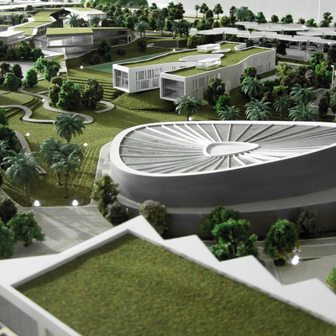
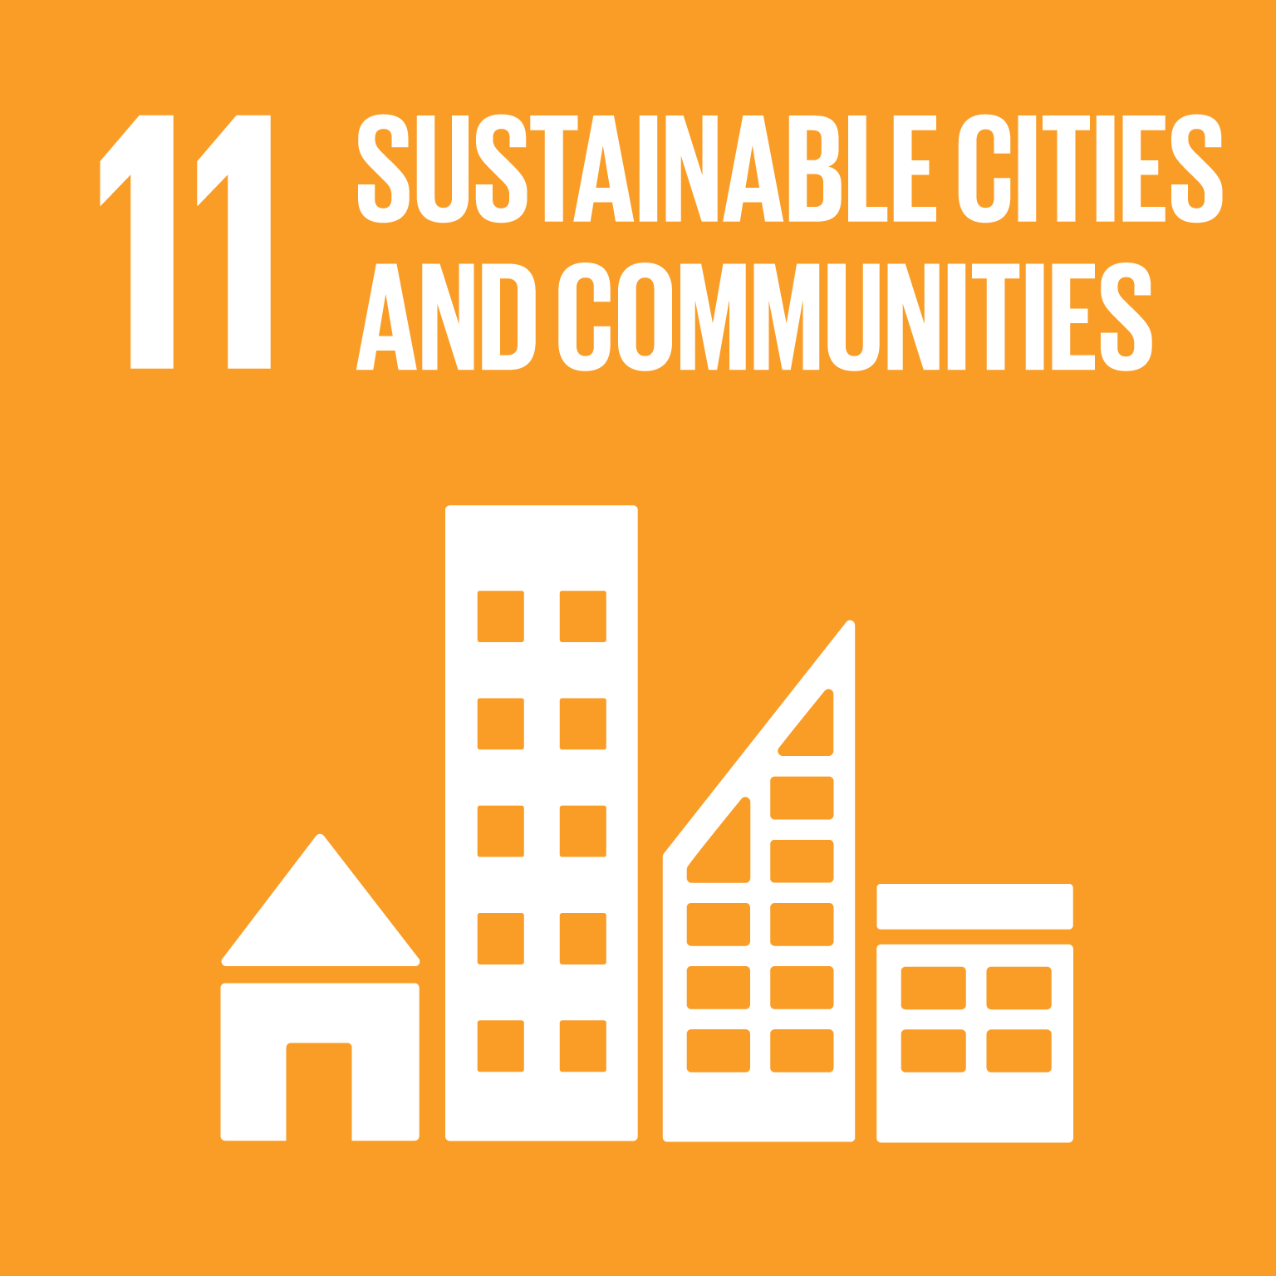
The role of sustainable city design in diabetes
Implementation in BIOS5200
Sustainable city design and exercise
Cities Changing Diabetes – interesting websites for students to look at
Students can improve their systems thinking by discussing the role that ample exercise has on diabetes and its management, which would fit into the diabetes and insulin topic when talking on type 2 diabetes treatment.
Students could be asked about what sustainable aspects of a city help to tackle the increase in diabetes cases worldwide e.g., easy access to cycling, walking and less car dependant infrastructure.
This could segway into the role of AMPK in exercise and its use in diabetes management. ‘
Exercise has been proven to be a viable treatment in patients with type 2 diabetes through the encouragement of weight-loss and lipid metabolism.
aerobic exercise is a well-established way to reduce HbA1c, HbA1c is the number of glycated haemoglobin and is a good indicator of diabetes progression
A sustainable city design is a city design that considers the social, economic, and environmental impact of urban development. A sustainable city aims to reduce air pollution and CO2 emissions, enhance air quality, and protect natural resources
More sustainable city design would include more opportunities for people to walk or cycle to their destinations instead of taking cars which would also encourage exercise. And reduce CO2 emissions.
Diabetes and climate change – PubMed (nih.gov)
The essential role of exercise in the management of type 2 diabetes – PubMed (nih.gov)
Notes:
‘Notably, aerobic exercise is a well-established way to improve HbA1c, and strong evidence exists with regard to the effects of aerobic activity on weight loss and the enhanced regulation of lipid and lipoprotein metabolism.’
Systems thinking: Systems thinking is a way of approaching problems that analyses how all the elements within a system influence one another. It is the ability to recognise and understand cause and effect in complex systems.
Problem solving competency

Slide 35
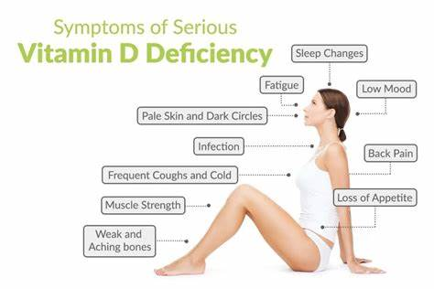
The role of sustainable city design in vitamin D deficiency
Implementation in BIOS5200
Sustainable city design and Vitamin D
This would be an interesting discussion point for students when discussing the sources of vitamin D and the causes of diseases like rickets.
This could encourage systems thinking when looking at sustainable cities and how they can benefit our health.
A study has shown that veterans that lived in large metropolitan areas, cities typically walkable and less dependent on cars, had the least cases of vitamin D deficiency.
One reason for this could be that people are more encouraged to go outside which would allow for more UV rays to start the process of vitamin D production in the skin.
Notes:
Systems thinking: Systems thinking is a way of approaching problems that analyses how all the elements within a system influence one another. It is the ability to recognise and understand cause and effect in complex systems.
Problem solving competency

Slide 36
BIOS5210: Metabolism and Metabolic Regulation
Dami Kuye

Slide 37
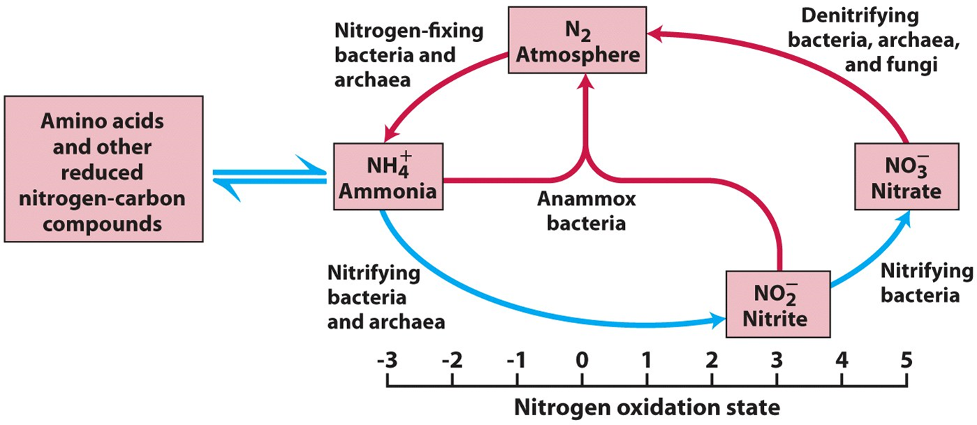
Sustainability in Nitrogen Metabolism
This can be incorporated seamlessly into the BIOS5210 curriculum as microbes play a big part in climate change and the production of greenhouse gasses through their metabolism.
Can be mentioned when talking about the denitrification process of the nitrogen cycle. Solutions like using less nitrogen fertilizers and using nitrification inhibitors can be mentioned.
Nitrogen fixation
Where nitrogen atoms are cycled through living and non-living systems
Denitrification
The process where nitrate (NO3) is converted to dinitrogen (N2). Nitrous oxide (N2O) produced as an intermediate.
Nitrous oxide
A greenhouse gas 300 times more potent than CO2 that lasts up to 114 years in the atmosphere.
75% of N2O emissions are caused by the agricultural industry and the use of nitrogen fertilizers in soil where denitrifying bacteria produce N2O under anaerobic conditions.
Notes:
N2O is a super-pollutant 300 times more potent than CO2 and has a lifespan of 114 years
Makes up 6% of greenhouse gasses in atmosphere but hasn’t been addressed or included in the Montreal Protocol to reduce greenhouse gasses affecting the ozone layer as for its pollutant capabilities bc its so closely linked to agriculture and food production
Nitrous oxide emissions caused by nitrogen loss in soil can be caused by waterlogging or temperature changes in the soil which are much more common now due to climate change.
Can also be exasperated by nitrogen fertilizers used in soil normally dependant on the type of fertilizer used. Positive relationship found with amount of nitrogen fertilizer used in tropical and subtropical regions and N2O emissions.
This can all be mentioned very easily when addressing denitrifying bacteria and could help students with understanding the nitrogen cycle with more real world applications as well as bring awareness and keep climate change in conversation.
Potential solutions can be presented to students like using less nitrogen fertilizer, nitrification inhibitors and preventing waterlogging which all address the issue of nitrogen loss in the soil.
Another change that students could personally make would be to shop more locally and getting produce from smaller independent farmer’s markets and community gardens.
industrial farming doesn’t have the capability to personally address every case of waterlogged soil due to the sheer magnitude of production. Individual farmers would have an easier time holding themselves accountable and have less chance of over fertilizing their soil. Could also mention any health benefits to locally grown organic produce or and the reduction of carbon emissions too.

Slide 38
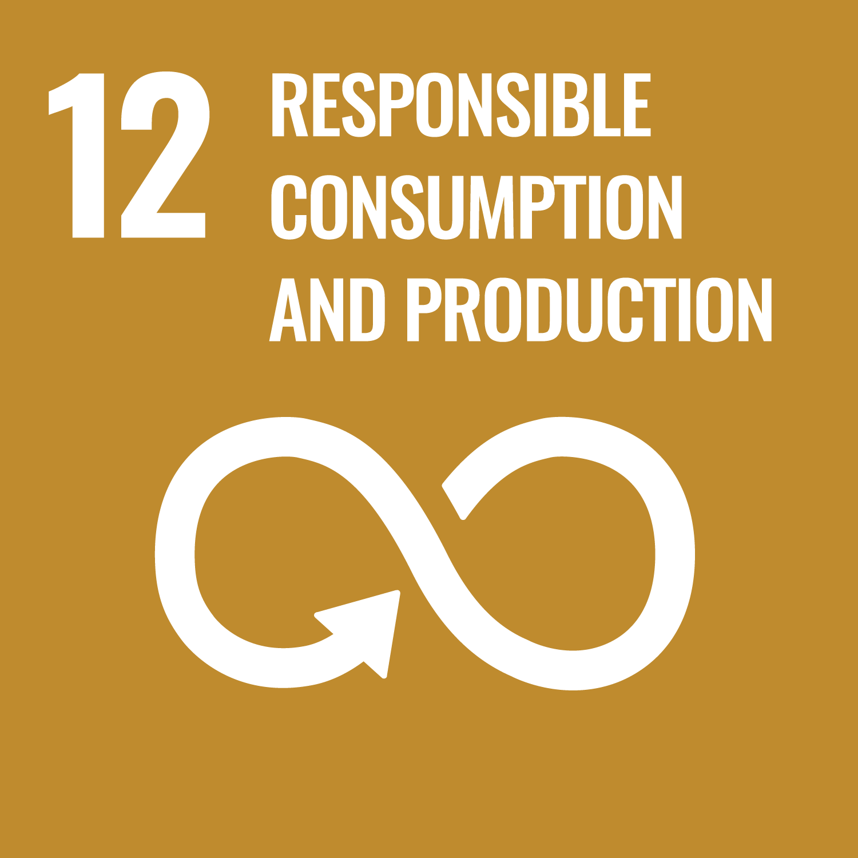
Biocatalysts as sustainable alternative to other industrialised processes of producing organic materials
Biocatalysts and sustainability
Implementation in BIOS5210
Can be mentioned when talking about biodegradation and the advantages of using biocatalysts.
We can ask students why they think biocatalysts would be a sustainable/viable option compared to linear models of production (vexox or discussion forum post).
Can frame it as problem solving e.g. ‘There’s a problem with food and agricultural waste buildup in landfills that turns into CO2 and CH4 emissions, do you have any ideas on how biocatalysts could be used to help mitigate this process?’
Biocatalysts use a circular economy as they can utilise organic waste products to produce desired products.
We can use agricultural waste products, food waste and products from landfills to extract triglycerides and lignocellulosic biomass.
‘Food wastes contain a high content of lignocellulose, starch, and triglyceride which can break down into fatty acids and glycerol, sugar, lignocellulose, and GHGs.’
Enzymes, In Vivo Biocatalysis, and Metabolic Engineering for Enabling a Circular Economy and Sustainability – PubMed (nih.gov)
Notes:
Systems thinking: Systems thinking is a way of approaching problems that analyses how all the elements within a system influence one another. It is the ability to recognise and understand cause and effect in complex systems.
Problem solving competency

Slide 39
BIOS5250: Investigation of Disease
Dami Kuye

Slide 40
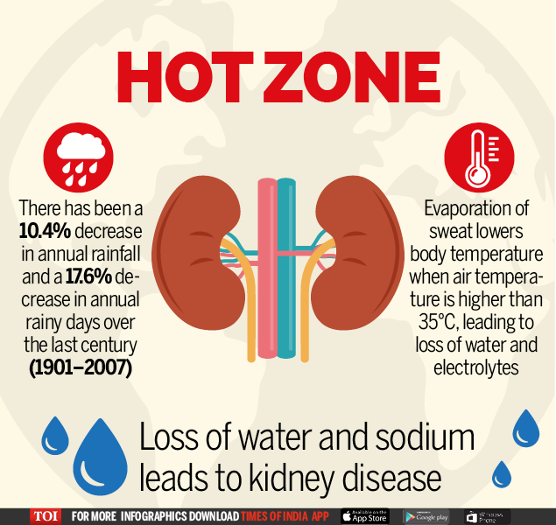
Climate change and its effect on the kidneys
Heatwaves and kidneys
Implementation in BIOS5250
The sharp increase in the number of heatwaves worldwide due to climate change is causing an increase in the number of people admitting to hospitals with AKI.
There are journals that demonstrate how the kidneys are the main site of damage in heat-related injury. Heatstroke creates major risk for kidney injury especially for those exercising or working while exposed to extreme temperatures.
This would be a good opportunity to demonstrate how the kidney could lose function due to heat-stress and can be outlined as a cause of AKI or CKD in a case study using an agricultural worker in a heat exposed country as an example.
This proves to be helpful in educating the students on what AKI can be caused by, using realistic examples while also keeping climate change in conversation. Students would be reminded of the bigger picture rather than just focusing on kidney physiology in a clinical setting.
Students could also be asked for solutions or treatments they would recommend to the example in the case study which would home in on their problem-solving and critical thinking skills.
Climate Change and the Kidney - PubMed (nih.gov)
Notes:
Systems thinking: Systems thinking is a way of approaching problems that analyses how all the elements within a system influence one another. It is the ability to recognise and understand cause and effect in complex systems.
Problem solving competency

Slide 41
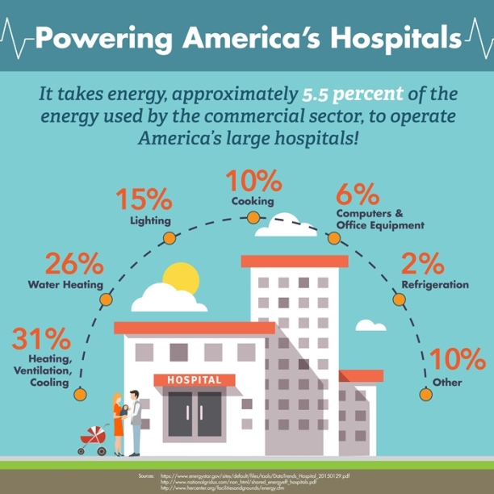
Sustainability in hospitals and the importance of disease prevention
Implementation in BIOS5250
Sustainability in the hospital setting
The module has a big focus on employability in clinical sciences as well as common diseases that would be tested in such a setting, and taking the time to discuss sustainability in hospital settings would be another opportunity to remind students of the roles they could play in sustainability in future employment.
Students could be asked to discuss areas where energy consumption within hospitals could negatively and positively contribute to sustainability. Mentioning how much water and energy is consumed by hospitals daily would help them to see the bigger picture regarding climate change.
Looking at the sustainability of hospitals as a whole would help students to further understand the importance of prevention in diseases like CKD and liver disease as well as signify the importance of screening programmes in the UK.
This also would exercise student’s systems thinking competency regarding sustainability, by looking at hospitals as a whole system they would be able to understand how elements within a system would influence each other and how cause and effect come into play in a hospital setting.
Environmental sustainability in hospitals - a systematic review and research agenda - PubMed (nih.gov)
Notes:
Systems thinking: Systems thinking is a way of approaching problems that analyses how all the elements within a system influence one another. It is the ability to recognise and understand cause and effect in complex systems.
Problem solving competency

Slide 42
BIOS5470: Plant Physiology and Disease
Dami Kuye

Slide 43
Precision farming and circular economy in agriculture
Soil and crop management to save food and enhance food security - ScienceDirect
Precision Agriculture | Nesta
Precision Agriculture | Nesta
Circular agriculture for sustainable rural development (un.org)
Circular economy in agriculture
What is precision farming?
Circular economy encourages the reuse and recycling of materials, in agriculture this would include using minimal amounts of external inputs, closing nutrients loops, regenerating soils, and minimizing the impact on the environment.
Examples of circular economy in agriculture would be:
Manure and food waste as fertiliser and using wastewater in irrigation.
Mixed crop farming where crop diversity encourages soil fertility and increases yield while reducing inputs.
Encouraging students to learn about circular economy would greatly increase their systems thinking in understanding how different practices in agriculture could aggravate issues like climate change.
This could be done through vevox questions or discussions posts encouraging students to research examples of circular economy in agriculture.
Precision farming is the practice of only using the precise amount of nutrients in farm management by using satellite position data, remote sensing devices and proximal data gathering technologies.
This would drastically reduce the amount of food waste and greenhouse gas emissions caused by farm runoff due to over-fertilisation.
This concept could be easily introduced into the BIOS5470 module while taking about the process of plant growth and the new ideas that come with agriculture in sustainability. this would also improve student’s system’s thinking as they would be able to apply their knowledge to a relevant industry.
Notes:
Systems thinking: Systems thinking is a way of approaching problems that analyses how all the elements within a system influence one another. It is the ability to recognise and understand cause and effect in complex systems.
Problem solving competency

Slide 44
BIOS5480: The Microbial World
Dami Kuye

Slide 45
The sustainable role that biofilms play in wastewater treatment
Biofilms and wastewater treatment
Implementation in BIOS5480
Biofilms play an environmentally friendly role in the process of wastewater treatment as they are energy efficient and are low cost as well as having the ability to absorb specific nutrients and organic pollutants from wastewater.
‘Biofilms-based reactors due to their economic and ecofriendly nature are used for the treatment of industrial wastewaters. Electrodes coated with electro-active biofilm (EAB) which are obtained from sewage sludge, activated sludge, or industrial and domestic effluents are getting popularity in bioremediation.’
This would fit in well when discussing the beneficial roles that biofilms play in systems that we use daily. It would allow students to informed on the sustainable role that bacteria can play in infrastructure and allow them to advocate for these more environmentally friendly and energy effective methods of treatment.
This would also be a good opportunity to encourage critical thinking in students if they were to be asked how they think bacteria could play a beneficial role in systems like wastewater management as well as the shortcomings like the chance of spreading antibacterial resistance to the environment.
Provided students can understand that bacteria can use organic material in wastewater which would link into the previous lecture on microbial culturing and growth.
Exploring the role of microbial biofilm for industrial effluents treatment – PMC (nih.gov)
Notes:
Systems thinking: Systems thinking is a way of approaching problems that analyses how all the elements within a system influence one another. It is the ability to recognise and understand cause and effect in complex systems.
Problem solving competency

Slide 46
BIOS5490: The Genome
Dami Kuye

Slide 47
CRISPR in sustainability
https://youtu.be/6tw_JVz_IEc - TEDed video on CRISPR
Incorporation into BIOS5490
CRISPR and gene editing
This module goes over the CRISPR system and its functions and could be a good opportunity to mention the benefits that gene editing using methods like CRISPR could have on sustainability.
Being able to identify where gene editing would be useful in the form of a vevox questionnaire, or a discussion forum could be a good activity for students.
This would also help with student’s critical thinking and systems thinking as it would encourage innovative thinking in students while deepening their understanding on the genome and how it works in a real-world setting.
CRISPR gene editing is a powerful tool in sustainability, where a synthetic guide RNA is used to edit the desired sequence while utilising the CRISPR-cas9 bacterial antiviral defence system.
An example of this would be the use of gene drives in the eradication of malaria where CRISPR is used to disrupt female fertility in mosquitoes thereby supressing the population.
Another example would be the genetic modification of crops using CRISPR. This is where crops are engineered to be more resilient to disease, famine and heat stress which would be widely beneficial in developing countries under food stress.
Responsible governance of gene editing in agriculture and the environment | Nature Biotechnology
Gene Editing Is a Key to Environmental Sustainability | Innovature
Beginning Stages of CRISPR Detection in Athletes – Dartmouth Undergraduate Journal of Science
Notes:
Systems thinking: Systems thinking is a way of approaching problems that analyses how all the elements within a system influence one another. It is the ability to recognise and understand cause and effect in complex systems.
Problem solving competency

Slide 48
What I've gotten from the project
A better understanding of sustainability and its relationship to Biosciences
More confidence in identifying areas where sustainability can be improved and ways I could go about improving them
Increased passion for sustainability

Slide 49
Thank you
Dami Kuye
dk396@kent.ac

