Slide 1
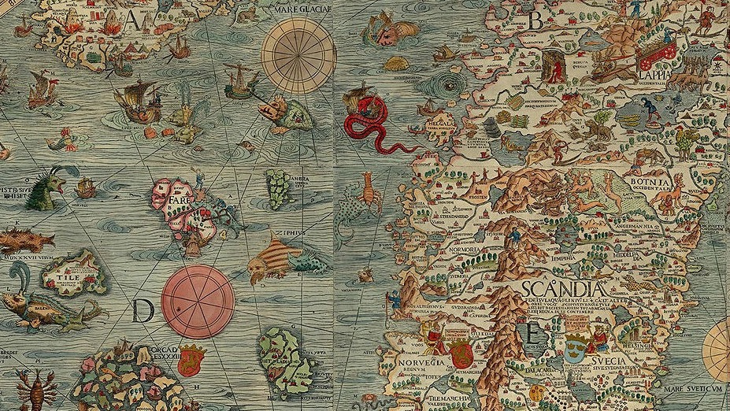
Safeguarding Separated Young Migrants
Dr Rachel Larkin
University of Kent

Slide 3
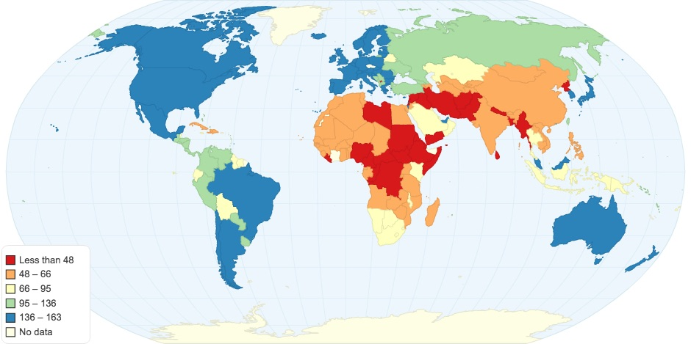
Passports and ‘Paper’ Borders
United Arab Emirates 180
USA and UK 172
Albania 117
S Africa 107
Syria 39
Afghanistan 39
The UK is home to approx. 1% of the 27.1 million refugees forcibly displaced across the world. (Refugee Council 2023)
Passport Index https://www.passportindex.org/byRank.php
2022 - 5 main countries of origin: Syria, Venezuela, Afghanistan, South Sudan, Myanmar
2022 - 5 main ‘host’ countries: Turkey, Germany, Pakistan, Uganda, Russia

Slide 4
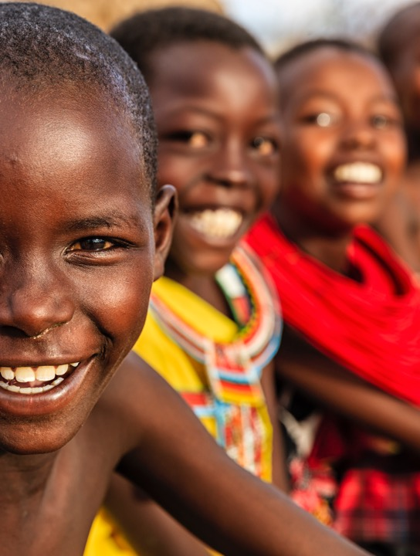
Post-Colonialism
Off-shore detention held up as evidence of ‘the persistence of the very structures of colonialism and practices of control’
(Giannacopoulos and Loughnan 2020).
Acts intended as care can be based on notions of post-colonial ‘white rescue’, which frame people of colour as ‘charitable subjects’ – and some lives are seen as less grievable than others
(Danewid 2017).

Slide 5
Children on the Move: SOCIAL WORK IN A Global COntext

Slide 6
Child and Youth Migration (UNHCR 2023)
At end of 2022, estimated 43.3 million children lived in forced displacement – record number
60% were internally displaced by conflict and violence
estimated 17m children crossed national borders
Children (under 18) made up about 40% of displaced populations in 2022
Climate Change:
1.2 billion people could be at risk of displacement by 2050 (UNHCR 2021)

Slide 7
UK Context
At 31 March 2022, English LAs were caring for 5,570 unaccompanied young people
- 95% male
- 87% were 16 +
English LAs supporting 11,650 former UASC care leavers aged 17-21.
- 91 % were male.
In 2022, 5,836 under 18s applied for asylum
446 Females
5,360 Males
30 ’unknown’ sex (Home Office 2023)
Afghanistan main country of origin for young men
Eritrea main country of origin for young women

Slide 8
Why do children and young people move?
Community violence/War
Physical/sexual violence
Forced recruitment
Death of family members /reunification
Political/religious persecution
Forced marriage
FGM
Trafficking – promise of reunification/jobs
Economic and educational opportunities
Sent or sold
Famine/climate change
LGBTQ+ persecution

Slide 9
Hopes, Fears and Aspirations
I want a better life, to be safe, to protect myself, so that’s why I choose to live in the UK
Education I found is very important because a lot of women or young lady in my country, they’re not allowed to complete them education
I wear a hijab or not, so it is my choice. In my country I do not have that freedom
Here I be like, if I’m 15 or 16 I’m underage .. no one can force me to marry.
I can have a better future, if I have a bad past experience
I have a voice
(Grace, in Larkin 2022)

Slide 10
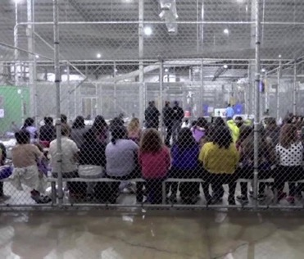
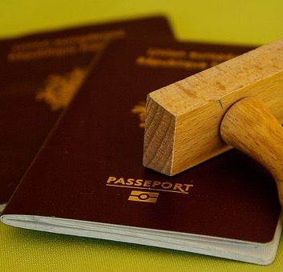
Journeys
Journeys can be swift or prolonged. Making strategic decisions at every stage
Children may leave alone, or with siblings/peers. Or can leave with adults and become separated on the way
Young people can form significant friendships and mutually caring relationships (Rosen, Crafter and Mitra 2021)
Violence and abuse are commonly reported, including ‘transactional sex’ for crossings – borders are high risk spaces
Many EU States now have laws against the intentional assistance of someone who is not a ‘national’. The ‘criminalisation of solidarity’ (ReSoma 2020)
Social workers can be involved in separation of children at borders

Slide 11
Global Context: UN Convention on rights of the child (UNCRC)
Article 22 (refugee children) If a child is seeking refuge or has refugee status, governments must provide them with appropriate protection and assistance to help them enjoy all the rights in the Convention. Governments must help refugee children who are separated from their parents to be reunited with them.
Article 35 (abduction, sale and trafficking) Governments must protect children from being abducted, sold or moved illegally to a different place in or outside their country for the purpose of exploitation.
Article 3 of the UNCRC obligates states to ensure the best interests of the child are a primary consideration in all actions concerning the child.

Slide 12
Key categories for children
Unaccompanied:
‘children under 18 years of age who have been separated from both parents and are not being cared for by an adult who, by law or custom, is responsible to do so’ (UNHCR 2004)
Refugee:
‘someone who is unable or unwilling to return to their country of origin owing to a well-founded fear of being persecuted for reasons of race, religion, nationality, membership of a particular social group, or political opinion’ (UNHCR 1951)
Trafficking:
‘the recruitment, transportation, transfer, harbouring, or receipt of persons by improper means (such as force, abduction, fraud, or coercion) for an improper purpose including forced labour or sexual exploitation’ (UN 2018)
UN
National Law/Policy
Local policy/procedure
Practitioner

Slide 13
In June 2023 UNICEF said states should be:
Recognising refugee, migrant and displaced children as children first and foremost – with rights to protection, inclusion, and participation
Providing safe and legal pathways for children to move, seek asylum and reunite with family
Ensuring no child is detained because of their migration status or returned without safeguards unless return has been determined to be in a child’s best interests
Strengthening national education, health, child protection and social protection systems to include displaced children without discrimination
Investing in national child protection systems to better protect children on the move at risk from exploitation and violence, particularly unaccompanied children
Listening to and meaningfully engaging displaced children in finding solutions that are sustainable and inclusive and that can help them realize their full potential
‘a continuum of protection, care and services’ (Global Compact on Refugees 2018 p34).

Slide 14
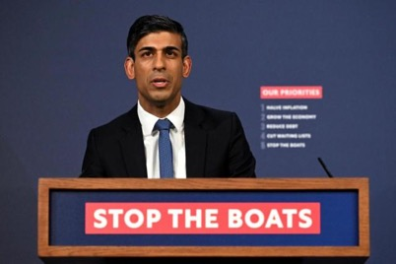
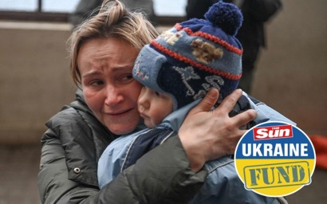
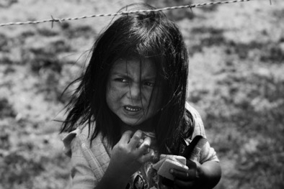
Here’s how YOU can help the one million innocent refugees fleeing Ukraine

Slide 15
I was expecting a lot more almost traumatised, shell-shocked young people
I wasn’t expecting them to be as assertive
Why am I expecting something different because they’re a refugee? ‘Susan’ in Larkin (2022)
The ways social workers think and feel about young migrants can shape how refugee children are seen, and how they see others, in spaces where practitioners and young migrants meet.
These can impact what happens to young people (e.g. the ‘grateful’ refugee)
Young people can absorb narratives into their sense of self
What would I want her to be, in order to look like a worthy asylum seeker?
‘Alice’ in Larkin (2022)

Slide 16
Black girlhood
The sexualisation of black girls’ bodies can mean social workers are more likely to see black girls as promiscuous, as complicit in their sexual exploitation rather than as survivors (Constance-Huggins et al. 2021, Jean et al. 2022).
Muslim young women can be seen as passive (Miled 2020) but can also be framed as a threat (Larkin 2022)
Need to be wary of post-colonial narratives which construct women of colour as in need of rescue from their ‘oppressive’ cultures (Gray and Franck 2019)

Slide 17
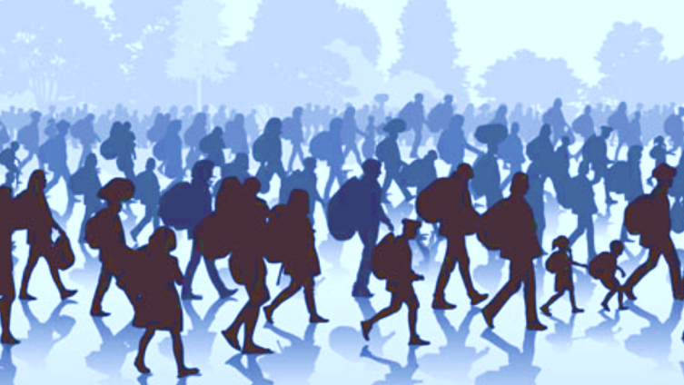
Safeguarding Young Migrants in the UK

Slide 18
UK LEGISLATIVE FRAMEWORK
Human Rights Act 1998 /Section 55 of Borders, Citizenship and Immigration Act 2009
Home Office duty to have regard, in all its functions, to the safeguarding and welfare of children in the UK
Children Act 1989 (and equivalent Welsh/N. Irish/Scottish acts)
In the UK children entitled to the same care and protection as citizen children.
Children first - Migrants second (Ang 2019)

Slide 19
Nationality and Borders Act 2022
Commitment to ‘scientific’ age assessment
National Age Assessment Board and medical methods.
Centralisation of decision-making
Powers for the Home Office to override the decisions of local authorities about young people in their care
Deprivation of nationality without notice, leading to risks of statelessness, including for children.
Off-shore ‘processing’ facilities
Government says UASC claims will not be processed overseas but unclear how disputed ages will be dealt with.
Children will not be exempt from removal – Home Office does not ‘generally expect children to be a priority’ for removal
Make the National Transfer Scheme mandatory for all local authorities

Slide 20
Who is a child?
Globally age assessment has been seen as a means of preventing child detention and ensuring children are protected.
UNHCR (2012) states age assessment should be a ‘measure of last resort’ (p. 109) and take place in a ‘safe, child and gender sensitive manner with due respect for human dignity’ (p 108)
BUT…
Research has indicated age assessment processes are deeply flawed (Kenny and Loughry 2018)
- ‘imprecise, inaccurate and inconclusive’ methods of measuring bodies (Mishori 2019) within cultures of disbelief
Calls for social workers to withdraw and age assessments to be stopped (Ortiz 2019).
‘the worst thing I can remember they made me sit there and like a slave market other immigration officers were told to look at me and guess my age’
(16 year old boy from Iran, quoted in Children’s Commissioner 2017 p12).

Slide 21
Age Assessment in the UK
In 2020 Home Office Guidance to the Kent Intake Unit (withdrawn in 2022) stated: “primary objective 1” was for social workers to provide opinions on the age of young people and “primary objective 2”, was providing social work support where there are “immediate welfare concerns”
Are age assessments an ethical and effective method of protection?
Can all young migrants truly consent to medical tests?
What role should social work play?
In response to plans for a National Age Assessment Board and reintroduction of ‘scientific’ measures BASW issued a statement:
‘Given the risk of political priorities intruding on professional objectivity, BASW is discouraging our members, as well as other social workers from applying for, or taking up, age assessment roles in the National Age Assessment Board’ (BASW 2023)

Slide 22
SAFEGUARDING and care on ARRIVAL – WHOSE ROLE?
From February 2022, LAs expected to accommodate separated young people on a rota system
Over 4,600 unaccompanied children have been accommodated in hotels since July 2021.
There have been 440 missing occurrences
Robert Jenrick, Minister for Immigration
(Hansard , Jan 24th 2023 )
The concern is the period between the child landing and being placed with a Local Authority.
The Home Office are clear that they have no statutory responsibility for this provision - the LAs state these are transient children in the care of the Home Office for whom they do not have statutory responsibility.
(Robson 2023)

Slide 23
High Court ruling July 23 2023:
Home Office's policy of placing unaccompanied asylum-seeking children in hotels was unlawful when it became “systematic and routine”
decision by Kent County Council to cease taking unaccompanied children was in breach of the Children Act 1989
agreement between Home Office and KCC that capped the number of unaccompanied children the council would take was unlawful
’we are no closer to developing a long-term response that allows us, as corporate parents, to fulfil our duties. Now is the time for a real step change towards a more sustainable system, one that is child-centred and developed in partnership’ (ADCS July 2023)
Full Judgement at : https://www.bailii.org/ew/cases/EWHC/Admin/2023/1953.html

Slide 24
Illegal Migration Act 2023 (not all in force)
People entering the UK will be removed if:
They arrive through an “illegal” route as determined by the Government, on or after 7th March 2023.
They did not come directly from the country they are fleeing.
These rules will apply to unaccompanied asylum-seeking children at 18.
When a child arrives “illegally”, their claim will be deemed inadmissible, but they will be kept in Home Office accommodation or the care of the local authority until they turn 18.
The Home Secretary has powers to remove unaccompanied children from the care of the local authority
It is vital that the measures in the Illegal Migration Act, which would create a legal basis for children to be accommodated by the Home Office, are not brought into force.
(Children’s Commissioner Oct 19th 2023)

Slide 25
What do young people say they want?
Safe place to live, with access to education, health care and networks - choices
Social workers who engage with them and understand their aspirations and their fears – and acts for them when needed
Support to tell their ‘story’ in their own time to people they trust
Support to practice their culture, in the way they choose, and help to learn about the culture in new country
Informed practitioners who understand the local social care and immigration systems
Support to maintain links with transnational families
Durable solutions – a future that is secure in their country of choice
Best Interests Rule
Participation
Survival and development
Non-discrimination
UNCRC Triangle of Rights

Slide 26
Some Good News
There are examples of resourceful, skilled, empathetic and committed practice with children in care systems across every region of the world (Crock and Benson 2018, IFSW 2021)
Young migrants in Italy and the UK have talked of carers helping them to realise their aspirations (Chase and Allsopp 2021)
Young people in English foster care have described social workers as providers of ‘advice, guidance and emotional support and encouragement’ (Wade et al. 2012, p.302)
Separated girls in Sweden, Ireland and the UK, have spoken of feeling welcomed, valued and supported, and of relationships with practitioners and carers which have sustained them (Bjerneld et al. 2018, Ní Raghallaigh and Sirriyeh 2015)
Engagement after trauma is possible when practitioners are skilled, reflective and knowledgeable (Boyles et al. 2019, Treisman 2017)
Everyday acts of practical care can build relationships which persist over time. Bonds are formed when carers position themselves as allies in navigating asylum processes and share in the emotional shifts (Drammeh 2019)

Slide 27
Communication and Engagement Skills
Language – use of interpreters
Trust and fear
Physical needs
Cultural expectations
Trauma
Disbelief
Time and place
Rigby and Whyte (2015) - assessments of potential trafficking of children could be strengthened by ‘engaging with children in a therapeutic relationship that permits children...to share their stories in a safe environment that is not associated with the immigration/prosecution paradigm’ (p.47)
‘there were about four different professionals afterwards asking her lots of questions, trying to get intelligence about this supposed trafficker…the more confident I became as a worker the more I was able to say ‘no I don’t want it done like that’.
(Eva in Larkin 2022)

Slide 28
Developing and sustaining good practice - 1
Social work is more than the provision of a service. Relationships can make a difference to young migrants – trust in and build on engagement and communication skills
Support durable relationships for young people – family, peers, carers, community
Take a rights-based approach and use this language in practice
Make contact with legal representatives for UASC and question when needed
Keep up to date – ask for training

Slide 29
Developing and sustaining good practice - 2
Be open to challenge and to reflecting on your perspectives
Using a theoretical, intersectional lenses to question power relations – what difference might gender/age/sexuality/ethnicity make here?
Keep social work values at the centre of your work and challenge excluding narratives
Remember - current practice and policies do not define the profession and are never beyond challenge.
Connect with others and get support - share knowledge within and between organisations, across borders and disciplines – LOOK UP AND LOOK OUT

Slide 30
Thank You

Slide 31
References - 1
Ang, J., ‘Working with Separated Children and Young People seeking International Protection’ in Wroe, L., Larkin, R., Maglajlic, R.A. (Eds.), (2019) Social work with refugees, asylum seekers and migrants: theory and skills for practice. Jessica Kingsley Publishers, London.p117 – 142
ADCS (2023) Comment on High Court judgement on UASC in hotels Available at https://adcs.org.uk/care/article/comment-on-high-court-judgement-on-uasc-in-hotels
Bjerneld, M., Ismail, N., & Puthoopparambil, S. J. (2018). Experiences and reflections of Somali unaccompanied girls on their first years in Sweden: A follow-up study after two decades. International Journal of Migration, Health and Social Care, 14(3), 305-317
Boyles, J., Tuner, A., & Tolman, K., (2019) Social Work with Survivors of Torture in Wroe, L., Larkin, R., & Maglajlic, R. A. (Eds.) Social work with refugees, asylum seekers and migrants: Theory and skills for practice. Jessica Kingsley, London
Chase, E., & Allsopp, J. (2021). Youth migration and the politics of wellbeing: Stories of life in transition. Bristol University Press
Constance-Huggins, M., Moore, S., & Slay, Z. (2021) Sex Trafficking of Black Girls: A Critical Race Theory Approach to Practice Journal of Progressive Human Services
Crafter, S., Rosen, R.,& Mitra, S., (2022) Children Caring on the Move Report 2 . Available at https://www.ccomstudy.com/wp-content/uploads/2022/02/CCoM-REPORT-2-FEB-2022.pdf [Accessed May 23rd 2022]
Crock, M., & Benson, L. B. (Eds.). (2018). Protecting migrant children: In search of best practice. Edward Elgar Publishing, Cheltenham
Danewid, I. (2017). White innocence in the Black Mediterranean: hospitality and the erasure of history Third World Quarterly 38, 1674-1689.

Slide 32
References - 2
Drammeh, L,. (2019). Spaces of belonging and social care in Clayton, S., Gupta, A., & Willis, K. Unaccompanied young migrants: Identity, care and justice Policy Press, Bristol
Giannacopoulos, M., & Loughnan, C. (2020). ‘Closure’ at Manus Island and carceral expansion in the open air prison. Globalizations, 17(7), 1118-1135.
Gray, H., & Franck, A. K. (2019). Refugees as/at risk: The gendered and racialized underpinnings of securitization in British media narratives. Security Dialogue, 50(3), 275-291 Jean, E. A., Neal-Barnett, A., & Stadulis, R. (2022). How We See Us: An Examination of Factors Shaping the Appraisal of Stereotypical Media Images of Black Women among Black Adolescent Girls. Sex Roles 86(5/6), 334-345
Hansard Jan 24th 2023 Unaccompanied Asylum-seeking Children Available at https://hansard.parliament.uk/commons/2023-01-24/debates/290AF292-5D7E-411C-8FB8-A6E0F288365C/UnaccompaniedAsylum-SeekingChildren
International Federation of Social Workers (IFSW) (2021) Promoting the Importance of Human Relationships: 2020 End of Year Report. Available at https://www.ifsw.org/wp-content/uploads/2021/01/2020-IFSW-End-of-Year-Report.pdf
Kenny, M. A., & Loughry, M. (2018). Addressing the limitations of age determination for unaccompanied minors: A way forward. Children and Youth Services Review, 92, 15-21
Larkin, R. (2022). Separated Migrant Young Women in State Care: Living in Contested Spaces. Palgrave Macmillan
Miled, N. (2020). ‘Can the displaced speak? Muslim refugee girls negotiating identity, home and belonging through Photovoice’. Women’s Studies International Forum, 81, 102381.

Slide 33
References - 3
Mishori R. (2019). The Use of Age Assessment in the Context of Child Migration: Imprecise, Inaccurate, Inconclusive and Endangers Children's Rights. Children (Basel, Switzerland), 6(7), 85
Ní Raghallaigh, M., & Sirriyeh, A. (2015). The negotiation of culture in foster care placements for separated refugee and asylum seeking young people in Ireland and England. Childhood, 22(2), 263-277
Ortiz, E,. (2019). Age Assessments of Unaccompanied Minors in Wroe, L., Larkin, R., & Maglajlic, R. A. (Eds). Social work with refugees, asylum seekers and migrants: Theory and skills for practice. Jessica Kingsley, London
Robson, C. (2023.). Unaccompanied Asylum-Seeking Children Scrutiny Paper. Available at https://www.bhscp.org.uk/wp-content/uploads/sites/3/2023/02/UASC-Scrutiny-Report-FINAL-23-02-2023.pdf
ReSoma (2020). The criminalisation of solidarity in Europe. Available at https://www.migpolgroup.com/wp-content/uploads/2020/03/ReSoma-criminalisation-.pdf
Treisman, K. (2017). Working with relational and developmental trauma in children and adolescents. Routledge, Taylor & Francis Group.
UNHCR (2018) Global Compact on Refugees. Available at https://www.unhcr.org/5c658aed4 UNHCR (2021) Global Trends in Forced Displacement. Available at https://www.unhcr.org/flagship-reports/globaltrends/
UNICEF (2023) Number of displaced children reaches new high of 43.3 million. 13 June 2023. Available at https://www.unicef.org/press-releases/number-displaced-children-reaches-new-high-433-million
UNHCR (2023) Figures at a Glance – available at https://www.unhcr.org/uk/figures-at-a-glance.html
Wade, J., Sirreyeh, A,. Kohli, R,. & Simmonds, J,. (2012). Fostering unaccompanied asylum-seeking young people: Creating a family life across a ‘world of difference’. British Association for Adoption and Fostering, London

