Slide 1

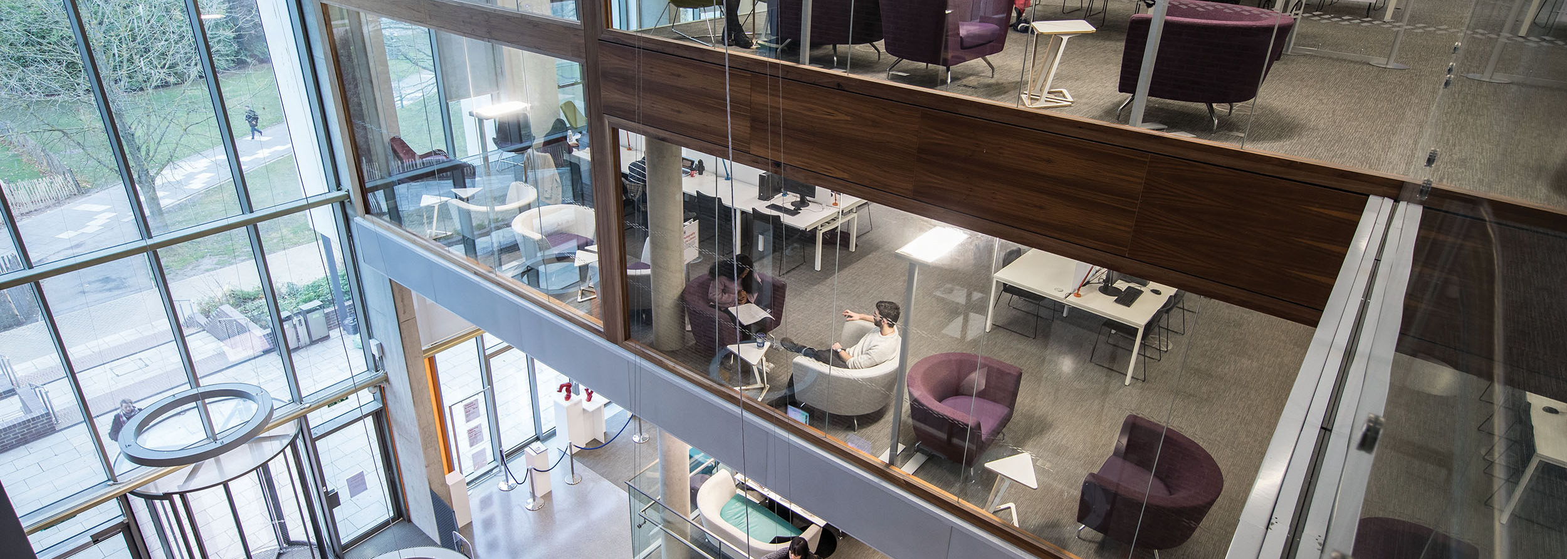
MA PROGRAMMES IN THE SCHOOL OF POLITICS AND INTERNATIONAL RELATIONS
Dr Tim Aistrope Director of Graduate Studies

Slide 2
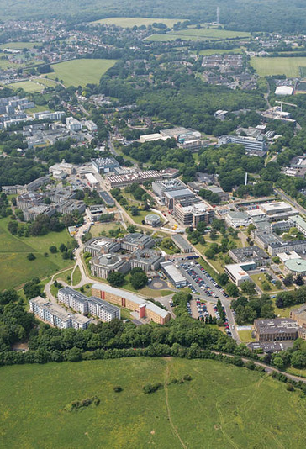
Located in the “Garden of England”
Easy access to central London and major UK airports
Teaching, accommodation and social spaces in one place
10 minutes bus to centre of Canterbury
Set in beautiful parkland
Canterbury campus

Slide 3
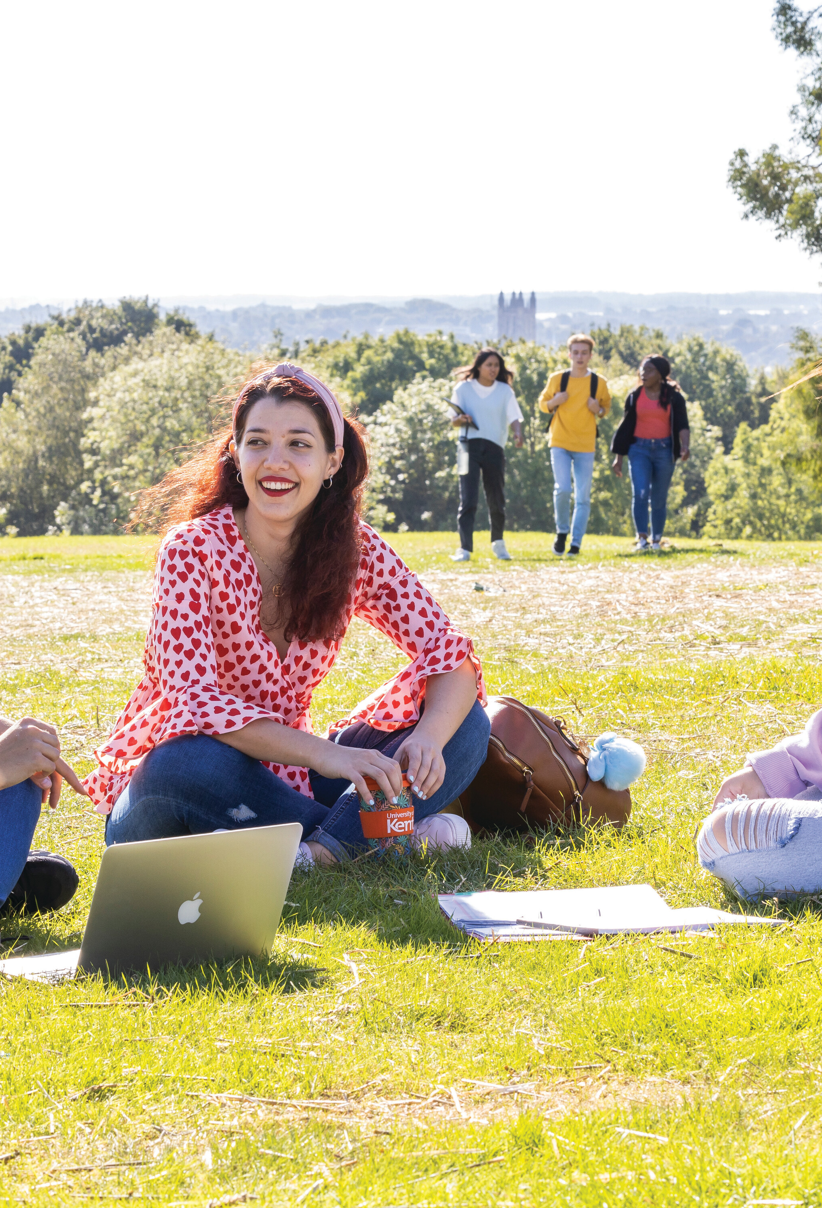
Total number of students: 18,865
Canterbury campus: 15,645
UG: 14,530
PG: 2,510
54%women, 46% men
152 countries
20% non-UK
400 institutional links around the world

Slide 4

Societies
Notes:
Updated from KU website 07.06.18

Slide 5
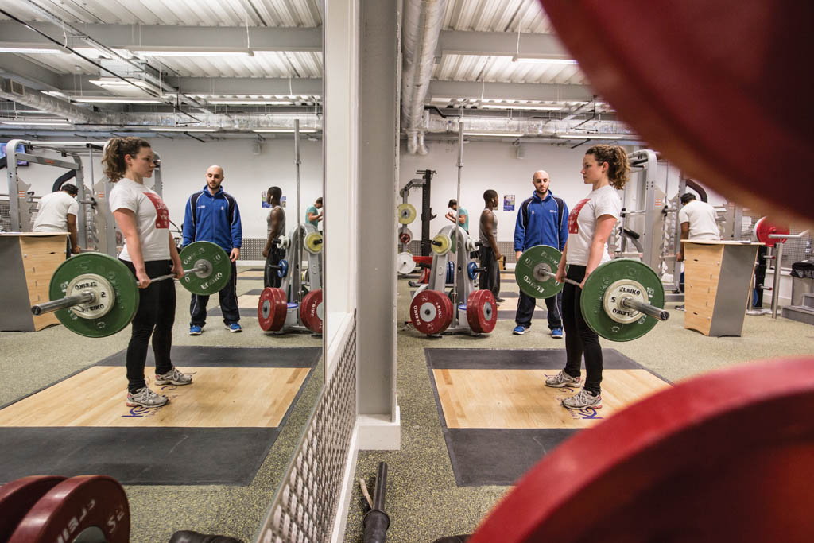
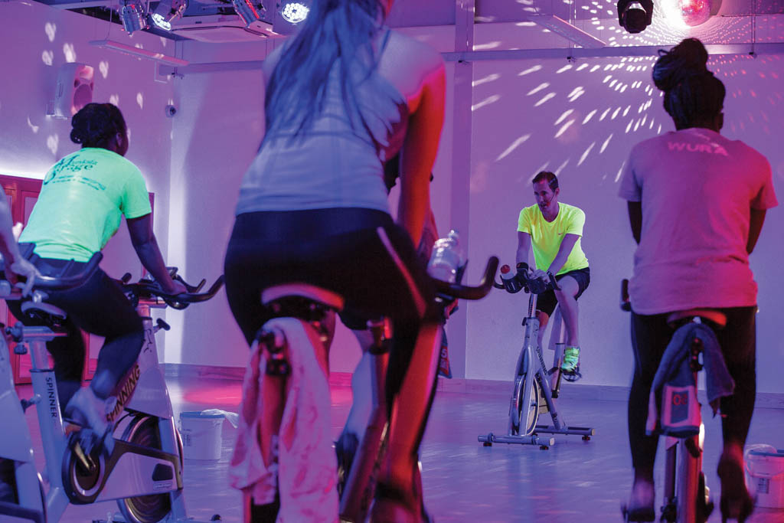
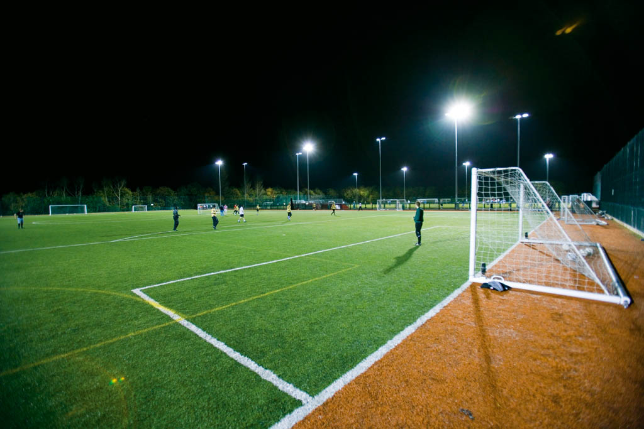
Kent Sport
Fitness suite, training and conditioning area
Multi-purpose sports halls, Sports Pavilion, range of courts and pitches
Indoor and outdoor facilities
Range of classes
Coaching and courses available
Let’s Play – 30 min activity sessions across a range of sports
Weekly Parkrun on-campus

Slide 6
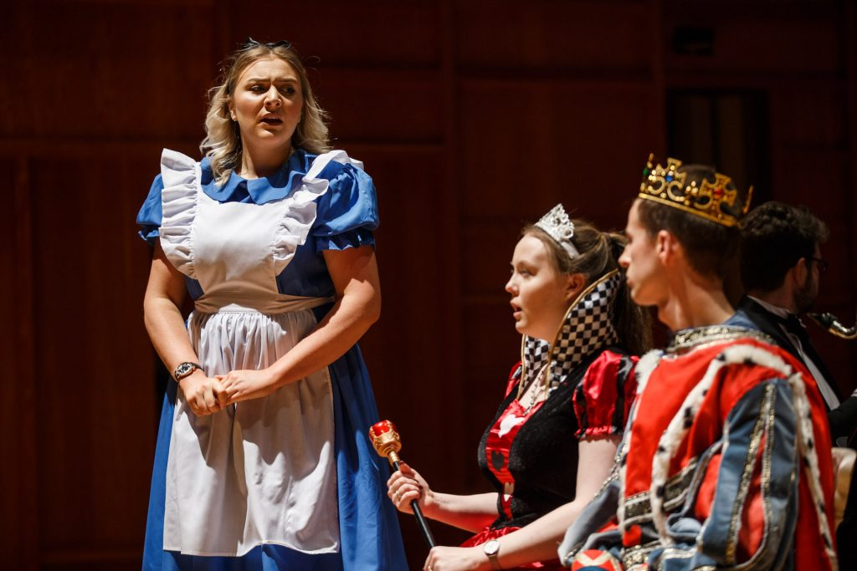

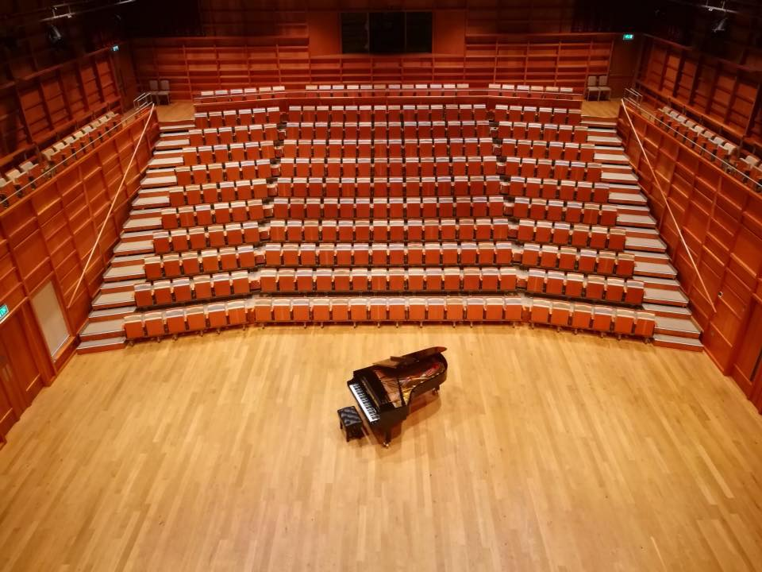
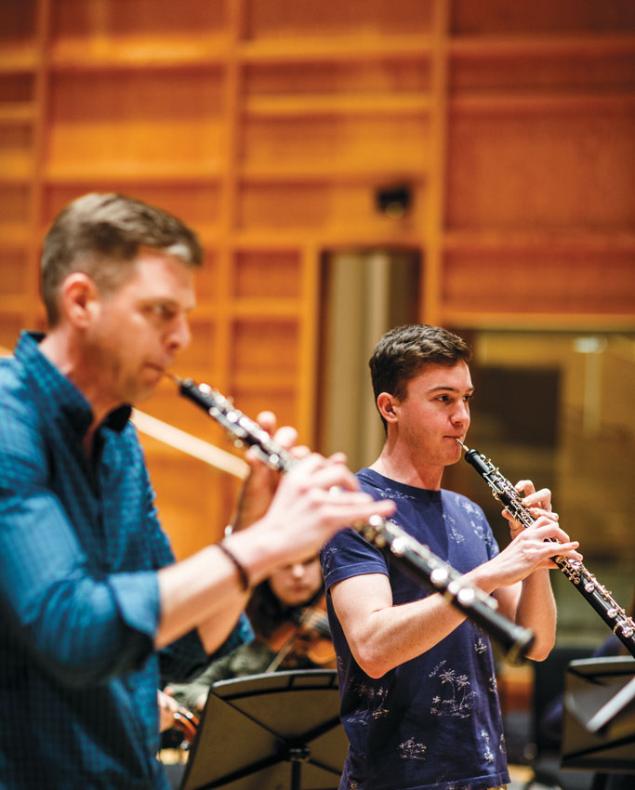
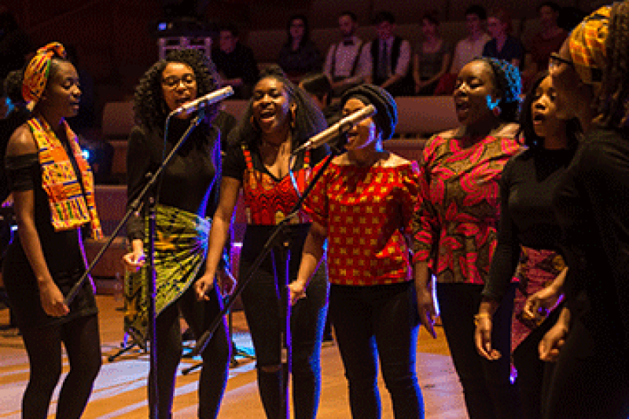
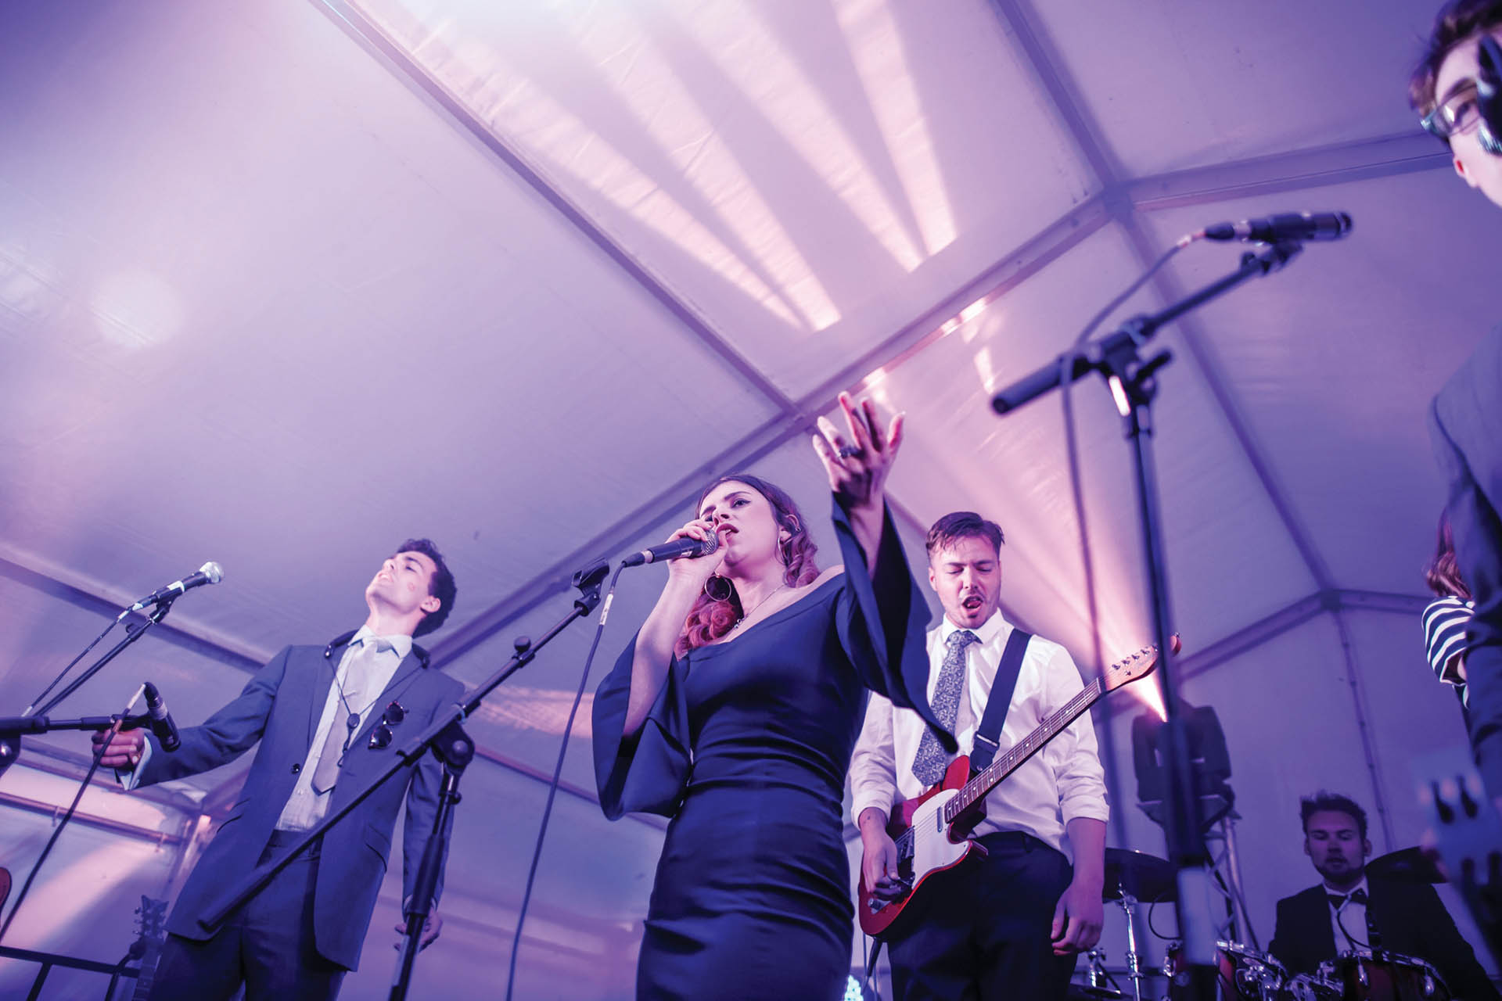
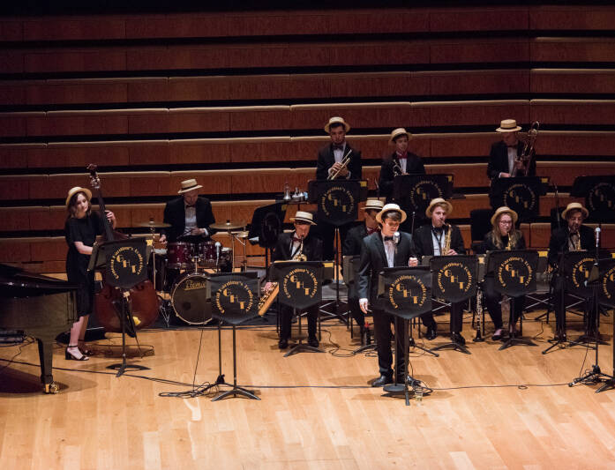
Kent Arts
Notes:
DISCUSSION POINTS:
Gulbenkian Cinema, Theatre. Gulbenkian Youth Theatre. Theatre seats 340
Performance space in the Gulbenkian café
Cinema screens blockbusters, independent films and world cinema
Gulbenkian offer a 6 week volunteer work placement for those wanting to work in the arts
Colyer Fergusson: Extra curricular music: big band, chorus, symphony orchestra
Annual family festival – bOing! Organised by the Gulbenkian
T:24 Drama Society
Music Society
Keynestock festival
WorldFest
Various music events on campus

Slide 7

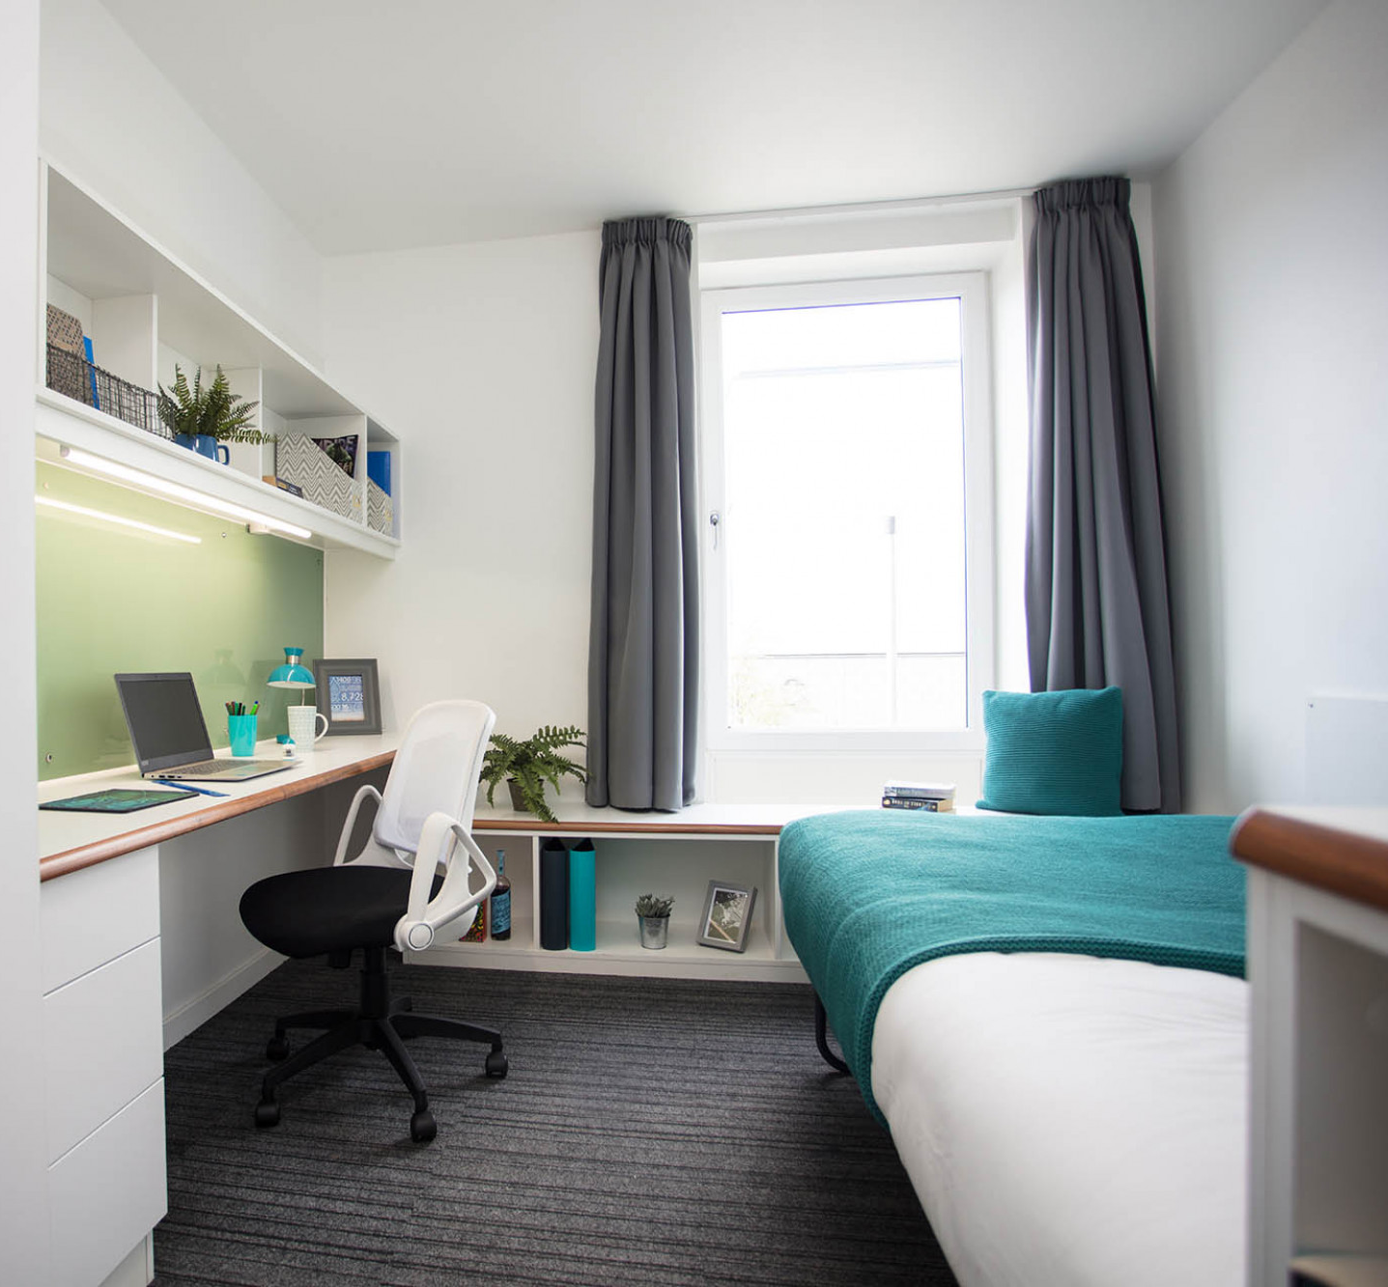
Accommodation

Slide 8
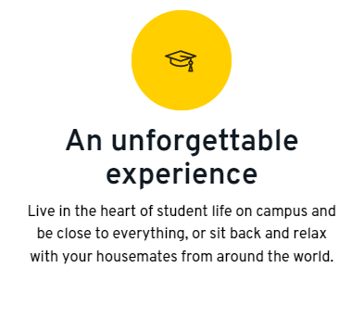



Canterbury Accommodation

Slide 9
MA International Negotiation and Conflict Resolution
MA Security and Terrorism
MA International Relations
MA International Relations and International Law
MA Peace and Conflict Studies (with Marburg)
Two year program
Includes internship

Slide 10
Programme organisation
Two modules (each 20 credits) per term across Autumn, Spring and Summer terms – 120 credits in total (one-year programme)
Compulsory and optional modules
Choices within two weeks of starting
Dissertation (60 credits)
Supervision from Spring term
Write-up over summer and submit in August
January Entry Point Spring term entry, finishing in December.
EMMA’S EXPERIENCE

Slide 11
Modules
Research Methods Training I
Analysing Word Politics
Pathways to Peace
Politics and Conflict in Sub-Saharan Africa
Security in a Changing World
Middle Eastern Politics and Society
Governance and War in Cyberspace
The Politics of Global Environmental Change
Dissertation
Conflict Resolution in Practice
Negotiation and Mediation
Resistance in Practice
Terrorism and Crimes of the State
International Ethics and Human Rights
Public Opinion: Nature and Measurement
EMMA’S EXPERIENCE

Slide 12
University services
STUDENT LEARNING ADVISORY SERVICE
Individual and group study skills
PERSONAL ACADEMIC SUPPORT SYSTEM (PASS)
Academic advice, support and guidance
Maths and Stats clinics
Progression monitoring/reporting
Academic writing
Academic advisers for every student - 1-2-1 guidance
Range of learning resources
CAREERS & EMPLOYABILITY
OTHER SERVICES
Employability points scheme
Visas
Work placements
Accommodation
Employability festival
Student Support & Wellbeing
Job shop

Slide 13
Resources
VIRTUAL VISIT:
www.kent.ac.uk/virtual-visit
COURSES
www.kent.ac.uk/courses/postgraduate
SCHOLARSHIPS:
www.kent.ac.uk/scholarships
ACCOMMODATION:
www.kent.ac.uk/accommodation

Slide 14

QUESTIONS

