Slide 1
Female genital mutilation/cutting: A global concern. A local challenge.
Orchid Project
Orchid Project
Sundial Centre

Slide 2
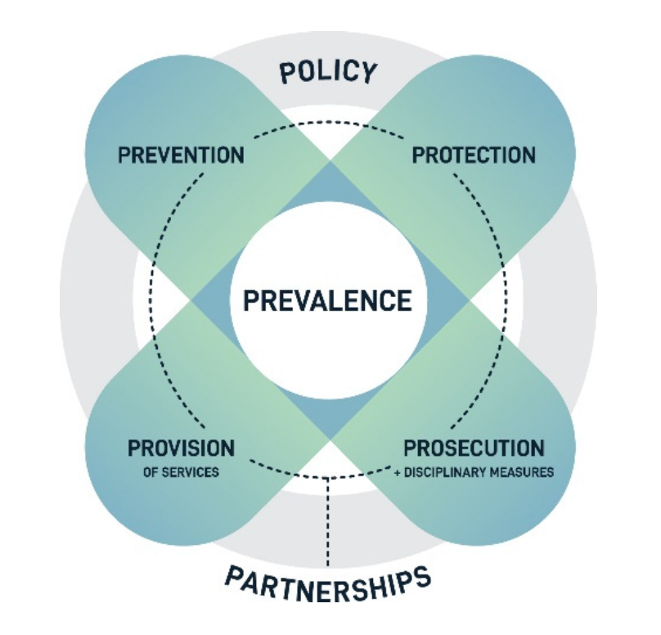
“It is important to recognise that in the 7P framework, measures can contribute to more than one P, and the delineation between the Ps is not always clear-cut.
What the model offers is the ability to pinpoint various facets that contribute to addressing gender-based violence, as this allows different entry points to the analysis of the design and effectiveness of policies put in place.”
Mergaert et al. (2023) Theorising Gender-Based Violence Policies: A 7P Framework

Slide 3
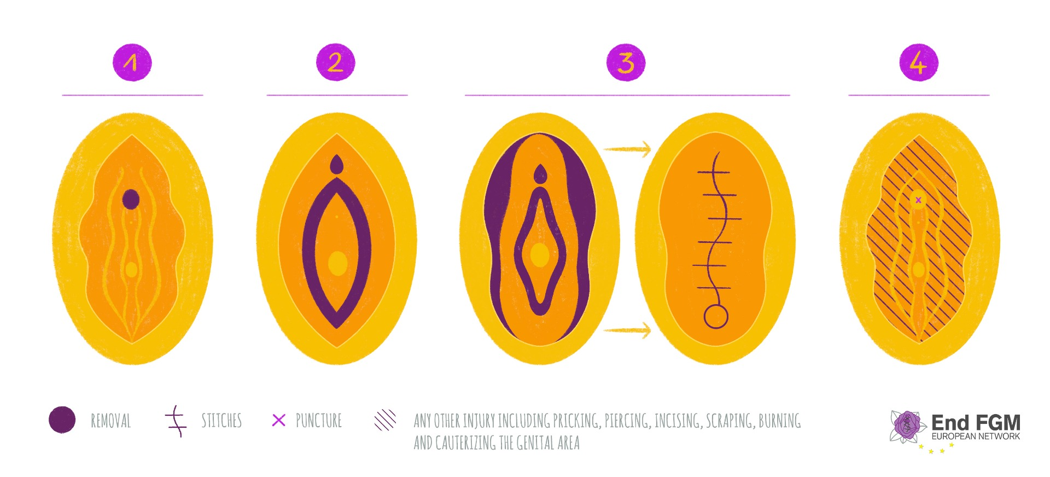
Female genital mutilation (FGM) comprises all procedures that involve partial or total removal of the external female genitalia, or other injury to the female genital organs for non-medical reasons.
World Health Organisation (nd) Types of FGM

Slide 4
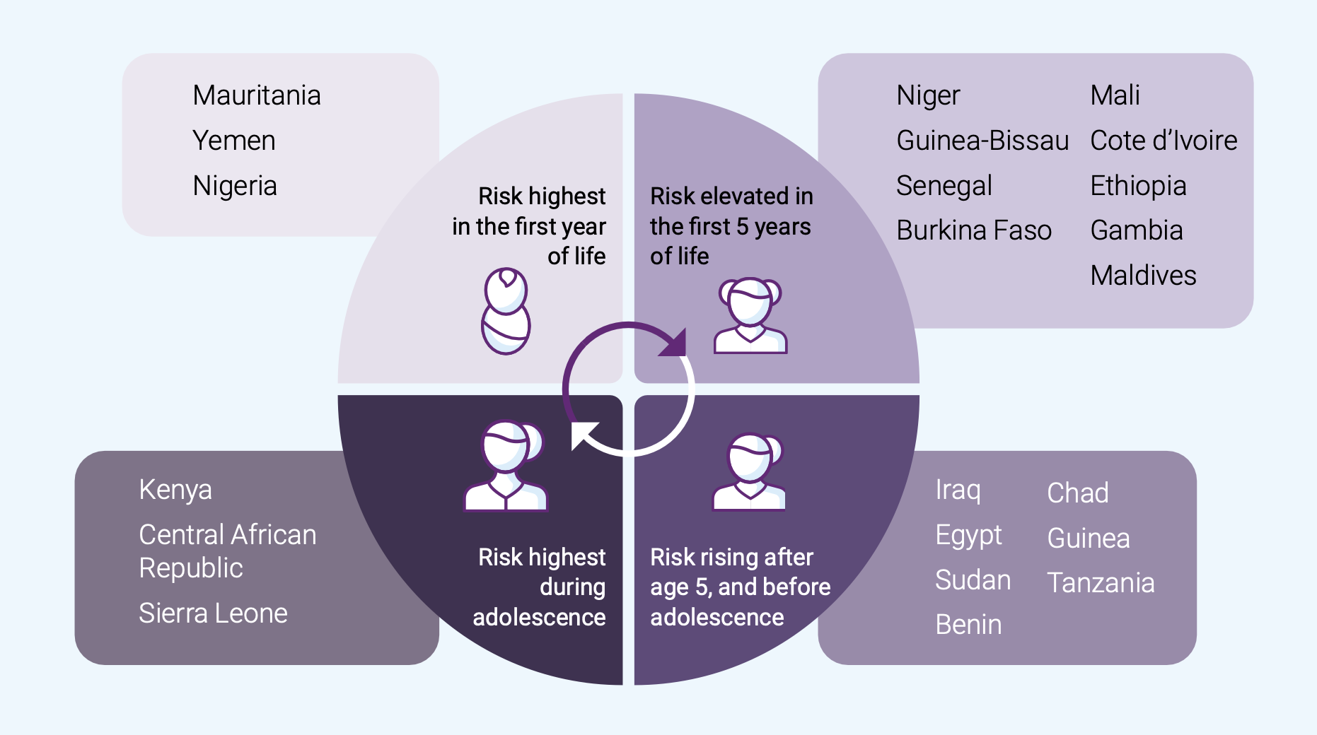
Indonesia
Malaysia
Somalia
UNFPA(2020) Tailoring steps to end FGM based on age
Notes:
6. Failure to take age of cutting into account;

Slide 5
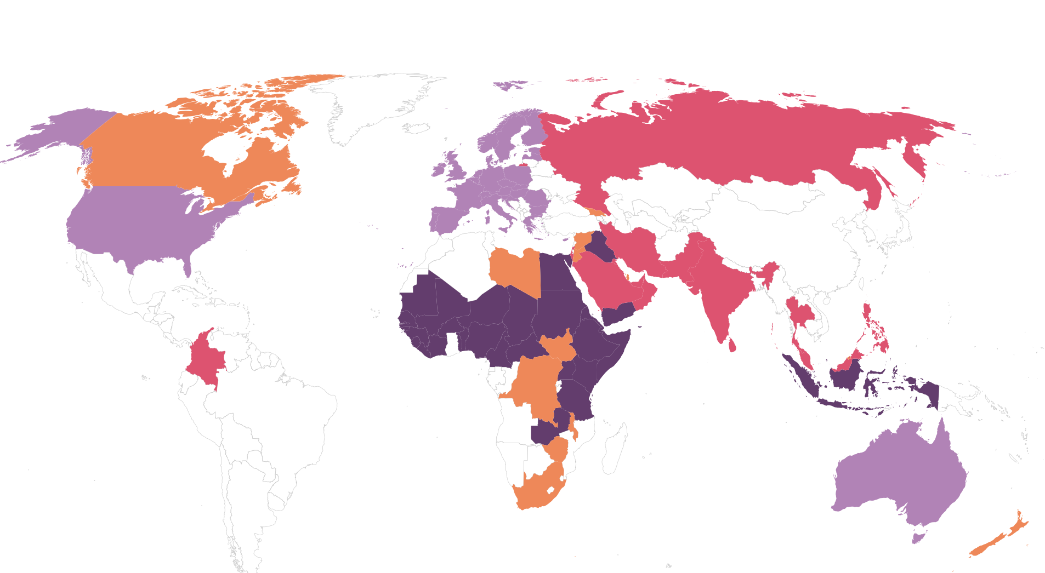
Over 90 countries:
National representative surveys (n=32)
Small-scale studies (n=15)
Indirect estimates (n=31)
Anecdotal evidence (n=15)
Equality Now et al (2020) FGM/C: A call for a global response
Notes:
Limiting the countries-of-origin considered relevant

Slide 6
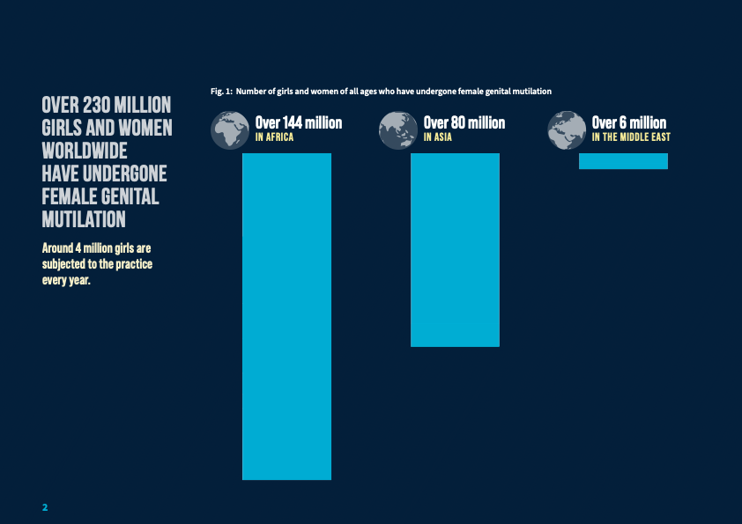
UNICEF (2024) FGM: A global concern

Slide 7
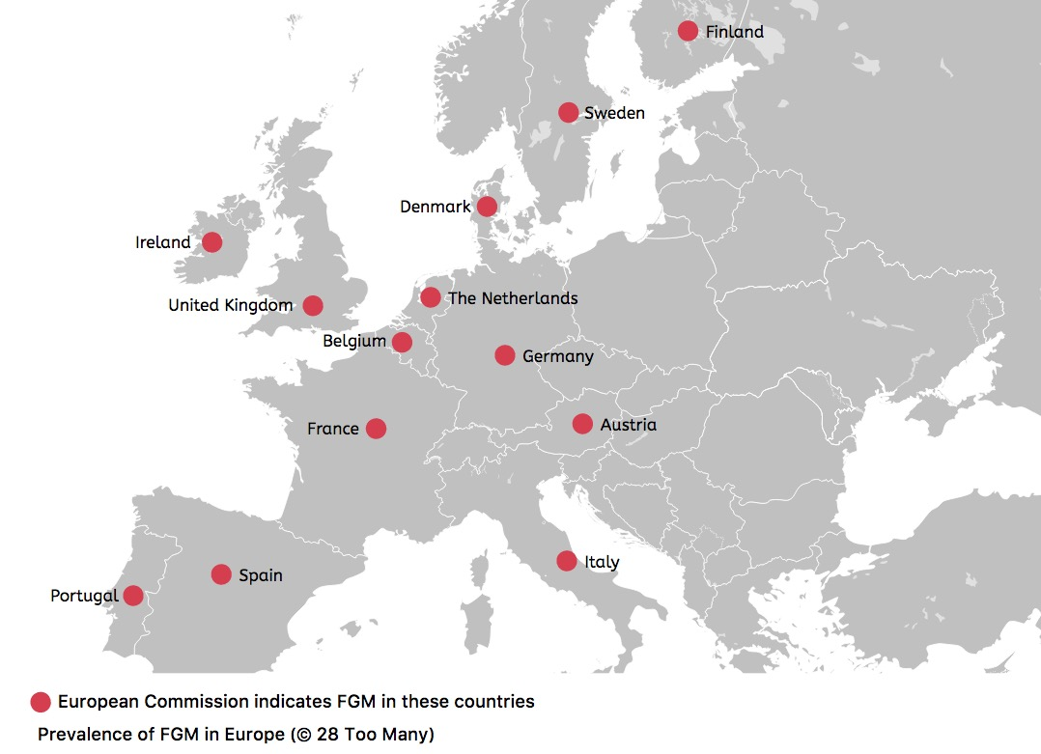
~ 500,000 in EU
~ 130,000 in UK
28 Too Many (2021) The Law and FGM in Europe

Slide 8
fgmcri.org

Slide 9
“It is important to recognise that in the 7P framework, measures can contribute to more than one P, and the delineation between the Ps is not always clear-cut.
What the model offers is the ability to pinpoint various facets that contribute to addressing gender-based violence, as this allows different entry points to the analysis of the design and effectiveness of policies put in place.”
Mergaert et al. (2023) Theorising Gender-Based Violence Policies: A 7P Framework

