Slide 1
Despite the push and pull factors they stayed: What are some of the causes, consequences and responses to girl soldiering in Africa?
Critical Conversations in Child Protection: A Webinar Series
Anastasiia Doroshenko
PhD Student, Alumna MA Advanced Child Protection
October 29th, 2024

Slide 2
Girl soldier : What do we think?
What are some of your thoughts when you hear a “girl soldier”?
Who is she?
What does her day look like?
What are her thoughts? Experiences and aspirations?
What does her life journey look like?

Slide 3
Girl soldier : What do we know?
While the phenomenon of child soldiering is centuries-old, the concept of “child soldier” underwent many changes throughout the past decades (Denov 2019).
Although war is predominantly considered a male preserve, women and girls take part in warfare to a far greater extent than is generally recognized (Brett 2002).
Estimates suggest girls make up between 6% to 50% of child soldiers (Spellings 2008).
It is argued that in international discourse, girls are invisible in terms of their unique needs and, simultaneously, too visible as “super-victims” (Park 2006, p. 316).
Child rights-based approach:
UN Convention on the Rights of the Child (1989), particularly Art. 38, Art. 39, Art. 12
Optional Protocol to the UN CRC on the Involvement of Children in Armed Conflict (2000)
“A child associated with an armed force or armed group” refers to any person below 18 years of age who is or who has been recruited or used by an armed force or armed group in any capacity, including but not limited to children, boys and girls, used as fighters, cooks, porters, spies or for sexual purposes. It does not only refer to a child who is taking or has taken a direct part in hostilities”.
The Paris Principles (2007, p.7)

Slide 4
Ecological systems theory
The ecology of human development is conceptualized as a life-long accommodation between the individual, the changing immediate environment, and the larger formal and informal social contexts (Bronfenbrenner 1997).
Ecological systems theory currently underpins international child protection policy and practice (Wulczyn et al. 2010), guiding child protection in humanitarian settings (The Alliance for Child Protection in Humanitarian Action 2019) which was the drive for including it as the theoretical lens.
Diagram 1: ECOMAP developed to depict ecological systems perspective (Guy-Evans 2020)

Slide 5
Research questions:
Applying an ecological systems framework, what are the contributing factors of girl soldiering in Africa?
Using an ecological systems perspective, what are the consequences of girl soldiering in Africa?
Using an ecological systems lens, what are the current prevention and response measures to girl soldiering in Africa?

Slide 6
Methodology:
Cumulatively these studies:
Overwhelmingly authored by researchers from and/or funded by institutions based in the Global North
Limited investigation of contributing factors from girls’ own perspectives
Disproportionate emphasis on girls’ vulnerabilities, difficulties coping and reintegrating
A dearth of longitudinal studies
A lack of investigation into prevention measures
Secondary data analysis
Literature search through the EBSCOhost Academic Complete database, Google Scholar, the Alliance for Child Protection in Humanitarian Action, chain referencing
Year range 2000-2023
Geographical scope limited to African countries
Peer-reviewed works published in English
Discussion of findings through a gender lens

Slide 7
To bear in mind throughout the presentation:
There are inherent difficulties in straightforwardly placing contextual facts in any given system.
The lived realities of conflict-affected girls differ greatly both across and within national contexts (Denov & Ricard-Guay 2013). Former girl soldiers are a heterogenous and diverse cohort (Denov & Ricard Guay 2013) which makes generalizability across contexts and across unique lived experiences highly problematic.
While the concept of voluntary recruitment is much contested (Coomaraswamy 2010, Denov & Ricard-Guay 2013), it is this blindspot of “voluntary” form of girls’ participation that the current analysis is more focused on.
While the scope of this research prevented from engaging in a comprehensive strengths-based analysis, this note of caution is important to keep in mind not to deprive former girl soldiers of their agency and rights-holder status.
There is a dearth of studies relevant to the research questions that employed participatory methods of research with girls’ voices at their centre.

Slide 8
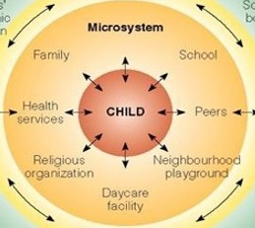
Contributing factors of girl soldiering : Microsystem
One of the key themes is the association with girls’ sense of physical and emotional unsafety in their families
High levels of association between experiences of domestic abuse or exploitation for girls’ motivations to join armed groups (Keairns 2002, Brett 2002, Brett and Specht 2004, Denov & Ricard-Guay 2013).
A microsystem-level violent home environment in its interaction with macrosystem-level discriminatory and exclusionary gendered societal attitudes creates circumstances where girls have few avenues for escape other than joining armed groups (Brett and Specht 2004).
Experiences of physical and emotional neglect:
The vulnerability of children to be recruited into armed groups is closely linked with situations of endemic poverty, whereby children and their families struggle to have their basic needs met (Keairns 2002, Kohrt, Rai & Maharjan 2015).
Girls’ experiences of being marginalized in their family structures and not having a voice on matters affecting their lives (Keairns 2002).
Particularly strong gendered dimension:
Numerous articles highlight experiences of girls joining armed groups in their attempt to escape forced marriages (Denov 2008; Spellings 2008; Denov & Ricard-Guay 2013; Kohrt, Rai & Maharjan 2015).

Slide 9
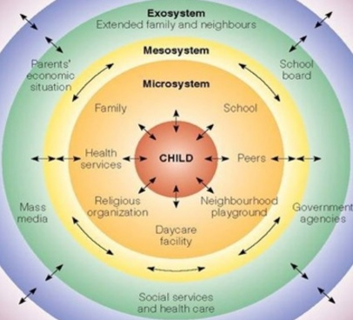
Contributing factors of girl soldiering : Mesosystem & exosystem
Thus far, the mesosystem factors contributing to child soldiering generally and girl soldiering specifically are one of the most underexplored areas of research.
Some girls joined armed groups following significant others who were already part of such groups (Keairns 2002) and pursued some political motives (Brett and Specht 2004).
Regarding the exosystem factors, poor economic conditions, limited employment opportunities, and difficulties to meet basic needs in the community were cited as reasons for children joining (Kohrt, Rai & Maharjan, 2015).
While poverty may create general vulnerability to being recruited, in and of itself it cannot be the sole factor (Brett & Specht 2004, Keairns 2002).
Considering the high levels of sexual and physical abuse that characterize some armed conflicts, it is more pronounced for girls than for boys to opt for joining for their own protection (Brett 2002; Brett & Specht 2004; Ndongo & Derivois 2022).

Slide 10
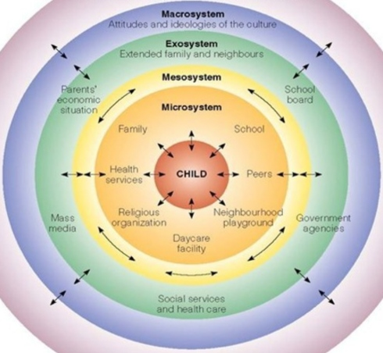
Contributing factors of girl soldiering : Macrosystem
Notwithstanding robust legislative frameworks underpinning the prohibition of child soldiering within international law, the number of children at risk of and/or being involved in child soldiering continues to grow.
The relevance and effectiveness of legal frameworks in their ability to protect and reintegrate child soldiers in Africa is questioned due to Western-centric definitions of what constitutes a child and childhood within these frameworks. The differing practical realities and local perceptions relegate international legal frameworks to ‘paper protection mechanisms’ (Francis 2007, p. 1).
Kiyala (2018) holds the view that the phenomenon of child soldiering in Africa is closely associated with the postcolonial legacies in Africa and the processes of globalisation.
Child soldiering is considered as the “new face” of child labour traditionally practised across much of Africa (Francis 2007).
In societies enforcing confining and rigid gender roles, joining the armed groups may be perceived by girls as an avenue for empowerment and emancipation (Denov & Ricard-Guay, 2013).

Slide 11
Consequences of girl soldiering : Microsystem
One of the key themes in the literature relates to the physical health (Brett 2002; Burman & McKay 2007), e.g. severe physical injuries and disabilities, the practice of branding (Denov 2010), sexual violence (Betancourt et al. 2010).
Implications on mental health and psychosocial wellbeing:
former girl soldiers, in comparison with boys, scored significantly higher on depression and anxiety, while scoring lower on their levels of confidence and prosocial attitudes (Betancourt et al. 2010).
a study of 330 former child soldiers Uganda with 49% of the sample being girls did not reveal major differences in mental health outcomes across gender (Klasen et al. 2010).
a strong association between the psychological symptoms and post-soldiering exosystem-level variables, such as limited access to food, difficulty accessing schooling, and experiences of being insulted and stigmatized in Uganda (Vindevogel et al. 2013).
exosystem-level elements like stigma and social order were found to play an important role in shaping the mental health outcomes of former female and male child soldiers in Sierra Leone (Betancourt et al. 2014).
mental health difficulties and challenges with social functioning continue to endure into the adult lives of former child soldiers (Betancourt et al. 2020).
Relational and social consequences feature prominently in the literature (Denov 2010; Vindevogel et al. 2013; Tonheim 2014; Schiltz et al. 2016; Parker et al. 2021) which mirror macrosystem perceptions of violated gender norms and transgressed gendered expectations (Burman and McKay 2007).

Slide 12
Consequences of girl soldiering : Mesosystem & exosystem
Within the scope of this secondary data analysis, difficulties were encountered in locating mesosystem consequences of girls soldiering in Africa.
Exposure to domestic violence in tandem with war-related traumatic experiences and community violence were found to be significant predictors of emotional and behavioural problems and the symptoms of post-traumatic stress disorder (Klasen et al. 2010).
As far as the exosystem is concerned, challenges with education and economic opportunities were reported among the most significant across genders for both former child soldiers and children without direct involvement in soldiering. The effects of such exclusionary exosystem-level experiences reverberate in the microsystem of individual children having significant implications on their psychosocial well-being (Vindevogel et al. 2013).
Lessons from northern Uganda, Mozambique, Angola, and Sierra Leone indicate that former child soldiers live in impoverished conditions with limited financial opportunities: being mostly engaged in subsistence agriculture, petty trading and low-pay jobs (Denov 2008, Parker et al. 2021).

Slide 13
Consequences of girl soldiering : Macrosystem
The individual, relational, and social consequences for former girl soldiers in Africa as well as their educational and economic opportunities in a post-conflict life are heavily influenced by macrosystem factors.
For girls, experiences of post-conflict stigmatization are even more inescapable due to perceived violations of gender norms and traditionally defined gender roles (Burman and McKay 2007).
Macrosystem social stereotypes surrounding girls’ expected roles within society and the lack of enforcement of UN CRC Art.2 (non-discrimination) trickle down to the microsystem and exosystem; impacting their prospects of marriageability, employment and education (Brett 2002).
However,
A longitudinal study of former child soldiers in their adulthood (Betancourt et al. 2020) found that former girl soldiers started experiencing greater community acceptance with time contrary to their male counterparts who perceived limited acceptance.

Slide 14
Prevention and response measures : Microsystem
The main outcomes expected from reintegration processes are associated with improvements in their safety and care, family situation, education, empowerment, and economic self-sufficiency as well as their physical and mental health (The Alliance 2020; 2023a; 2023b).
The importance of locating PTSD treatment of former child soldiers within their communities, and the possibility of it to be provided by non-specialized community-based lay counsellors (Ertl et al. 2011).
Engagement of former girl and boy soldiers, and local youth affected by the war more generally, in exploring some of the strengths and challenges present in their communities by means of photography:
the mentorship component was found to be significant;
difficulties accessing food, circumstances of violence, and other daily struggles;
engagement with policy makers did not materialize in tangible outcomes (Denov, Doucet & Kamara 2012).
A phenomenological research concerned with the meaning of reintegration as perceived by former child soldiers in Liberia found feelings of powerlessness and dissatisfaction with their reintegration experiences due to a range of exosystem obstacles, including a perceived lack of support from their government, lack of financial resources, and unemployment (Brownell & Basham 2017).

Slide 15
Prevention and response measures : Mesosystem & exosystem
Psychosocial rehabilitation programmes have the potential to improve the psychosocial well-being of former child soldiers, positively impacting their human growth as well as decreasing their aggressive behaviour. Mesosystem elements are built into the programme to positively contribute to the outcomes (Kiyala 2020).
Olso Conference on Protecting Children in Armed Conflict took place in June 2023
rich preparatory works having directly consulted over 300 children in 10 war-affected countries
a priority to discussing the importance of prevention, especially by means of strengthening child protection systems, and building capacities of local and national actors
stressed the need to ensure implementation of legal and policy frameworks by the states both during the conflict and peacetime (The Alliance 2023c).

Slide 16
Prevention and response measures : Macrosystem
Western-centric definitions do not echo cultural and traditional perceptions in and across Africa (Francis 2007).
Findings of ethnographic study indicated that community members in Sierra Leone defined childhood through the lens of children’s activities, roles, and levels of dependency rather than through their age (Columbia Group for Children in Adversity 2011).
Uncareful top-down imposition of the concepts of child protection, as conceptualized by the global North, and child rights, as codified in the UN CRC and OPAC, risks being perceived disrespectful to indigenous communities and running contrary to their social customs (The Columbia Group for Children in Adversity 2011).
The interaction of macrosystem factors with exosystem factors results in significant difficulties to enforce existing and ratified international legal standards aimed at protecting children; relegating them to the level of ‘paper protection’ (Francis, 2007, p. 207).
However,
A recently enhanced emphasis of the global child protection humanitarian sector on the importance of the centrality of child participation in their own protection and their UN CRC-defined status of rights holders (The Alliance 2023d) is a promising development.

Slide 17
Research recommendations
For funding and educational institutions to create favourable opportunities for researchers from conflict-affected countries to progressively engage in and lead on empirical evidence.
To further investigate the factors contributing to girl soldiering from their own perspective through participatory research methods, esp. the blindspot of “voluntary soldiering”.
To make further investment in exploring girls’ internal and external resources, coping mechanisms and sense of agency.
To address knowledge gap regarding the mesosystem and chronosystem-level contributing factors and consequences of girl soldiering.
To increase academic interest in the function of the chronosystem and the conduct of longitudinal studies.
To scale up research efforts regarding the effectiveness of response measures to girl soldiering by both community members and humanitarian child protection actors.

Slide 18
Capacity strengthening recommendations
For humanitarian child protection actors to prevent and respond to girl soldiering:
sufficient knowledge of international and national legal frameworks
effective skillset, attitudes and behaviours on how to engage with girls and different actors within their social ecology
capacity to facilitate meaningful, ethical and sustainable participation of girls and community members in decision-making processes
practical application of an ecological systems theory supported by an Ecological Systems Model of Prevention and Response Measures to Girl Soldiering
Points of attention:
The exact scope of capacity strengthening ultimately depends on each unique context and individual and collective needs and capacities of girls
Centrality of community-based and child rights-based programming
Capacity strengthening is a process, not a one-off activity

Slide 19
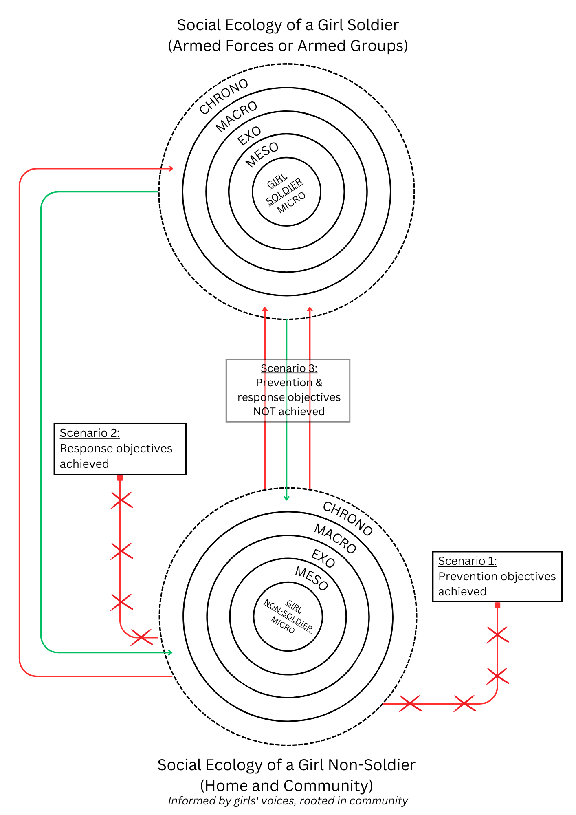
Ecological Systems Model of Prevention and Response Measures to Girl Soldiering
Considering that the social ecology of a girl at home/in her community is different from her social ecology in soldiering,
Scenario 1 - If prevention objectives are achieved, the girl is not recruited.
Scenario 2 – If response objectives are achieved, the girl is not re-recruited.
Scenario 3 – If prevention and/or response measures
are absent or fail, the girl is (re)recruited.
Such measures are:
based on a child rights-based approach
rooted in girls’ communities
informed by girls’ voices
Diagram 2: Ecological Systems Model of Prevention and Response Measures to Girl Soldiering

Slide 20
Reference list
Betancourt, S.T., Agnew-Blais, J., Gilman, E. S., Williams, R. D. and Ellis, B.H. (2010). Past horrors, present struggles: The role of stigma in the association between war experiences and psychosocial adjustment among former child soldiers in Sierra Leone. Soc Sci Med, 70(1), 17–26.
Betancourt, S.T., McBain, R., Newnham, A. E. and Brennan T. R. (2014). Context matters: community characteristics and mental health among war-affected youth in Sierra Leone. Journal of Child Psychology and Psychiatry, 55:3, 217–226.
Betancourt, S.T, Thomson, L.D., Brennan, T.R., Antonaccio, M.C., Gilman, E.S. and VanderWeele, J.T. (2020). Stigma and Acceptance of Sierra Leone’s Child Soldiers: A Prospective Longitudinal Study of Adult Mental Health and Social Functioning. Journal of the American Academy of Child & Adolescent Psychiatry, Volume 59, Number 6, 715-726.
Brett, R. (2002). Girl Soldiers: Challenging the Assumptions. [Online]. Working Paper. New York and Geneva: Quaker United Nations Offices. Available from: https://quno.org/sites/default/files/resources/Girl%20Soldiers_Challenging%20the%20assumptions.pdf [Accessed 22 May 2023].
Brett, R. and Specht, I. (2004). Young Soldiers: Why they choose to fight. Colorado: Lynne Rienner Publishers, Inc.
Brownell, G. and Basham, R. (2017). NGO strategy toward the reintegration of child soldiers in Liberia, Africa: An online survey of services, roles, and activities. International Social Work, Vol. 60(5), 1074-1986.
Bronfenbrenner, U. (1977). Toward an Experimental Ecology of Human Development. American Psychologist, July 1977, 513-531.
Burman, M.E. and McKay, S. (2007). Marginalization of girl mothers during reintegration from armed groups in Sierra Leone. International Nursing Review, 54, 316–323.
Coomaraswamy, R. (2010). The Optional Protocol to the Convention of the Rights of the Child on the Involvement of Children in Armed Conflict - Towards Universal Ratification. International Journal of Children’s Rights, 18 (2010), 535-549.
Denov, M. (2019). Children born of conflict-related sexual violence within armed groups: a case study of northern Uganda. In: Drumbl, M. A. and Barrett, C.J. eds. Research Handbook on Child Soldiers. Cheltenham: Edward Elgar Publishing Limited, pp. 240-257.
Denov, M. (2010). Coping with the trauma of war: Former child soldiers in post-conflict Sierra Leone. International Social Work, 53(6), 791-806.
Denov, M., Doucet, D. and Kamara, A. (2012). Engaging war affected youth through photography: Photovoice with former child soldiers in Sierra Leone. Intervention, Vol. 10, Number 2, 117-133.
Denov, M. (2008). Girl Soldiers and Human Rights: Lessons from Angola, Mozambique, Sierra Leone and Northern Uganda. The International Journal of Human Rights, Vol. 12, No. 5, 813-836.
Denov, M. and Ricard-Guay, A. (2013). Girl soldiers: towards a gendered understanding of wartime recruitment, participation, and demobilisation. Gender & Development, 21:3, 473-488.
Ertl, V., Pfeiffer, A., Schauer, E., Elbert, T., and Neuner, F. (2011). Community-Implemented Trauma Therapy for Former Child Soldiers in Northern Uganda: A Randomized Controlled Trial. American Medical Association, Vol. 306, No. 5, 503-512.
Francis, D.J. (2007). ‘Paper protection’ mechanisms: child soldiers and the international protection of children in Africa’s conflict zones. Journal of Modern African Studies, 45, 2 (2007), 207–231.
Guy-Evans, O. (2020). Bronfenbrenner's ecological systems theory. Available from: www.simplypsychology.org/Bronfenbrenner.html [Accessed 06 October 2024].
Keairns, Y.E. (2002). The Voices of Girl Child Soldiers: Summary. Quaker United Nations Office. Research project.
Kiyala, K. C. J. (2018). The impact of globalization on child soldiering: challenges and opportunities in the context of the Democratic Republic of Congo. International Social Science Journal, 221-222, 271-284.

Slide 21
Reference list
Klasen, F., Oettingen, G., Daniels, J. and Adam, H. (2010). Multiple Trauma and Mental Health in Former Ugandan Child Soldiers. Journal of Traumatic Stress, Vol. 23, No. 5, 573–581.
Kohrt, A. B., Rai, S. & Maharjan, M. S. (2015). Child Soldiers. In: International Encyclopedia of the Social & Behavioral Science. Vol. 3. 2nd edn. pp. 430-438.
Ndongo, T.O. and Derivois, D. (2022). Understanding voluntary enrollment of child soldiers: A key to reintegration. Annales Medico-Psychologiques, 180 (2022), 145–148.
Park, A. S.J. (2006). “Other Inhumane Acts”: Forced Marriage, Girl Soldiers and the Special Court for Sierra Leone. Social & Legal Studies, 15(3), 315-338.
Schiltz, J., Vindevogel, S., Broekaert, E. and Derluyn, I. (2016). Dealing with Relational and Social Challenges After Child Soldiering: Perspectives of Formerly Recruited Youth and Their Communities in Northern Uganda. Journal of Community & Applied Social Psychology, 26, 307–322.
Parker, M., Fergus, A. C., Brown, C., Atim, D., Ocitti, J., Atingo, J. and Allen, T. (2021). Legacies of humanitarian neglect: long term experiences of children who returned from the Lord’s Resistance Army in Uganda. Conflict and Health, 15:43, 1-19.
Schiltz, J., Vindevogel, S., Broekaert, E. and Derluyn, I. (2016). Dealing with Relational and Social Challenges After Child Soldiering: Perspectives of Formerly Recruited Youth and Their Communities in Northern Uganda. Journal of Community & Applied Social Psychology, 26, 307–322.
Spellings, R. C. (2008). Scratching the Surface: A Comparison of Girl Soldiers from Three Geographic Regions of the World. International Education, Vol. 38, Issue (1), 21-39.
The Alliance for Child Protection in Humanitarian Action (2019). Minimum Standards for Child Protection in Humanitarian Action, 2019 Edition. [Online]. Available from: https://alliancecpha.org/en/cpms_home [Accessed 29 July 2023].
The Alliance for Child Protection in Humanitarian Action (2020). Technical Note: Girls Associated with Armed Forces and Armed Groups: Lessons Learnt and Good Practices on Prevention of Recruitment and Use, Release and Reintegration. [Online]. Available from: http://alliancecpha.org/sites/default/files/technical/attachments/tn_gaafag_eng.pdf [Accessed 28 August 2023].
The Alliance for Child Protection in Humanitarian Action (2023a). Technical Note: Education Interventions for CAFAAG. [Online]. Available from: http://alliancecpha.org/en/technical-materials/technical-note-education-interventions-children-associated-armed-forces-and-armed-groups [Accessed 28 August 2023].
The Alliance for Child Protection in Humanitarian Action (2023b). Technical Note: Livelihood Interventions for CAFAAG. [Online]. Available from: http://alliancecpha.org/en/livelihood-interventions-caafag [Accessed 28 August 2023].
The Alliance for Child Protection in Humanitarian Action. (2023c). Session 3: Reflections on the Oslo Conference & the Children Associated with Armed Conflict Agenda. [Online]. [Accessed 07 August 2023]. Available from: https://www.youtube.com/watch?v=I9g9-I5CPgg&list=PLTqpcYbBSkF9CopKFJ-47eB1fJ8l_r8lS&index=3
The Alliance for Child Protection in Humanitarian Action (2023d). The Centrality of Children and their Protection in Humanitarian Action - A Visual and Written Introduction. [Online]. Available from: https://alliancecpha.org/en/centrality-of-children-visual-and-written-introduction [Accessed 08 August 2023].
The Columbia Group for Children in Adversity (2011). An Ethnographic study of community-based child protection mechanisms and their linkage with the national child protection system of Sierra Leone.
The Paris Principles. Principles and Guidelines on Children Associated with Armed Forces or Armed Groups 2007. Available from: https://www.unicef.org/mali/media/1561/file/ParisPrinciples.pdf [Accessed 18 March 2023].

Slide 22
Reference list
Tonheim, M. (2014). Genuine social inclusion or superficial co-existence? Former girl soldiers in eastern Congo returning home. The International Journal of HumanRights, Vol. 18, No. 6, 634-645.
United Nations General Assembly (1989). Convention on the Rights of the Child. Available from: https://www.ohchr.org/sites/default/files/crc.pdf [Accessed 18 March 2023].
United Nations General Assembly (2000). Optional Protocol to the Convention on the Rights of the Child on the involvement of children in armed conflict. Available from: https://www.ohchr.org/en/instruments-mechanisms/instruments/optional-protocol-convention-rights-child-involvement-children [Accessed 18 March 2023].
Vindevogel, S., Schryver, D. M., Broekaert, E. and Derluyn, I. (2013). Challenges Faced by Former Child Soldiers in the Aftermath of War in Uganda. Journal of Adolescent Health, 52, 757-764.
Wulczyn et al. (2010). Adapting a Systems Approach to Child Protection: Key Concepts and Consideration. UNICEF, UNHCR, Chaplin Hall & Save the Children.

