Slide 1
Intro Slide Title 1
Family Group Conferences
Is trust enough in child protection?
Sarah Brown
Staff Tutor and Regional Academic
November 2024

Slide 2
Slide Title 8
Overview of the session
Defining restorative practice and outlining elements of a ‘restorative encounter’
Introducing Family Group Conferences as a restorative approach in child protection.
Explore the underpinning concept of trust in Family Group Conferences using a practice example
Consider ways in which Family Group Conferencing can enhance cultural humility
Review the evidence base for Family Group Conferences in child protection.

Slide 3
How do we feel about ourselves when things are going well, or not so well?

Slide 4
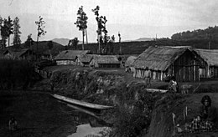
Slide Title 9
What is ‘restorative practice’?
Developed in New Zealand and started to inform practice in the 1970’s, initially in justice settings.
Started to inform social work practice in the UK in the 1990’s (FGCs and Restorative Justice for young people who offend).
Relies on mutual understanding of an issue and a collaborative approach to get the best outcome.
Belief that ‘repairing harm’ is best done through a non blaming approach which externalizes the problem from the person.
It is the skill of the restorative practitioner to move conversations from ‘shame’ to re-integration (Braithwaite 1989)– Remember that central blueprint…

Slide 5
Slide Title 10
Elements of a ‘restorative encounter’
Links to Practice
A restorative encounter (Hopkins 2016) can happen in planned or unplanned ways – it is one where there is an intention of healing relationships where there has been a break down.
Reach an understanding of what has happened and why
Understand the context
Let people tell their own stories
Allows for a safe space for remorse to be expressed and healing to take place
Responsibility versus blaming (managing emotions of shame, guilt and how people respond in those scenarios e.g. Holland and Rivett 2008)
How can the damage be fixed?
How can future harmful behaviour be prevented?
This Photo by Unknown Author is licensed under CC BY-ND

Slide 6
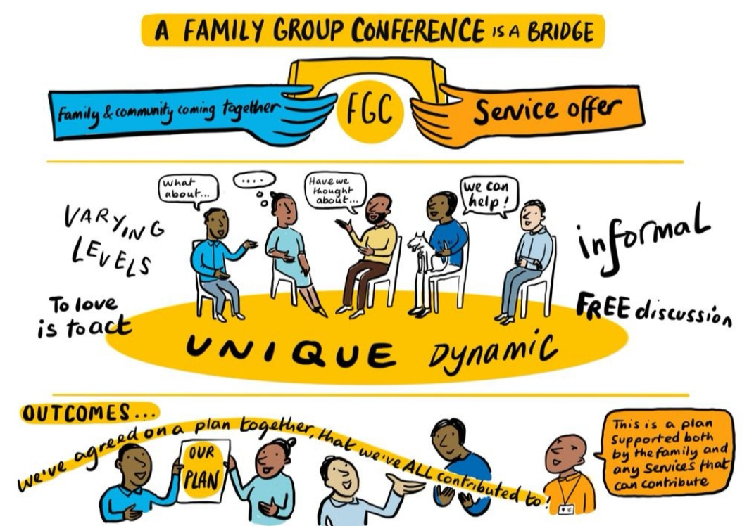
Slide Title 11
Family Group Conferencing – a restorative approach in child protection
Picture taken from Camden Council

Slide 7
What do we mean by trust?
Confidence is different to trust (Smith 2001)
Trust implies some form of personal engagement between individuals.
Requires a level of vulnerability and a commitment to free will
We need trust in child protection:
The fear of
…..What if I get it wrong?
……Feeling of being let down, disappointed
…..am I compromising safety?
People with lived experience need to experience trust
Trust creates the space for more truthful accounts
Confidence implies a level of ‘technical rationality’ not always present in child protection

Slide 8
Slide Title 12
Can we apply principles of trust in child protection?
There is a desire in child protection to ‘pin down’ risk factors and address them. This does not recognise the informality of family life (Featherstone et al 2016)
Is the vulnerability of ‘trust’ a tenable response?
Family Group Conferences enhance social integration as opposed to functional integration (Burns and Fruchtel 2014) which rely on an element of trust and consequently confidence.
Trust in child protection has been explored in relation to children trusting their social workers (Cossar et al 2014)
Family Group Conferences also rely on ‘mutual trust’ between the coordinator, social worker and the family.
We can only achieve trust by allowing some uncertainty – with the acceptance that there might be disappointment and loss.
Linking back to those ideas of increasing the positive affect and minimising the negative affect we can see here how using trust in FGCs might impact on that individual ‘central blueprint’ in restorative practice.

Slide 9
Links to Practice
Difficult separation between mother (Shelley) and father (Dan) of Katie-Rose (7 years old)
Katie-Rose living between the two houses and not long after her parents separated, she was not attending school on a regular basis, not eating regular or healthy meals and showing worrying behaviour in relation to her own safety (running away from home, climbing onto roofs and jumping down, harming herself with toys by being very physical)
Significant family members around both maternal and paternal but there was a lot of conflict and possibly historical harmful behaviours towards their own children (now parents of Katie-Rose)
Social work involvement due to risk of significant harm to Katie-Rose

Slide 10
Slide Title 12
Family Group Conferences and Cultural Humility
FGCs are derived from First Nation communities in New Zealand, in response to oppressive racist practices.
On that basis, are FGCs suitable to work with Global Majority families in the UK?
Barn and Das (2016) concluded that cultural humility might be enhanced through use of FGCs by
matching coordinators to the families,
appropriate use of interpreters
paying attention to language used in meetings,
understanding culturally relevant services,
accessing community resources for meetings
monitoring data.
FGCs and Decolonisation (Mohamed 2023)
A move away from Eurocentric decision-making processes.
Social work must be sensitive to time, locations and contexts in which people live.
Value of indigenous knowledge
Need to ensure authentic delivery of the model

Slide 11
Family Group Conferences in Childrens Services:
What the evidence tells us
Williams (2019) evaluated family support services using a restorative approach. She observed practitioners in Wales making visits to families using the restorative approach outlined previously. She concluded that families found the approach acceptable, positive and enhanced their engagement.
Mitchell (2019) explored ‘outcomes’ of child welfare work highlighting ‘outcomes’ are often framed according to professional definitions. She encourages practitioners to see these alongside the more nuanced outcomes children and families may strive for – an FGC provides opportunity for that.
Coram (cited in WWCCF, 2023) concluded that children whose families were referred for FGC were significantly less likely to go into care (pre-proceedings stage in England)

Slide 12
So, is trust enough?
Restorative practices and Family Group Conferences align with social work values regarding rights, empowerment and social justice.
The evidence shows us that Family Group Conferences can result in better outcomes for children.
They create opportunities for re-balancing the ‘central blueprint’
FGCs provide an opportunity to deliver a culturally responsive approach to children and their families.
Families operate in ‘unstructured spaces’ – this is where we must locate our trust in families. It requires active involvement – confidence follows on from that
There are risks involved – creating discomfort for practitioners to balance the risk v advantageous outcomes.
This Photo by Unknown Author is licensed under CC BY-SA

Slide 13
References
Barn, R. and Das, C. (2016) ‘Family Group Conferences and Cultural Competence in Social Work’, The British journal of social work, 46(4), pp. 942–959. Available at: https://doi.org/10.1093/bjsw/bcu105.
Burns, G. and Früchtel, F. (2014) ‘Family Group Conference: A Bridge between Lifeworld and System’, The British journal of social work, 44(5), pp. 1147–1161. Available at: https://doi.org/10.1093/bjsw/bcs192.
Cossar, J. Brandon, M. and Jordan, P. (2016)‘You've got to trust her and she's got to trust you’: children's views on participation in the child protection system . Child and Family Social Work 21 (1) pg 103-112 https://doi.org/10.1111/cfs.12115
Featherstone, B., Gupta, A., Morris, K. and Warner, J (2016) ‘Let’s stop feeding the risk monster: towards a social model of ‘child protection’’, Families, Relationships and Societies http://dx.doi.org/10.1332/2046743 16X14552878034622. Volume 7, Number 1, March 2018, pp. 7-22(16)
Holland, S. and Rivett., M. (2008) Everyone started shouting: Making connections between the process of FGC’s and Family Therapy Practice. British Journal of Social Work. 38 21-38
Hopkins, B. (2016) Restorative Theory in Practice. Insights into What Works and Why. London: Jessica Kingsley Publishers
Mitchell, M. (2020) Reimagining child welfare outcomes: Learning from Family Group Conferencing. Child and Family Social Work 25 pg 211-220
Mohamed, O. (2024) ‘A Systematic Literature Review With Racially Minoritised People Using Family Group Conferencing in England’, Practice (Birmingham, England), 36(1), pp. 19–37. Available at: https://doi.org/10.1080/09503153.2023.2234102
Smith, C. (2001) ‘Trust and confidence: possibilities for social work in “high modernity”’, The British journal of social work, 31(2), pp. 287–305. Available at: https://doi.org/10.1093/bjsw/31.2.287.
Tomkins, Silvan S. (1962), Affect Imagery Consciousness: Volume I, The Positive Affects. London: Tavistock.
What Works Centre for Children and Families (2023) Randomised controlled trial of family group conferencing at pre-proceedings stage available onfamily-group-conferencing-report.pdf (coram.org.uk) date accessed October 2024
Williams, A. (2019) Family support services delivered using a restorative approach: A framework for relationship and strengths‐based whole‐family practice. Child and Family Social Work 24 (4) pg 555-564

Slide 14
Slide Title 30
Thank you and any questions?
Sarah.brown1@open.ac.uk

Slide 15
Slide Title 31

