Slide 1

Academic Advising Tutorial
Find out more about the support we can provide to you as an Academic Adviser, as well as the wider support provided by the University.

Slide 2
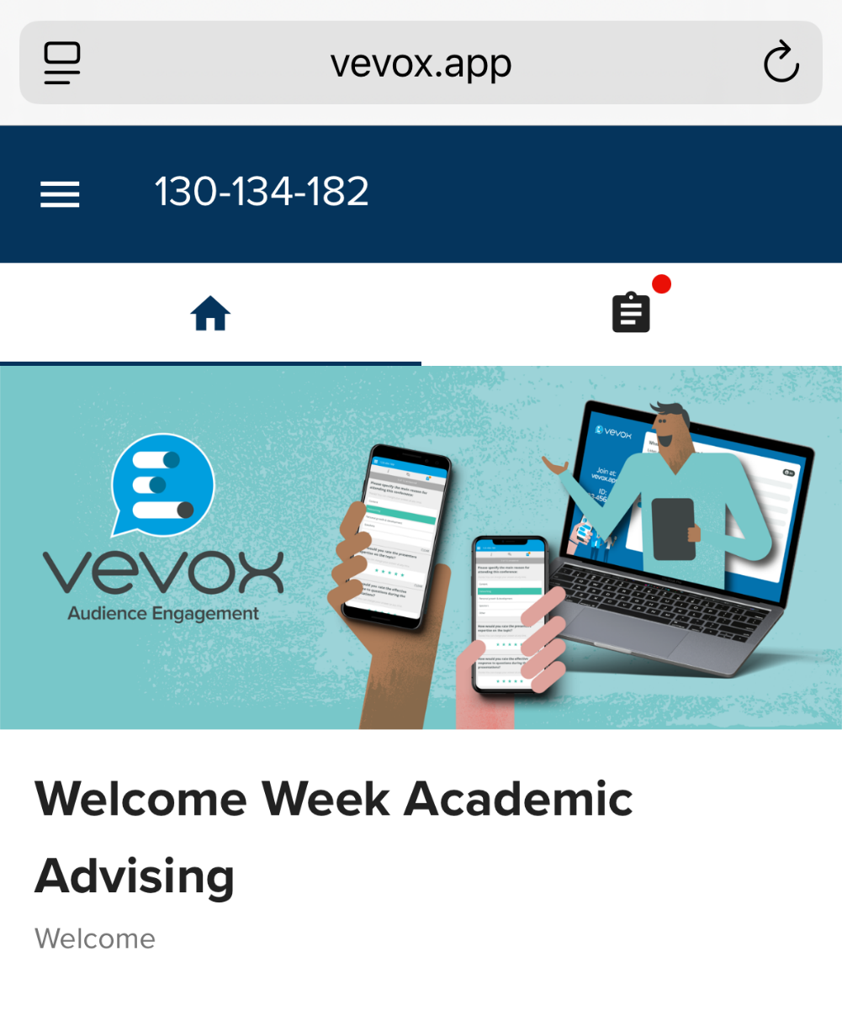
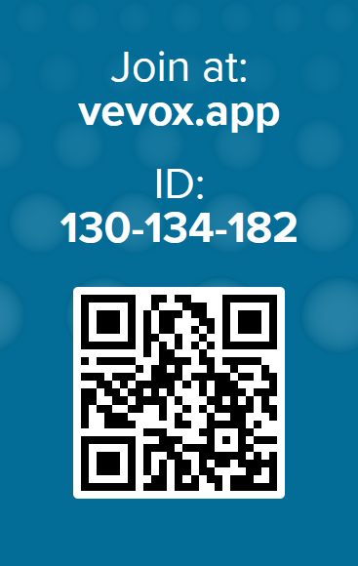
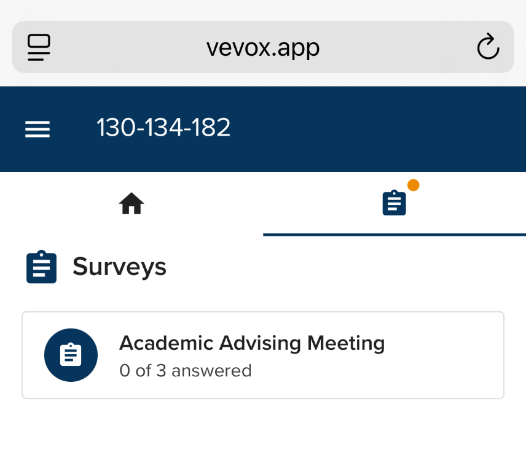
Register your Attendance

Slide 3

Welcome to Kent!
What is an Academic Adviser?
An Academic Adviser is here to support your academic progress, personal development, and professional readiness.
Every student at Kent has an Academic Adviser. I am your Academic Adviser for the entire length of your time at Kent.
I am a member of academic staff in your School, so I know about the course you are on.
I am here to support you. If you are finding anything challenging, I am your first point of call.

Slide 4

Name, Course & One Thing
👋 Let’s go around the room!
Can you tell us…
🙋Your Name
🎓Your Course
🎉One thing you’re excited about
🤔One thing you’re nervous about

Slide 5

Kent First Impressions
👋 Let’s go around the room!
Can any of you tell me…
What is your favourite thing about the campus?
Who’s already got lost on campus?
Who’s already had food delivered (Deliveroo, UberEats, JustEat etc.)
Who wants to join a society?

Slide 6

What does University mean to you?
University means a different thing to each of us and every Student Journey will be unique
Some of our current students built Lego models to describe their experiences
Self-reflection
Lecturers guiding
Your degree – the reward for your hard work
The view to employment
5 Minute Self-Reflection Task
What does University mean to you?
Take 5 minutes to draw an image that represents this.
You can do this any way you want. You can be literal, or like our students with Lego more abstract – have fun with it!
I will do this too.
As you progress how do you think your drawing might change?
Levels of learning
Opening the door to opportunities of HE
There are many friends along the way but ultimately you have to be able to drive yourself – Stage 2 student

Slide 7

Did you know…
…that students who engage with their Academic Advisers are more likely to succeed and obtain a higher-class degree?
"The Academic Adviser service is superb; mine has always been available and has helped me a lot about my course and my future choices.“
“My academic advisor thoroughly believed in my ability and motivated me to push through.”
“My Academic Adviser was amazing; they provided so much support and helped me on numerous occasions”

Slide 8
What role do I play?
🧠 Help you understand academic expectations
📝 Discuss your progress and feedback
📚 Provide guidance on module choices and academic development
💼 Support your career planning
🧭 Help with personal development and life at university
💬 Refer you to additional support services when needed
🖊️ Write references for job or further study applications
🗣️ Share concerns and feedback with the Student Experience Lead in your School
📂 Keep track of Academic Adviser meetings using Presto

Slide 9

How to contact me?
📧 Email
Use your Kent student email
Allow up to 3 working days for a reply
📅 Appointments
Book via MS Bookings link
Choose a time that suits you
🏫 In Person
Office
Drop-in times
💡 Tip: If it’s urgent, please put “Academic Advising Support” in the subject line of your email.

Slide 10
Academic Adviser Meetings
All meetings appear in your Presto Timetable. You can also request extra meetings if needed
Group Meeting
Meet me, your peers, and ask questions
Personal Feedback
Reflect on progress, set goals
Group Meeting
Shared focus: feedback, skills, careers
Personal Feedback
Discuss feedback, plan next steps
Welcome Week
Autumn
Spring
Summer
1 hr
20 min
1 hr
20 min

Slide 11
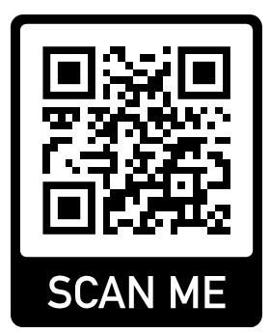
Presto Timetable
Shall we try accessing your Presto Timetable?
📱 Step 1: Scan the QR code on this slide to open Presto.
📅 Step 2: You will see your timetable. Click the calendar symbol to view future dates.
✅ Step 3: To record your attendance:
Select the event you are attending.
Enter the code your lecturer or adviser provides at the start of the session.

Slide 12
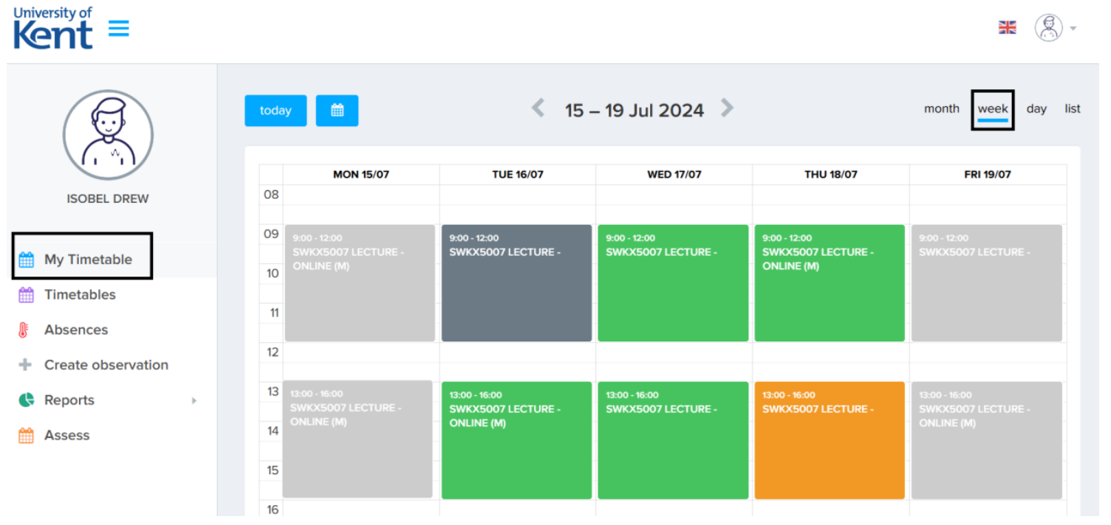
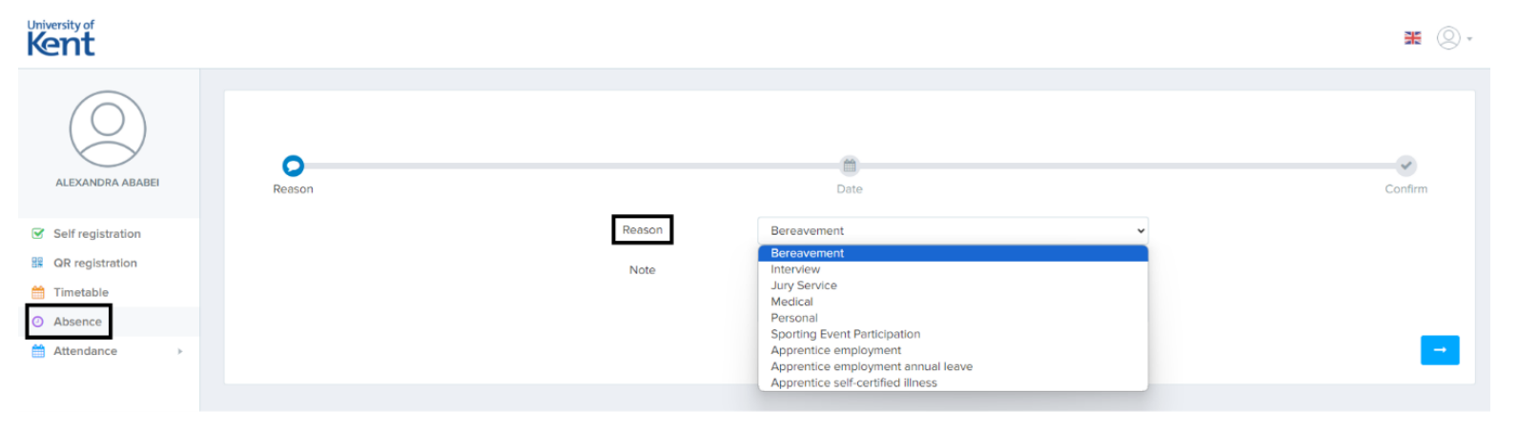
Registering Attendance
You must record your attendance at all timetabled and scheduled events, including your Academic Advising meetings.
You do this by scanning the QR code or entering the short text code provided during the session. Speak to the lecturer at the start or end of the session if you have trouble registering your attendance.
If you cannot attend a timetabled session, you must register your absence in Presto.
When absent for an advising meeting, you must contact your Academic Adviser as soon as possible to let them know and reschedule.

Slide 13

How to use KentVision
🧭 Please note that your attendance should be registered in Presto, not Moodle.

Slide 14

Assessments and Feedback
Deadlines for assessments will be advertised well in advance on:
📌 KentVision 📌 Moodle
Your Module Convenor will guide you on where and how to submit your work.
It is your responsibility to manage your time and meet coursework deadlines.
Most modules are assessed by a combination of coursework and exams, though some may differ (e.g. 100% coursework).
✅ Your Academic Adviser will support you in understanding your feedback, reflect on your progress, and plan how to improve in future assessments.

Slide 15
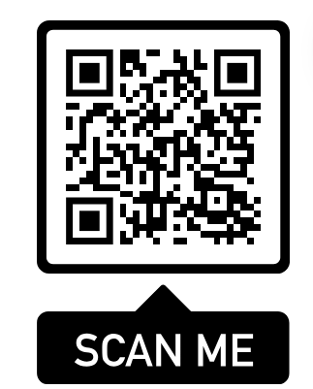
Your Voice Matters
🎤 Your Voice at Kent
Your feedback matters – it helps us improve the University experience for you and future students.
Share your views through Student Reps, who attend termly Student Voice Forums with staff.
Reps raise themes and ideas anonymously, so your input is safe and valued.
Together, Kent Union and the University work in partnership to act on feedback at Subject, School, and Institutional levels.
Getting involved means you can shape your course, build community, and gain transferable skills – plus earn Employability Points and leadership experience.
👉 Speak to or become a Student Rep and help shape Kent.

Slide 16
Expectations
You are expected to…
Take guidance from your lecturers and academic advisers.
Study independently.
Submit coursework by the deadline and learn from feedback.
Attend all lectures, tutorials, workshops, labs and academic adviser meetings.
Actively participate in group discussion.
Know and follow all academic standards.
What should you expect from University…
Guidance from your lectures, module convenors and academic adviser.
Offered support when you need it.
Clear and concise instructions on deadlines and coursework.
Opportunities to enhance your independent study, such as academic papers.
Employability and careers advice .

Slide 17


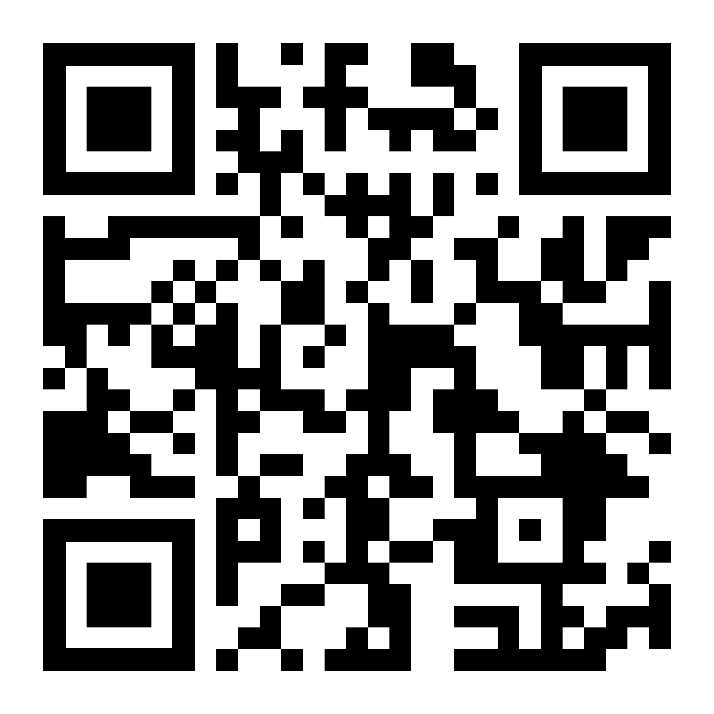



Finding the teams that can help
There are lots of resources and people to help you as a student.
If you have questions and are not sure where to start, then ask Nexus.
Start by checking the webpages - use the search tool at the top right to find the information you need - https://student.kent.ac.uk/
Visit a Nexus Information Desk if you need help finding information, need guidance or would like to speak to someone directly.
Nexus will get you in contact with the right team if you need individual advice and need to speak to someone privately.
Nexus will also get you in contact with more specialist services if you need specialist support or advice.
Get in contact: Email, call, or drop-in and visit in Sibson building, Templeman Library, or Medway Building.

Slide 18
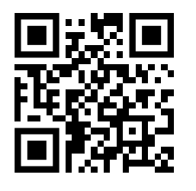
Kent Students’ Union
Website: KSU.co.uk
Email: Hello@KSU.co.uk
🌟 Supporting Your Student Journey
We’re here to support, represent, and empower you throughout your time at Kent.
🗣️ Your Student Voice
We make sure your views are heard across the University and beyond. 📚 Campaigning for better facilities, academic improvements, and key student issues.
🤝 Find Your Community
Join one of hundreds of student-led societies and sports clubs. ✨ Can’t find your niche? We’ll help you start your own group.
🛟 Get the Support You Need
💬 Free, confidential Advice Service – housing, academic, money matters & more. 🎉 Social spaces & events: Woody’s Bar, The Venue, and beyond.
👩‍🎓👨‍🎓 Led By You
Run by students, for students – shape the Union by voting, giving feedback, or standing in elections.
💜 Your Student Life, Made Incredible
We’re here to help you make memories, build community, and thrive at Kent.

Slide 19
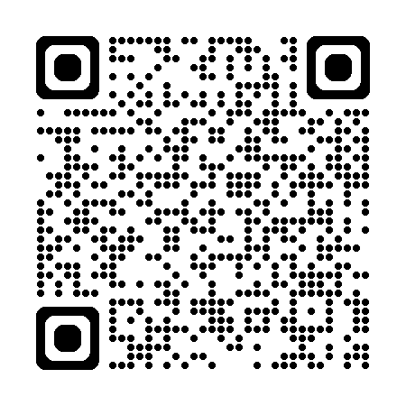
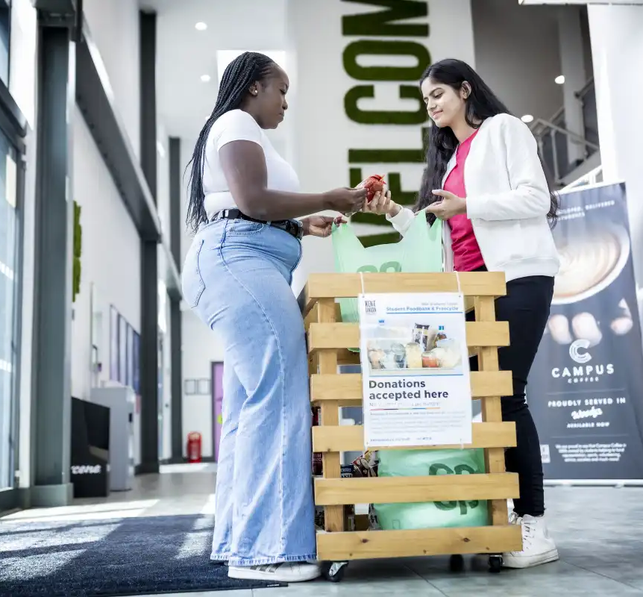
Student Finance
💳 Paying Tuition & Accommodation Fees
💻 Pay online: Tuition Fees | Accommodation
🏢 The Student Fee Collections team handles all payments for tuition and campus accommodation.
📑 Applying for Student Finance
🌐 Apply via: GOV.UK Student Finance
❓Questions about your fee status?
Visit: Fee Status Support
✅ Confirming Your Registration
👩‍💼 The Student Funding Office confirms your registration with Student Finance England so your loan is released.
🚨Emergency Funding Support
💷 Experiencing a delay in funding? You may be eligible for an Emergency Short-Term Loan (ESTL)
🙋 Need Help or Have a Question?
📞 Full list of contacts: Finance Support Contacts

Slide 20

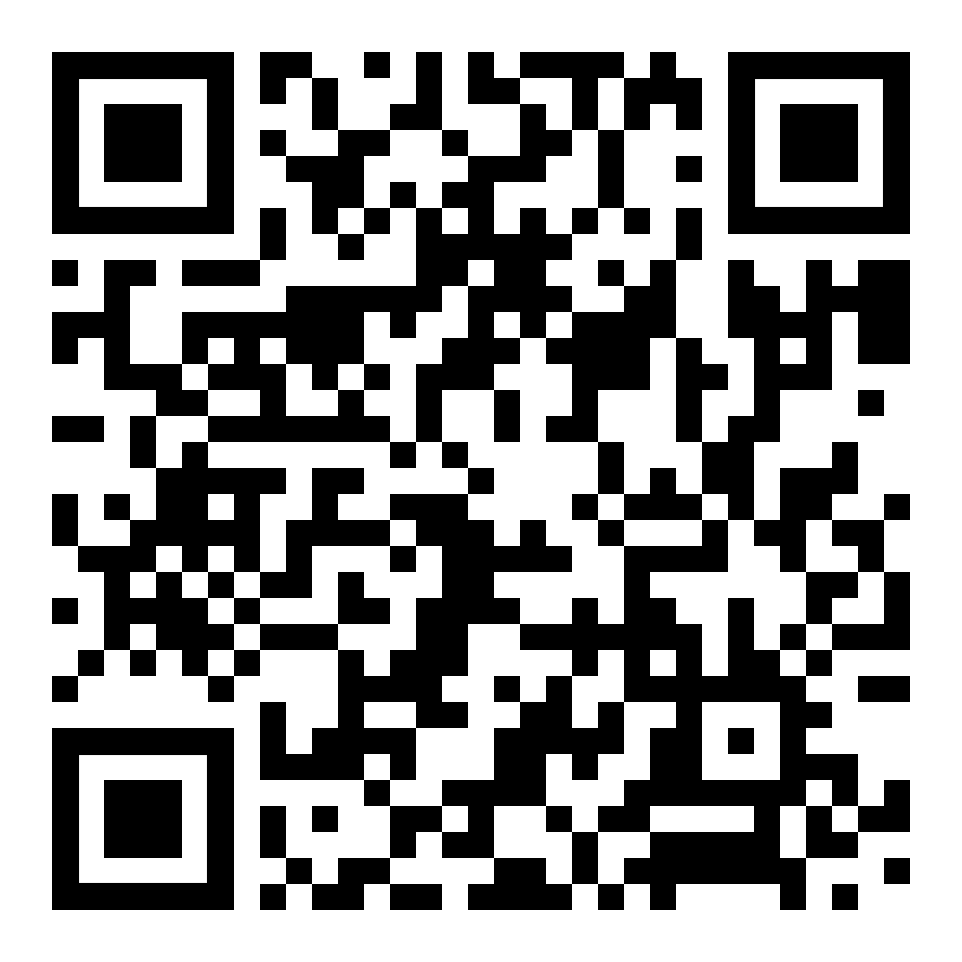

Engagement Support
Feeling overwhelmed? Struggling with deadlines? Illness or injury?
Missing home? These are just some of the things we can help with …
Personalised and individual advice and practical support for your specific circumstances. We can help:
If you are struggling to meet
(or if you miss) a deadline.
If you are missing a lot of teaching and cannot attend and engage with your studies.
Help if you are finding it hard to navigate life at University.
If you have an issue and need to speak to someone.
If you are worried about another student, and want someone to check-in.
Get in contact: Email, call, meet on Teams or in-person by appointment, or drop-in and visit.

Slide 21
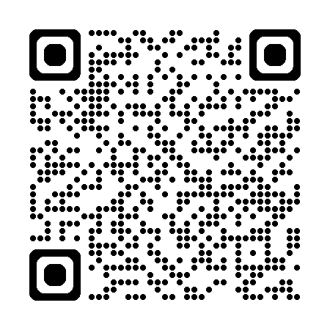
Student Support & Wellbeing
💜Wellbeing & Mental Health Support
🧠 Counselling, mental health advice, and emotional wellbeing guidance.
🤝 Confidential, non-judgmental support whenever you need it.
♿ Disability & Health Support
💡Support for students with disabilities or long-term health conditions.
📘 Tailored help to manage your academic journey with confidence.
📄 Inclusive Learning Plans (ILPs)
✍️ Once registered with us, we’ll work with you to create an ILP
⚖️ Includes reasonable adjustments for your studies and assessments.
🔗 Find out more about Inclusive Learning Plans.
🛡️Specialist Support & Safeguarding
🚫 Help with issues such as harassment, sexual violence, bullying, discrimination, or hate incidents.
📢 Report and Support Tool
🔒 Report concerns anonymously or with your name:
🌐 Visit: ReportAndSupport.kent.ac.uk
📬Get in Touch
Visit: Kent.ac.uk/student-support
✉️ Email: KentSSW@kent.ac.uk

Slide 22

Skills for Academic Success
📚 Build Core Academic Skills
🧠 Critical thinking, academic writing, referencing, time management, communication & more.
➗ Get support with Maths & Stats for courses with quantitative elements.
🤝 Support for Every Student
🎓 From Foundation to PhD – we're here for all students, whatever your background or experience.
🔑 How to Access Support
👩‍🏫 1:1 appointments, skill-specific workshops, and online resources.
👥 Peer support also available via Peer-Assisted Learning (PAL).
📅 Top Tip: Stay Organised!
📝 Free time planners available – get yours from the SAS team.
📬 Get in Touch
Website: Skills for Academic Success (SAS)
Book: Book an Appointment with SAS
Email: Sas@kent.ac.uk
Peer-Assisted Learning – What is PAL?

Slide 23

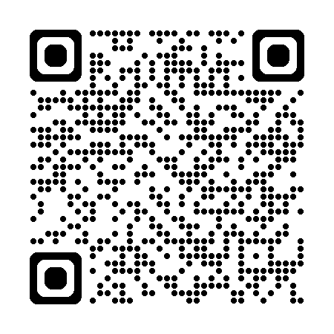
Library Services
📖 Access Resources for Free
Millions of books, e-resources, journals & films – borrow, don’t buy.
💻 Explore the Digital Library
E-books, databases, film streaming & more – available anytime, anywhere.
🔎 Boost Your Research Skills
Learn how to find, evaluate & use information effectively.
👩‍🏫Subject Librarians
Get expert, tailored support for your subject area.
🪑Spaces That Suit You
From silent desks to group rooms – study your way.
💜 Supporting Your Wellbeing
Relax with our Love to Read collection, events & exhibitions.
Find Out More
Webpage: Library Services
Meet your Librarian
Moodle: Module: Library e-induction | 2025
Email: AcademicLibrary@kent.ac.uk

Slide 24
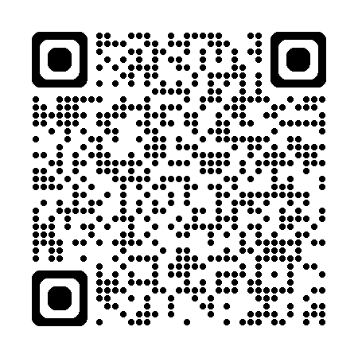

Kent IT
💻 IT Services – What You Need to Know from Day One
📱 Scan the QR for your go-to guide to digital tools & services supporting your studies.
🔐 Activate your IT Account & Get Connected Activate your Kent IT account as soon as you’re enrolled. 📶 Set up Eduroam Wi-Fi for free, secure campus access. 💡 Top tip: Do this during Welcome Week so you’re ready from day one.
🆓 Free Software & Tools Download Microsoft 365, use OneDrive, and access other course tools. 💡 Top tip: Install on up to 5 devices for free.
🖨️ Printing on Campus Use your KentOne ID card to print, scan & copy. 💡 Top tip: Top up print credit and check queues online.
🛠️ IT Support When & Where You Need It Get help online, by phone, or at the IT helpdesk.
⚙️ Digital Study Tools & Tech Explore equipment & tools to work smarter. 💡 Top tip: Search “IT Services” on the Kent website to see what’s free.
Webpage: Kent IT for students

Slide 25

Careers & Employability Services
🙋 Careers Advice & Guidance 1:1 support with CVs, interviews, applications & more.
💪 Skills & Confidence Building Workshops, events & mock interviews to prepare for work or further study.
🌐 Online Tools & Resources Explore opportunities via the Careers Hub and Moodle module.
🤝 Mentoring & Employability Points Join the Mentoring Programme or earn rewards through the Employability Points Scheme.
🔍 Explore Opportunities Find part-time jobs, placements, volunteering & graduate roles.
☝️Business Start-up Support
ASPIRE supports anyone interested in starting or developing their own business. Contact ASPIRE@kent.ac.uk
📬 Get Involved Webpage: Careers & Employability Service

Slide 26
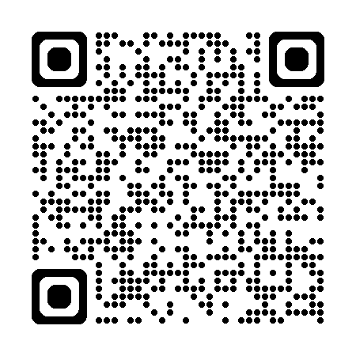

Student Success
🎯Our Mission
⚖️ We acknowledge that the University of Kent has risks to the equality of opportunity for our students.
💜 Our mission is to provide a university experience that is inclusive and equitable.
📚 What We Offer
🛠️ Workshops & Skills Programmes – Build confidence and develop key academic skills.
🎤 Inspirational Speakers – Be inspired by diverse voices and experiences.
🏅 Diversity Mark
📖 Helping to ensure inclusive, representative teaching.
🙋 Opportunities to get involved as a Diversity Mark Officer.
🤝 Belonging & Community
👋 Inductions and term-time events to connect with your peers and build your place at Kent.
📬Get Involved
🌐Webpage: Student Success
✉️Email: StudentSuccess@kent.ac.uk

Slide 27
Important email addresses
Nexus staff can help with any query, signposting you in the right direction.
Engagement Support | EngagementSupport@kent.ac.uk | We provide all taught students with personalised and individual advice and practical support for your specific circumstances.
Employability and Placements | CareerHelp@kent.ac.uk | We can help with specialist careers advice as well as employability and placement development and support.
Student Voice, Events and Experience | StudentExperience@kent.ac.uk | We can help with questions about Student Voice Forums, student representation, module evaluations, academic communities, events and student feedback.
Course administration | ProgAdmin@kent.ac.uk | We are responsible for all UG, and PGT student administration including timetabling and exams processes.
IT and Technical services | HelpDesk@kent.ac.uk | We can help with IT support requests including email and software, IT in teaching spaces, and provision of computer hardware for staff in the Division as well as questions about campus buildings, furniture and telephones.

Slide 28

Do you have any questions?

