Slide 1
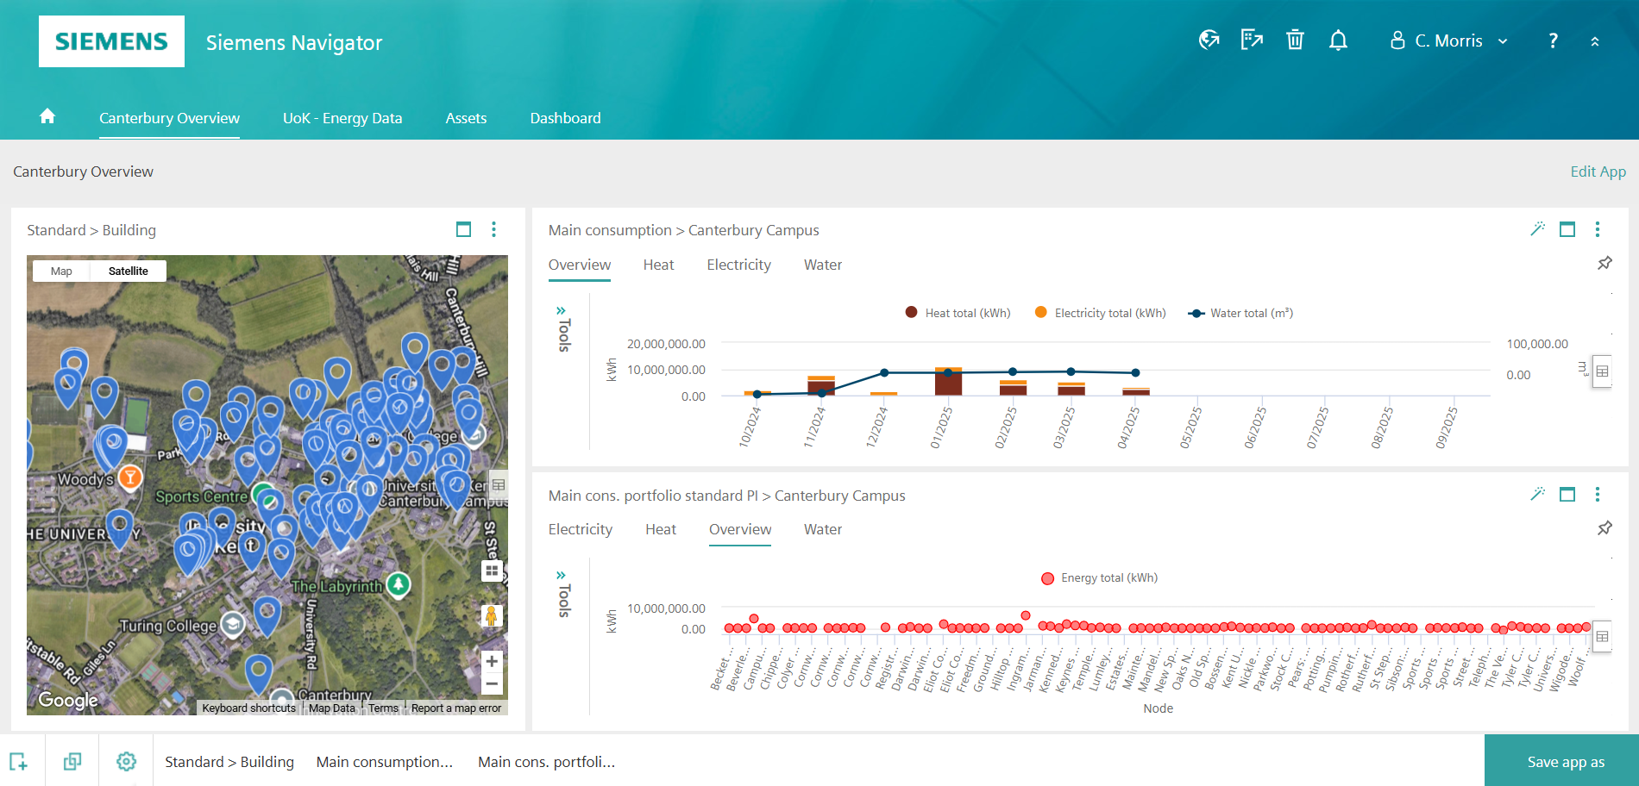
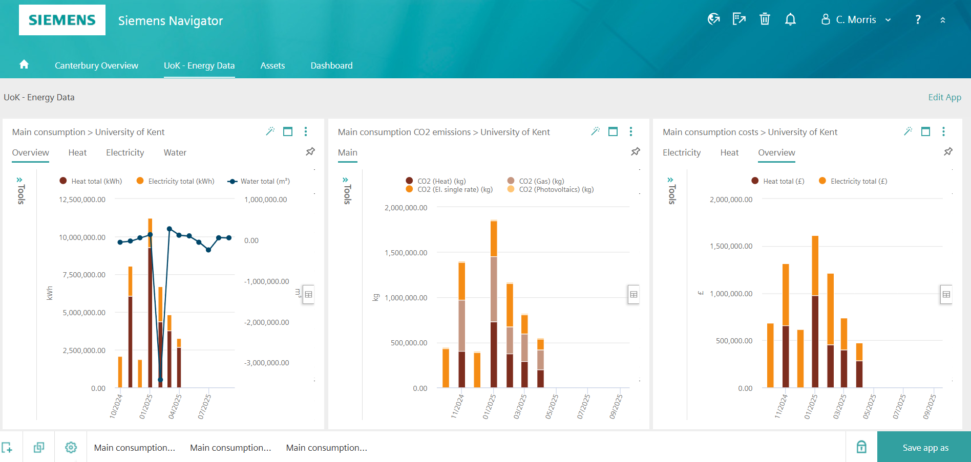

Select the section of text you want to update and type/insert your poster copy.
If cutting and pasting from another file, click on the mini clipboard icon after pasting and select “Keep Text Only” to preserve the font style in this template.
Do’s
Only use the approved
fonts, Overpass or Verdana
Only use one highlight colour per poster (except in charts)
Keep your copy short and concise
Only use good quality images
Make sure your image is correctly proportioned, check – Picture format > Size > Scale – the height and width % should be the same
Make sure your have copyright permission to use the image
Printing
When you are happy with the content of the poster save it as a PDF. The file is set up at A1, once saved as a PDF it can be scaled when printing to A0 or A2.
Send the PDF to designandprintcentre@kent.ac.uk , confirm the size and quantity required and deadline.
Smart Metering for a Smarter Campus
Automated Monitoring & Targeting with Siemens Navigator
The Project
As part of the University of Kent’s journey toward Net Zero Carbon by 2040, Siemens has implemented a cutting-edge metering solution across the campus. This initiative focuses on Automated Monitoring & Targeting (AM&T), enabling real-time visibility of energy and water consumption through the Siemens Navigator platform.
The project includes the installation and integration of 133 meters across 20 buildings, covering electricity, gas, heat, and water. Data is transmitted securely into the Siemens Navigator cloud-based dashboard, which performs analytics and highlights areas to reduce energy and carbon.
Benefits
Buildings such as Templeman Library, Keynes College, Sports Centre, Rutherford, and Parkwood now benefit from granular consumption data, leak detection, and performance insights. The system supports anomaly alerts, user-defined dashboards, and secure multi-user access—empowering facilities teams to act quickly and efficiently.
Savings
The project is set to save nearly £30,000 per year in water-related reductions alone. The infrastructure also lays the foundation for future energy optimisation and reporting.
This metering upgrade is a cornerstone of the university’s “Need Now” phase—delivering smarter operations, enhanced sustainability, and data-driven decision-making
kent.ac.uk/sustainability/net-zero

Slide 2
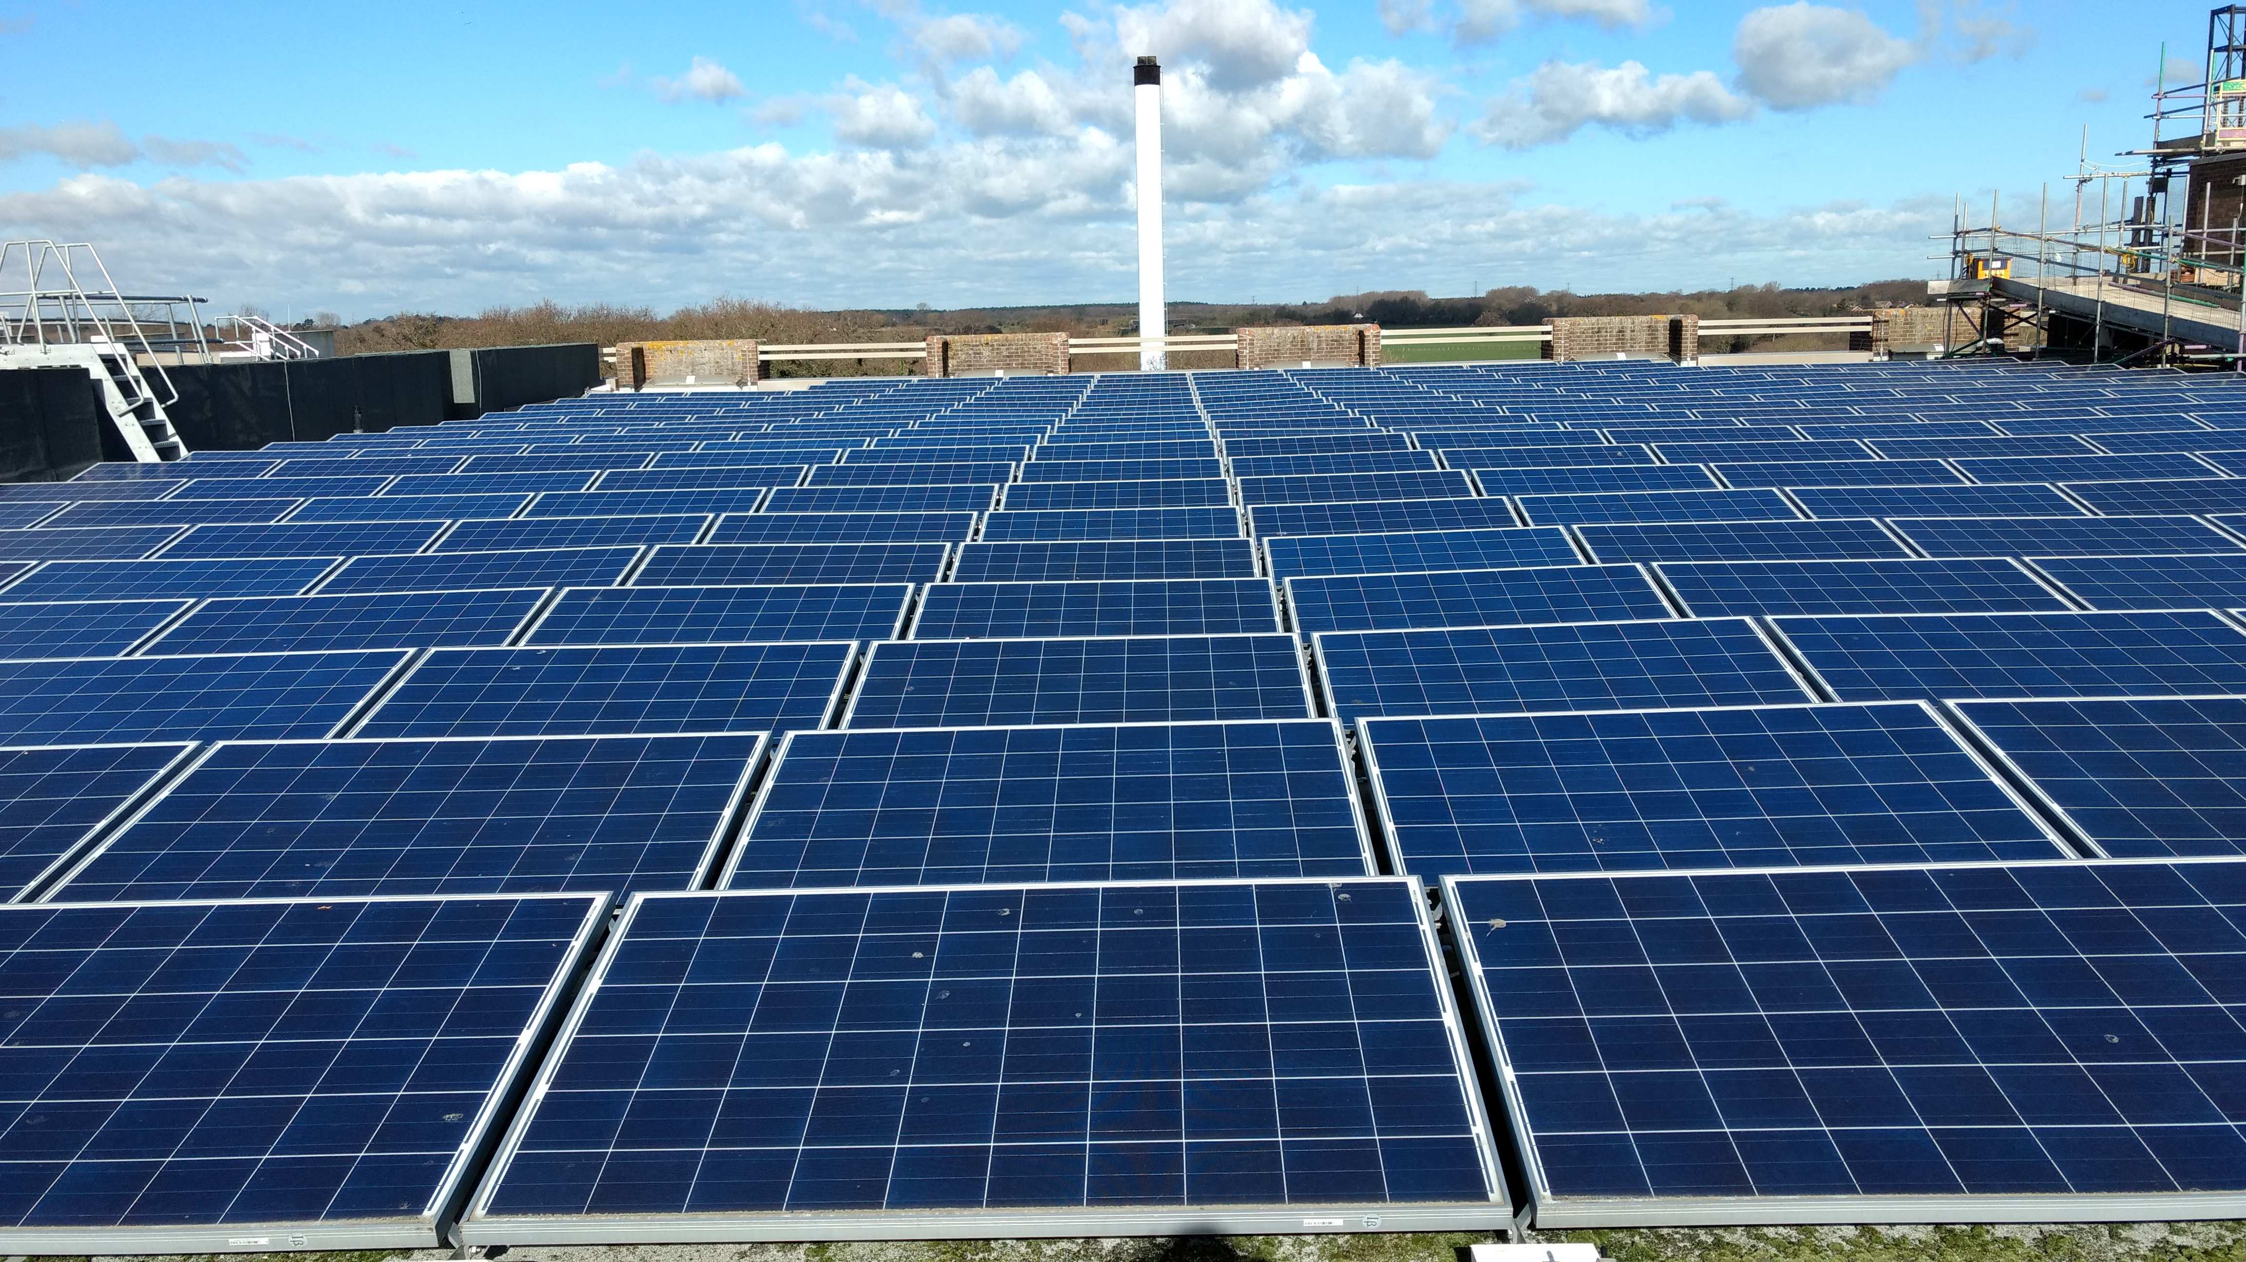
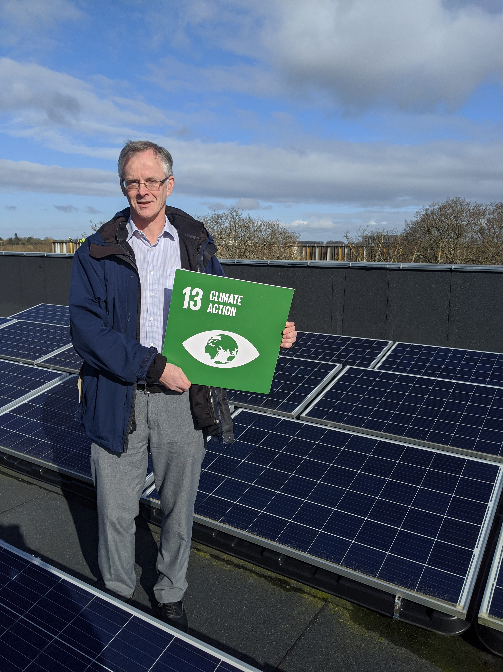
Select the section of text you want to update and type/insert your poster copy.
If cutting and pasting from another file, click on the mini clipboard icon after pasting and select “Keep Text Only” to preserve the font style in this template.
Do’s
Only use the approved
fonts, Overpass or Verdana
Only use one highlight colour per poster (except in charts)
Keep your copy short and concise
Only use good quality images
Make sure your image is correctly proportioned, check – Picture format > Size > Scale – the height and width % should be the same
Make sure your have copyright permission to use the image
Printing
When you are happy with the content of the poster save it as a PDF. The file is set up at A1, once saved as a PDF it can be scaled when printing to A0 or A2.
Send the PDF to designandprintcentre@kent.ac.uk , confirm the size and quantity required and deadline.
Harnessing the Sun – Solar PV at Kent
Clean Energy for a Net Zero Future
The Project
As part of its commitment to achieving Net Zero Carbon by 2040, the University of Kent has partnered with Siemens to install rooftop solar photovoltaic (PV) systems across seven buildings. These systems have a combined capacity of 740.35 kWp, using high-efficiency Trina PV modules and SolarEdge inverters with advanced monitoring and safety features.
Benefits
The installations are designed to generate over 674,000 kWh of clean electricity annually, with a projected 15-year total of 9.7 million kWh. All energy produced is consumed onsite, reducing reliance on grid electricity and supporting energy resilience. Siemens guarantees system performance through annual Performance Ratio (PR) targets, with compensation provided if targets are not met.
Savings
The initiative is expected to save the university nearly £200,000 per year in energy costs, while contributing significantly to carbon reduction. Monitoring is handled via the SolarEdge cloud platform, with quarterly efficiency reports and annual service maintenance included.
This solar PV rollout is a key component of the university’s “Need Now” phase—delivering immediate environmental and financial benefits while laying the foundation for long-term sustainability.
kent.ac.uk/sustainability/net-zero

Slide 3
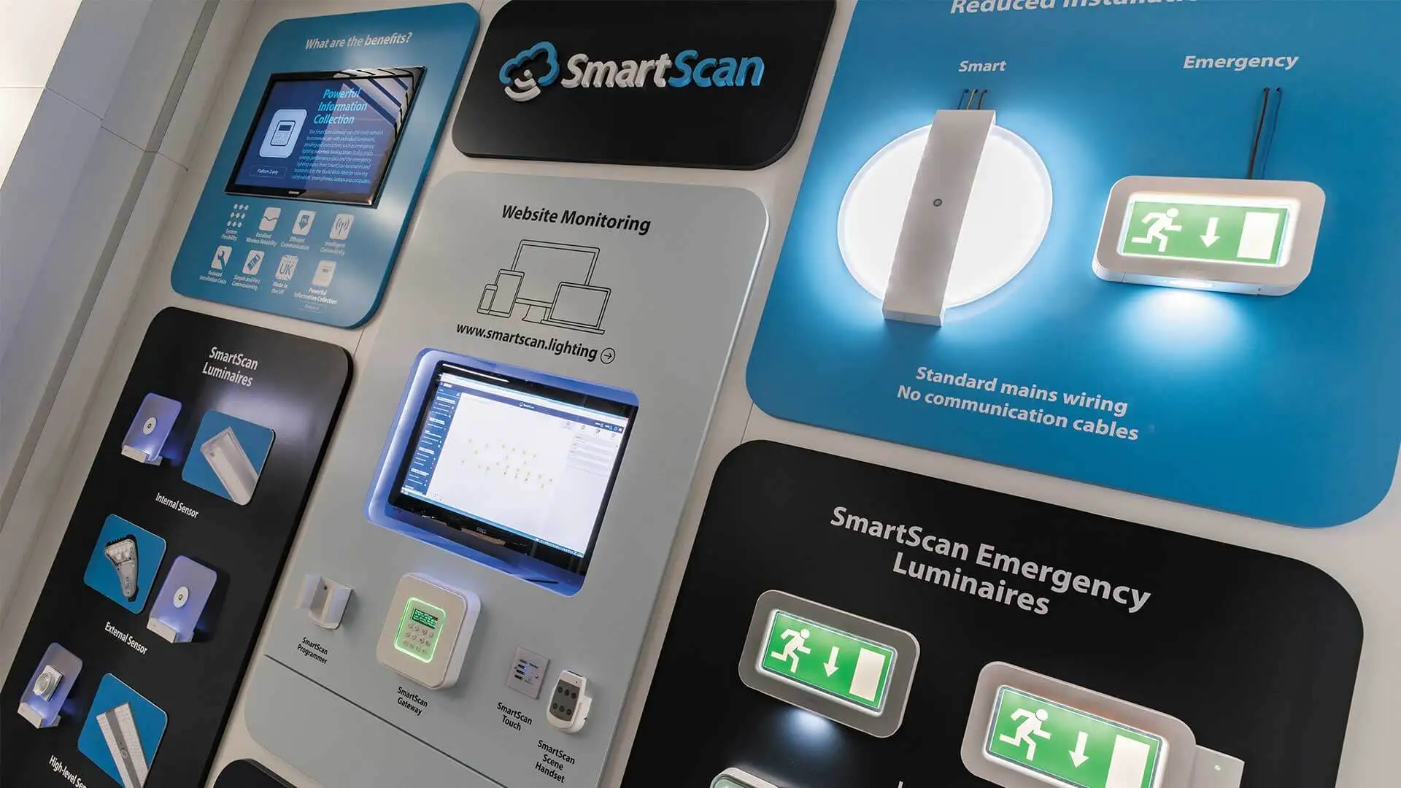
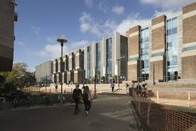

Select the section of text you want to update and type/insert your poster copy.
If cutting and pasting from another file, click on the mini clipboard icon after pasting and select “Keep Text Only” to preserve the font style in this template.
Do’s
Only use the approved
fonts, Overpass or Verdana
Only use one highlight colour per poster (except in charts)
Keep your copy short and concise
Only use good quality images
Make sure your image is correctly proportioned, check – Picture format > Size > Scale – the height and width % should be the same
Make sure your have copyright permission to use the image
Printing
When you are happy with the content of the poster save it as a PDF. The file is set up at A1, once saved as a PDF it can be scaled when printing to A0 or A2.
Send the PDF to designandprintcentre@kent.ac.uk , confirm the size and quantity required and deadline.
Lighting the Way to Net Zero
LED Upgrades & Smart Controls Across Campus
The Project
As part of the University of Kent’s “Need Now” phase toward Net Zero Carbon by 2040, Siemens has delivered a major lighting upgrade across key campus buildings. The initiative includes the replacement of outdated fluorescent and incandescent fixtures with high-efficiency Thorlux LED lights, integrated with SmartScan wireless controls.
Lighting upgrades were completed in Templeman Library, Marlowe, Jarman, Keynes College, Cornwallis, and the Sports Centre, covering thousands of fittings. Emergency lighting systems were also modernised, converting maintained fixtures to non-maintained types compatible with SmartScan’s automated testing platform.
Savings
The lighting retrofit guarantees annual energy savings of 493,349 kWh, with financial savings of nearly £140,000/year. Additional benefits include £30,000/year in reduced maintenance costs and up to major improvements in space utilisation across the campus.
Siemens is providing guaranteed savings as part of this initiative, and recent tests have shown the University will achieve savings 26% higher than originally expected. This initiative delivers immediate impact, aligning with the university’s sustainability goals and enhancing the student experience.
Benefits
SmartScan sensors provide occupancy and daylight control, space utilisation data, and remote monitoring, enabling smarter energy management and operational insights. The system supports compliance, fault detection, and wireless configuration—reducing maintenance and improving safety.
kent.ac.uk/sustainability/net-zero

Slide 4


Select the section of text you want to update and type/insert your poster copy.
If cutting and pasting from another file, click on the mini clipboard icon after pasting and select “Keep Text Only” to preserve the font style in this template.
Do’s
Only use the approved
fonts, Overpass or Verdana
Only use one highlight colour per poster (except in charts)
Keep your copy short and concise
Only use good quality images
Make sure your image is correctly proportioned, check – Picture format > Size > Scale – the height and width % should be the same
Make sure your have copyright permission to use the image
Printing
When you are happy with the content of the poster save it as a PDF. The file is set up at A1, once saved as a PDF it can be scaled when printing to A0 or A2.
Send the PDF to designandprintcentre@kent.ac.uk , confirm the size and quantity required and deadline.
Siemens & University of Kent – A Partnership for Sustainable Transformation
Delivering Innovation, Efficiency, and Net Zero Goals
The Partnership
The University of Kent has partnered with Siemens to deliver a transformative, campus-wide sustainability programme aimed at achieving Net Zero Carbon by 2040. This strategic collaboration combines cutting-edge technology, data-driven solutions, and long-term planning to modernise infrastructure, reduce emissions, and enhance operational efficiency.
The programme is structured into three phases:
Need Now: Immediate upgrades including LED lighting retrofits, rooftop solar PV installations, and smart metering.
Need Next: Expansion of energy conservation and generation technologies.
Need Eventually: Campus-wide heating transformation and smart grid integration.
Key initiatives include:
LED Lighting: Installed across six buildings with Thorlux SmartScan controls, saving over 493,000 kWh/year and £138,000/year.
Solar PV: 740 kWp installed on Templeman Library, Keynes College, and Sports Centre, generating 674,000 kWh/year and saving £189,000/year.
Smart Metering (AM&T): 133 meters across 20 buildings, integrated with Siemens Navigator for real-time analytics and leak detection.
The partnership also supports research, student engagement, and innovation, with Siemens providing project management, monitoring, and performance guarantees. Acceptance is managed through a two-stage process, and all systems are backed by rigorous measurement and verification protocols.
Together, Siemens and the University of Kent are building a smarter, greener campus—setting a benchmark for sustainability in higher education.
kent.ac.uk/sustainability/net-zero

Slide 5
Select the section of text you want to update and type/insert your poster copy.
If cutting and pasting from another file, click on the mini clipboard icon after pasting and select “Keep Text Only” to preserve the font style in this template.
Do’s
Only use the approved
fonts, Overpass or Verdana
Only use one highlight colour per poster (except in charts)
Keep your copy short and concise
Only use good quality images
Make sure your image is correctly proportioned, check – Picture format > Size > Scale – the height and width % should be the same
Make sure your have copyright permission to use the image
Printing
When you are happy with the content of the poster save it as a PDF. The file is set up at A1, once saved as a PDF it can be scaled when printing to A0 or A2.
Send the PDF to designandprintcentre@kent.ac.uk , confirm the size and quantity required and deadline.
The Energy Masterplan – A Roadmap to Net Zero
Strategic Sustainability at the University of Kent
The University of Kent has partnered with Siemens to deliver a comprehensive Energy Masterplan—an ambitious, phased strategy to achieve Net Zero Carbon emissions by 2040. This plan is structured around three key phases:
Need Now: Immediate actions to reduce energy use, carbon emissions, and operational costs. This includes LED lighting upgrades with SmartScan controls, rooftop solar PV installations, and advanced metering systems.
Need Next: Expansion of energy conservation measures and major investments in renewable energy generation and building automation.
Need Eventually: Transformation of campus-wide heating systems and integration of smart grid technologies to maximise renewable energy use.
The Masterplan supports broader university goals, including attracting research funding, enhancing the student experience, and positioning Kent as a leader in campus sustainability. Phase 1 alone is projected to save over 1.1 million kWh annually and £639,761 in energy costs.
Siemens’ PM@Siemens framework ensures quality execution, with weekly updates, monthly reporting, and rigorous measurement and verification protocols based on IPMVP standards. Acceptance is managed through a two-stage process—Phase Acceptance Certificate (PAC) and Final Acceptance Certificate (FAC).
This strategic roadmap not only delivers immediate environmental and financial benefits but also lays the foundation for long-term transformation, making Kent a model for sustainable universities
kent.ac.uk/sustainability/net-zero

